Slide 1
non-LTEゼミ Program structure of MULTI
20111125
T. Anan

Slide 2
Description of Program Structure and Routines Carlson, M., 1986 §5.2
The routines of the program fall into 7 blocks in the following order
The main program MULTI
The three main subroutines START, ITER and FORMAL
The main iteration routines TRANSP, TRANF, BMAT, and EQSYST
DISK I/O routines (CSTRIP and routines with names in READ and WRITE)
The rest of the non-output routines in approximate calling order
Output routines (names starting with W) in alphabetical order
The routines that might be slightly machine dependent: OPEN, CLOSE, REWIND, STOP, CTIME

Slide 3
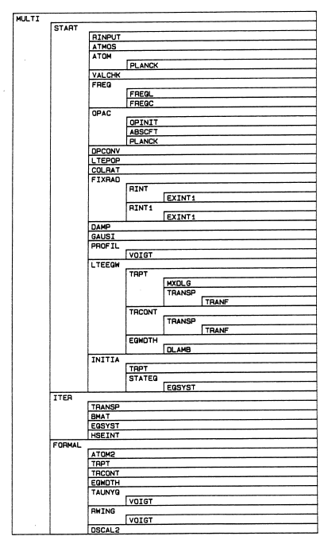
Structure
Input fileを読む
大気モデル
原子モデル
妥当性チェック
振動数
Background opacity
τ とmass scale
LTE population
Collisional routineの選択
Radiative rate
Damping parameters
Profile
LTE 等価幅
初期値
輻射輸送方程式を解く
Grand matrix
Grand matrix eq.
、、
START
Administers input and the calculation of constants and the starting approximation
ITER
Calculate the error terms (TRANSP, TRANF) sets up the grand matrix (BMAT), and solves the grand matrix equation (EQSYST). This is done until the population numbers converge.
FORMAL
Administers the calculation of physically interesting quantities from the solution and handles the printouts
＊ FORTRAN
＊ COMMON-blockで定数統一
＊大気モデル：平行平面大気
＊ versionが上がっている(v2.3)ので細かい点は変わっているかも
どう分担しますか？

