Slide 1
NLTE vs LTE -Hα-
Naoki Nakamura
NLTE seminar 2/3

Slide 2
Important subroutines in “Multi”

Slide 3

Equations(ITER内)
Set and fixed at “Start”
Vary in “ITER”
Static equilibrium(1)
$$n_{i}\sum_{j≠i}{P_{ij}}−\sum_{j≠i}{{n_{j}P}_{ji}}=0$$
Particle conservation(2)
$$\sum_{j=1}{n_{j}}=n_{tot}$$
Radiative transfer(3)
$$μ\frac{dI_{νμ}}{dz}={−κ}_{νμ}I_{νμ}+j_{νμ}$$
$$P_{ij}=R_{ij}+C_{ij}$$
radiation collision
$$κ_{νμ}=κ_{νc}+α_{ij}(n_{i}−G_{ij}n_{j})$$
$$j_{νμ}=j_{νc}+\frac{2hν^{3}}{c^{2}}G_{ij}α_{ij}n_{j}$$

Slide 4
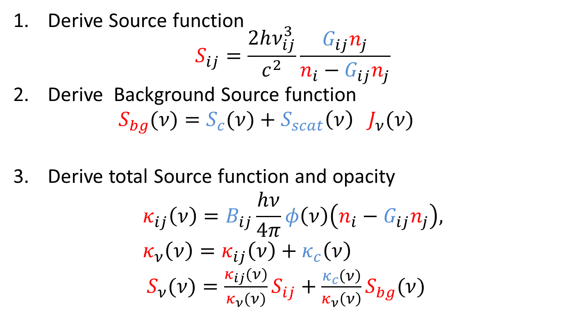
Iteration①
Line transition
$${(ν}_{ij}−dν_{ij}<ν<ν_{ij}+dν_{ij)}$$
red：Variable
blue：Fix
Derive Source function $S_{ij}=\frac{2hν_{ij}^{3}}{c^{2}}\frac{G_{ij}n_{j}}{n_{i}−G_{ij}n_{j}}$
Derive Background Source function $S_{bg}(ν)=S_{c}(ν)+S_{scat}{\left(ν\right) J}_{ν}(ν)$
Derive total Source function and opacity $κ_{ij}\left(ν\right)=B_{ij}\frac{hν}{4π}φ\left(ν\right)\left(n_{i}−G_{ij}n_{j}\right),$ $κ_{ν}\left(ν\right)=κ_{ij}\left(ν\right)+κ_{c}\left(ν\right)$ $S_{ν}(ν)=\frac{κ_{ij}(ν)}{κ_{ν}(ν)}S_{ij}+\frac{κ_{c}\left(ν\right)}{κ_{ν}\left(ν\right)}S_{bg}(ν)$
4.Solve radiative transfer Eq

Slide 5
Iteration②
4-a. Derive $dτ_{νμ}(ν)=κ_{ν}\left(ν\right)dh/μ$
4-b. Solve radiative transfer equations
Direct integral or Feautrier method.
5. Solve Static equilibrium equations (1)
Iterate until the solution converge

Slide 6
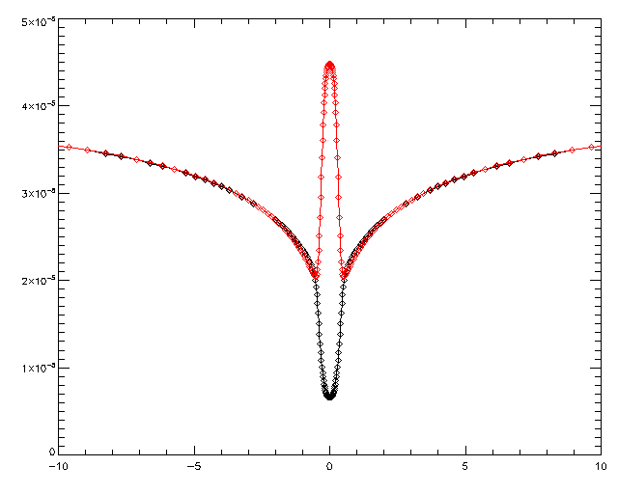
LTE vs NLTE(Hα Intensity)
Red : LTE
Black :NLTE
$$∆λ(Å)$$

Slide 7
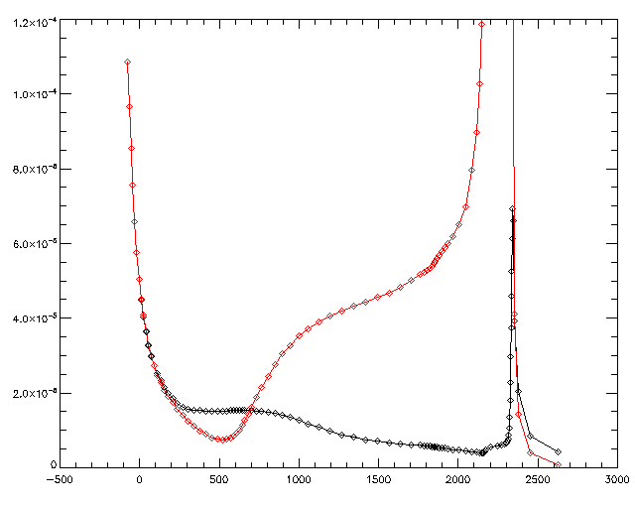
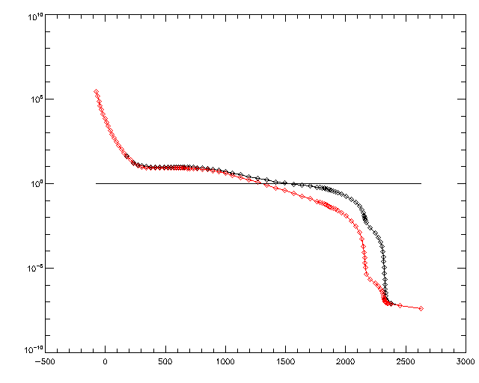
Hα Line center
Red : LTE
Black :NLTE
Source function
Optically depth
LTE formation height
$$τ_{ν}=1$$
NLTE formation height
Height
Height
Source functions have significant difference between LTE and NLTE
Formation height is also difference

Slide 8
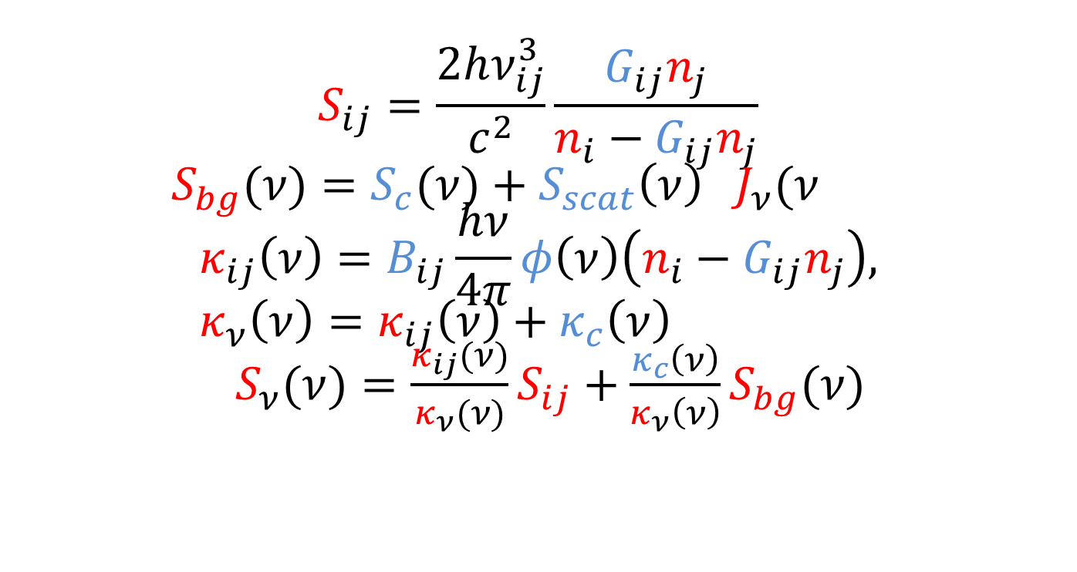
Source function
Line transition
$${(ν}_{ij}−dν_{ij}<ν<ν_{ij}+dν_{ij)}$$
red：Variable
blue：Fix
$$S_{ij}=\frac{2hν_{ij}^{3}}{c^{2}}\frac{G_{ij}n_{j}}{n_{i}−G_{ij}n_{j}}$$ $S_{bg}(ν)=S_{c}(ν)+S_{scat}{\left(ν\right) J}_{ν}(ν$ $$κ_{ij}\left(ν\right)=B_{ij}\frac{hν}{4π}φ\left(ν\right)\left(n_{i}−G_{ij}n_{j}\right), \\ κ_{ν}\left(ν\right)=κ_{ij}\left(ν\right)+κ_{c}\left(ν\right)$$ $S_{ν}(ν)=\frac{κ_{ij}(ν)}{κ_{ν}(ν)}S_{ij}+\frac{κ_{c}\left(ν\right)}{κ_{ν}\left(ν\right)}S_{bg}(ν)$
At line center background term is negligible

Slide 9
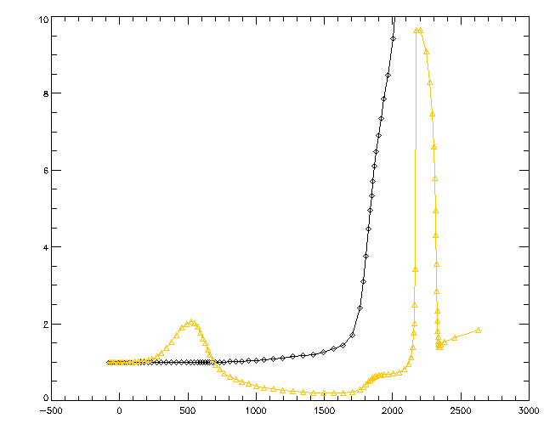
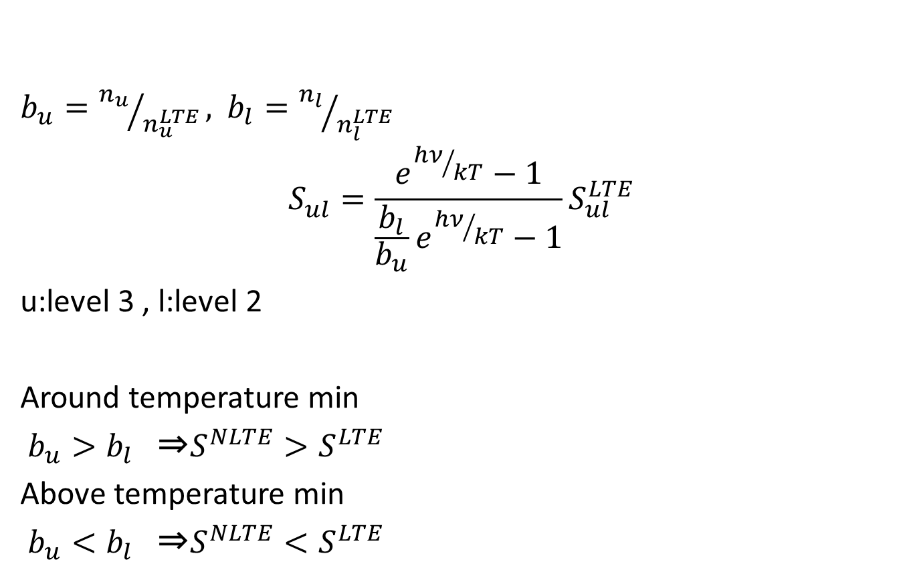
NLTE Source Function
$b_{u}={n_{u}}/{n_{u}^{LTE}},$ $b_{l}={n_{l}}/{n_{l}^{LTE}}$
$$S_{ul}^{}=\frac{e^{{hν}/{kT}}−1}{\frac{b_{l}}{b_{u}}e^{{hν}/{kT}}−1}S_{ul}^{LTE}$$
u:level 3 , l:level 2
Around temperature min
$b_{u}>b_{l}$ ⇒$S^{NLTE}>S^{LTE}$
Above temperature min
$b_{u}<b_{l}$ ⇒$S^{NLTE}<S^{LTE}$
Black :b2
Yellow :b3
$$b_{i}$$
Height

Slide 10
NLTE opacity
$$κ_{ν}^{NLTE}=\frac{1−{\frac{b_{u}}{b_{l}}e}^{{hν}/{kT}}}{1−e^{{hν}/{kT}}}b_{l}κ_{ν}^{LTE}$$
~$b_{l}κ_{ν}^{LTE}$(Wien approximation)
Only depend on lower level
Optically depth
Black :b2
Yellow :b3
$$b_{i}$$
Height
Height

Slide 11
Level transition (Z=1500km:around line formation height)
Height 1494.15
i(lower)| j(upper)| Rji nj- Rij ni | Cji nj -Cjiini
1 2 2.09715e+06 1.42502e+06
1 3 -20480.0 -98601.1
1 4 -7680.00 -14936.5
1 5 -4800.00 -4828.55
2 3 9.43262e+08 -1.27972e+07
2 4 -2.53378e+08 -1.44377e+06
2 5 -2.32799e+08 -397397.
3 4 6.29717e+08 -2.63164e+06
3 5 1.19693e+08 -565368.
4 5 2.26359e+08 -324608.
1 6 -1.25696e+06 -10841.8
2 6 -4.44847e+08 -271172.
3 6 1.88089e+08 80667.5
4 6 1.43692e+08 2.56136e+06
5 6 1.03133e+08 8.82792e+06
level: 1 2 3 4 5 6
1.3e+12 43419. 489.0 169.4 148.1 6.4e+10
1.21 1.26 0.201 0.132 0.129 0.214
6
5
4
3
2
1
青：radiation, 赤: collision

Slide 12
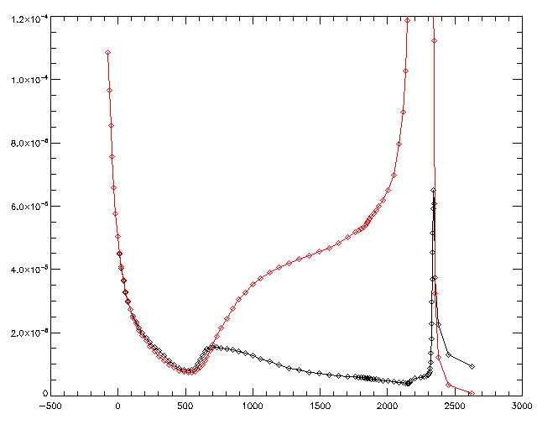
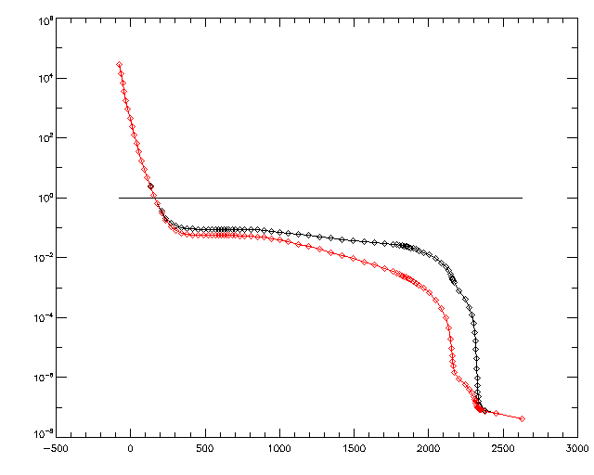
Hα +0.5Å
Red : LTE
Black :NLTE
NLTE formation height
LTE formation height
$$τ_{ν}=1$$
Source function
Optically depth
Source functions and formation height have No differences between LTE and NLTE

Slide 13
Appendix

Slide 14
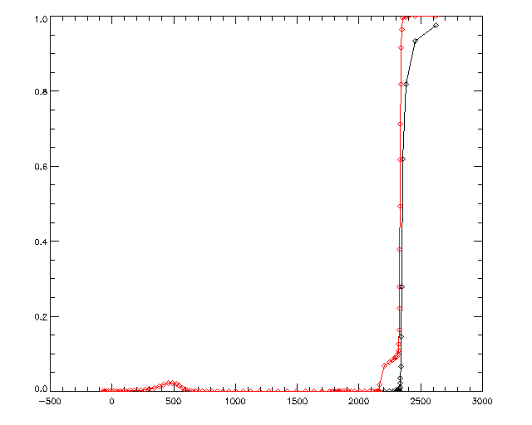
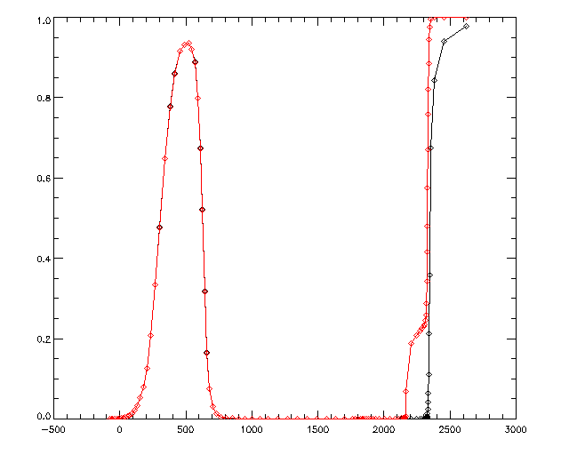
Opacity contribution
$$R_{ν}≡\frac{κ_{c}}{κ_{ν}}$$
Line center
Line center+0.5 Å
Formation height
Formation height
Height
Height

Slide 15
LTE transision
Height 1494.15
i(lower)| j(upper)| Rij ni | Rji nj | Cij ni | Cji nj
0 1 1.61062e+13 1.61062e+13 2.59098e+07 2.59098e+07
0 2 1.35166e+11 1.35166e+11 97669.1 97669.1
0 3 1.64169e+10 1.64169e+10 13839.5 13839.5
0 4 4.72596e+09 4.72595e+09 4463.09 4463.09
1 2 7.85938e+10 1.09389e+11 1.20213e+07 1.20213e+07
1 3 4.01000e+09 1.08470e+10 1.27286e+06 1.27286e+06
1 4 8.60856e+08 2.90329e+09 349549. 349549.
2 3 7.95369e+09 1.39074e+10 3.77426e+07 3.77426e+07
2 4 1.25088e+09 2.73407e+09 7.81516e+06 7.81516e+06
3 4 3.30489e+09 4.97380e+09 1.24072e+08 1.24072e+08
0 5 4.64484e+09 4.64475e+09 10877.9 10877.9
1 5 7.09336e+08 2.17603e+09 257846. 257846.
2 5 4.30819e+08 1.28251e+09 6.27221e+06 6.27221e+06
3 5 3.67026e+08 8.95779e+08 3.10140e+07 3.10140e+07
4 5 3.39788e+08 6.85731e+08 1.03610e+08 1.03610e+08
level: 1 2 3 4 5 6
1.11426e+12 34292.1 2425.51 1284.64 1146.01 2.99520e+11
1.00000 1.00000 1.00000 1.00000 1.00000 1.00000

Slide 16
NLTE trnsision
Height 1494.15
i(lower)| j(upper)| Rij ni | Rji nj | Cij ni | Cji nj
0 1 2.03930e+13 2.03930e+13 3.13807e+07 3.28057e+07
0 2 2.72512e+10 2.72511e+10 118292. 19691.3
0 3 2.16516e+09 2.16515e+09 16761.8 1825.23
0 4 6.10927e+08 6.10922e+08 5405.49 576.942
1 2 2.07164e+10 2.16596e+10 1.52208e+07 2.42364e+06
1 3 1.68064e+09 1.42726e+09 1.61164e+06 167873.
1 4 6.07842e+08 3.75043e+08 442583. 45186.1
2 3 1.10787e+09 1.73759e+09 7.60936e+06 4.97771e+06
2 4 2.31480e+08 3.51173e+08 1.57563e+06 1.01026e+06
3 4 3.92119e+08 6.18478e+08 1.63633e+07 1.60387e+07
0 5 9.97432e+08 9.96175e+08 13174.8 2333.02
1 5 9.11548e+08 4.66701e+08 326473. 55301.1
2 5 8.69777e+07 2.75066e+08 1.26455e+06 1.34522e+06
3 5 4.84330e+07 1.92125e+08 4.09031e+06 6.65168e+06
4 5 4.39462e+07 1.47079e+08 1.33936e+07 2.22215e+07
level: 1 2 3 4 5 6
1.34954e+12 43419.0 489.012 169.426 148.144 6.42390e+10
1.21115 1.26615 0.201612 0.131886 0.129270 0.214473

