Slide 1
NLTE 2/10
中村 尚樹

Slide 2
Multi Input files(mul23/input/)
Input.~: option
atmos~:atmospheric model
dscale~:atmospheric scale
atom~:atomic model
abund~:atomic abundance
atom2~:atomic model2?
rstat~:initial condition

Slide 3
Input~
Input some parameter
Input option for calculation
Ex) input.h6
DIFF=5.0,ELIM1=0.001,ELIM2=0.001,QNORM=12.85,THIN=0.1,
IATOM2=0,ICONV=0,IHSE=0,ILAMBD=4,IOPAC=1,ISTART=4,ISUM=0,
ITMAX=50,ITRAN=0,NMU=5,
IWABND=0,IWATMS=0,IWATOM=0,IWCHAN=0,IWDAMP=00,IWEMAX=1,IWEQW=0,
IWEVEC=0,IWHEAD=0,IWHSE=0,IWLGMX=1,IWLINE=0,IWLTE=0,IWN=0,IWNIIT=0,
IWOPAC=0,IWRAD=0,IWRATE=0,IWSTRT=0,IWTAUQ=0,IWTEST=0,IWWMAT=0,
IWJFIX=0,IWARN=2,IOPACL=0,INCRAD=0,INGACC=1,ICRSW=0,
IOSMET=0,EOSMET=0.5,
IDL1=1,IDLNY=1,IDLCNT=1,IDLOPC=1

Slide 4
Parameter in input~
Parameter value(h6)
 | Diffusion parameter
 | Threshold error value to change matrix in iteration
 | Threshold error value to continue calculation
 | Unit of Doppler coordinate (Km/s)
 | Threshold optically thickness to use lambda iteration
 | Output option
 | Hydrostatic flag if atom is hydrogen
 | Number of lambda iteration
 | Opacities option for restart
 | 0:intensity=0, 1:population=LTE,-1: read start value from “rstart” :: sub. INITIA
 | The level which is determined by particle conservation.
 | Maximum number for iteration
 | Method for radiative transfer eq 0: feautrier, 1:Feautrier + cubic spline, 2: feautrier with Helmite
 | Number for angle discrimination
DIFF=5.0
ELIM1=0.001
ELIM2=0.001
QNORM=12.85
THIN=0.1
IATOM2=0
ICONV=0
IHSE=0
ILAMBD=4
IOPAC=1
ISTART=4
ISUM=0
ITMAX=50
ITRAN=0
NMU=5

Slide 5
Options
IWABND=0
IWATMS=0
IWATOM=0
：
：
IOPACL=0 : inclusion of background opacities from lines.
ISCAT=1 :switches on a scattering version of Feautrier
INCRAD=0: input of incident radiate field
INGACC=1:???
ICRSW=0:switching collisional radiative switch
IOSMET=0:background line opacity
EOSMET=0.5:
IDL1=1,IDLNY=1,IDLCNT=1,IDLOPC=1
[Iwxxxx]
Printout option. IWxxxx=0 inhibits printout from the specific routine.
IWxxxx¿0 normally gives a printout for every IWxxxx depth point. If IDL
is available, most printouts should be switched off and the IDL routines usedinstead (see variables IDL1, IDLNY, IDLCNT and IDLOPC).
(multi_manual.pdf pg.13)

Slide 6
Atmos~
Input atomic model
Scale ,M:mass scale ,H:height scale, T:$τ_{5000}$ scale
Input: scale, Temp, Ne, Vz, Vturb
Ex) atmos.h6
VAL3C
MASS SCALE
* LG G
4.44
* NDEP
52
*LG COLUMN MASS TEMPERATURE NE V VTURB
-5.279262E+00 4.470000E+05 1.205000E+09 0. 1.128000E+01
-5.270430E+00 1.410000E+05 3.839000E+09 0. 9.870000E+00
：
：

Slide 7
Fixed parameter in .h
MDEP1: NUMBER OF DEPTH POINTS.
MK1: NUMBER OF LEVELS INCLUDING CONTINUUM LEVELS.
MDEP: MAXIMUM NUMBER OF DEPTH POINTS.
MK: MAXIMUM NUMBER OF LEVELS INCLUDING CONTINUUM LEVELS MLINE: MAXIMUM NUMBER OF BOUND-BOUND LINES
MWIDE: MAXIMUM NUMBER OF BROAD LINES + CONTINUA IN DETAIL MRAD: MLINE+MWIDE
MRFIX: MAXIMUM NUMBER OF FIXED TRANSITIONS
MQ : MAXIMUM NUMBER OF FREQUENCY POINTS IN ONE TRANSITION
MMU: MAXIMUM NUMBER OF ANGLE POINTS

Slide 8
Equations(ITER)
variable
Set in “Start “
Set in “Iteration”
Statistical equilibrium
$n_{i}\sum_{j≠i}{P_{ij}}−\sum_{j≠i}{{n_{j}P}_{ji}}=0$
Particle conservation
$$\sum_{j=1}{n_{j}}=n_{tot}$$
Radiative transfer equation
$$μ\frac{dI_{νμ}}{dτ_{νμ}}=−I_{νμ}+S_{νμ}$$
$$P_{ij}=R_{ij}+C_{ij}$$
radiation collision
${dτ}_{νμ}=(κ_{c}+α_{ij}(n_{i}−G_{ij}n_{j})$)ds

Slide 9

How to set functions
Line transition
$${(ν}_{ij}−dν_{ij}<ν<ν_{ij}+dν_{ij)}$$
red：set in “ITER”
blue：set in “START”
$S_{ij}=\frac{2hν_{ij}^{3}}{c^{2}}\frac{G_{ij}n_{j}}{n_{i}−G_{ij}n_{j}}$ $S_{bg}(ν)=S_{c}(ν)+S_{scat}{\left(ν\right) J}_{ν}(ν)$
$$α_{ij}=B_{ij}\frac{hν}{4π}φ\left(ν\right)$$
$$κ_{ij}\left(ν\right)=α_{ij}\left(n_{i}−G_{ij}n_{j}\right), \\ κ_{ν}\left(ν\right)=κ_{ij}\left(ν\right)+κ_{c}\left(ν\right)$$ $S_{ν}(ν)=\frac{κ_{ij}(ν)}{κ_{ν}(ν)}S_{ij}+\frac{κ_{c}\left(ν\right)}{κ_{ν}\left(ν\right)}S_{bg}(ν)$
$$R_{ij}=\{\begin{matrix}\frac{1}{2}\int{\frac{4π}{hν}α_{ij}G_{ij}\left(I_{ν}+\frac{2hν^{3}}{c^{2}}\right)dν}(i>j) \\ \frac{1}{2}\int{\frac{4π}{hν}α_{ij}I_{ν}dν} (i<j)\end{matrix}$$

Slide 10
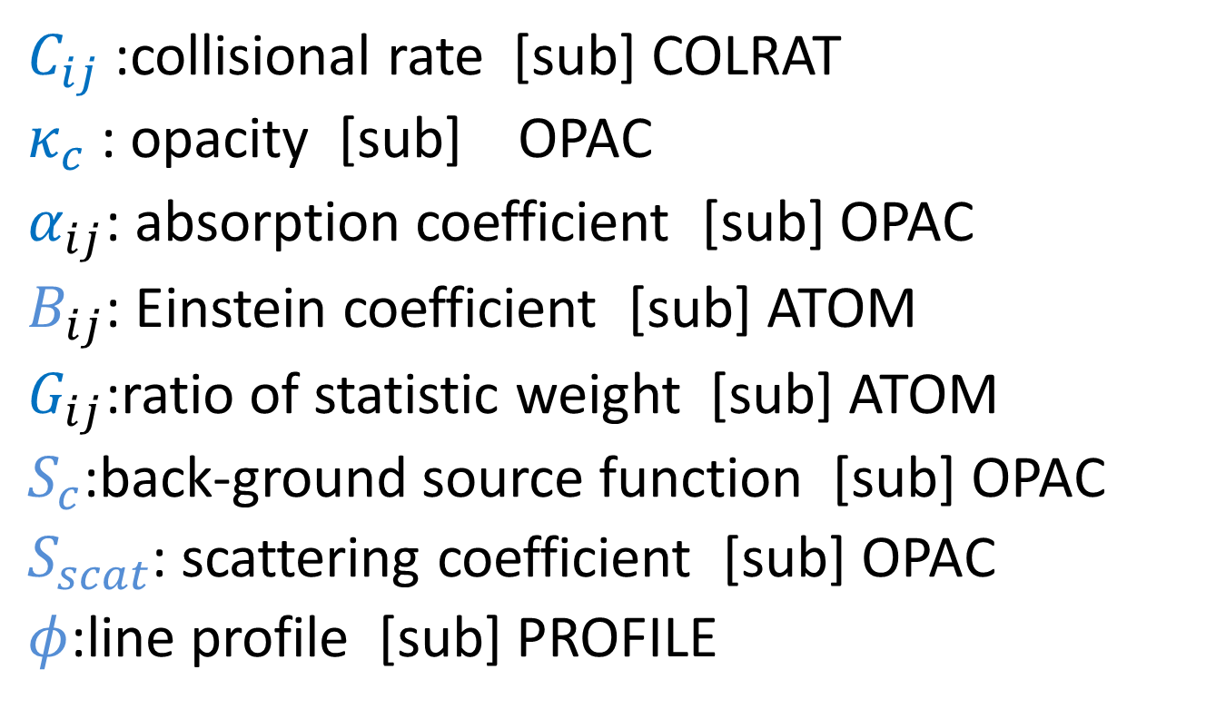
Necessary parameter for iteration
$C_{ij}$ :collisional rate [sub] COLRAT
$κ_{c}$ : opacity [sub] OPAC
$α_{ij}$: absorption coefficient [sub] OPAC
$B_{ij}$: Einstein coefficient [sub] ATOM
$G_{ij}$:ratio of statistic weight [sub] ATOM
$S_{c}$:back-ground source function [sub] OPAC
$S_{scat}$: scattering coefficient [sub] OPAC
$φ$:line profile [sub] PROFILE

Slide 11
Flow chart(START)
START
ATMOS ⇐atoms.val3c & dscale.val3d ([in] scale,T, Ne, vz, vturb,(NH))
ITER
ITERATION
ATOM ⇐atom.h6 ([in] atomic model)
FRQ ⇐atomic information ⇒frequency
OPAC ⇐ atom, atmosphere ⇒opacity
LTEPOP⇐ atom, atmosphere ⇒LTE population
COLRAT⇐atom, atmosphere ⇒ collisional rate coefficient
GAUSI ⇒angle coordinate
PROFILE ⇐ atom, atmosphere ⇒line profile function
INITIA ⇒ initial value of Number density and intensity
RINPUT ⇐input.h6 ([in] option)
Subroutine

