Slide 1
NLTE_3_29
3/29 NLTE

Slide 2
Subroutine opac
[Opac] calculate standard and background opacity
[OPINIT]initialize opacity package
[INJON]read data about atoms for JON
[INABS]reading data about absorption coefficient
[ABSKO]administer absorption coefficient
[TABS] calculate interpolation factor to T
[JON] calculate ionization equilibrium
[DETABS]gives detailed mechanism of absorption
[OSMET]read opacity tabulated at various wavelength
：

Slide 3
ATMOSPHERE
ABSDAT(opacity package)
T, P
Atomic
information
Absorption
information
OPAC
OPINIT
INJON
INABS
JON
TABS
Ionization equilibrium
ABSKO
DETABS
Detailed Absorption
Opacity

Slide 4
INJON(injon.pro)
[input] ABSDAT, ABUND
[purpose]
Read data for JON

Slide 5
absdat
21
H HE C N O NE NA MG AL SI S K CA SC TI V CR MN FE CO NI
1.008 4.003 12.01 14.01 16.00 20.18
23.00 24.32 26.97 28.06 32.06 39.10
40.08 45.0 47.9 50.9 52.01 54.9
55.85 58.9 58.69
2 3 4 4 4 4 4 4 4 4 4 4
4 4 4 4 4 4 4 4 4
2 1 H I
13.595 2 11.0 2 H I
10.853 20.4976 13.342 747.5023 H I
1 1 H II
1000. 0 1.0 0 H II
1 1 HE I
24.580 4 8.0 2 HE I
21.170 28.1703 24.125 527.8296 HE I
2 1 HE II
54.403 2 12.0 2 HE II
43.708 22.2809 53.542 987.7189 HE II
1 1 *HE III
1000. 0 1.0 0 *HE III
Number of atom and Names of atoms
Mass of atoms
Number of ionization level
①statistical weight of ground state(g0)
②number of electron configuration(nk)
③Ionization energy (xion)
④statistical weight of (2L+1)(2J+1) (g2)
⑤lowest quantum number (xl)
⑥Number of terms for partition function (nl)
⑦Excitation potential array(gamma)
⑧Statistical weight array(alfa) for partition function
①
②
④
⑤
⑥
③
⑧
For hydrogen
⑦
⑧
⑦

Slide 6
INABS
[input] ABSDAT
[purpose]
Read data and make interpolation to lambda

Slide 7
Absdat (latter part)
Number of mechanism
KOMP=153 NEXTR=0 NUTZE=0 NEXTT=0 NUTZT=0 NULL=0
H- BF DOUG. FR
ILOGL=0 KVADL=1 MINEX=0 MAXEX=0 NLATB= 19
00000 1000 1500 2000 3000 4000
5000 6000 7000 8000 9000 10000
11000 12000 13000 14000 15000 16000
16421
ILOGT=0 KVADT=0 MINET=0 MAXET=0 NTETB= 1 ITETA=0
0.000 0.390 0.629 0.912 1.567 2.219
2.810 3.306 3.676 3.887 3.913 3.741
3.377 2.842 2.176 1.437 0.708 0.124
0.000 . . . . .
H BF N=1 KARZ. LA
：
：
Wave length
$$κ(λ,T)$$
One mechanism
$κ\left(λ_{i},T_{j}\right)$ is interpolated in ・ wavelength(INABS)
・ temperature(TABS)

Slide 8
Main subroutines
TABINI ・・・ INITIALIZES OPACITY PACKAGE FOR OPCTAB PROGRAM
INJON・・・READS DATA NECESSARY FOR THE COMPUTATION OF IONIZATION
CSTRI2・・・STRIPS COMMENT LINES
INABS・・・ READS ABSORPTION COEFFICIENT TABLES AND INTER/EXTRAPOLATES THEM TO OUR WAVELENGTHS GIVEN IN XL
ELMCMP・・・FINDS ELEMENT NUMBER CORRESPONDING TO ABSORPTION COMPONENT ABNAME(KOMP)
ABSKO・・・ THE ROUTINE ADMINISTERS THE COMPUTATION OF ABSORPTION COEFFICIENTS
TABS・・・COMPUTES FACTORS FOR INTERPOLATION IN T (TETA IF ITETA(KOMP) IS GREATER THAN ZERO) IN THE ABKOF TABLE, INITIATED BY SUBROUTINE INABS. CONCERNING THE OTHER CONTROL INTEGERS, SEE INABS.THE RESULTING FACTORS ARE PUT IN AFAK
JON・・・COMPUTES IONIZATION EQUILIBRIA FOR A GIVEN TEMPERATURE AND A GIVEN ELECTRON PRESSURE
MOLFYS・・・GIVES DISSOCIATION CONSTANTS XKH2
MOL・・・COMPUTES DISSOCIATION EQUILIBRIA FOR THE MOLECULES
MOLMAT・・・COMPUTES THE ELEMENTS OF MATRIX A AND VECTOR F IN THE NEWTON-RAPHSON PROCEDURE FOR DETERMINING THE MOLECULAR EQUILIBRIUM.
AINV2・・・THIS SUBROUTINE EVALUATES THE INVERSE OF A
DETABS・・・THIS ROUTINE GIVES THE DETAILS OF THE ABSORPTION MECHANISMS
CORONA・・・CORONAL ION BALANCE CALCULATION
RCORON・・・READS CORONAL ION BALANCE PARAMETERS
INLIN・・・READS ABSLIN FILE WITH DATA FOR BACKGROUND OPACITIES FROM LINES
ELMCLL・・・ FINDS ELEMENT NUMBER CORRESPONDING TO ABSORPTION COMPONEN
gencol・・・
Rcoll・・・general routine for reading collisional datai s to be used to read data for gencol
Gencl・・・general routine for computing collisional rates
CORONR・・・CORONAL ION BALANCE CALCULATION
RDALP・・・READS POPULATIONS FROM RSTRT
HEPOP・・・RATIOS OF HELIUM IONIZATION FRACTIONS FROM TABLE IV OF ARNAUD AND ROTHENFLUG
AR85CEA・・・NEW ROUTINE FOR COMPUTING COLLISIONAL AUTOIONIZATION
TAUTSP・・・
INTERV・・・
Lcase
COCOL・・・COLLISION RATES FOR VIB-ROT LEVELS WITHIN THE GROUND STATE
HSEINT・・・DOES THE HYDROSTATIC EQUILIBRIUM INTEGRATION ROUTINE ELCNTM IS FOUND IN THE OPACITY PACKAGE
CHECK・・・CHECK DERIVATIVES IN HSEINT
FORMAL・・・ADMINISTERS THE PRINTOUTS. VERSION FOR CONTRIBUTION PRINTOUTS
RDBMET・・・READS DEPARTURE COEFFICIENTS OF BACKGROUND ABSORBERS
WRBMET・・・ WRITES DEPARTURE COEFFICIENTS OF BACKGROUND ABSORBERS
OPINIT・・・INITIALIZES OPACITY PACKAGE
OSMET・・・READ FROM FILE <OSFILE> (SEE INCLUDE FILE OSMPAR)
OSINTP・・・THIS SUBROUTINE PERFORMS A LINEAR INTERPOLATION OF LINE OPACITY
HUNT・・・THIS SOUBROUTINE HAS BEEN TAKEN FROM 'NUMERICAL RECIPES', W.H.Press et al., CAMBRIDGE UNIV. PRESS
OSP6・・・THIS SUBROUTINE CALCULATES THE VAN DER WAALS PARAMETER P6 AT VARIOUS OPTICAL DEPTHS
OSLINE・・・THIS SUBROUTINE PERFORMS A LINEAR INTERPOLATION OF LINE OPACITIES FROM THE ARRAY OPLIN FOR ALL THE DEPTH POINTS
QTRAV・・・HERE THE PARTITION FUNCTIONS ACCORDING TO TRAVING ET AL., ABH. HAMB. STERNW. VIII, 1 (1966) ARE COMPUTED
QAS ・・・THIS ROUTINE COMPUTES THE ASYMPTOTIC PARTS OF THE PARTITION FUNCTIONS FOLLOWING
MASKWR ・・・CHECKS BIT NUMBER IBIT OF INTEGER I AND RETURNS TRUE IF BIT IS ONE
PROFLL ・・・CALCULATES HNY4P*B(I,J)*PHI IN UNITS CM**2/PARTICLE
SPLIN・・・SPLINE INTERPOLATION OF T IN A GIVEN TABLE OF POINTS(X(I),Y(I)).
SEARCH・・・SEARCHES THE POINT X WITHIN AN ERROR BOUND -ERR- IN ARRAY ARR
SEMIC・・・RETURNS COLLISION RATE DOWNWARDS USING SEMI-EMPIRICAL GF'S
PSEMI・・・THERMAL P-FUNCTION FOR SEMIC EMPIRICAL COLLISION RATES
IATOMN・・・GIVES ATOMIC NUMBER OF ARELEMENT IF STRING IS A STRING CONTAINING
ATOMNM・・・GIVES ATOMIC NAME OF ARELEMENT IF I IS AN INTEGER CONTAINING
FONE・・・CALCULATES F1(X) NEEDED FOR COLLISIONAL RATES OF ARNAUD AND ROTHENFLUG
FTWO・・・CALCULATES F2(X) NEEDED FOR COLLISIONAL RATES OF ARNAUD AND ROTHENFLUG
SUMMER・・・COMPUTING COLLISIONAL REDUCTION OF DIELECTRONIC RECOMBINATION RATE BY ELECTRON COLLISIONS FOLLOWING SUMMERS 1974
PPVALU・・・SETS VALUE TO 0 IF EXTRAPOLATIONe
IVFIND・・・
ELCNTM・・・ RETURNS THE NUMBER OF FREE ELECTRONS PER HYDROGEN NUCLEUS

Slide 9
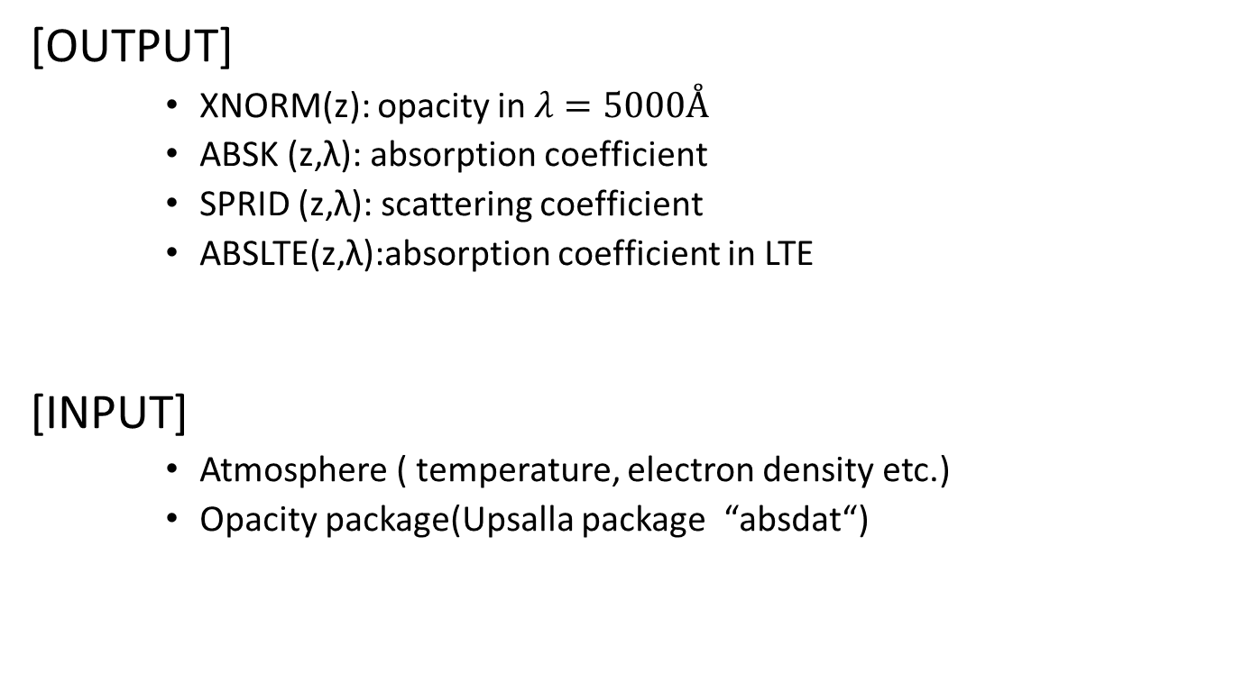
OPAC
[OUTPUT]
XNORM(z): opacity in $λ=5000Å$
ABSK (z,λ): absorption coefficient
SPRID (z,λ): scattering coefficient
ABSLTE(z,λ):absorption coefficient in LTE
[INPUT]
Atmosphere ( temperature, electron density etc.)
Opacity package(Upsalla package “absdat “)

