Slide 1
NLTE_5_30
中村 尚樹

Slide 2
Subroutine opac
[Opac] calculate standard and background opacity
[OPINIT] initialize opacity package
[INJON]read data about atoms for JON
[INABS]reading data about absorption coefficient
[ABSKO] administer absorption coefficient
[TABS] calculate interpolation factor to T
[JON] calculate ionization equilibrium
[DETABS]gives detailed mechanism of absorption
[OSMET]read opacity tabulated at various wavelength
[OUTPUT]

Slide 3
OPAC 内の流れ
[opinit] package 読み込み
[ABSKO]一回目
[JON],[TABS]を用い、各点における
イオン平衡、質量密度、補間係数などを 求め,その後[DETABS]で標準opacity （λ=5000Å)を求める。
[ABSKO]二回目以降
各波長、各点において[DETABS]を用いて opacity を求める。
各波長を計算していく

Slide 4
ATMOSPHERE
ABSDAT(opacity package)
T, P
Atomic
information
Absorption
information
OPAC
OPINIT
INJON
INABS
JON
TABS
Ionization equilibrium
ABSKO
DETABS
Detailed Absorption
XCIDL, SCIDL, SCATIDL

Slide 5
INJON(injon.pro)
[input] ABSDAT ：原子データおよび吸収係数関連
ABUND :各原子の存在比
[purpose]
Read data for JON
イオン・及び分子平衡を計算するために原子データを読み込む。

Slide 6
absdat
21
H HE C N O NE NA MG AL SI S K CA SC TI V CR MN FE CO NI
1.008 4.003 12.01 14.01 16.00 20.18
23.00 24.32 26.97 28.06 32.06 39.10
40.08 45.0 47.9 50.9 52.01 54.9
55.85 58.9 58.69
2 3 4 4 4 4 4 4 4 4 4 4
4 4 4 4 4 4 4 4 4
2 1 H I
13.595 2 11.0 2 H I
10.853 20.4976 13.342 747.5023 H I
1 1 H II
1000. 0 1.0 0 H II
1 1 HE I
24.580 4 8.0 2 HE I
21.170 28.1703 24.125 527.8296 HE I
2 1 HE II
54.403 2 12.0 2 HE II
43.708 22.2809 53.542 987.7189 HE II
1 1 *HE III
1000. 0 1.0 0 *HE III
Number of atom and Names of atoms
Mass of atoms
Number of ionization level
①statistical weight of ground state(g0)
②number of electron configuration(nk)
③Ionization energy (xion)
④statistical weight of (2L+1)(2J+1) (g2)
⑤lowest quantum number (xl)
⑥Number of terms for partition function (nl)
⑦Excitation potential array(gamma)
⑧Statistical weight array(alfa) for partition function
①
②
④
⑤
⑥
③
⑧
For hydrogen
⑦
⑧
⑦

Slide 7
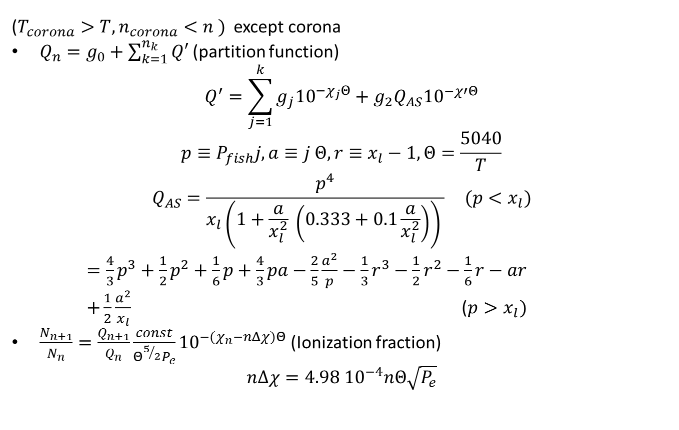
Baschek et al (1966)
($T_{corona}>T, n_{corona}<n )$ except corona
$Q_{n}=g_{0}+\sum_{k=1}^{n_{k}}{Q′}$ (partition function)
$$Q^{′}=\sum_{j=1}^{k}{g_{j}{10}^{−χ_{j}Θ}+g_{2}Q_{AS}{10}^{−χ′Θ}}$$
$$p≡P_{fish}j, a≡j Θ, r≡x_{l}−1,Θ=\frac{5040}{T}$$
$$Q_{AS}=\frac{p^{4}}{x_{l}\left(1+\frac{a}{x_{l}^{2}} \left(0.333+0.1\frac{a}{x_{l}^{2}}\right)\right) } (p<x_{l})$$
$=\frac{4}{3}p^{3}+\frac{1}{2}p^{2}+\frac{1}{6}p+\frac{4}{3}pa−\frac{2}{5}\frac{a^{2}}{p}−\frac{1}{3}r^{3}−\frac{1}{2}r^{2}−\frac{1}{6}r−ar$
$+\frac{1}{2}\frac{a^{2}}{x_{l}}$ ($p>x_{l})$
$\frac{N_{n+1}}{N_{n}}=\frac{Q_{n+1}}{Q_{n}}\frac{const}{Θ^{5/2}P_{e}}{10}^{−(χ_{n}−nΔχ)Θ}$ (Ionization fraction)
$$n∆χ=4.98 {10}^{−4}nΘ\sqrt{P_{e}}$$
LTEならSaha-Boltzmannで良い
ミハラスに書いてあるかな？

Slide 8
JON
Calculate equilibrium
[default]
[ion]
H HE C N O NE NA MG AL SI S K CA SC TI V CR MN FE CO NI
[molecule] sub.mol
H2,H2+, H2O,OH,CH,CO,CN,C2,O2,N2,NH AND NO WITH H,H-,H+,C,C+,O,O+,N,N+ CON-
⇓
mean atomic mass
⇓
Get mass density

Slide 9
INABS
[input] ABSDAT
[purpose]
Read data and make interpolation to lambda
[output] abkof

Slide 10
Absdat (latter part)
Number of mechanism
KOMP=153 NEXTR=0 NUTZE=0 NEXTT=0 NUTZT=0 NULL=0
H- BF DOUG. FR
ILOGL=0 KVADL=1 MINEX=0 MAXEX=0 NLATB= 19
00000 1000 1500 2000 3000 4000
5000 6000 7000 8000 9000 10000
11000 12000 13000 14000 15000 16000
16421
ILOGT=0 KVADT=0 MINET=0 MAXET=0 NTETB= 1 ITETA=0
0.000 0.390 0.629 0.912 1.567 2.219
2.810 3.306 3.676 3.887 3.913 3.741
3.377 2.842 2.176 1.437 0.708 0.124
0.000 . . . . .
H BF N=1 KARZ. LA
：
：
Wave length
$$κ(λ,T)$$
One mechanism
$κ\left(λ_{i},T_{j}\right)$ is interpolated in ・ wavelength(INABS)
・ temperature(TABS)

Slide 11
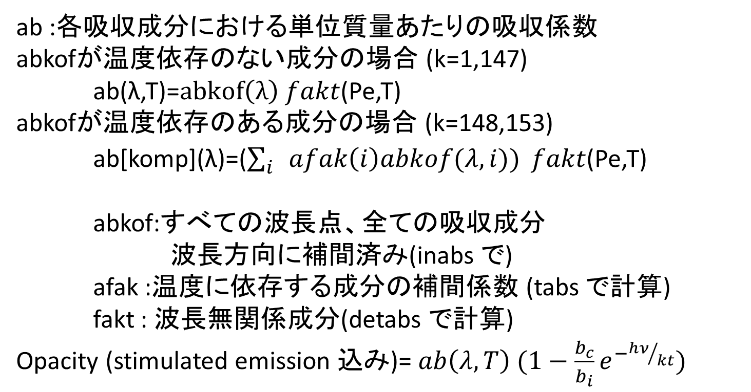
計算式
ab :各吸収成分における単位質量あたりの吸収係数
abkofが温度依存のない成分の場合 (k=1,147)
ab(λ,T)=$abkof\left(λ\right) fakt$(Pe,T)
abkofが温度依存のある成分の場合 (k=148,153)
ab[komp](λ)=($\sum_{i}{afak\left(i\right)abkof(λ,i)) }fakt$(Pe,T)
abkof:すべての波長点、全ての吸収成分
波長方向に補間済み(inabs で)
afak :温度に依存する成分の補間係数 (tabs で計算)
fakt : 波長無関係成分(detabs で計算)
Opacity (stimulated emission 込み)= $ab\left(λ,T\right) (1−\frac{b_{c}}{b_{i}}e^{−{hν}/{kt}})$

Slide 12
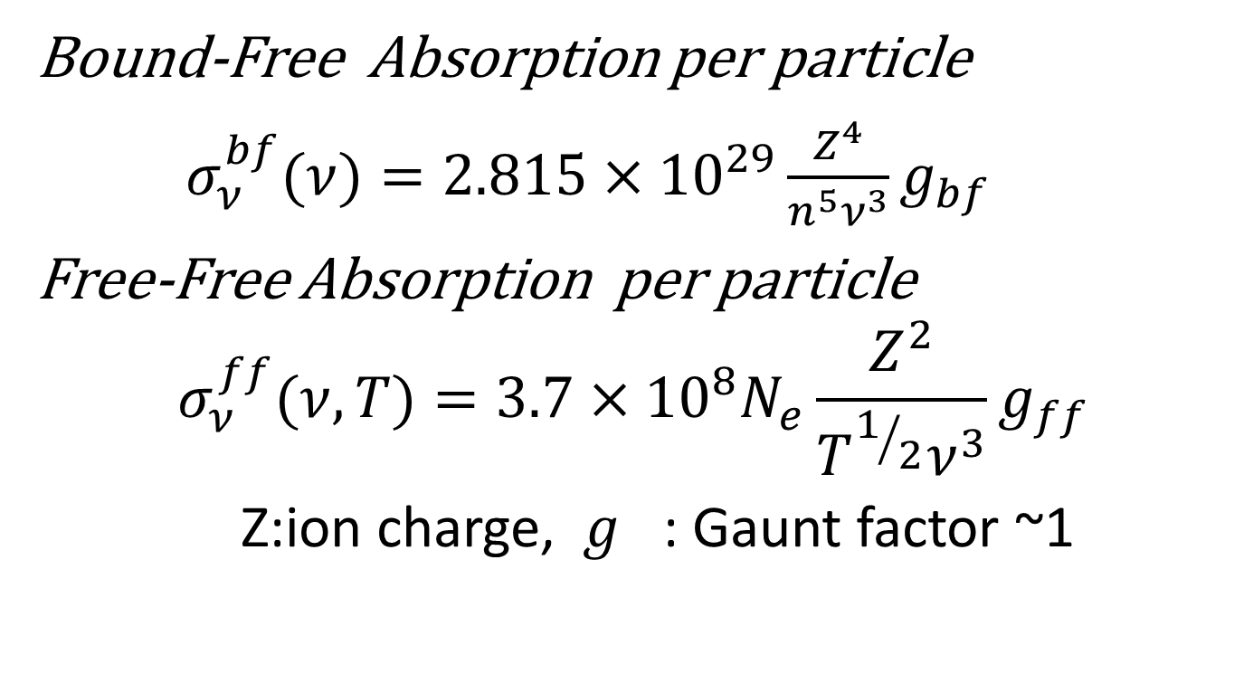
連続吸収(BF, FF)
Bound-Free Absorption per particle
$σ_{ν}^{bf}(ν)=2.815×{10}^{29}\frac{Z^{4}}{n^{5}ν^{3}}g_{bf}$
Free-Free Absorption per particle
$$σ_{ν}^{ff}(ν, T)=3.7×{10}^{8}N_{e}\frac{Z^{2}}{T^{1/2}ν^{3}}g_{ff}$$
Z:ion charge, $g_{}$: Gaunt factor ~1

Slide 13
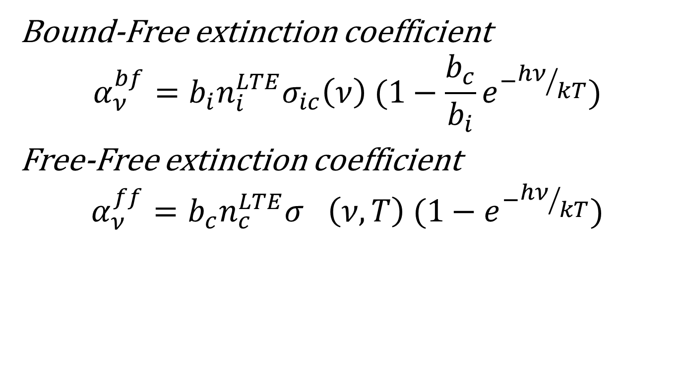
NLTE extinction coefficient
Bound-Free extinction coefficient
$$α_{ν}^{bf}=b_{i}n_{i}^{LTE}σ_{ic}\left(ν\right) (1−\frac{b_{c}}{b_{i}}e^{−{hν}/{kT}})$$
Free-Free extinction coefficient
$$α_{ν}^{ff}=b_{c}n_{c}^{LTE}σ_{}\left(ν,T\right) (1−e^{−{hν}/{kT}})$$

Slide 14
Detabs
[吸収] 変数 absk
各波長ごとに各吸収要素を足しあげる。
K=1 H- Bound-Free
K=2,16 : 水素のBF (N=1~5 はNLTE効果を加味)
K=17~147: その他 (温度に依存しない) INABSで係数を補間
K=148:H Free-Free
K=149:H- Free-Free
K=150: H+H
K=151: H2+
K=152: H2-
K=153: electron free-free
[散乱] 変数 sprid
電子のトムソン散乱 真面目に計算
Hのレーリー散乱 真面目に計算
H2のレーリー散乱 真面目に計算
Extinction coefficient =absk + sprid

Slide 15
output
構造体 opac の要素
選ばれた原子の数密度 : totn
質量密度 :rho
標準opacity :xnorm (各点)
各波長点に対して
opacity : xcont=(absk+aprid)/xnorm
sc =abslte/(absk+sprid)*$B_{ν}$
scat=sprid/(absk+aprid)
abslte:Saha-Boltzman の式による分布を用いた 吸収係数(誘導放射は考慮していない)
s
κc
Sc
Scat

Slide 16
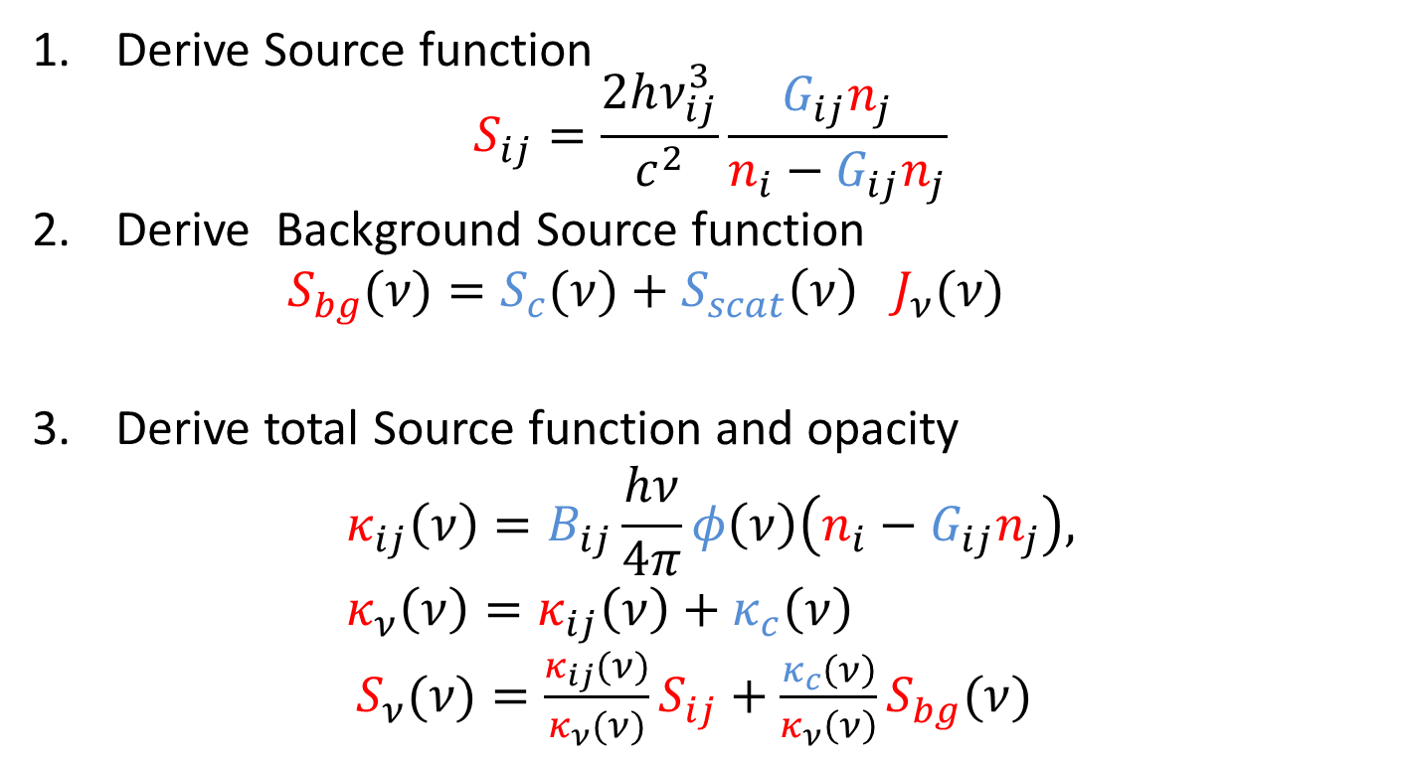
Iteration①
Line transition
$${(ν}_{ij}−dν_{ij}<ν<ν_{ij}+dν_{ij)}$$
red：Variable
blue：Fix
Derive Source function $S_{ij}=\frac{2hν_{ij}^{3}}{c^{2}}\frac{G_{ij}n_{j}}{n_{i}−G_{ij}n_{j}}$
Derive Background Source function $S_{bg}(ν)=S_{c}(ν)+S_{scat}{\left(ν\right) J}_{ν}(ν)$
Derive total Source function and opacity $κ_{ij}\left(ν\right)=B_{ij}\frac{hν}{4π}φ\left(ν\right)\left(n_{i}−G_{ij}n_{j}\right),$ $κ_{ν}\left(ν\right)=κ_{ij}\left(ν\right)+κ_{c}\left(ν\right)$ $S_{ν}(ν)=\frac{κ_{ij}(ν)}{κ_{ν}(ν)}S_{ij}+\frac{κ_{c}\left(ν\right)}{κ_{ν}\left(ν\right)}S_{bg}(ν)$
4.Solve radiative transfer Eq

Slide 17
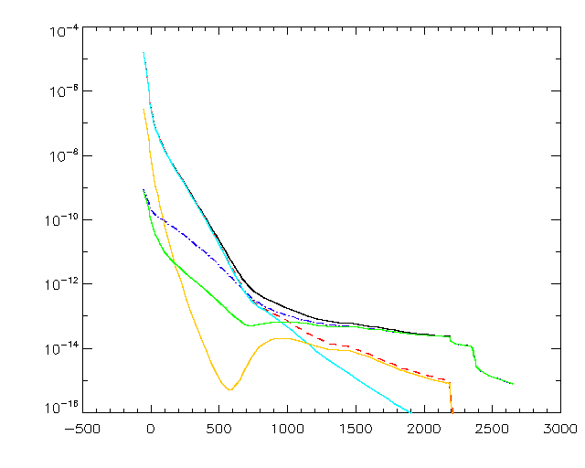
Result of OPAC (λ=5000 Å)
Black：total opacity
Red : absorption
Blue: scattering
Orange: H n=3 BF
Sky-blue : H- FF
Green : e- Thomson
scattering
光学的厚み
高さ

Slide 18
Main subroutines
TABINI ・・・ INITIALIZES OPACITY PACKAGE FOR OPCTAB PROGRAM
INJON・・・READS DATA NECESSARY FOR THE COMPUTATION OF IONIZATION
CSTRI2・・・STRIPS COMMENT LINES
INABS・・・ READS ABSORPTION COEFFICIENT TABLES AND INTER/EXTRAPOLATES THEM TO OUR WAVELENGTHS GIVEN IN XL
ELMCMP・・・FINDS ELEMENT NUMBER CORRESPONDING TO ABSORPTION COMPONENT ABNAME(KOMP)
ABSKO・・・ THE ROUTINE ADMINISTERS THE COMPUTATION OF ABSORPTION COEFFICIENTS
TABS・・・COMPUTES FACTORS FOR INTERPOLATION IN T (TETA IF ITETA(KOMP) IS GREATER THAN ZERO) IN THE ABKOF TABLE, INITIATED BY SUBROUTINE INABS. CONCERNING THE OTHER CONTROL INTEGERS, SEE INABS.THE RESULTING FACTORS ARE PUT IN AFAK
JON・・・COMPUTES IONIZATION EQUILIBRIA FOR A GIVEN TEMPERATURE AND A GIVEN ELECTRON PRESSURE
MOLFYS・・・GIVES DISSOCIATION CONSTANTS XKH2
MOL・・・COMPUTES DISSOCIATION EQUILIBRIA FOR THE MOLECULES
MOLMAT・・・COMPUTES THE ELEMENTS OF MATRIX A AND VECTOR F IN THE NEWTON-RAPHSON PROCEDURE FOR DETERMINING THE MOLECULAR EQUILIBRIUM.
AINV2・・・THIS SUBROUTINE EVALUATES THE INVERSE OF A
DETABS・・・THIS ROUTINE GIVES THE DETAILS OF THE ABSORPTION MECHANISMS
CORONA・・・CORONAL ION BALANCE CALCULATION
RCORON・・・READS CORONAL ION BALANCE PARAMETERS
INLIN・・・READS ABSLIN FILE WITH DATA FOR BACKGROUND OPACITIES FROM LINES
ELMCLL・・・ FINDS ELEMENT NUMBER CORRESPONDING TO ABSORPTION COMPONEN
gencol・・・
Rcoll・・・general routine for reading collisional datai s to be used to read data for gencol
Gencl・・・general routine for computing collisional rates
CORONR・・・CORONAL ION BALANCE CALCULATION
RDALP・・・READS POPULATIONS FROM RSTRT
HEPOP・・・RATIOS OF HELIUM IONIZATION FRACTIONS FROM TABLE IV OF ARNAUD AND ROTHENFLUG
AR85CEA・・・NEW ROUTINE FOR COMPUTING COLLISIONAL AUTOIONIZATION
TAUTSP・・・
INTERV・・・
Lcase
COCOL・・・COLLISION RATES FOR VIB-ROT LEVELS WITHIN THE GROUND STATE
HSEINT・・・DOES THE HYDROSTATIC EQUILIBRIUM INTEGRATION ROUTINE ELCNTM IS FOUND IN THE OPACITY PACKAGE
CHECK・・・CHECK DERIVATIVES IN HSEINT
FORMAL・・・ADMINISTERS THE PRINTOUTS. VERSION FOR CONTRIBUTION PRINTOUTS
RDBMET・・・READS DEPARTURE COEFFICIENTS OF BACKGROUND ABSORBERS
WRBMET・・・ WRITES DEPARTURE COEFFICIENTS OF BACKGROUND ABSORBERS
OPINIT・・・INITIALIZES OPACITY PACKAGE
OSMET・・・READ FROM FILE <OSFILE> (SEE INCLUDE FILE OSMPAR)
OSINTP・・・THIS SUBROUTINE PERFORMS A LINEAR INTERPOLATION OF LINE OPACITY
HUNT・・・THIS SOUBROUTINE HAS BEEN TAKEN FROM 'NUMERICAL RECIPES', W.H.Press et al., CAMBRIDGE UNIV. PRESS
OSP6・・・THIS SUBROUTINE CALCULATES THE VAN DER WAALS PARAMETER P6 AT VARIOUS OPTICAL DEPTHS
OSLINE・・・THIS SUBROUTINE PERFORMS A LINEAR INTERPOLATION OF LINE OPACITIES FROM THE ARRAY OPLIN FOR ALL THE DEPTH POINTS
QTRAV・・・HERE THE PARTITION FUNCTIONS ACCORDING TO TRAVING ET AL., ABH. HAMB. STERNW. VIII, 1 (1966) ARE COMPUTED
QAS ・・・THIS ROUTINE COMPUTES THE ASYMPTOTIC PARTS OF THE PARTITION FUNCTIONS FOLLOWING
MASKWR ・・・CHECKS BIT NUMBER IBIT OF INTEGER I AND RETURNS TRUE IF BIT IS ONE
PROFLL ・・・CALCULATES HNY4P*B(I,J)*PHI IN UNITS CM**2/PARTICLE
SPLIN・・・SPLINE INTERPOLATION OF T IN A GIVEN TABLE OF POINTS(X(I),Y(I)).
SEARCH・・・SEARCHES THE POINT X WITHIN AN ERROR BOUND -ERR- IN ARRAY ARR
SEMIC・・・RETURNS COLLISION RATE DOWNWARDS USING SEMI-EMPIRICAL GF'S
PSEMI・・・THERMAL P-FUNCTION FOR SEMIC EMPIRICAL COLLISION RATES
IATOMN・・・GIVES ATOMIC NUMBER OF ARELEMENT IF STRING IS A STRING CONTAINING
ATOMNM・・・GIVES ATOMIC NAME OF ARELEMENT IF I IS AN INTEGER CONTAINING
FONE・・・CALCULATES F1(X) NEEDED FOR COLLISIONAL RATES OF ARNAUD AND ROTHENFLUG
FTWO・・・CALCULATES F2(X) NEEDED FOR COLLISIONAL RATES OF ARNAUD AND ROTHENFLUG
SUMMER・・・COMPUTING COLLISIONAL REDUCTION OF DIELECTRONIC RECOMBINATION RATE BY ELECTRON COLLISIONS FOLLOWING SUMMERS 1974
PPVALU・・・SETS VALUE TO 0 IF EXTRAPOLATIONe
IVFIND・・・
ELCNTM・・・ RETURNS THE NUMBER OF FREE ELECTRONS PER HYDROGEN NUCLEUS

