Slide 1
non-LTEゼミ 4章 Analytical Radiative Transfer 4.3章 Illustrative solutions
2012.7.30
T. Anan

Slide 2
4.3.1 Coherent scattering in the Eddington approximation
Assumptions
Eddington approximation
Depth-independent destruction probability (ε_{ν})
Analytically solvable
Unrealistic
Ex) stellar atmosphere in hydrostatic equilibrium => collision probability increases rapidly inwards
A landmark test for radiative transfer
(4.62)
a : absorption
s : scattering
(2.135)

Slide 3
4. 3.1 Coherent scattering in the Eddington approximation
Transport equation
(4.61)
=>
(4.63)
∵Eq. (4.62)
=>
(4.64)
∵ε_{ν} depth-independent

Slide 4
4. 3.1 Coherent scattering in the Eddington approximation
(4.64)
Boundary conditions
Rossland or diffusion approximation
J_{ν} = B_{ν} for τ_{ν} -> ∞
∴ C₂ = 0
No incident radiation at τ_{ν} = 0
∵ Eq. (4.54)
α_{ν}を定義
∵ Eq. (4.8)
=>

Slide 5
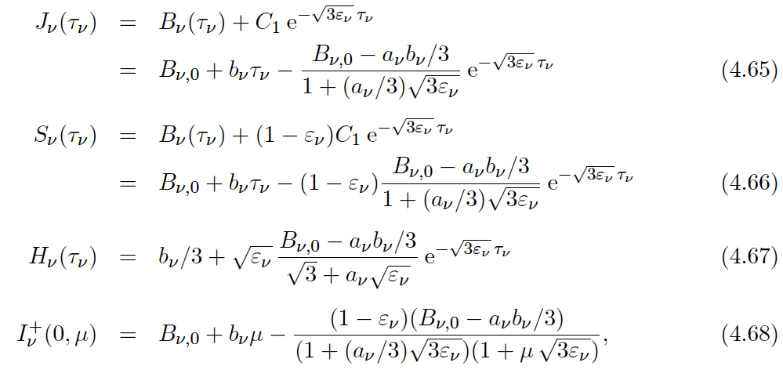
4. 3.1 Coherent scattering in the Eddington approximation
Solutions
τ_{ν} -> ∞ のとき、
J_{ν}〜B_{ν}、S_{ν}〜B_{ν} (LTE)、
H_{ν}〜b_{ν}/3〜(1/3)dS_{ν}/dτ_{ν}
(4.8), (4.54)
(4.17)

Slide 6
4. 3.2 Isothermal atmosphere
4.3.1節の仮定＋等温大気（b_{ν} = 0）を4.2節では扱う
Solutions
ε_{ν} < 1のとき
J_{ν} ≦ B_{ν}、S_{ν} ≦ B_{ν}、I_{ν}⁺(0,μ) ≦ B_{ν}
ε_{ν} < 1が小さいとき、
J_{ν}(τ_{ν})、H_{ν}(τ_{ν})の変化はゆるい
ε_{ν} = 1のとき
S_{ν} = B_{ν,0}、J_{ν}(τ_{ν})は（急激に）単調増加しB_{ν,0}に漸近する、H_{ν}(τ_{ν})は（急激に）単調減少し0に漸近する
(4.69)
(4.70)
(4.71)

Slide 7
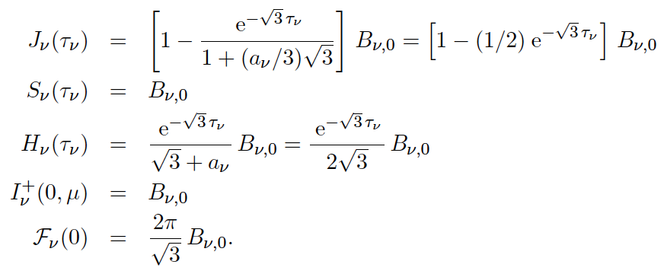
4. 3.2 Isothermal atmosphere
Without scattering
ε_{ν} = 1
α_{ν} = 3^{1/2}とおくと、

Slide 8
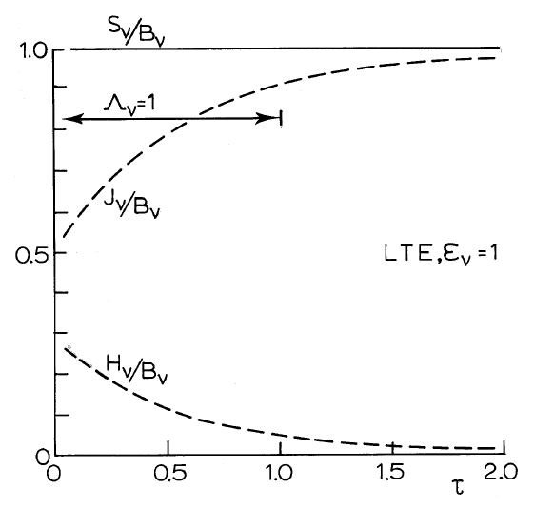
4. 3.2 Isothermal atmosphere
Without scattering
Thermalization depth（後述）

Slide 9
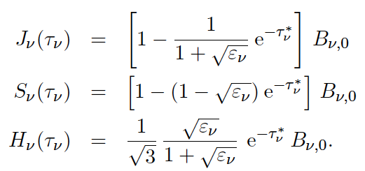
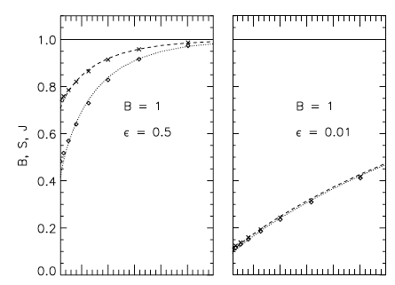
4. 3.2 Isothermal atmosphere
With scattering
さらに、a = 3^{1/2}とし、(3ε_{ν})^{1/2}τ_{ν} = τ_{ν}*と書くと、
Cf) Ribicki & Lightman 1979 p.320
実線：Planck関数
破線：Source function
点線：mean intensity J
0
1
2
0
1
2
τ
τ

Slide 10
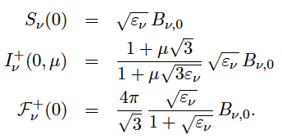
4. 3.2 Isothermal atmosphere
Surface values with scattering and α_{ν}=3^{1/2}
LTE (ε_{ν} = 1)
J_{ν}(0) = B_{ν,0}/2
ε_{ν} small
J_{ν}(0) 〜 S_{ν}(0) = ε_{ν}^{1/2} B_{ν,0}≪B_{ν,0}
ε^{1/2} law

Slide 11
4. 3.2 Isothermal atmosphere
(ε_{ν})^{1/2} law : S_{ν}(0) = (ε_{ν})^{1/2} B_{ν,0}
散乱によって観測者に向かっていた光子が減るため、Source of photonsが霧に包まれているような状況である

