Slide 1
Superflares on Solar type Stars and Their Impacts on Habitability of Exoplanets
COSPAR2014, Moskow 2014 Aug 7
Kazunari Shibata
Kwasan and Hida observatories, Kyoto University
Hiroaki Isobe
Unit of Synergetic Studies for Space, Kyoto University
isobe@kwasan.kyoto-u.ac.jp
Collaborators : Hiroyuki Maehara, Takuya Shibayama, Yuta Notsu, Shota Notsu, Satoshi Honda, Daisaku Nogami

Slide 2
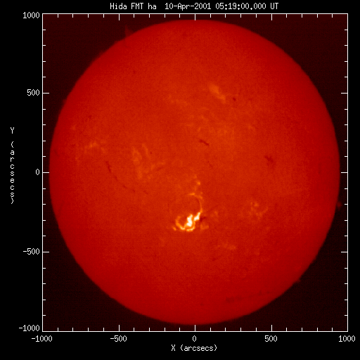
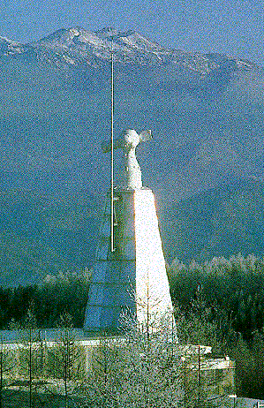
Solar flare
Ｈα
Discovered in 19c
Explosive energy release
that occur near sunspot magnetic energy is the source of energy
Size ~ 10⁹ – 10¹⁰ cm
Time scale ~ 1min – 1hour
Total energy ~
10²⁹ - 10³²erg
Hida Obs, Kyoto U.

Slide 3
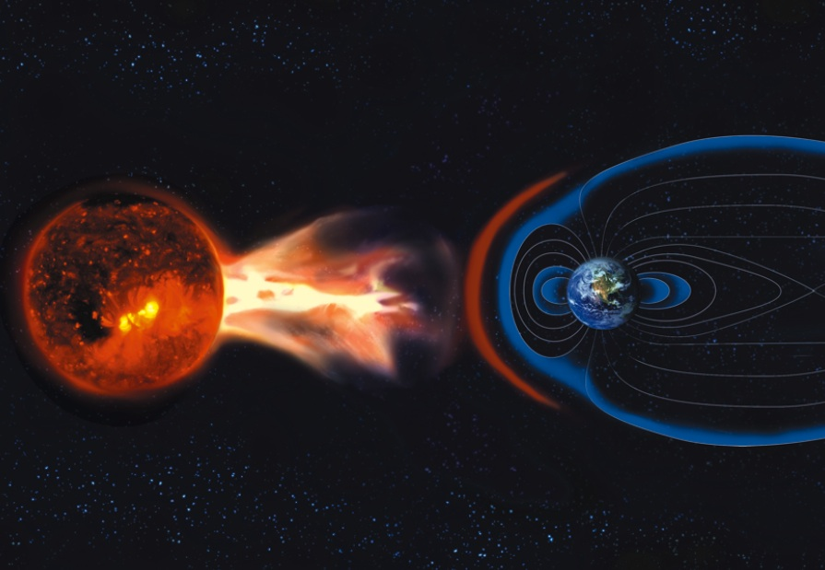
Space Weather:
Effects of solar activity on earth environment
and human civilization
Cause: Electromagnetic radiation
Effect: Ionospheric disturbances => problems in satellite navigation and communication
Cause: Coronal mass ejection
Effects: Auroral substorms, Geomagnetic induced current,
Cause: Energetic particles
Effects: Radiation exposure of astronauts and airplane passengers, damage on satellites, Ozon depletion

Slide 4
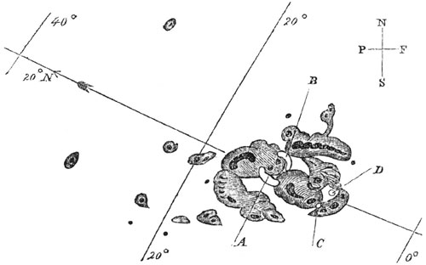
Carrington flare (1859, Sep 1, am 11:18 ）
The first record of flare observation by Richard Carrington in 1859
Very bright aurora appeared next day in Cuba, the Bahamas, Jamaica, El Salvador, and Hawaii.
Estimated to be the largest magnetic storm (> 1000 nT) in modern history
Telegraph systems all over Europe and North America failed.
Telegraph pylons threw sparks and telegraph paper spontaneously caught Fire （Loomis 1861）
The solar storm (flare) on 2012 July 23 observed by STEREO is supposed to be super-carrington class, though it occurred in the invisible side of the Sun from Earth
If it hit the Earth, the estimated economic impact is estimated to be >$2 trillion

Slide 5
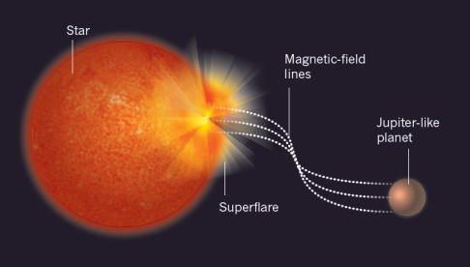
Super Carrington Flare in the Sun?
Total energy of largest solar flare ever obesrved is 10^32-33 erg.
Schaefer et al. (2000) reported 9 superflares (E>10^33 erg) on ordinary solar type stars with slow rotation.
The authors thought that the superflares were driven by a hot Jupiter, hence no such big flares in our Sun
Using Kepler data, we searched for super flares in solar type stars

Slide 6
Search for Superflares on Solar Type Stars : (Maehara et al. 2012, Nature)
We searched for superflares on solar type stars using Kepler satellite data, which include data of 83000 solar type stars
Since the data are so large, we asked 1st year undergraduate students to help analyzing these stars, because students have a lot of free time (2010 fall)
Surprisingly, we (they) found 365 superflares on 148 solar type stars (G-type main sequence stars)

Slide 7
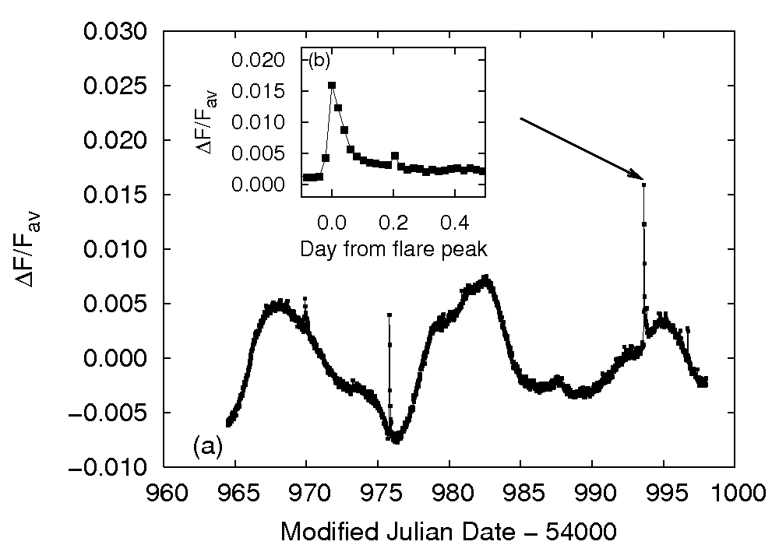
typical superflare observed by Kepler
Brightness
of a star
and a flare
Total energy
~ 10^35 erg
Time (day)
Maehara et al. (2012)

Slide 8
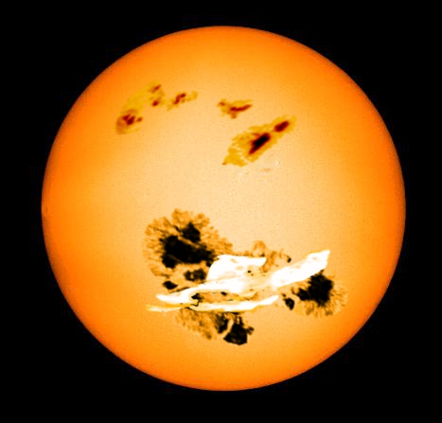
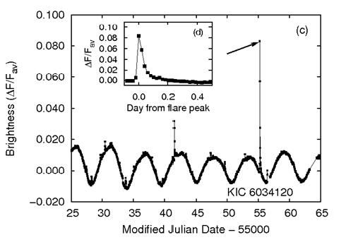
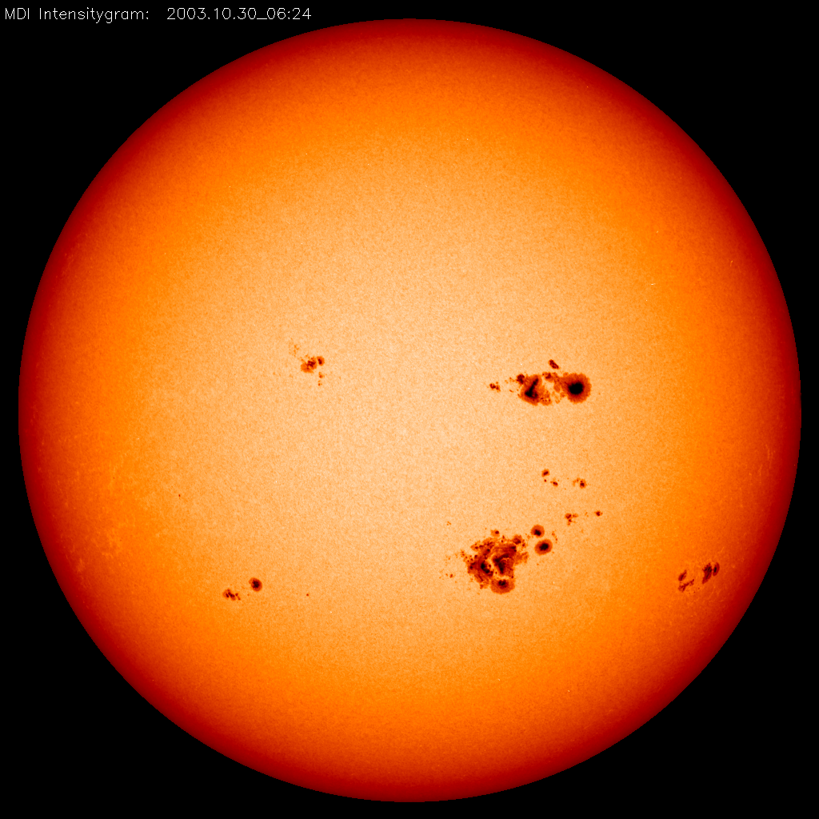
typical superflare observed by Kepler
What is the cause of stellar brightness variation ?
Brightness
of a star
and a flare
Total energy
~ 10^36 erg
It is likely due to rotation of a star with a big star spot
Time (day)
Maehara et al. (2012)

Slide 9
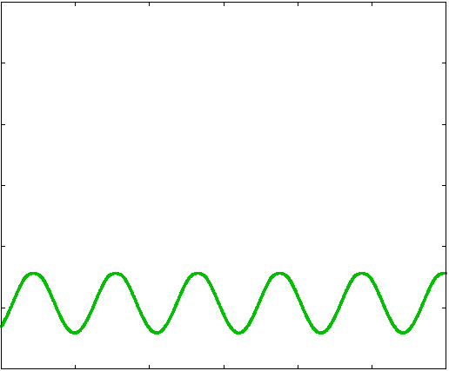
Model calculation of stellar brightness variation
KIC6034120
model(green)
inclination = 45°
Starspot radius
0.16 R*
Stellar
brightness
2％(平均基準)
5 days
time
Notsu et al.

Slide 10
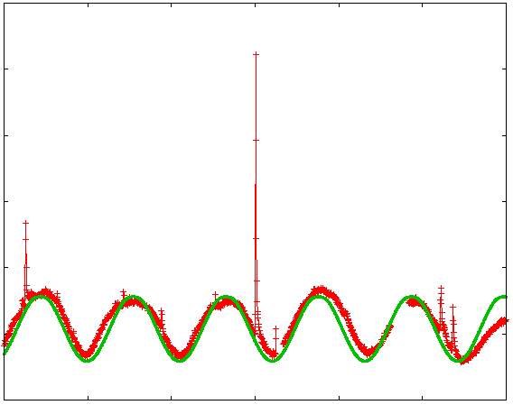
Model calculation of stellar brightness variation
KIC6034120
model(green)
inclination = 45°
Starspot radius
0.16 R*
Stellar
brightness
2％(平均基準)
5 days
time
Notsu et al.

Slide 11
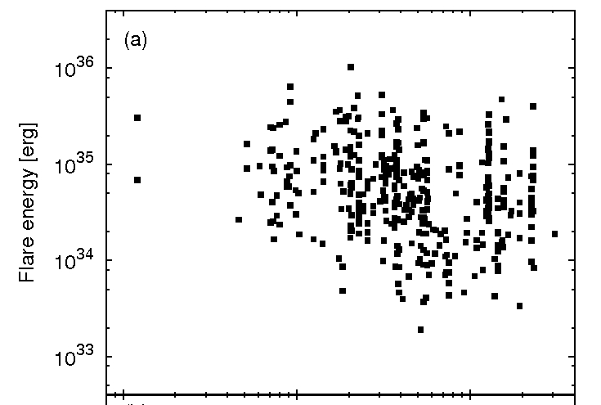
Flare energy vs rotational period
Fast rotation
(young)
Slow rotation
(old)
Stars with
period longer
than 10 days
cf solar rot period ~ 25days
There is no hot Jupiter in these
superflare stars
Maehara et al. (2012)

Slide 12
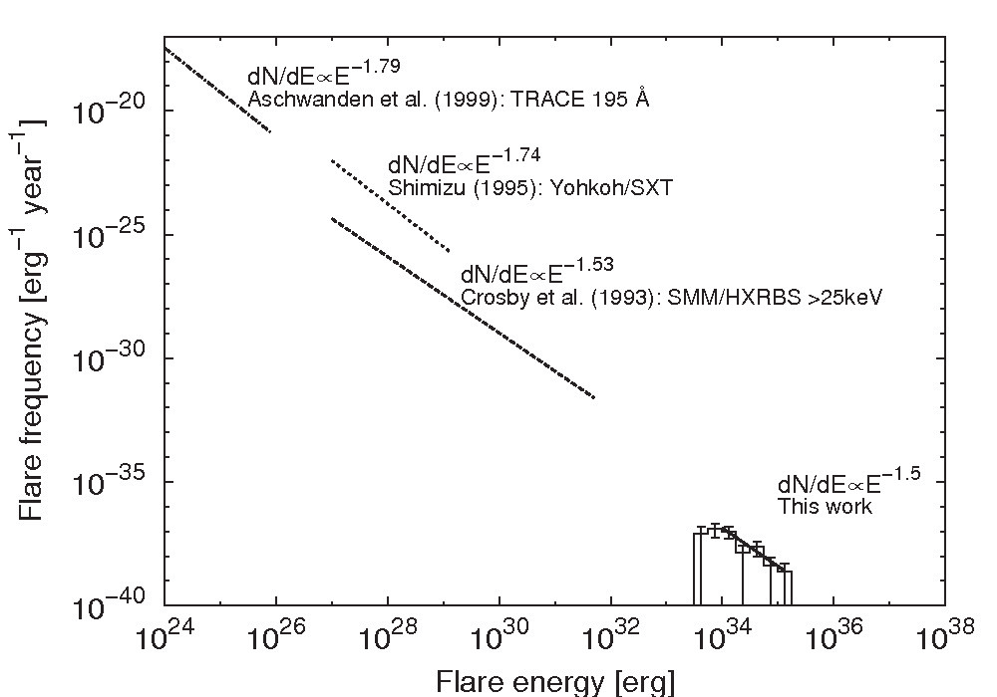
Comparison of statistics between solar flares/microflares and superflares
Shibata et al. 2013
nanoflare
microflare
solar flare
？
Largest solar flare
superflare

Slide 13
Comparison of statistics between solar flares/microflares and superflares
Shibata et al. 2013
Superflares of 1000 times more
Energetic than the largest solar flares occur once in 5000 years !
nanoflare
microflare
1000 in 1 year
100 in 1 year
10 in 1 year
1 in 1 year
1 in 10 year
1 in 100 year
1 in 1000 year
1 in 10000 year
solar flare
Largest solar flare
superflare
C M X X10 X1000 X100000

Slide 14
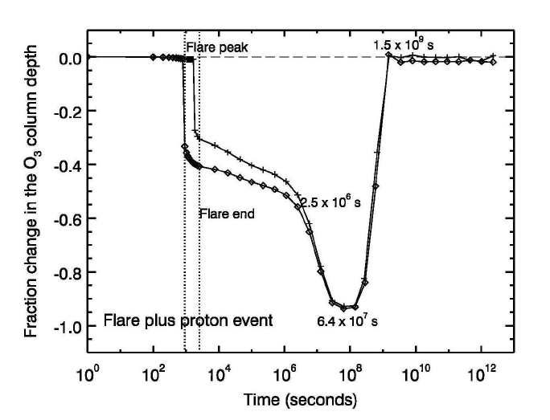
If superflares with 10^35 erg energy occur in a star, what happens to its habitable planet (and the lives and civilization on it)?
Energetic particles produce NOx in the upper atmosphere and cause Ozone depletion
Radiation intensity on the ground will be ~40mSv, which is bad but not fatal
All astronauts and some of airline passengers may be exposed to fatal radiation (> 4000 mSv)
Almost all artificial satellites die
Radio communication trouble and blackout would occur all over the planet.
Segura et al. 2010

Slide 15
Possibility of more extreme superflares ?
nanoflare
microflare
1000 in 1 year
100 in 1 year
10 in 1 year
1 in 1 year
1 in 10 year
1 in 100 year
1 in 1000 year
1 in 10000 year
1 in 10^5 year
1 in 10^6 year
1 in 10^7 year
1 in 10^8 year
solar flare
Largest solar flare
superflare
40mSv
4Sv
？
1.1xLsun
2xLsun
May cause mass extinction!

Slide 16
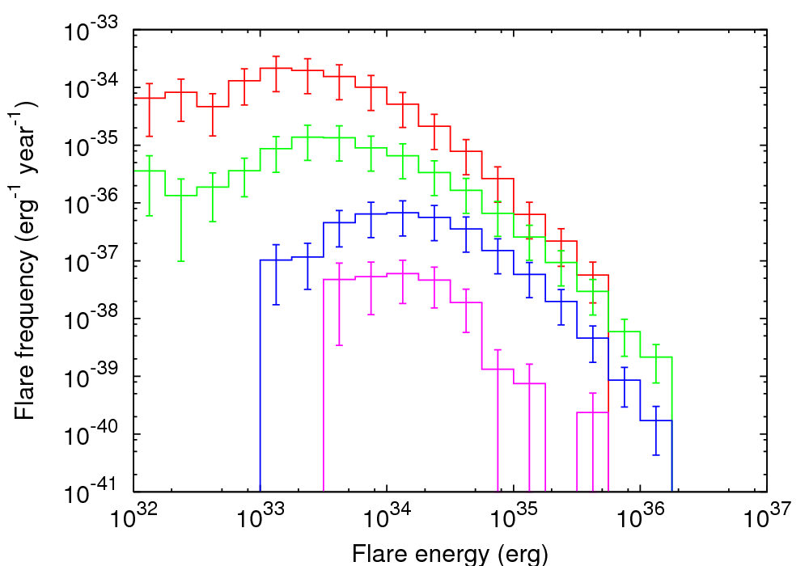
Flare frequency vs. energy for M, K, G type stars
M dwarfs
G dwarfs
K dwarfs
Sun-like
(P>10d, 5600K<Teff<6000K)
If 10^35 erg superflare occur on M type stars, the radiation intensity
on the ground of habitable planets around M stars will be ~ 4 Sv.

Slide 17
Summary
Using Kepler data, we found 365 superflares (10^33-10^36 erg) on 148 solar type stars (G type main sequence stars), including 101 from slowly rotating solar-type stars, from ~83,000 stars observed over 120 days (Maehara et al. 2012).
10^35 erg superflares(1000 times of the largest solar flare) occur once in 5000 years in our Sun (Maehara et al. 2012).
There is no hot Jupiter around these superflare stars.
10^35 erg superflares cause strong Ozon depletion and disaster in the civilization.
10^37 erg superflare may cause extinction.
10^35 erg superflares on M type stars have fatal radiation ~ 4 Sv on the ground of habitable planets around M stars. The frequency of flares on M type stars is also large, 100 times more than that of solar type stars.

