Slide 1
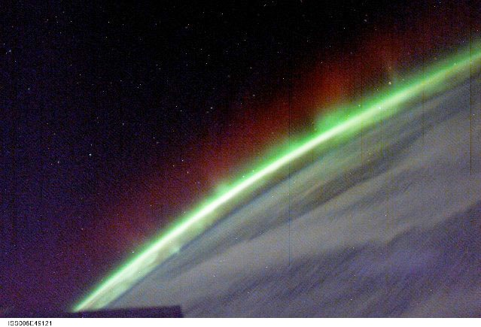
Extreme Space Weather as an Emerging Risk
ISOBE, Hiroaki (GSAIS, Kyoto Univ.)
Disaster and Human Survivability, 2016 Nov 21-22, Kyoto
NASA

Slide 2
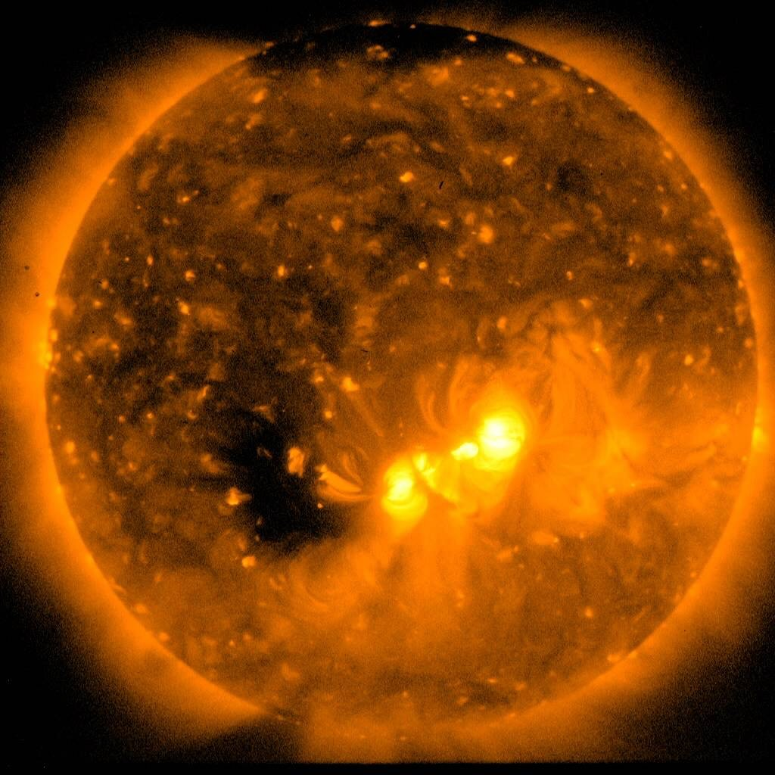
The Sun is a variable star
Hinode XRT
(JAXA/NAOJ)

Slide 3
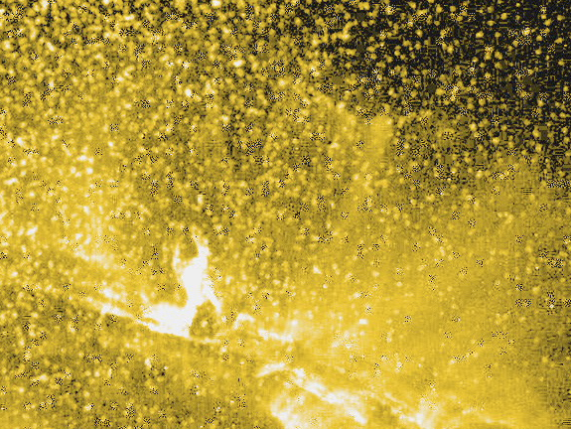
Solar flare
TRACE
(NASA)

Slide 4
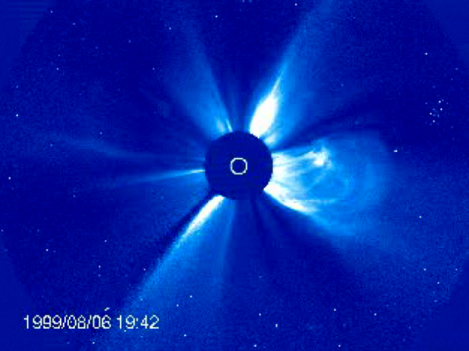
Solar wind and coronal mass ejections
SOHO/LASCO
(NASA)

Slide 5
Space Weather: disturbance of plasma environment in interplanetary and geo-space.
NICT

Slide 6
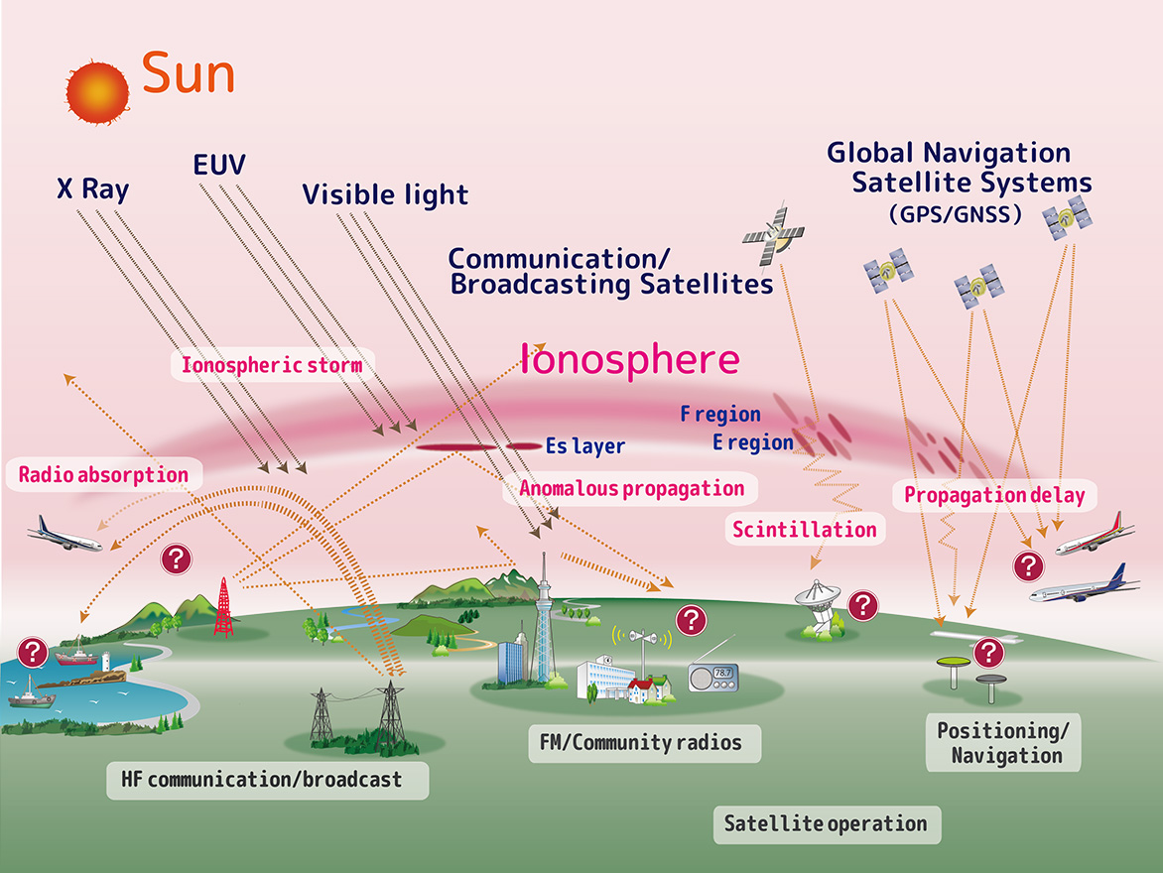
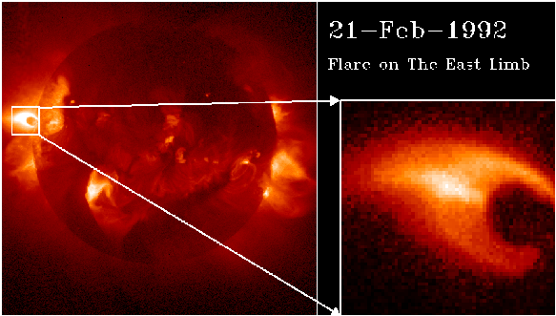
What come from the Sun and their effects
NICT
1. Electromagnetic wave (especially X-ray and EUV)
Increase of electron density in the Ionoshpere
Satellite communication and Navigation
Blackout of High-Frequency communication
NICT

Slide 7
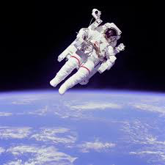
What come from the Sun and their effects
2. Solar Energetic Particles (SEPs)
Radiation dose to astronauts
Damage to satellites
Ionization and chemical reaction in upper atmosphere
NICT

Slide 8
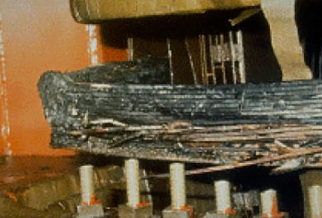
What come from the Sun and their effects
3. Solar wind and coronal mass ejections
Geomagnetic storm
Aurora
Failure of power plants and grids
Corrosion of pipe lines
NICT

Slide 9
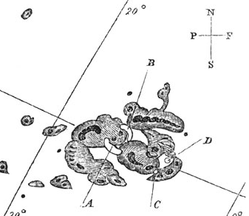
Carrington flare (1859, Sep 1, am 11:18 ）
Strongest solar flare / space weather event ever caught by modern observations
Bright aurora appeared next day in Cuba, the Bahamas, Jamaica, El Salvador, and Hawaii
Telegraph pylons threw sparks and telegraph paper spontaneously caught Fire （Loomis 1861）
Carrington 1859, MNRAS
If a Carrington-class event hits the Earth NOW, it will take years and trillions of dollars to recover (NRC, 2008)

Slide 10
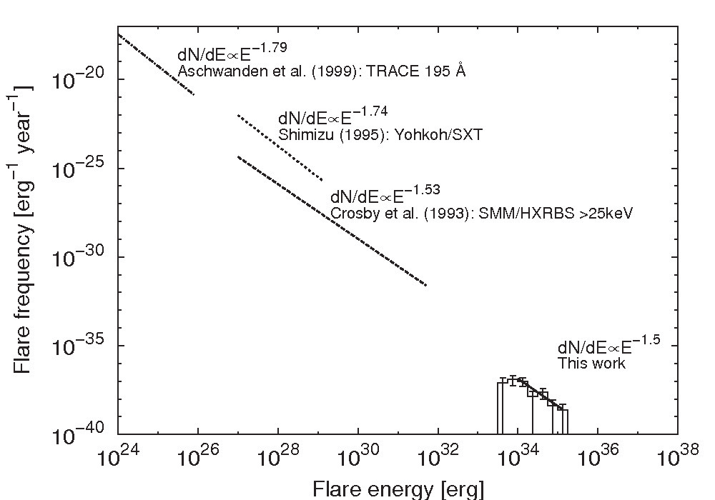
How strong a flare can be?
Carrington flare →
???

Slide 11
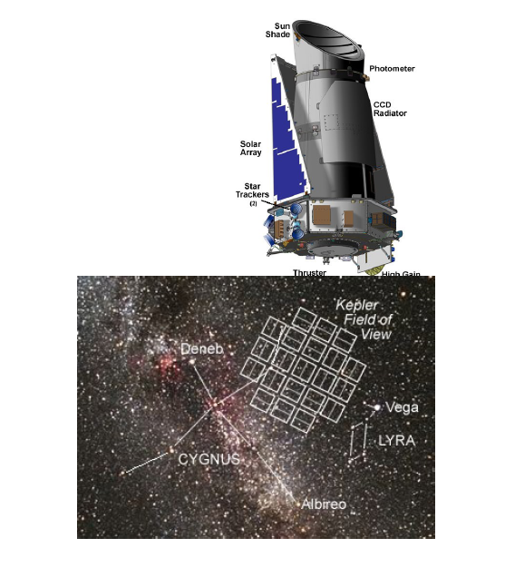
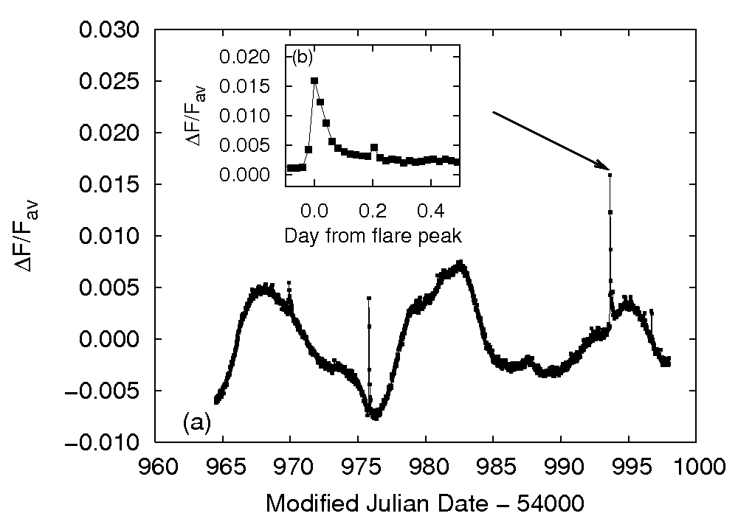
Discovery of superflares in sun-like stars (Maehara et al. 2012 Nature)
Kepler
(NASA)
Hundreds of superflares, whose energy is 100-1000 times larger than Carrington flare were found in stars similar to the Sun.

Slide 12
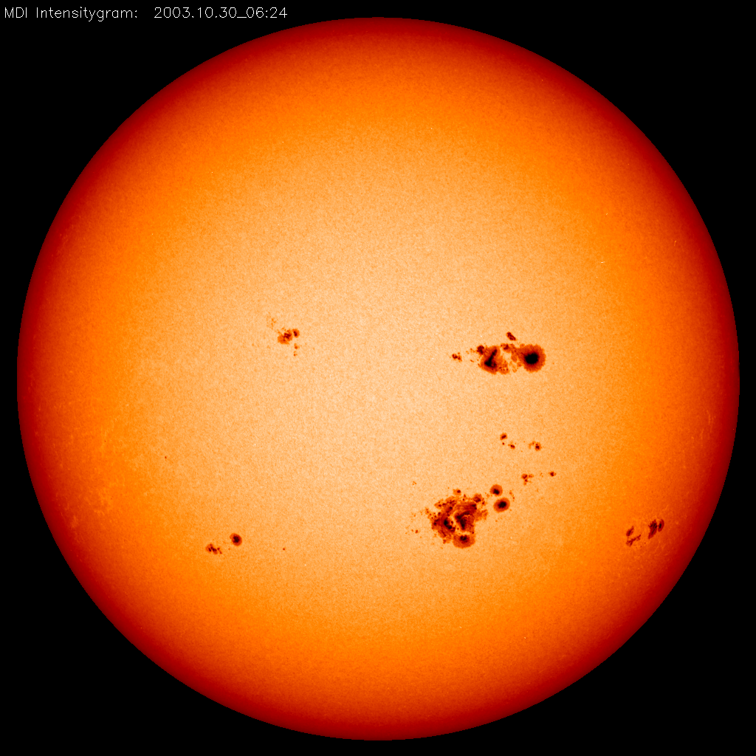
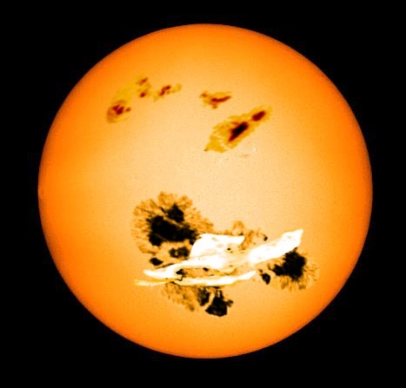
Image of superflare
Ｓｕｎ
Superflare star

Slide 13
Occurrence frequency
1000 in 1 year
100 in 1 year
10 in 1 year
1 in 1 year
1 in 10 year
1 in 100 year
1 in 1000 year
1 in 10000 year
Superflares occur every 5000 years?
Carrington
superflare
フレア解放エネルギー

Slide 14
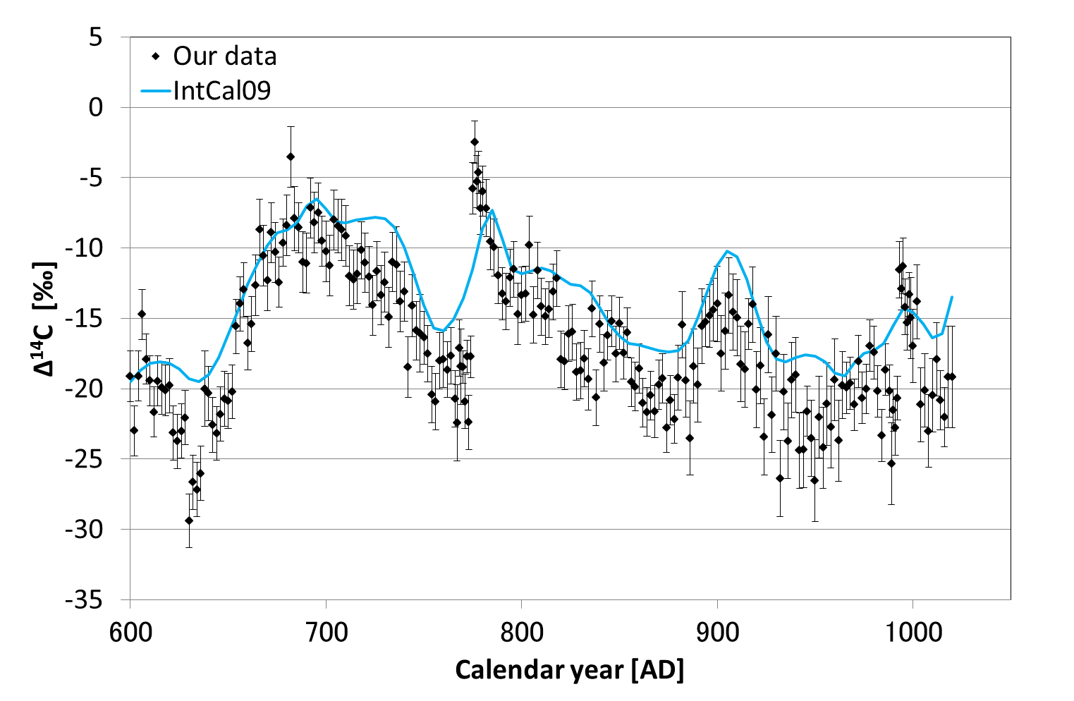
Evidence of solar superflare?
AD775
AD994
14C in tree rings indicates spikes of anomalously large cosmic ray flux in 8th and 10th centuries (Miyake et al. 2012, 2013).

Slide 15
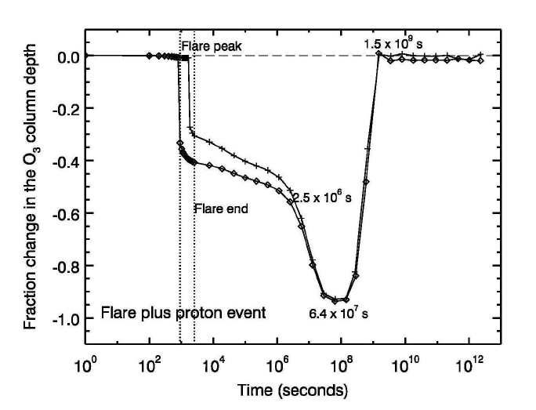
Consequence of E~10³⁵ erg (10²⁸ J) superflare
Ozone layer disappears for years
Significant radiation doze to aircraft passengers
Almost complete destruction of space assets
Global failure of satellites and high frequency communication
Global failure of power grids
Segura et al. 2010

Slide 16
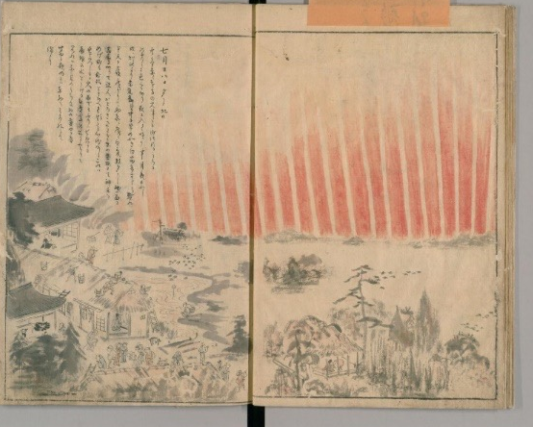
Learn from the Past
Records of law-latitude aurora observations are the proxy for extreme space weather event in the past.
Aurora records founds in Astronomical Diaries from Babilonia, BC652-61
(Hayakawa et al. 2016 Earth, Planets and Space).
Possible law-latitude aurora during Maunder minimum (Kawamura et al. 2016 , Publ. Astron. Soc. Japan)
Discovery of new records of Carrington aurora event from east Asia (Hayakawa et al. 2016, Publ. Astron. Soc. Japan)
『猿猴庵随観図会』
(Digital Archive in National Congress Library)
In collaboration with
H. Hayakawa, H. Tamazawa, A.D. Kawamura, Y. Ebihara,
K. Iwahashi, Y. Mitsuma, H. Miyahara, R. Kataoka, K. Shibata,
S. Kosaka, Y. Fujiwara et al.

Slide 17
Summary
Extreme space weather is a growing risk to the modern civilization due to increasing utilization of space assets.
Observations of solar-like stars and analyses of cosmogenic isotopes indicates the possibility of catastrophic superflare in our Sun
Historical records of aurora observations provide not only scientific information of the past solar activities but also tell us how people responded to such anomalous events.

