Slide 1
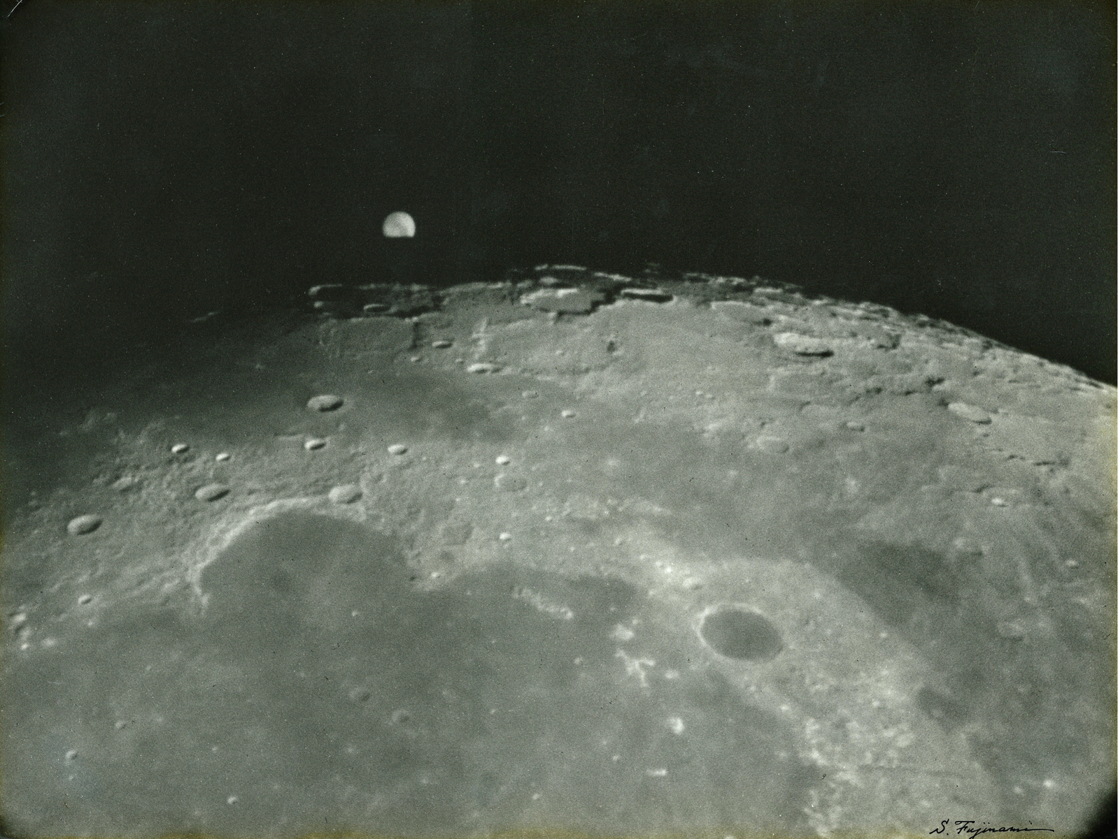
漢字 in 科学? Should we keel local languages and Chinese characters in top sciences? -- A case of astrophysics
Hiroaki Isobe / 磯部洋明
Unit of Synergetic Studies for Space, Kyoto University
京都大学宇宙総合学研究ユニット

Slide 2
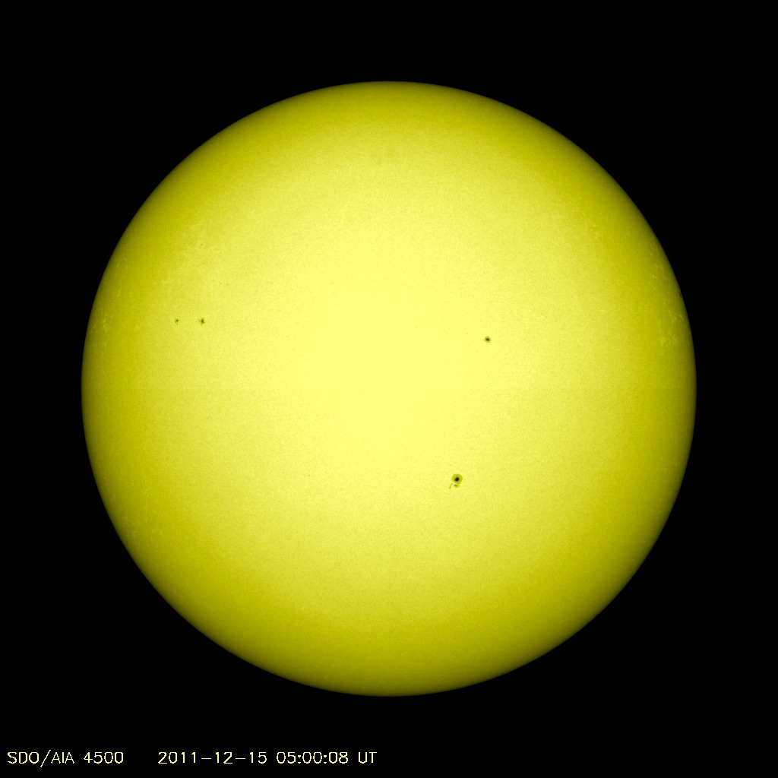
日
The Sun yesterday
NASA/Solar Dynamic Observatory
Sunspot （黒点/黒子）？

Slide 3
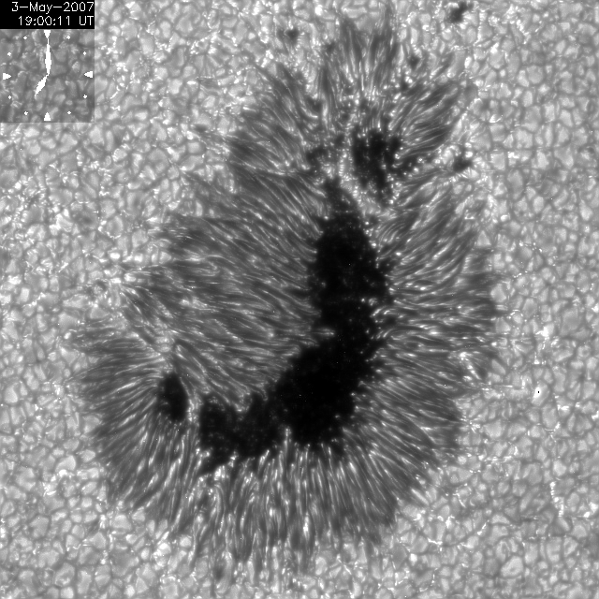
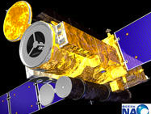
Sun and sunspot as seen by modern telescope in space
Hinode（日の出）
JAXA/NAOJ
movie courtesy of
T. J. Okamoto

Slide 4
Language of natural science is English
This was not true in Europe until recently...
e.g., Einstein’s paper on relativity (相対性理論) was in German
Today, practically all the important scientific papers are published in English (at least in astrophysics which I know. New discoveries and achievements are hardly recognized if not presented in English
Subjects of astrophysics are by definition universal. No localness. New ideas should be shared universally by common language, and English is (becoming) the only practical option.
We, scientists, have no choice but publish in English

Slide 5
So, no point in using Chinese character and our own languages in science? Some voices of astrophysicists:
Certainly no!
it is more effective to discuss in own languages
scientific results should be shared with public, who do not (or are not willing to) use English
Maybe yes?
need to publish in English anyway and I don’t want to pay effort to repeat it...
need to attract talents internationally

Slide 6
Different levels of scientific activities
Present and publish top scientific results
English
Daily research activities in the lab
English if there are international collaborators, but if not?
Education in graduate and undergraduate levels
English desirable to attract international students?
Public outreach and elementary/high-school level education
Local language

Slide 7
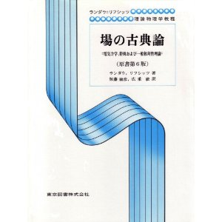
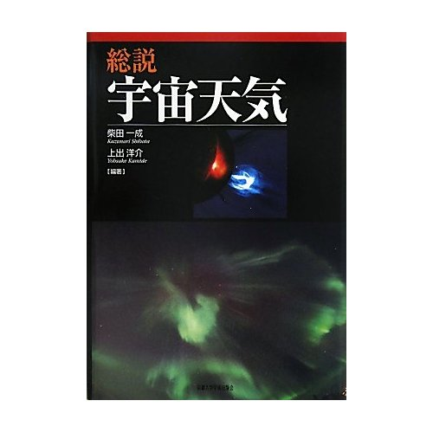
Efforts to integrate scientific concepts into the culture of Chinese characters
Dr Matsumoto and Prof Taketo’s talk:
New (scientific) terms had created: 温度、液体、空間、物理、科学、観測、工業、水素、炭素、酸素...
Textbooks for experts and graduate students have been written in and translated into Japanese
This certainly helps to bottom-up the scientific level of students and professional engineers, if not top scientists

Slide 8
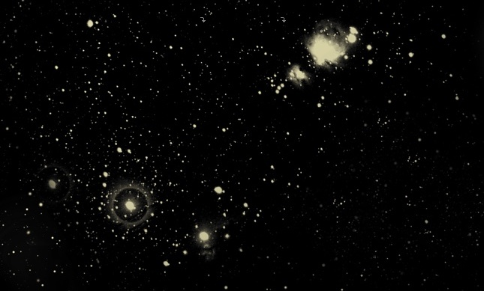
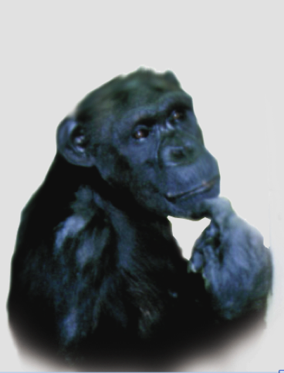
What does astrophysics mean for humankind?
Let me stay in my field for a while..

Slide 9
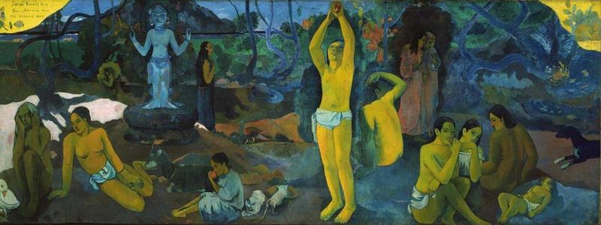
Where do we come from? What are we? Where are we going?
P. Gauguin, Boston museum of fine arts

Slide 10
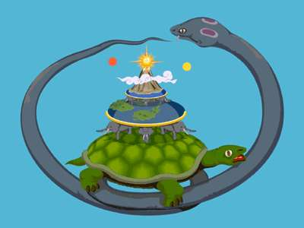
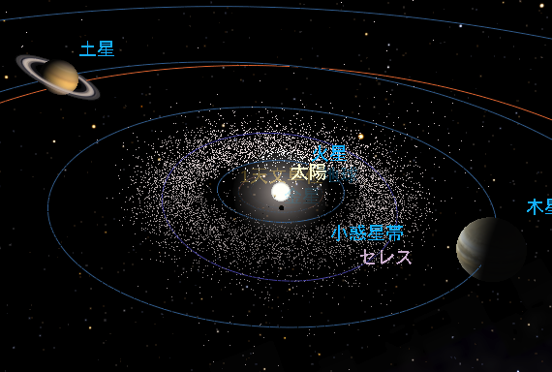
In ancient time, people created myths to describe the universe and the origin of themselves to obtain relieves.
Driven by the curiosity invoked by astronomical observations, people realized that the world is something they can understand and explore by their reason

Slide 11
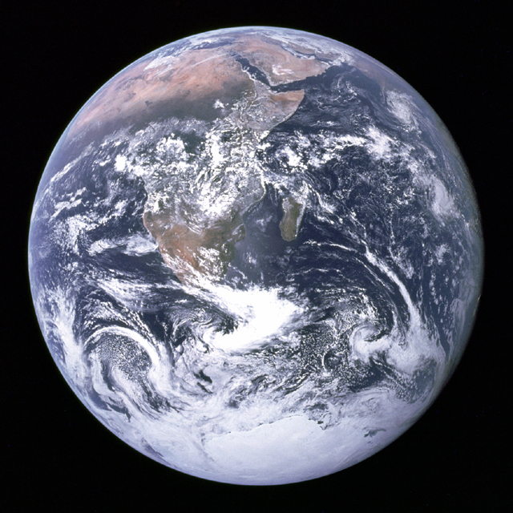
Most important achievement by modern space exploration

Slide 12
After
Space exploration in 20th century was contemporary with development of mass media.
Since this picture is now widely shared by public across the globe, concepts such as “spaceship earth” “environment protection”, “cosmopolitan”

Slide 13
Science is still one of the most important drivers that change and cultivate our way of life and our way of thinking
If it is lost from our own languages and the culture of Chinese characters, there will be long term influences...

Slide 14
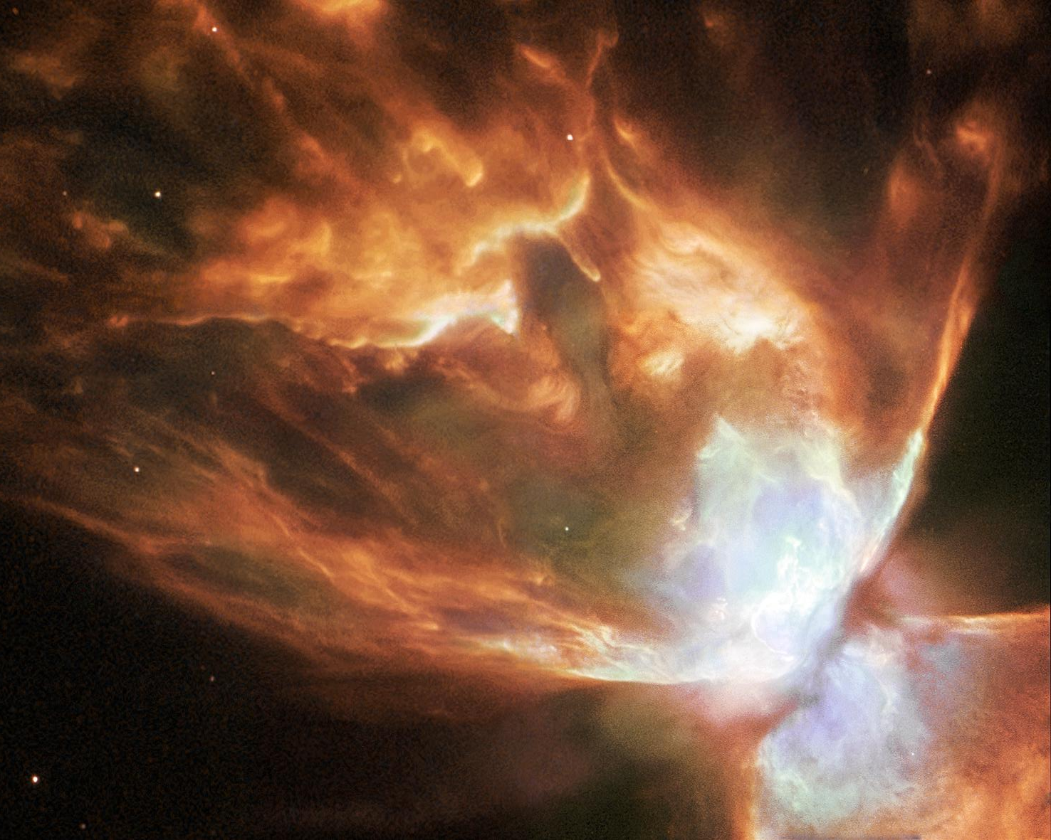
Another reason for science in 漢字
Beautiful picture of a dying star taken by
Hubble space telescope
Our sun will end like this after 6 billion years

Slide 15
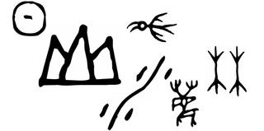
The sun they see in 10000 years ago

Slide 16
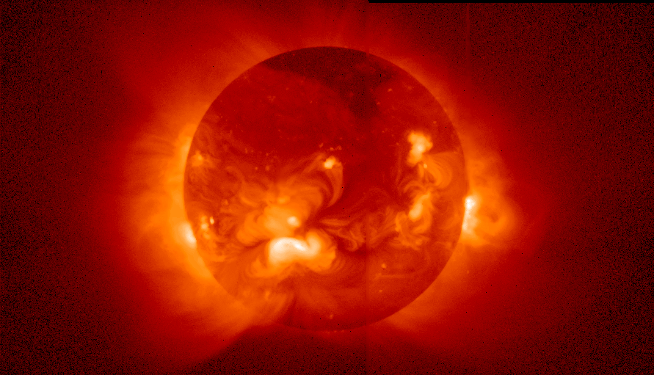
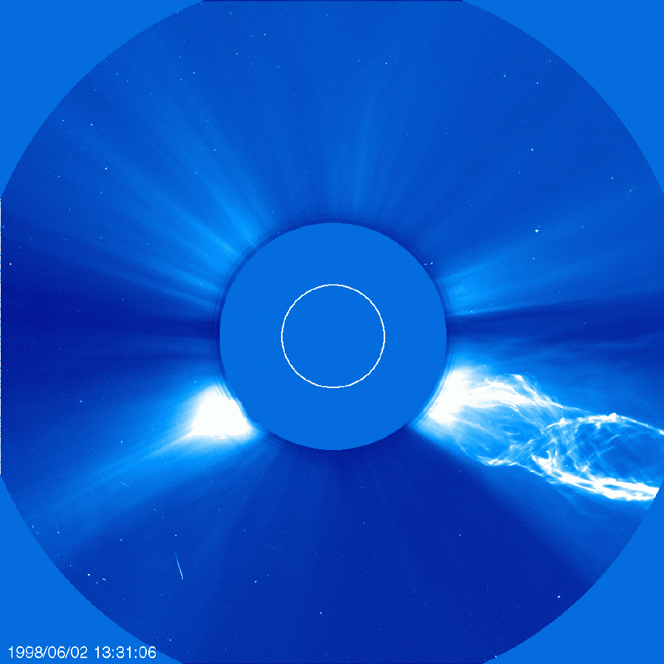
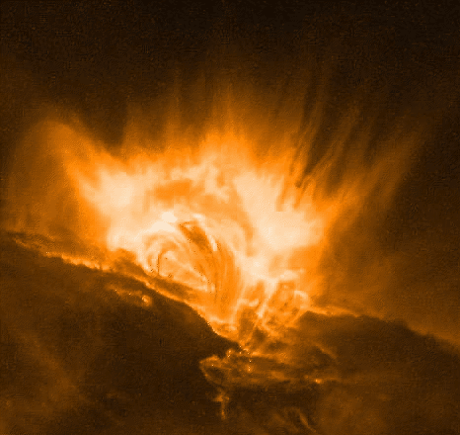
The sun we see today is a variable and violent star

Slide 17
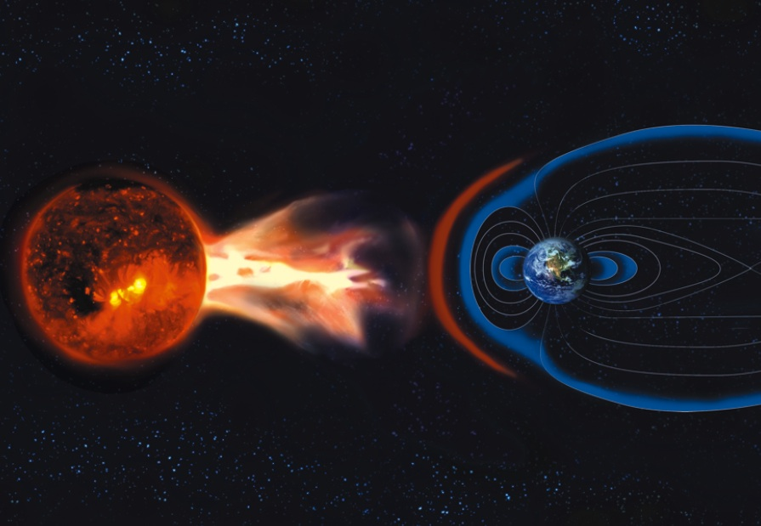

Slide 18
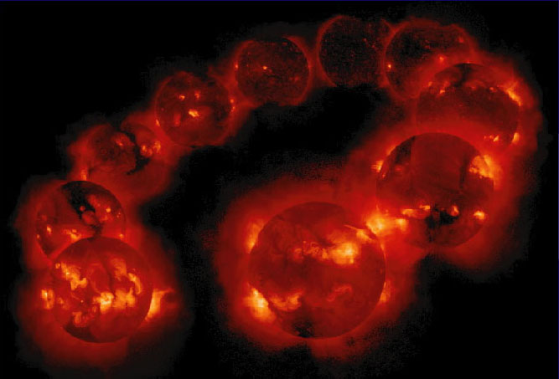
What astronomy and earth sciences are telling us:

Slide 19
Our star is a variable star. Environments, climates and even lands keep changing.
Our society looks even more variable.
In order to survive the changes and adopt to them, we need diversity.
Diversity!

Slide 20
Unification vs Diversity
After
“Globalization”, “cosmopolitan”, “宇宙船地球号”...
We need diversity also in science!

Slide 21
Prof Liu: “People today still can read and understand the official script 2000 years ago”
Chinese characters could be an important option to hand down our knowledge and thinking (incl. science) to generations thousands of years later?

Slide 22
A thousand years is well within our scope
In 1006, there was an super-nova explosion (超新星爆発) , which must have appeared as new, very bright star in the sky
It was recorded in a few literature in East Asia, including Meigetsu-ki（明月記） by Fujiwara Teika （藤原定家）
In 2006, Prof. Katsuji Koyama at Kyoto Univ observed the remnant of the supernova using modern X-ray telescope on board a satellite named Suzaku（朱雀）

Slide 23
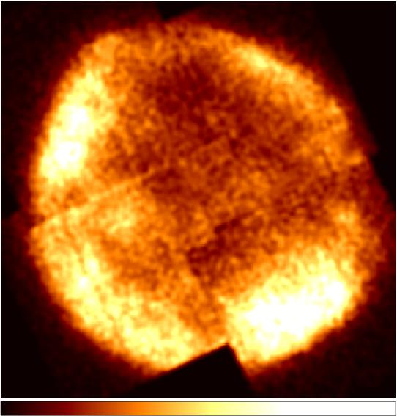
A thousand years is well within our scope
In 1006, there was an super-nova explosion (超新星爆発) , which must have appeared as new, very bright star in the sky
It was recorded in a few literature in East Asia, including Meigetsu-ki（明月記） by Fujiwara Teika （藤原定家）
In 2006, Prof. Katsuji Koyama at Kyoto Univ observed the remnant of the supernova using modern X-ray telescope on board a satellite named Suzaku（朱雀）
Because of the reliable ancient record, we knew when this supernova exploded. This allowed scientists to calculate, e.g., the accurate energy of the explosion.
Top-level scientific results by collaboration with 1000 years ago!

Slide 24
Summary
Natural science such as astronomy have been changing our view of the world, and thus our way of thinking. So we definitely need to keep integrating it to our language and culture.
East Asia’s Culture of Chinese characters has a potential to provide healthy diversity in the field of top-level science.
this is important not only for us, but for all the humankind in >1000 years!

Slide 25
Suggestion
Natural scientists alone cannot manage to keep integrating new scientific achievements into the culture of Chinese character
We need close collaboration with scholars and artists in various fields, as well as with the public.
AEARU could be an ideal platform for this sort of collaboration.

