Slide 1
宇宙（総合）学から見た総合生存学 GSAIS, the Unit of Synergetic Studies for Space, and some thoughts
磯部洋明
ISOBE, Hiroaki
2015 Dec 17 Shishukan Konwakai

Slide 2
Unit of Synergetic Studies for Space (USSS)
宇宙総合学研究ユニット
“Unit” is a Kyoto-U’s jargon for the cross-department group of researchers.
USSS is one of the first “units” in Kyoto-U, established in 2008. Its aim is to promote pioneering, interdisciplinary studies related to 宇宙/UCHU (space/universe/cosmos).
Currently more than 70 members join from Science, Engineering, Letter, Asia-Africa studies, Human and environment studies, energy science, Yukawa institutes, Kokoro-research center, Kyoto-U museum, Institutes of liberal arts and science, RISH, DPRI, Kokoro center, Hakubi center, and GSAIS (Yamashiki and Isobe)

Slide 3
USSS Organization
KU
USSS
Director: Prof. Toshihiko Iyemori
Vice directors: K. Shibata, T. Tanimori, R. Inamuro
Graduate Schools
Uchu-gaku 宇宙学拠点
JAXA
Four research divisions:
Space environment (A. Asai, solar physics)
Space sensing (Y. Mizumura, γ-ray astronomy)
Space civilization (M. Kureha, philosophy)
Public engagement (M. Abe, geoscience)
Research Institutes
Universities
Centers etc
Instites
Education program for graduate students
Industry
Students
BroadBandTower division
Run by the donation from the BBT inc., an ICT company
Schools

Slide 4
Some examples of interdisciplinary research projects in USSS
Ongoing
Space weather forecasting system using machine learning (BBT inc and RIKEN)
Space anthropology (Kobe-U, Osaka-U, National Museum of Ethnology)
Space ethics
Long-term solar activity from historical literature (with Hayakawa-kun etc)
Aurora 4D
Starting
Astrobiology
Social economic impacts of space disasters

Slide 5
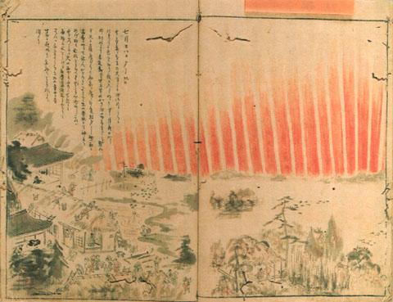
What happens in USSS: example 1
Students in astronomy (T, K) and a student in history (H) met in an event, chatted, and then came up with an idea for a collaboration.
In China (776)：「大曆十年…十二月丙子（Jan 12, 776），月出東方，上有白氣十餘道，如匹練，貫五車及畢、觜觿、參、東井、輿鬼、柳、軒轅，中夜散去」[新唐書天文二]
Historical documents can be used
to address the past solar activities?
Red aurora in Japan (1770)
National Diet Library of
Japan Digital archive

Slide 6
Any records in historical literature?
Red aurora in Japan (1770)
National Diet Library of
Japan Digital archive
“This year (774) also appeared in the heavens a red crucifix, after sunset; the Mercians and the men of Kent fought at Otford; and wonderful serpents were seen in the land of the South­Saxons.” Allen (2012)
There also is and German records on “Red shield-like thing above the church” [Annales Regni Francorum: 776]
In China (776)：「大曆十年…十二月丙子（Jan 12, 776），月出東方，上有白氣十餘道，如匹練，貫五車及畢、觜觿、參、東井、輿鬼、柳、軒轅，中夜散去」[新唐書天文二]
Pioneering works of the survey of aurora observation in Chinese, Korean and Japanese literature by Keimatsu (1973) and Yau (1995)
Association with the AD775 event pointed out by Allen (2012), Usoskin (2013), Cliver+(2014)

Slide 7
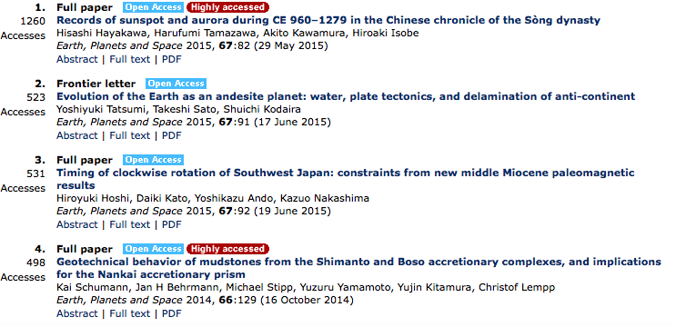
Access ranking of Earth, Planets and Space (as of July 2015)

Slide 8
What happens in USSS: example 2
I was talking with a researcher in ecology (now working in science communication at iCeMS) and we came up with interesting question:
does it have any impact on ecological system to wipe out the house roaches from the Earth?
is it ethically acceptable to apply genetic screening to the animals, and also to humans, when selecting the members of the emigration to other stars?

Slide 9
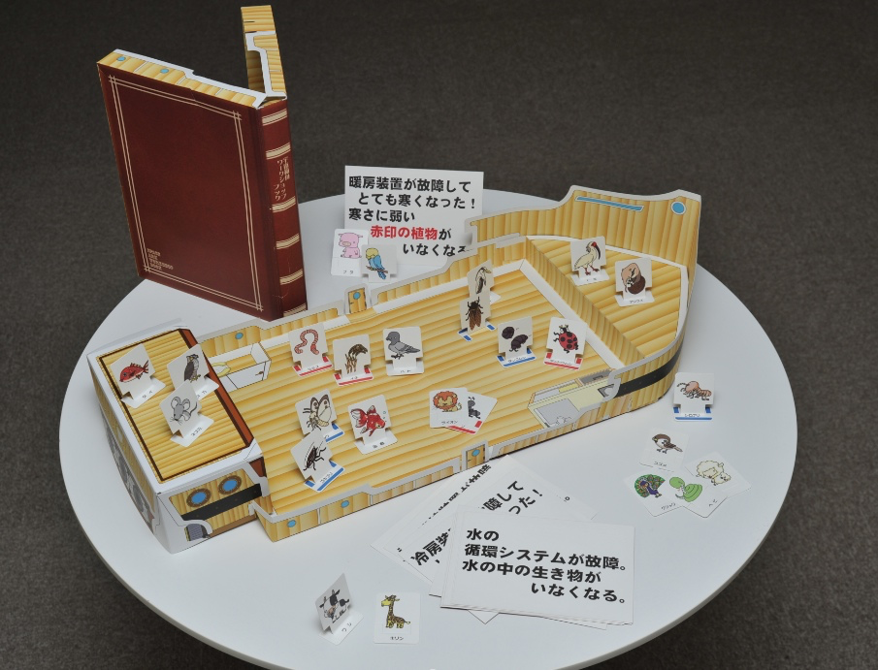
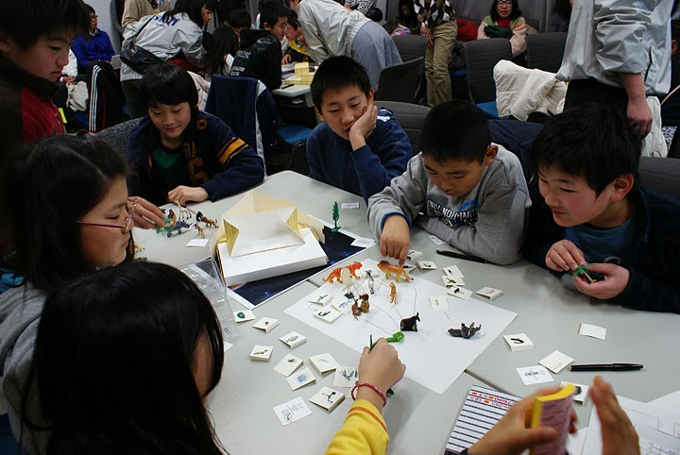
「答えのない課題」を扱う教育プログラム 宇宙箱舟ワークショップ
水町衣里、磯部洋明、神谷麻梨、黒川紘美、堂野能伸、森奈保子、塩瀬隆行
教材としての宇宙：答えのない課題を扱う教育プログラム『宇宙箱舟ワークショップ』
宇宙航空研究開発機構研究開発報告 JAXA-RR-12-007 (2013)

Slide 10
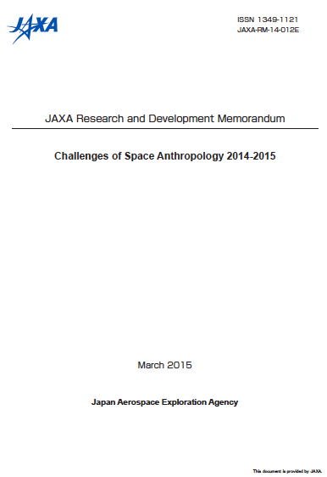
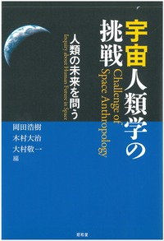
Space anthropology
The two faces of tomorrow: Human Bio-sociocultural Diversity Expanded thorough Space Development (K. Omura)
Television and Japanese Imagination of outer space (F. Itakura)
A socio-cultural study of the discources of mono-zukuri in the manufacturing of launch vehicles in Japan (H. Iwatani)
Anthropology of “First Contact” (D. Kimura)
The Humanistic Approach to Space Exploration: A Cultural Anthropological Look at Space Tourism (H. Okada)
Life in extraterrestrial space: An anthropological consideration on astronauts’ everyday experiences (T. Sato)
Do we disturb the universe? Diversity in space as a grotesque hope for humankind (H. Isobe)

Slide 11
Globalism?

Slide 12
Emigration to space… by whom?
F. Dyson “Disturbing the Universe”
 | Mayflower | Mormons | Space colony | Asteroid colony
Year | 1620 | 1847 | 2??? | 2???
Number | 103 | 1,891 | 10,000 | 23
Load (t) | 180 | 3,500 | 3.6 million | 50
Cost (USD in 1975) | 6 million | 15 million | 100 billion | 1 million
Cost per 1 poud | $15 | $2 | $13 | $10
Cost per family (annual income) | 7.5 | 2.5 | 1,500 | 6

Slide 13
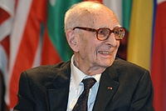
When integral communication with the other is achieved completely, it sooner or later spells doom for both his and my creativity. The great creative eras where those in which communication had become adequate for mutual stimulation by remote partners, yet was not so frequent or so rapid as to endanger the indispensable obstacles between individuals and groups or to reduce them to the point where overly facile exchanges might equalize and nullify their diversity (Levi-Strauss 1985）

Slide 14
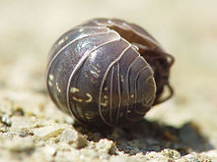
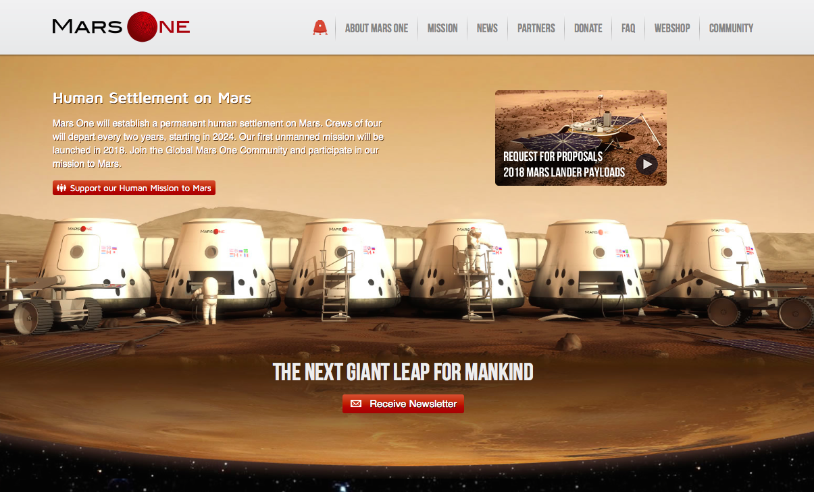
....
Space for a human is
the maze for a pill bug

Slide 15
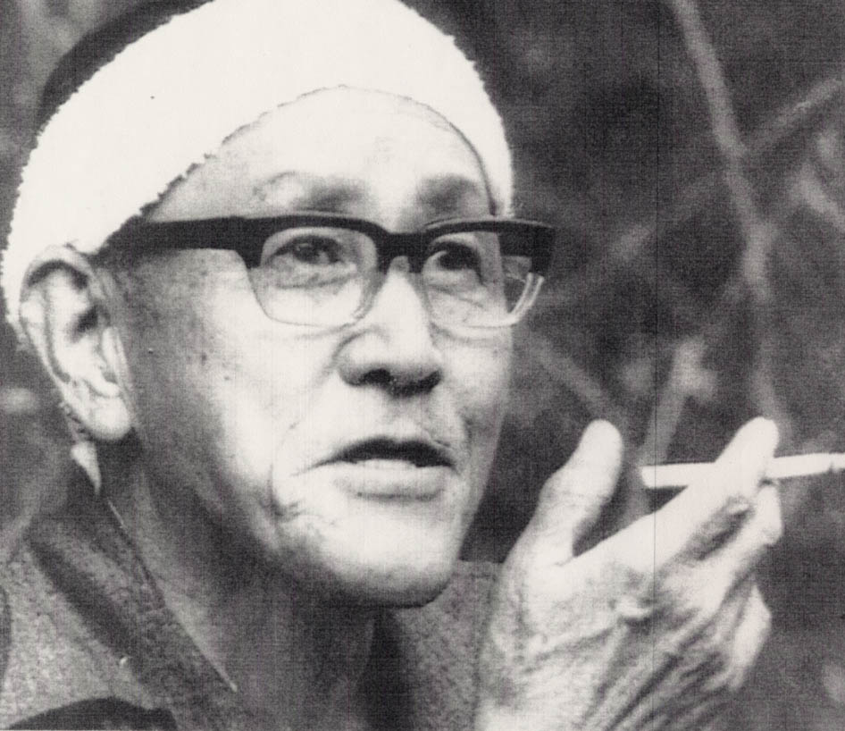
今西錦司『私なんかは、自分の一生については自然が破壊されていくのを悲しんだりしている。けれども人間の一生を考えたらサイボーグでもなんでもいいから、もっと発展してほしいという気持になるね』
今西錦司『民族文化などは、人間が意識的につくりあげようとしてできたものではなくて、自然にそうなってきたものでしょう。こういう文化と、サピエンスとして人間が意識的に努力して作り出した文化とは、はっきり分ける必要がある』
梅棹忠夫『目的的発想は自然的所与とちごうてかなり自由度が高い。洋々たる可能性をはらんでいるとともに、一面大変恐ろしいところがある』

Slide 16
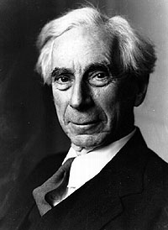
ICARUS or The Future of Science,
Bertrand Russell (1924)
Mr. Haldane's Daedalus has set forth an attractive picture of the future as it may become through the use of scientific discoveries to promote human happiness. Much as I should like to agree with his forecast, a long experience of statesmen and government has made me somewhat sceptical. I am compelled to fear that science will be used to promote the power of dominant groups, rather than to make men happy. Icarus, having been taught to fly by his father Daedalus, was destroyed by his rashness. I fear that the same fate may overtake the populations whom modern men of science have taught to fly.

Slide 17
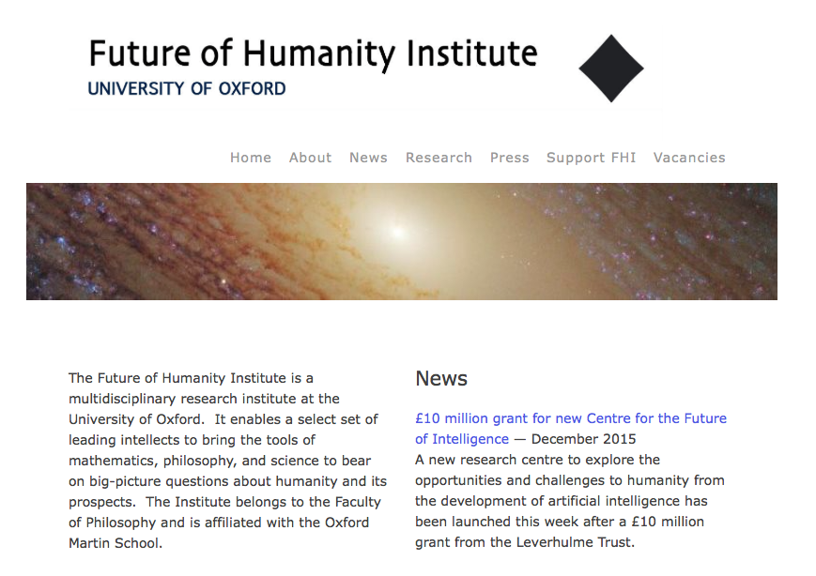
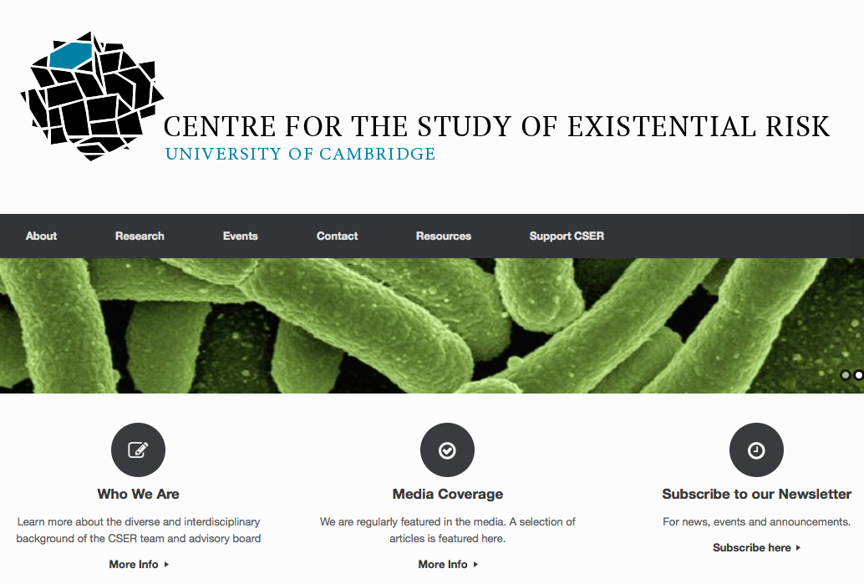

Slide 18
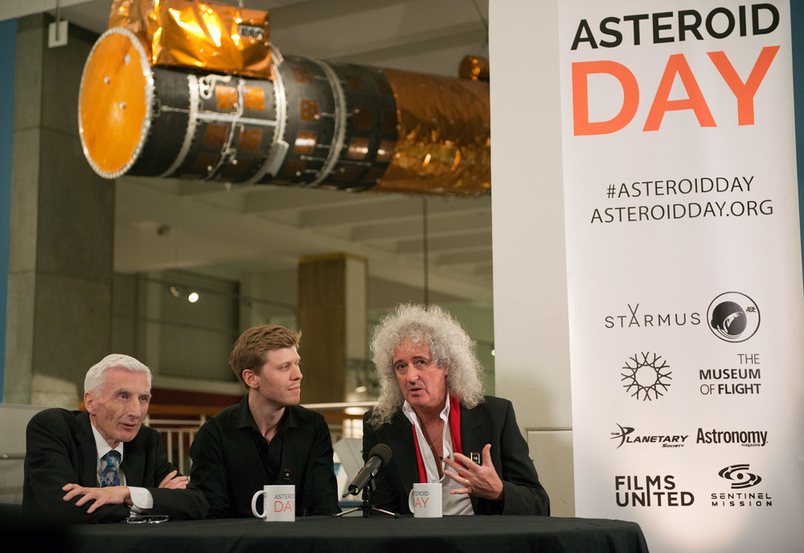
Public engagements in collaboration with a rock star

Slide 19
Archimedes’ point?

Slide 20
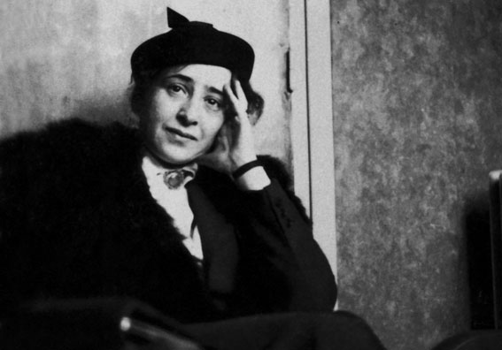
If we look down from this point upon what is going on on earth and upon the various activities of men, that is, if we apply the Archimedean point to ourselves, then these activities will indeed appear to ourselves as no more than “overt behavior,” which we can study with the same methods we use to study the behavior of rats.
The conquest of space and the statue of man, Hannar Arendt (1963)

Slide 21
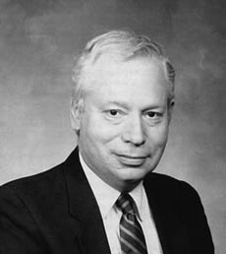
“The more the universe seems comprehensible, the more it also seems pointless.”
The First Three Minutes
S. Weinerg

Slide 22
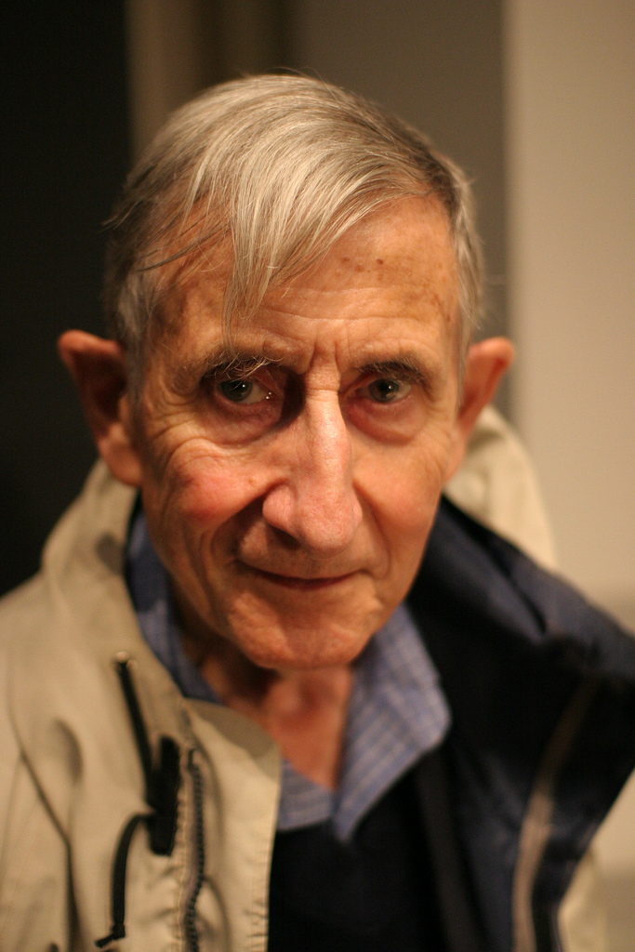
“I do not believe that we are tourists in our universe. I do not believe that the universe is mindless… We are not merely spectators; we are actors in the drama of the universe.“
Disturbing the Universe,
Freeman Dyson
Notes:
私たちは

Slide 23
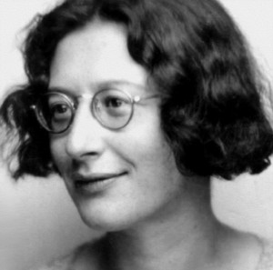
奴隷とは、ただ生存するためという以外に、この辛い労苦の目的としてどんな幸福も約束されていない者のことである
労働者たちは、パンよりも詩を必要とする。その生活が詩になることを必要としている。
工場日記 S. ヴェイユ
シモーヌ・ヴェイユ
https://upload.wikimedia.org/wikipedia/commons/0/0e/Simone1-300x297.jpg

Slide 24
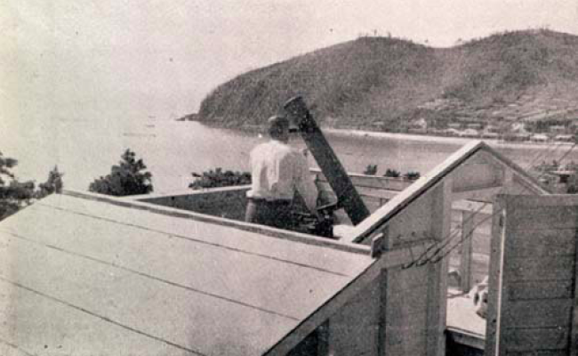
Astronomical observatory at Nagashima-Aiseien（長島愛生園）（1949〜50s）
“Concentration camp” for the patients of Hansen’s disease

Slide 25
長島愛生園入園者・依田照彦氏から 山本一清・初代花山天文台長への手紙（抜粋）
愛生学園にいた時は毎年夏期講習として、正座や星の話をプリントしては児童達と一緒に星の世界を眺めて楽しく宵を過ごしたこともあります。
私はこの島に一生を終わる運命にあり、生をかけてこのことをやりたい念願です。
今後同好の士を募り、この方面の趣味を開拓して園内の一般者にも自然科学に対する関心を昂め、少しでもうるほひのある生活が出来ますれば望外の幸せと存じています。
斯かる事は、国を賭しての今日の戦の下で、どうかと思われますが、私共にとっては、無為徒食に堕することなく、何か為すことが、せめてものみ国への御奉公と信じます。
冨田良雄 山本天文台モノ資料紹介 第３回天文台アーカイブプロジェクト報告会集録
（京都大学レポジトリKURENAIよりDL可）

Slide 26
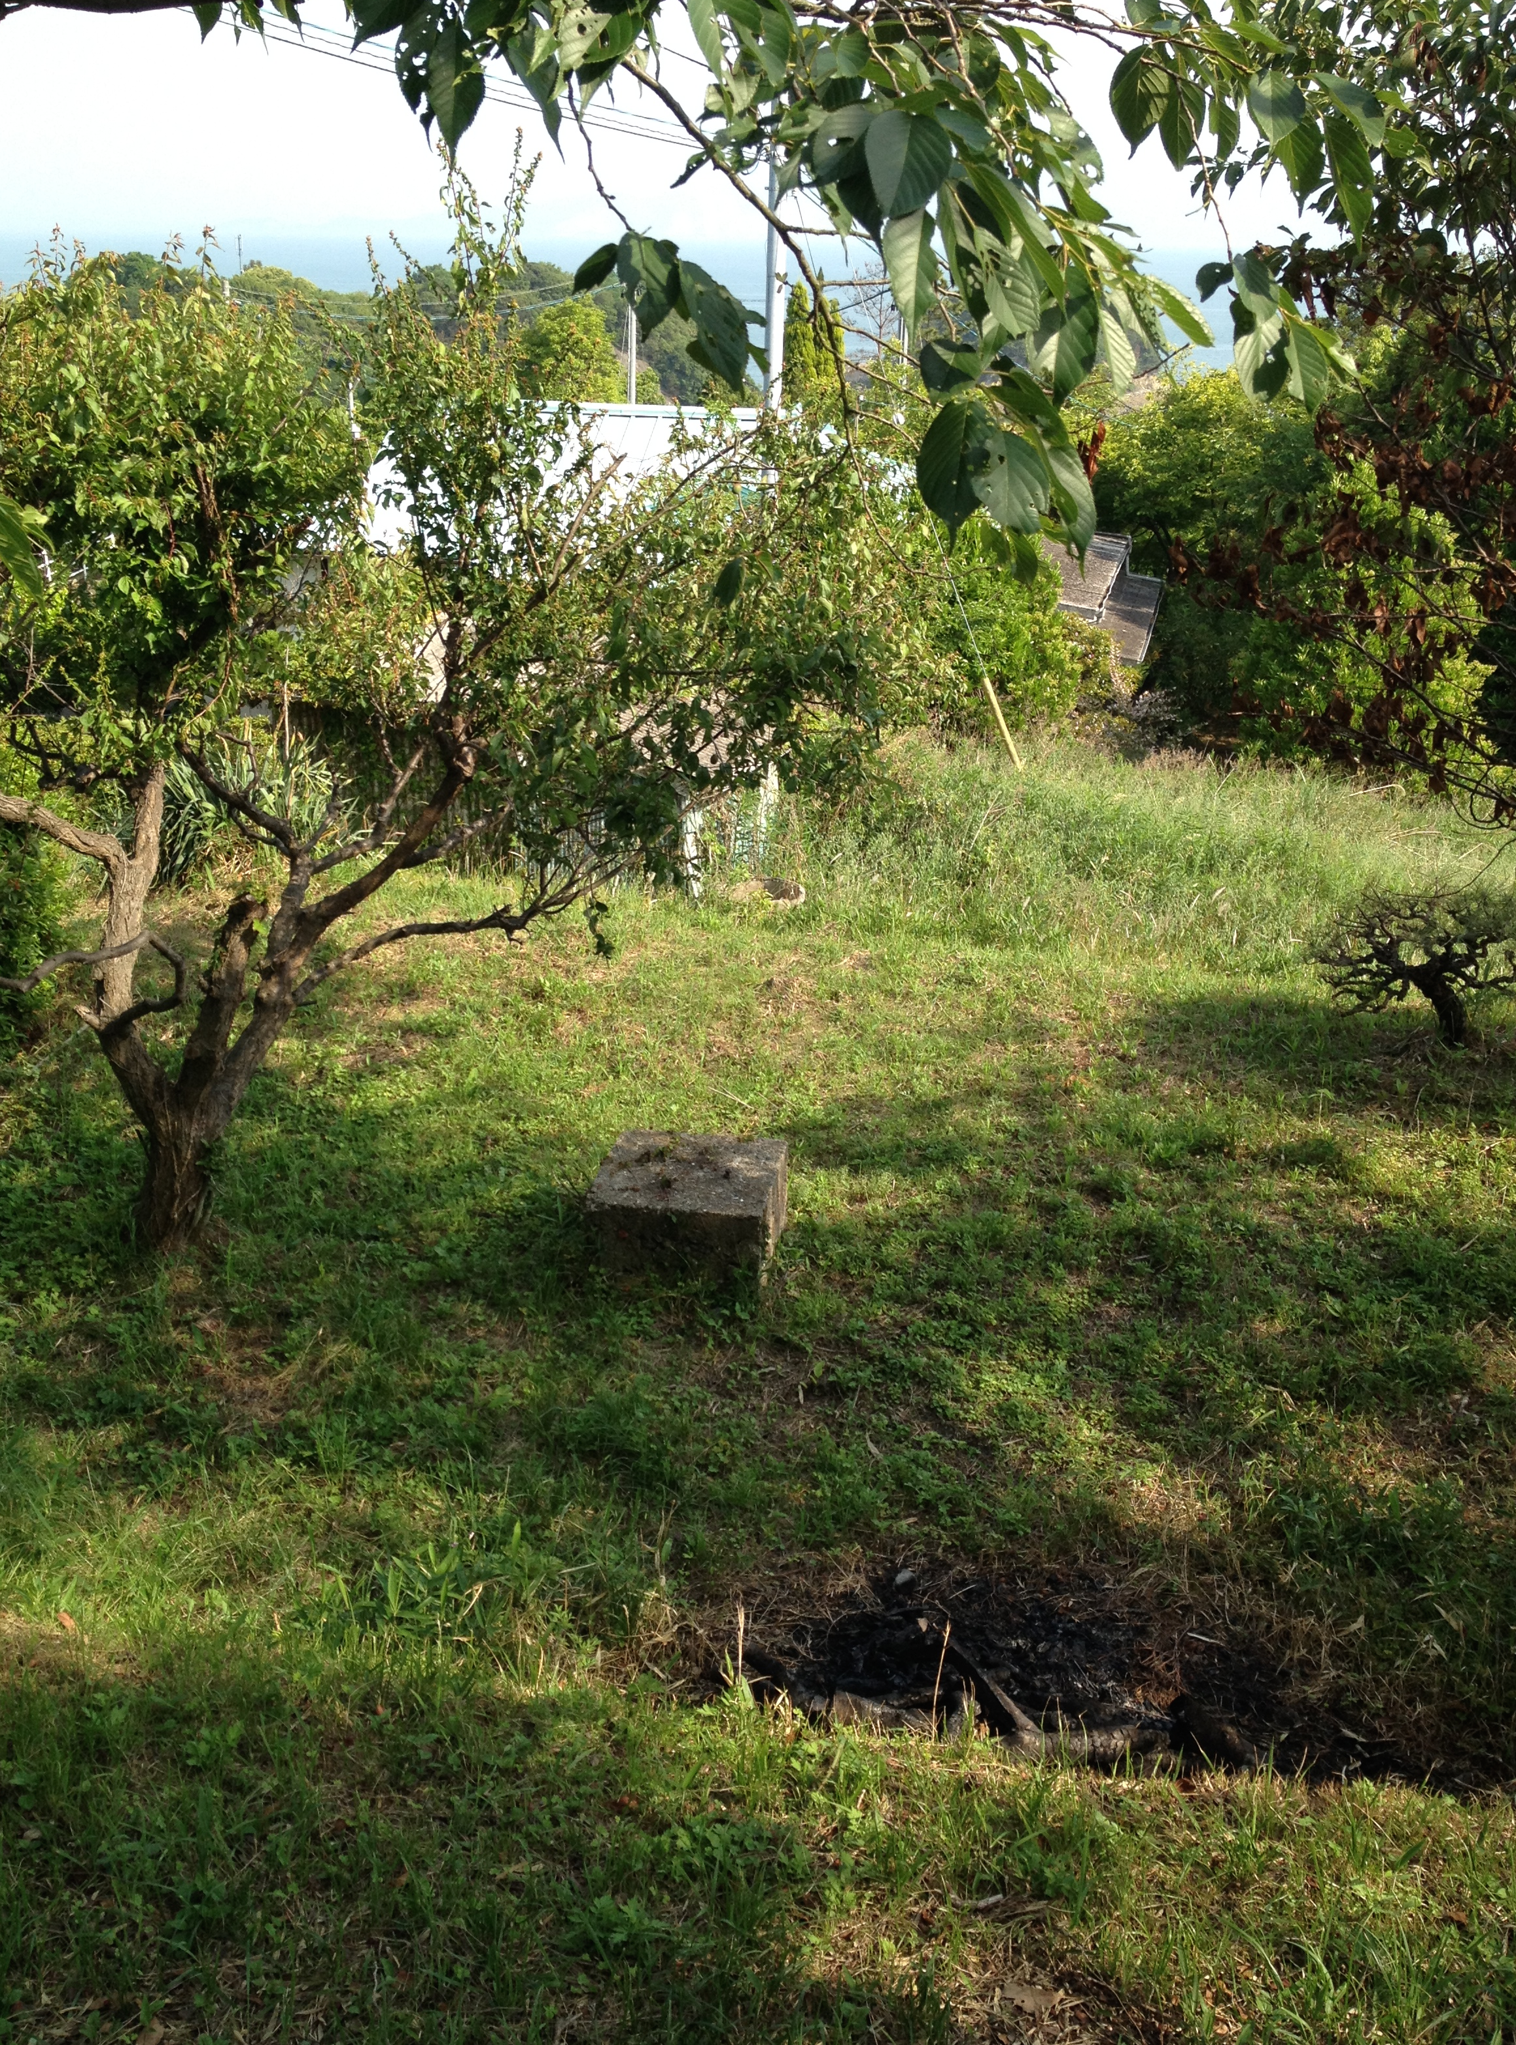
長島愛生園現地調査
（磯部洋明、大門美穂、高棹真介、山下俊介 2014年5月）

Slide 27
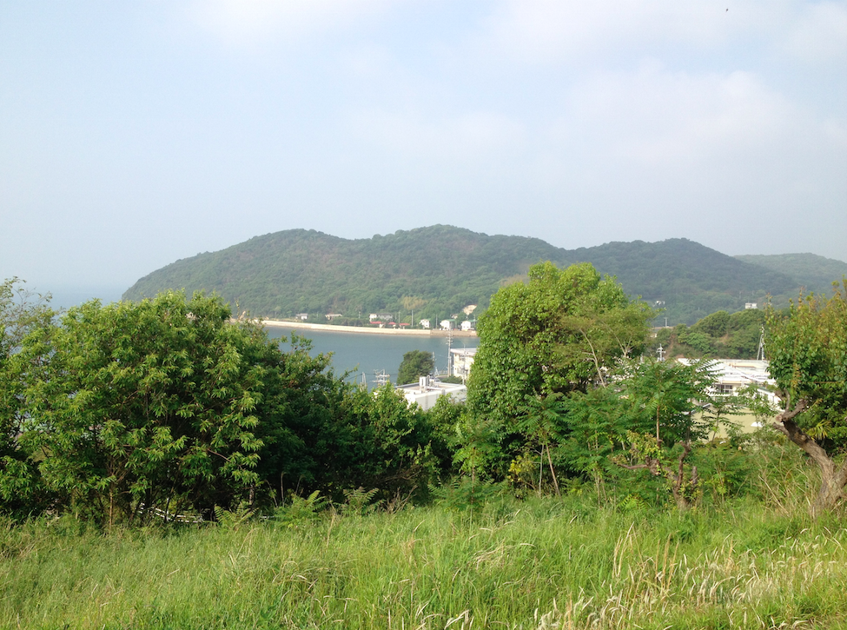
うちの微気圧計は高性能。米ソの核実験も誰より早く検出できてた（元観測所員Kさん、H26）
星をみるんも楽しかったけどなあ、みんなで望遠鏡で看護婦さんの寮をのぞくのが一番楽しかったなあ（入園者Hさん、H26）

Slide 28
My research plan at GSAIS
Extinct-level natural disasters
Science and religions in the contemporary society

