Slide 1
Kyoto 3.8m telescope project
and
future plans of our superflare studies
Daisaku NOGAMI
(Kyoto University)
2016/03/04(Fri)
Superflare WS 2016 @ Kyoto

Slide 2
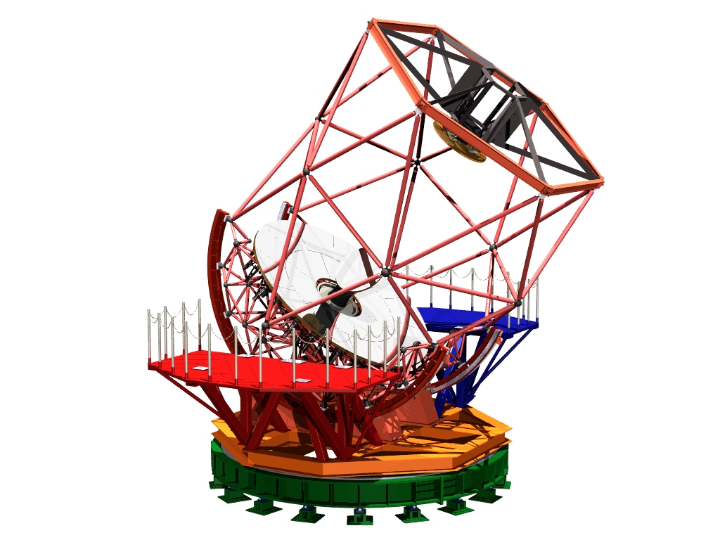
1999: Committee of the 3.8m telescope
↓
↓
↓
↓
2013: supplementary budget for construction of the telescope
2015: main budget for construction of the dome
Outlook figure of the 3.8m telescope

Slide 3
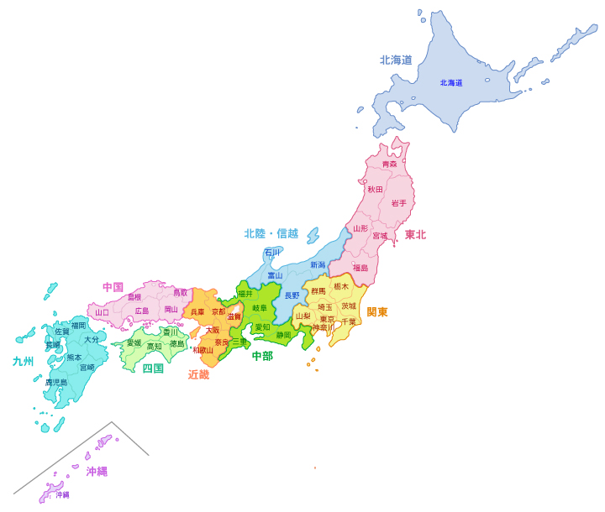
Constructed in Okayama
Kyoto
Tokyo
Okayama takes pride in the largest number of fine days in Japan.

Slide 4
Japan in the world
Mark: telescopes with a diameter over 3m
Good for ToO observations of transient objects/phenomena

Slide 5
Movies
Telescope and mirror in the plant in 2014
Moved to Okayama in 2015

Slide 6
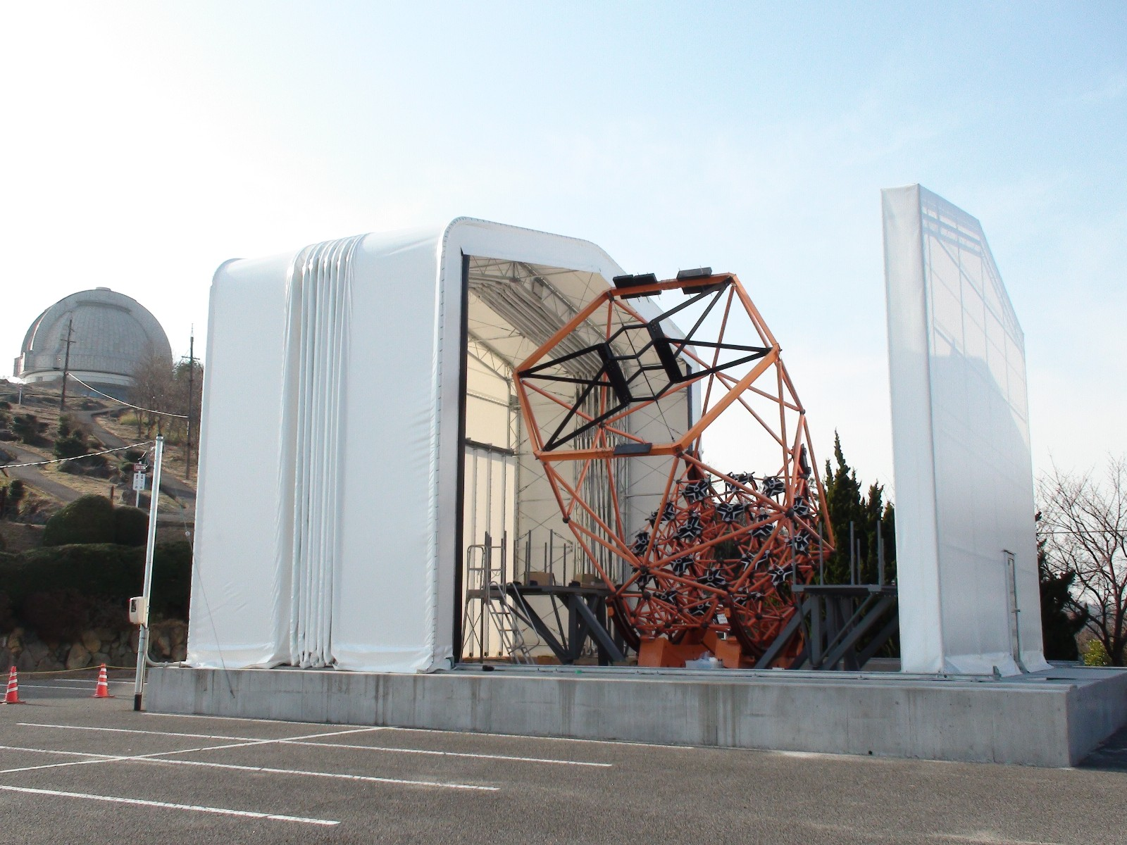
At present

Slide 7
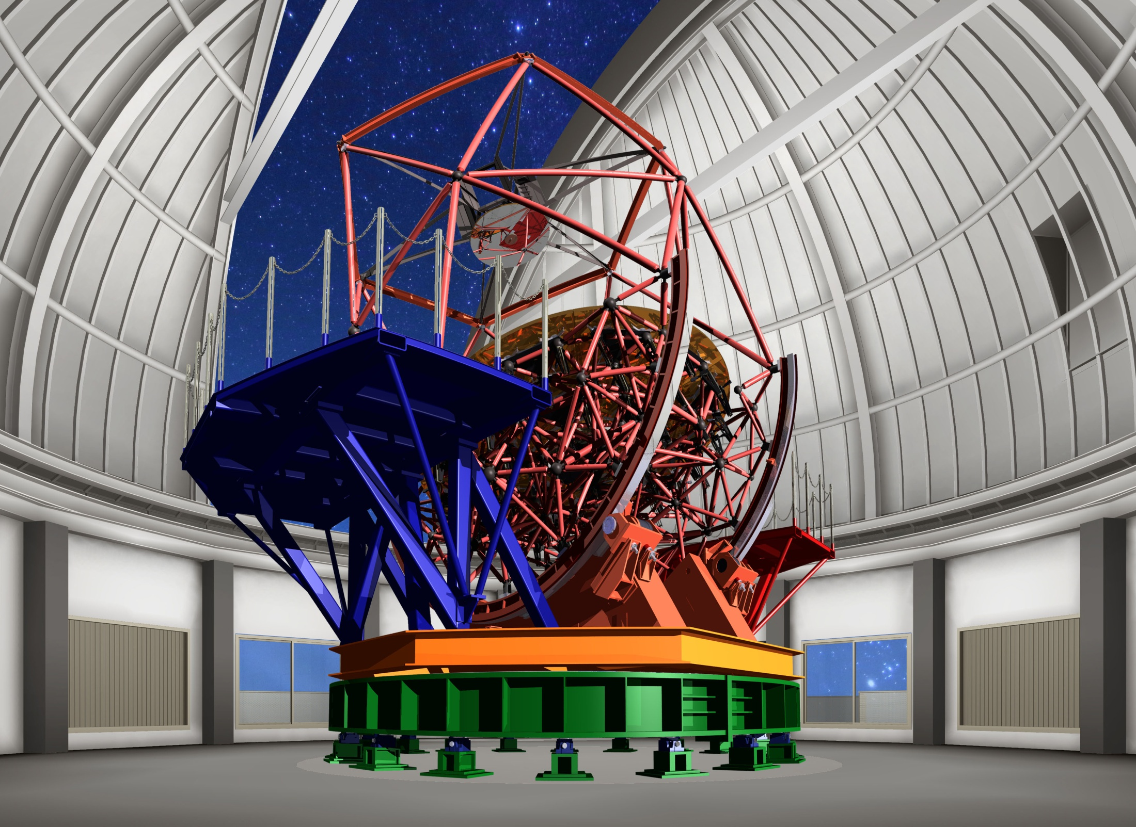
In 2017

Slide 8
This telescope will be in full operation in near future!?

Slide 9
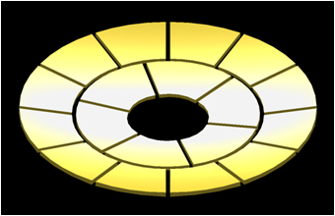
New technologies
Light weight but solid structure → low cost
Grinding (+polish) → rapid mirror shaping
Petal-segmented mirror

Slide 10
Main Science
Gravitational wave sources/ Gamma-ray bursts
Blackhole binaries
Exoplanets
and……
Superflares stars

Slide 11
Instruments
High Speed Imager and Spectrograph
2D (IFU) Spectrograph
Extreme AO+Coronagraph
High Dispersion Spectrograph
NIR high dispersion spectrograph, polarization unit, …

Slide 12
High Dispersion Spectrograph
Spectral resolution | 100,000
Wavelength | 3,600-10,500 Å
System efficiency | 10 %
Temperature stability | 0.1 ℃
Limiting magnitude | m=13 (S/N=50, 1h exp.)
Instrumental details will be introduced by Iwamuro-san later.

Slide 13
Telescope time
~50%: Kyoto University
~50%: Open Use
≲5%: Public Outreach
→We can carry out
time-consuming and long-term project!

Slide 14
Future plan with the HDS I
Long-term monitoring
Classify superflare stars into three groups,
fast rotators (P < 10 d),
medium rotators (10 < P < 20 d), and
slow rotators (P > 20 d)
Select 30 stars from each group.
Spectral monitoring of 90 stars once per 1-2 months.
Three years obs. → statistically clarifying the evolution of star spots, that is, birth, growth, and decay. (←Large spots have long life?)

Slide 15
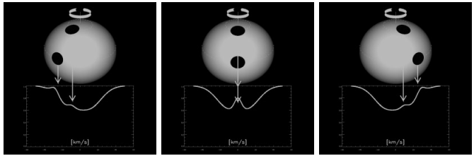
Future plan with the HDS II
Doppler tomography
Time-resolved spectroscopy covering the rotation period. → spot distribution, differential rotation,… (Only fast rotators?)
Polarization unit → Zeeman Doppler imaging?
The basis of doppler imaging (Rice 2002)

Slide 16
Summary
The 3.8m telescope will be in full operation in 2018.
We applied for a fund to construct a high dispersion spectrograph (R~100,000, 300-1050nm).
Half of the telescope time will be assigned for Kyoto University group.
To clarify the evolution of large spots, we monitor 90 stars of slow, medium, and fast rotators once per 1-2 months.
To clarify the spot distribution and differential rotation, we perform (Zeeman) Doppler imaging.

Slide 18
Future plan
Kepler data
Analyses of all the data (500 d → 1500 d): better statistics, long-term activity variation…
To determine the spot distribution → differential rotation (e.g. Davenport et al. 2015)
K2 data
Search for more superflares → better statistics, flare stars in the whole sky…
TESS, PLATO… → brighter star

