Slide 1
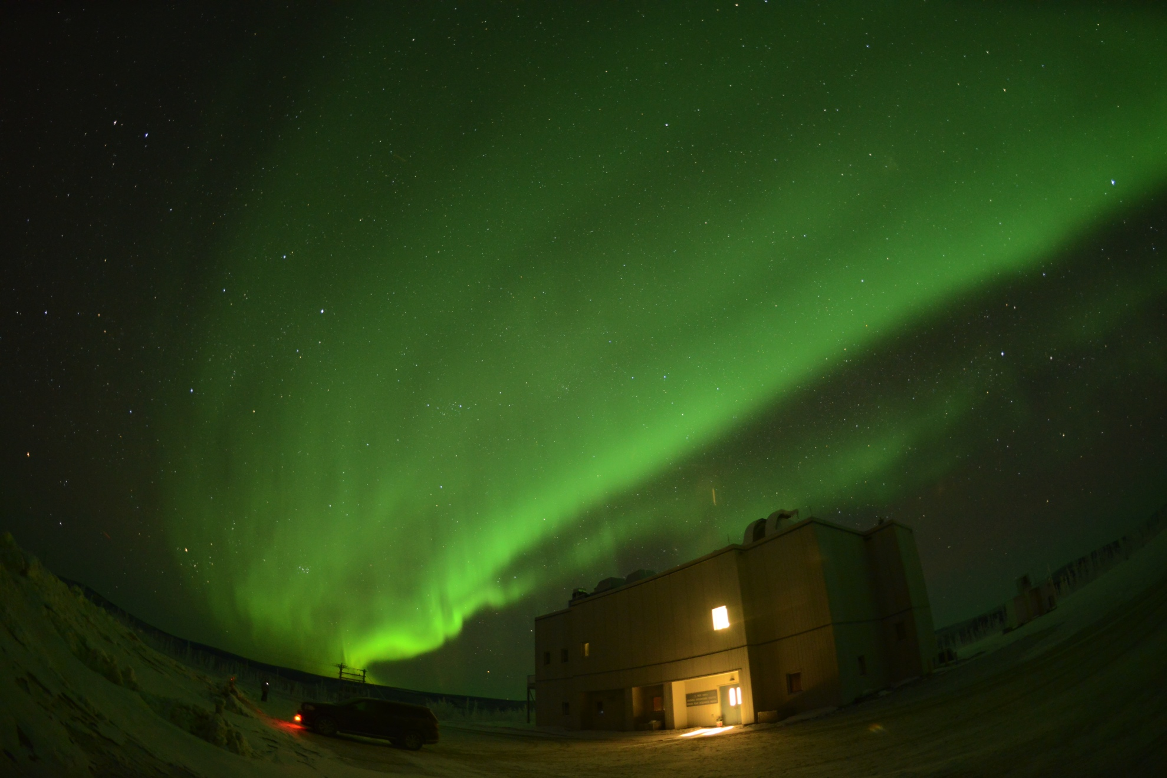
World-Wide Records of Solar Flare Candidates in the 10th and 18th century
*Hisashi HAYAKAWA, Harufumi Tamazawa, Akito D Kawamura，Hiroaki Isobe （Kyoto Univ）
2016/03/03 at Kyoto Univ.
Aurora in 15/01/2016 at Poker Flat in Alaska

Slide 2
Aim and Background for this Presentation
Did the Sun herself cause superflares ?
Theoretically it is possible according to Maehara et al. 2012 and Shibata et al. 2013
Miyake et al. 2012 & 2013 suggested sudden peaks of C14 which may be a candidate for superflares.
Then, there should be evidences in historical sources
Thus, we made historical surveys for two events
(1) 994 => one of two sudden peaks in C14 Miyake (2013)
(2) 1770/9/16 => The first historical sighting for conjugate auroras (Willis et al. 1997; Schlöeder 2004)

Slide 3
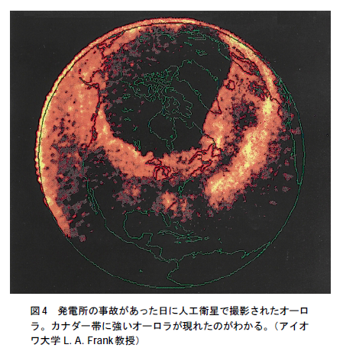
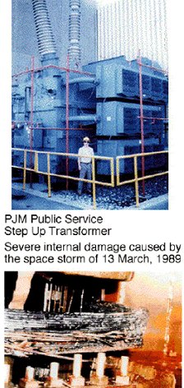
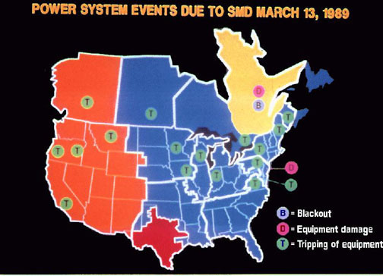
A Magnetic Storm Caused Severe Power Failures in Quebec on 13/03/1989
~ 540 nT、
Aurora observed even in Florida (N29) too ! ↑
ニュージャージー州の変圧器故障
http://www.stelab.nagoya-u.ac.jp/ste-www1/pub/ste-nl/Newsletter28.pdf

Slide 4
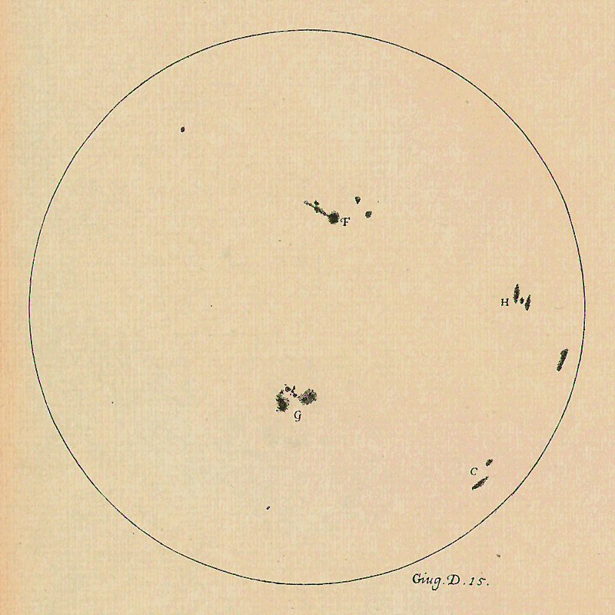
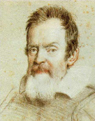
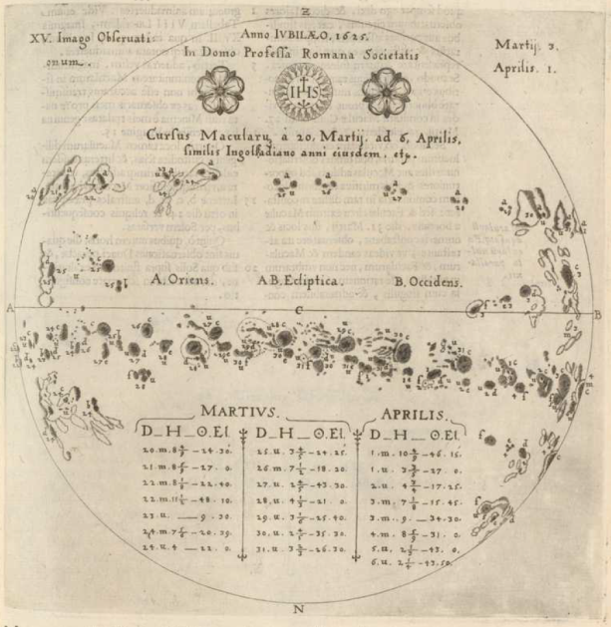
History of the Sun herself
We have 400-year telescopic data for Solar Activity
?
How to know more ??
Galileo Galilei
Christoph Scheiner

Slide 5
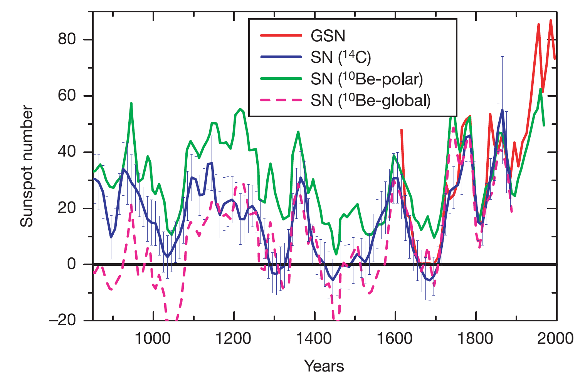
Method 1: Comparing Radioactive Isotopes
Solanki+(2004) reconstructed Sunspot number from isotope proxies; ¹⁴C from tree rings, ¹⁰Be from ice cores.
GSN =10-year averaged Group sunspot number
This method is roughly correct but not so exact
=> We need to compare this with other methods

Slide 6
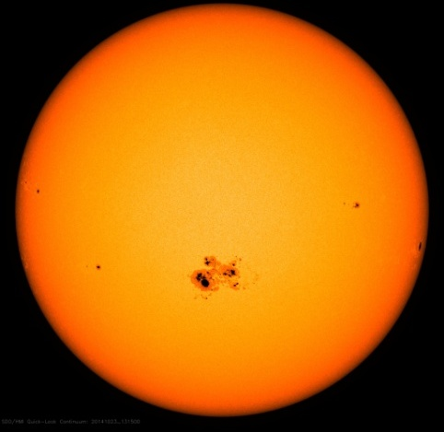
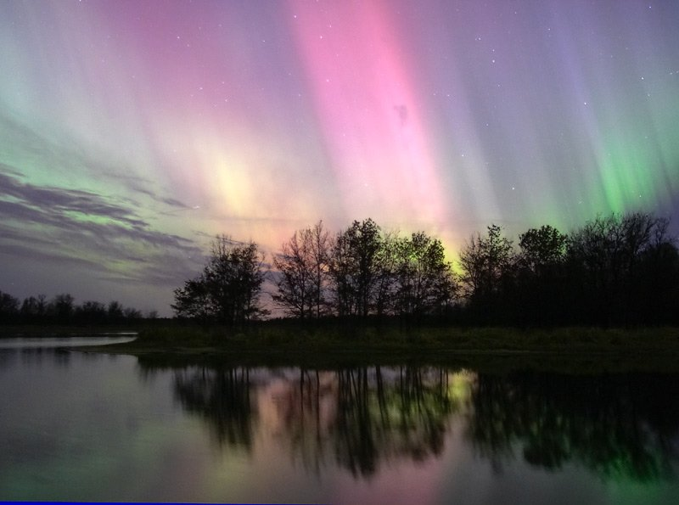
Method 2: Auroral Records in Historical Documents
Pre-modern people also observed the sky and recorded unusual celestial events: i.e. supernovas, auroras, etc.
Eddy (1980) has pointed out their importance.
Solar activity could be reviewed with records of
Sunspot
(low latitude) Aurora
Historical researches have been started for astronomical event in 775 which Miyake (2012) found out; i.e. Usoskin et al. 2013, Neuhäuser et al. 2015, Chapman et al. 2015, etc.

Slide 7
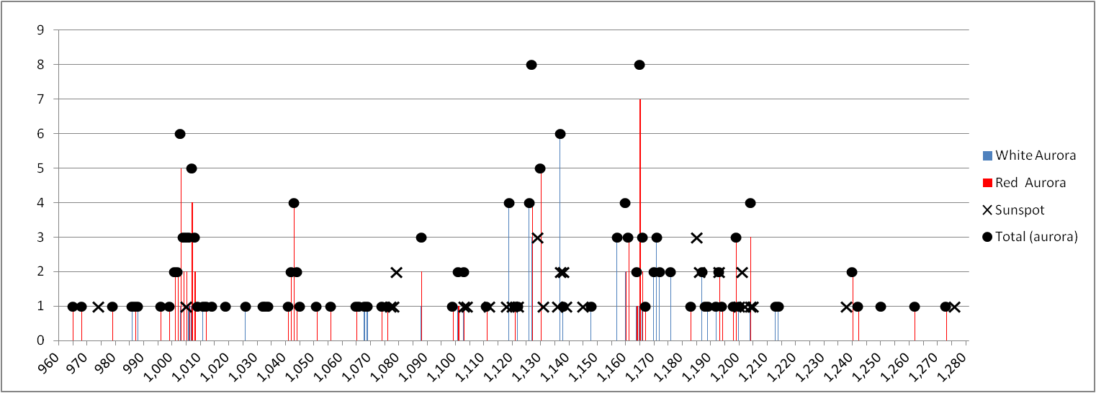
Historical Aurora Candidates and C14
40
Computed
Sunspot Number (SN)
20
0
(top) Solakin 2004; (bottom) Hayakawa et al. 2015

Slide 8
Astronomical Event around 994
We found clustering aurora records before 994
1) 991~992 Syria, Red glow (Basurah 2006)
2) 992.4.17 Germany, Light from heaven (Gronau 1875; Fritz 1873)
3) 992.10.21 Germany, Light from north (Link 1962; MGH: III-69, VI-637)
4) 992.12 Korea, Heaven’s gate opened (Lee 2004)
5) 992.12.24 Germany, Light from north (Fritz 1873; Calvisius 1620: 707)
6) 992.12.26 Ireland, Red sky (Hayakawa et al. 2015; Ulster Annales: 423)
7) 993.1.7 Germany, Light from north (Fritz 1873; Short I-92)
8) 993.12.26 Germany, Light from north (Link 1962; MGH: III-69, III-773 VI-637)

Slide 9
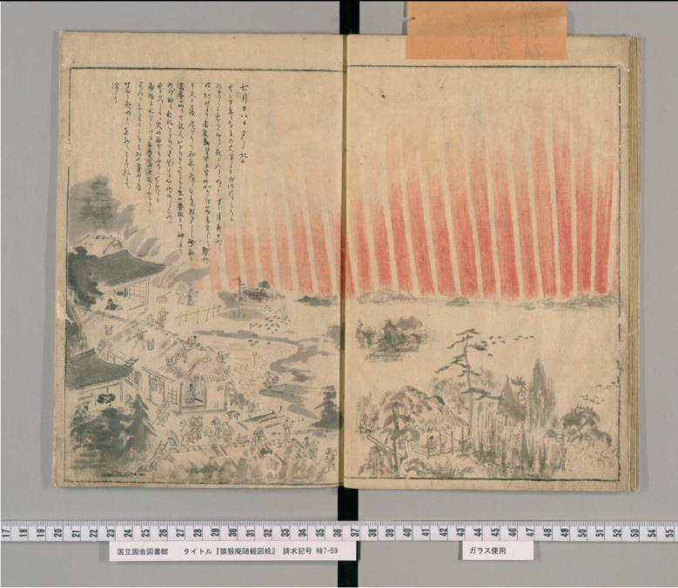
Aurora Events on 1770/09/16-18 in China
Japan (Right) 『猿猴庵随観図会』
(Digital Archive in National Congress Library)
肥城有赤光自北方起，夜半漸退。
At Féichéng, there was red vapor appeared from northward and gradually disappeared at midnight.
肥城有白氣十三道，至夜半乃退。
At Féichéng, there were 13 bands of white vapors and gradually disappeared until midnight.
長山西北見赤氣彌天，中有白氣如縷間之，四更後始散。
At Chángshān, northwestward red vapor filled up the heaven, in it white vapor like thread between it, and after around 01:00 to 03:00 it started to disappear.

Slide 10
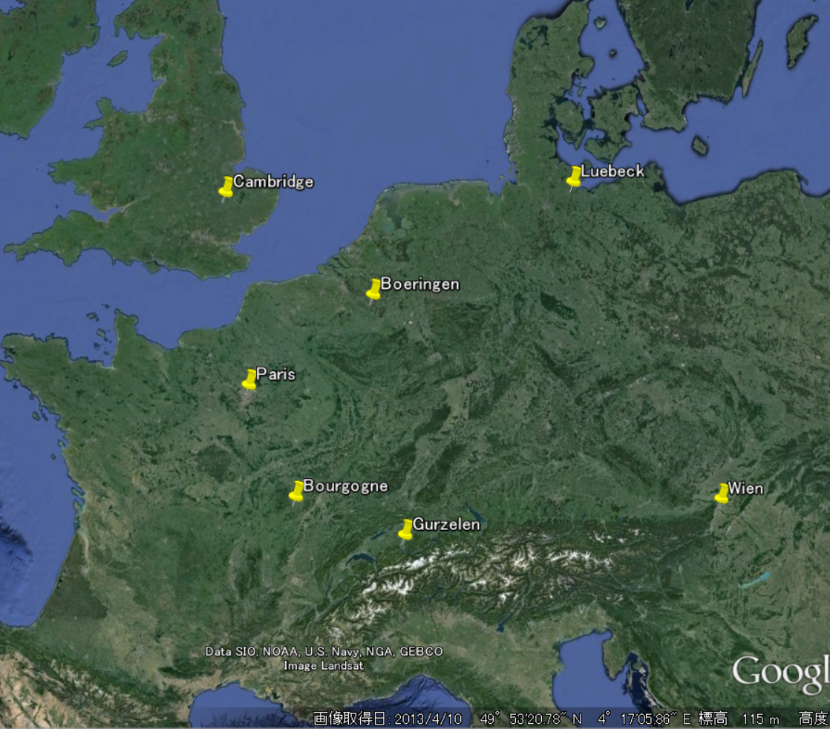
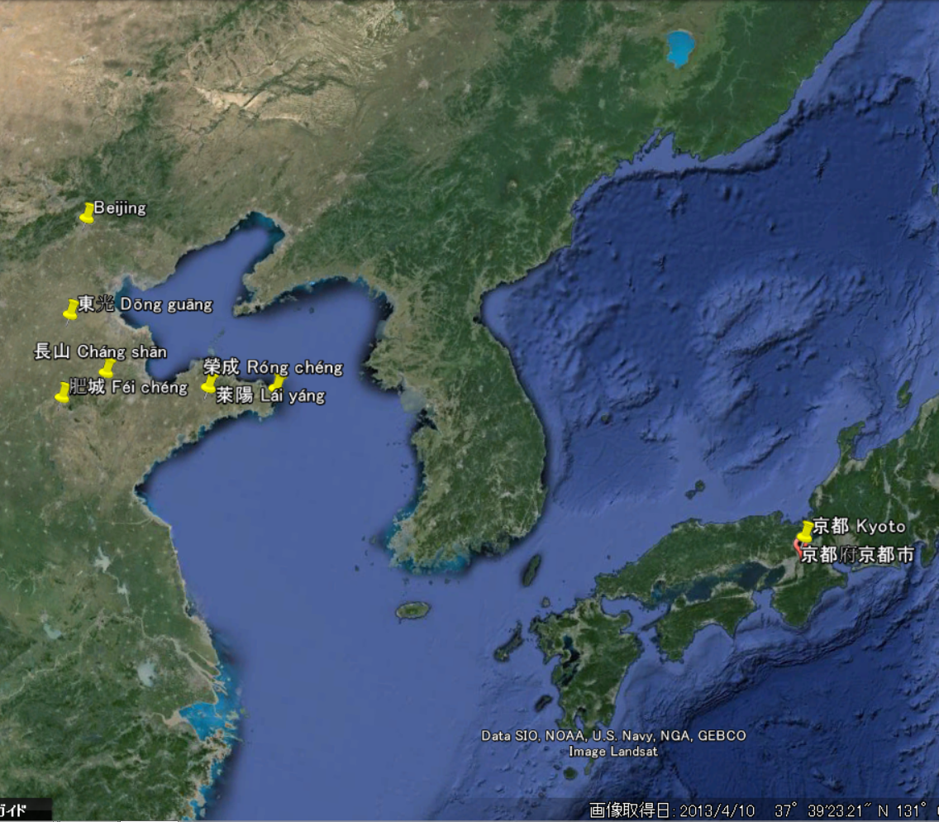
Aurora Observations on 1770/09/16-18 Kawamura+submitted, Fritz 1873
長山 Chángshān (Red in White)
N45°
N45°
肥城 Féichéng (Red & White)

Slide 11
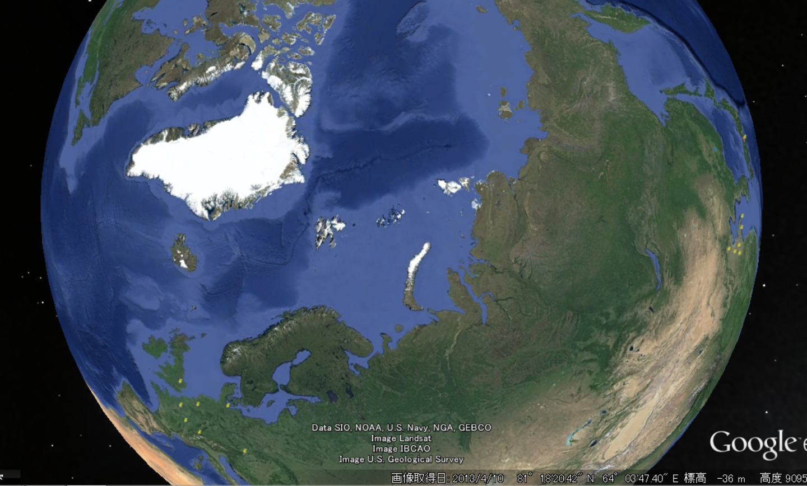
More Data on 1770/09/16-18 ??
Bulter (2004) : history of Magnetic dipole shift
?
北磁極
?

Slide 12
More Data on 1770/09/16-18 ??
Bulter (2004) : history of Magnetic dipole shift
?
北磁極
Rainy according to G. Washinton’s Diary
Whole Eastern Coast too?
?

Slide 13
More Data on 1770/09/16-18 ??
Bulter (2004) : history of Magnetic dipole shift
?
北磁極
Rainy according to G. Washinton’s Diary
Whole Eastern Coast too?
?
Future Work

Slide 14
Conclusion & Future Works
We searched for superflare candidates in historical sources
They can be reviewed by low-latitude aurora records
We found clustering auroras in 991-993 and in 1770
(1) Auroras in 991-993: especially, we have contemporary observations in 992.12 in Ireland, Germany, and possibly in Korea as well
(2) Auroras in 1770.9.16-20: We have simultaneous observations for clustering auroras both in western Europe, China, and Japan
We need to make detailed analysis for C14 to compare them with historical datasets.

