Slide 1
“Superflares on Solar-Type Stars and Solar Flares”
Kyoto University, Wednesday 02/03/2016
Quasi-periodic pulsations in solar and stellar flares
Valery M. Nakariakov^{1,2,3}
¹University of Warwick, United Kingdom
²Kyung Hee University, S Korea
³Pulkovo Observatory, Russia

Slide 2
Lightcurves (hard and soft X-ray, microwave, EUV) of flaring energy releases often have
quasi-periodic pulsations (QPP).
(first detected by Parks & Winckler, 1969)

Slide 3
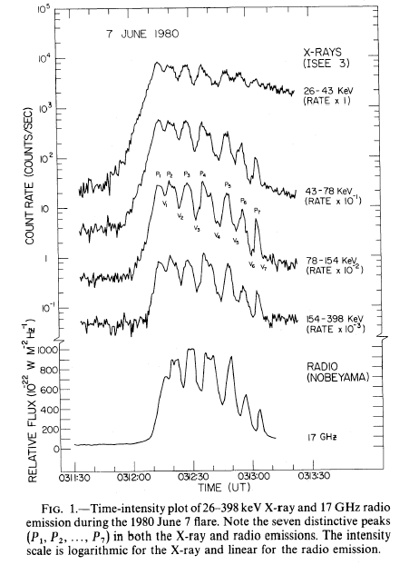
Typical examples:
“The Seven Sisters Flare” – Kane et al. (1983), with ISEE-3 and Nobeyama Radiopolarimeter, the period was about 8 s.
(+ very faint pulsations in < 17 GHz)

Slide 4
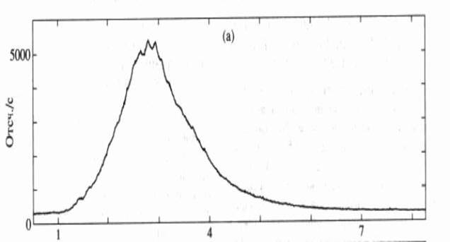
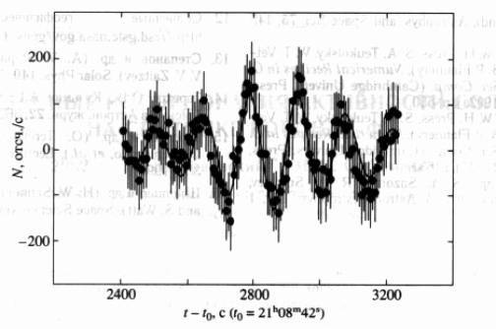
Terekhov et al. (2002), solar flare on 10/06/1990 observed with Granat,
Hard X-ray.
Period about 140 s

Slide 5
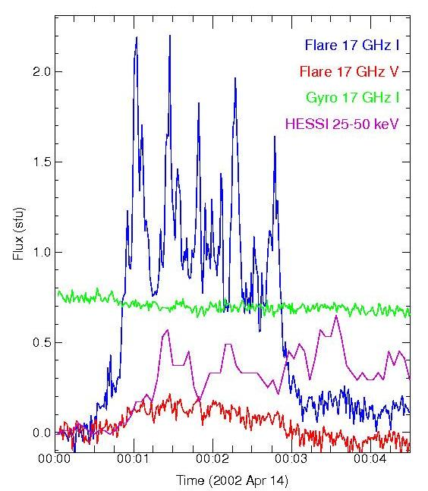
Also, in the microwave emission:
(NoRH S. White)
Period about 40 s

Slide 6
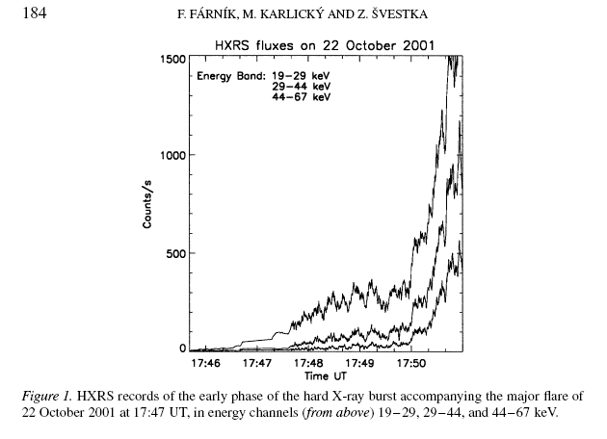
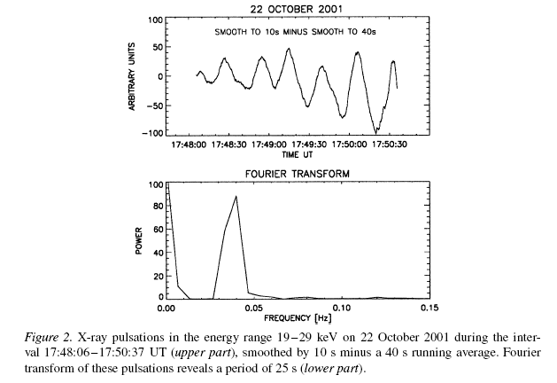
e.g. Farnik et al. 2003, MTI/HXRS: Period = 25 s

Slide 7
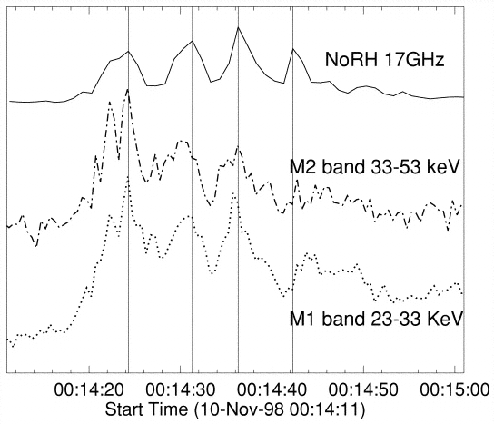
Often QPP are seen in both microwave (GS) and hard X-ray : e.g. Asai et al. (2001), P = 6 s

Slide 8
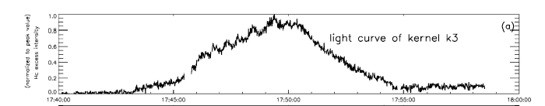
Also, what about WL?
E.g., Huang & Ji, 2005, H_{alpha} flare,
Period about 1 min.

Slide 9
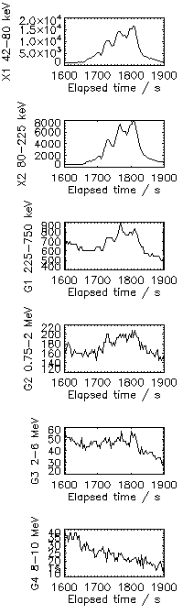
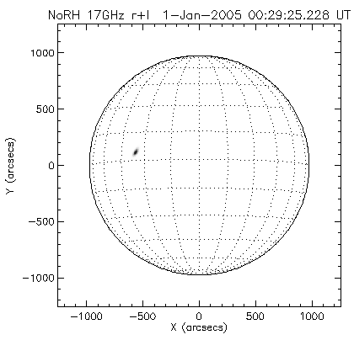
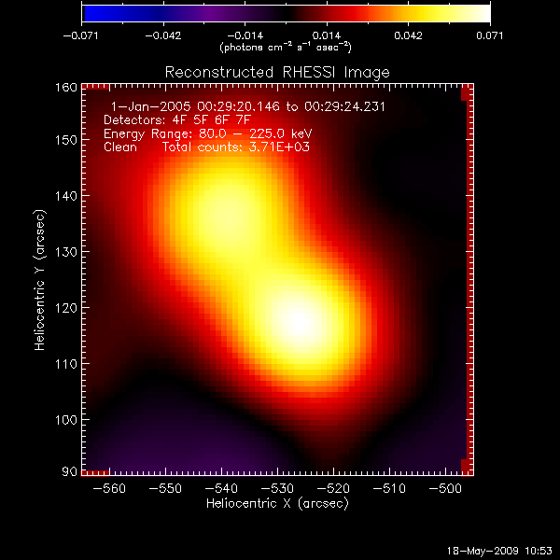
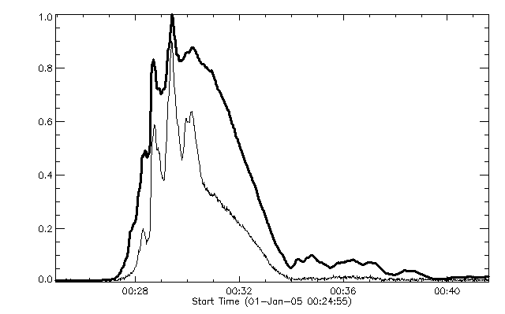

Slide 10
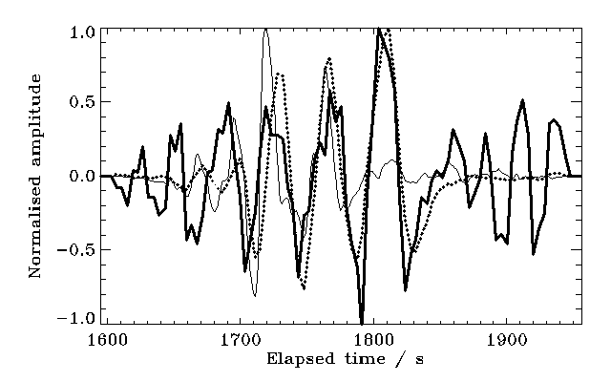

Slide 11
Spatial structure of the correlation of signals from individual pixels with the signal from the pixel with the highest intensity:
(“correlomap”):
Inglis et al. 2008

Slide 12
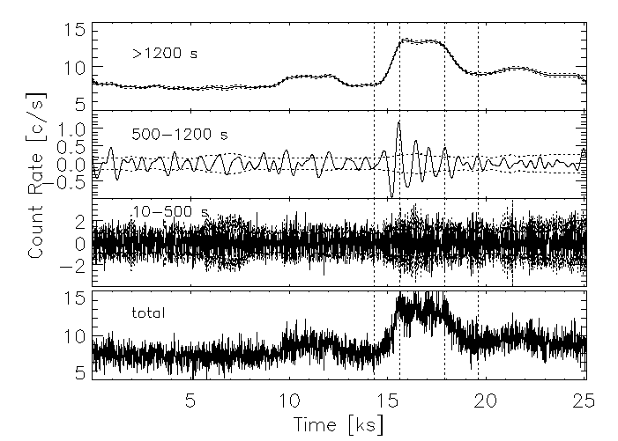
Occasional detections of QPP in stellar flares
Mitra-Kraev (2005), on the active M-type dwarf AT Mic, observed with XMM-Newton in Hard X-ray.

Slide 13
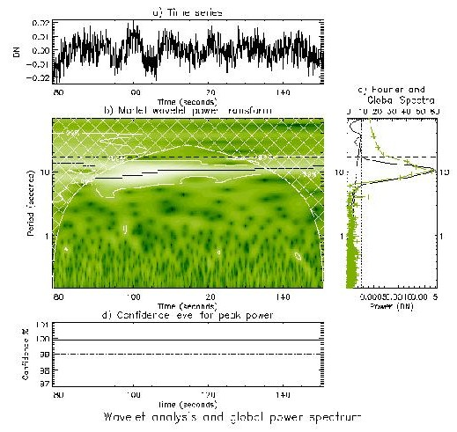
Another example of stellar flaring QPP:
EQ Peg B flare VL emission (Mathioudakis et al. 2004) :

Slide 14
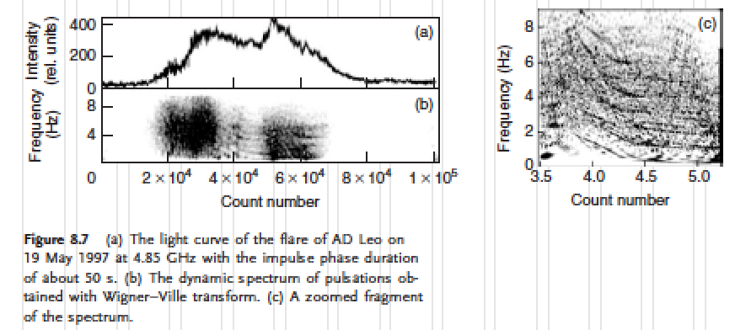
Zaitsev et al. 2004
AD Leo, radio
Period = 0.2 - 1 s

Slide 15
How common are the QPPs in solar flares?

Slide 16
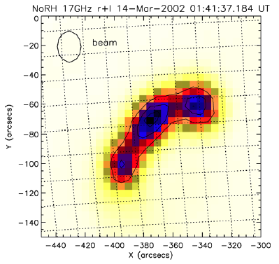
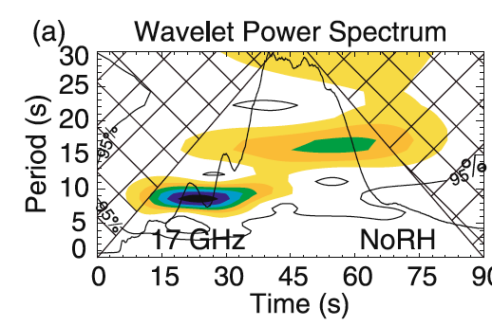
NON-THERMAL EMISSION:
Kupriyanova et al., 2010 used NoRH and NoRP:
“In ten out of twelve considered events, at least one or more significant spectral components with periods from 5–60 s have been found.”

Slide 17
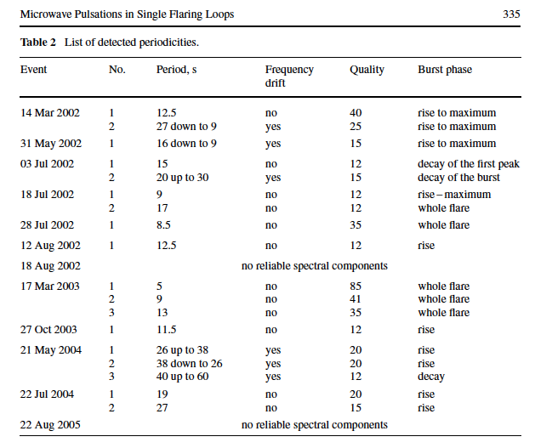

Slide 18
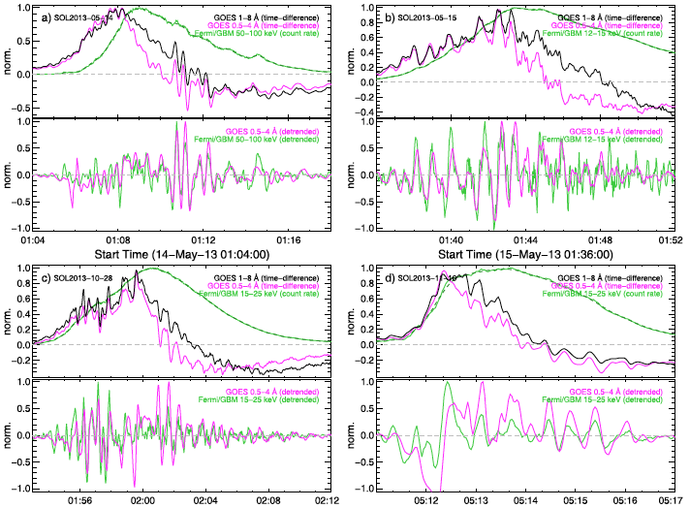
THERMAL EMISSION:
Simões et al., 2015 used GOES:
“80% of 35 X-class flares from Cycle 24 have QPP cleanly seen in both channels of the GOES data, with periods in the range 8-112 s.”
Time derivative of the GOES 1-8 Å time series:

Slide 19
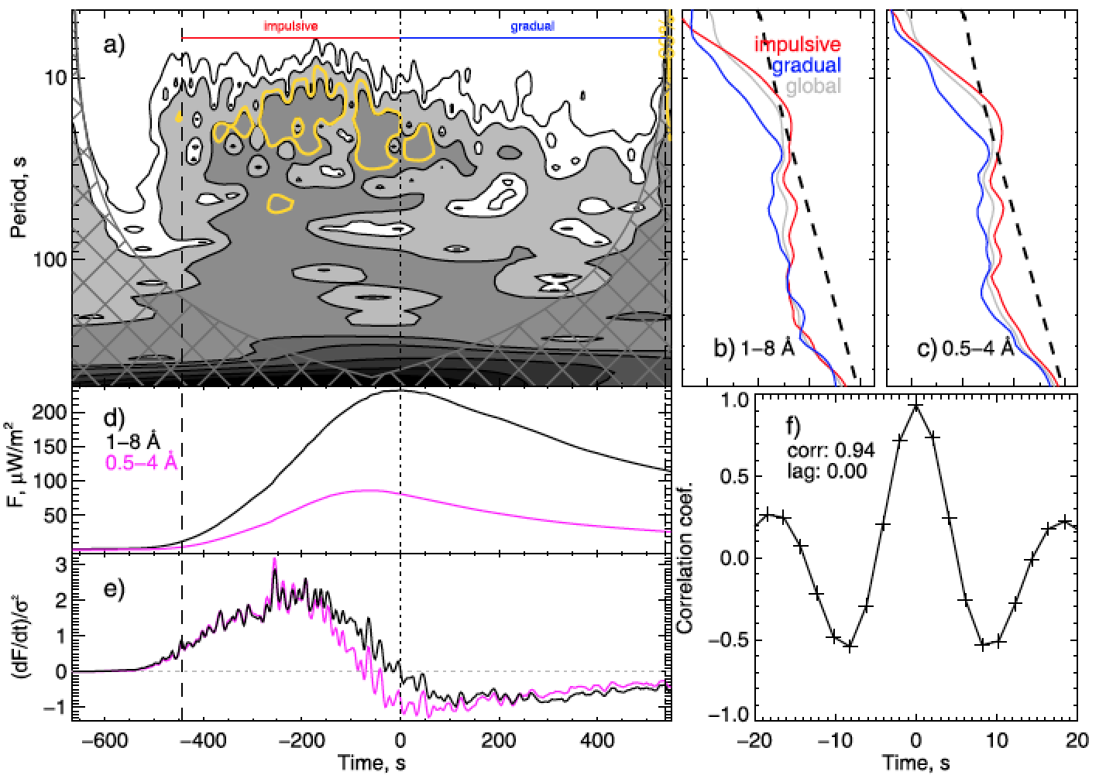

Slide 20
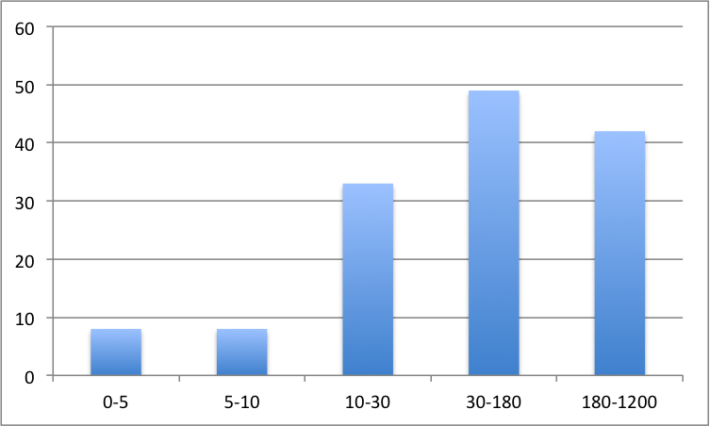
Published detected QPP periods in solar flares:
Number of cases
Period in s
http://www2.warwick.ac.uk/fac/sci/physics/research/cfsa/people/valery/research/qpp/

Slide 21
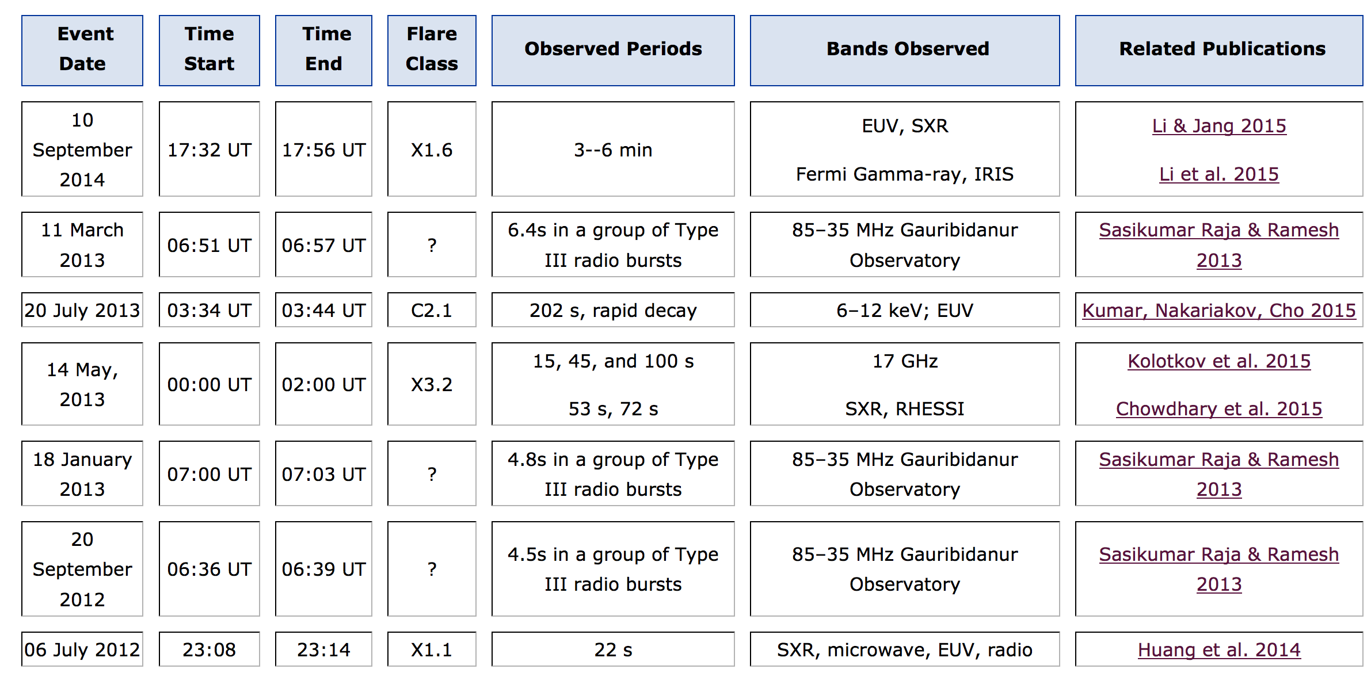
Solar QPP events catalogue provides a list of currently known solar QPP events, with links to relevant papers:
http://tinyurl.com/h7v6pcb

Slide 22
Mechanisms for QPP in flares:
MHD oscillations in flaring plasma structures;
Self-oscillatory regimes of spontaneous magnetic reconnection (“magnetic dripping”);
Periodically induced magnetic reconnection (e.g. by MHD oscillations).

Slide 23
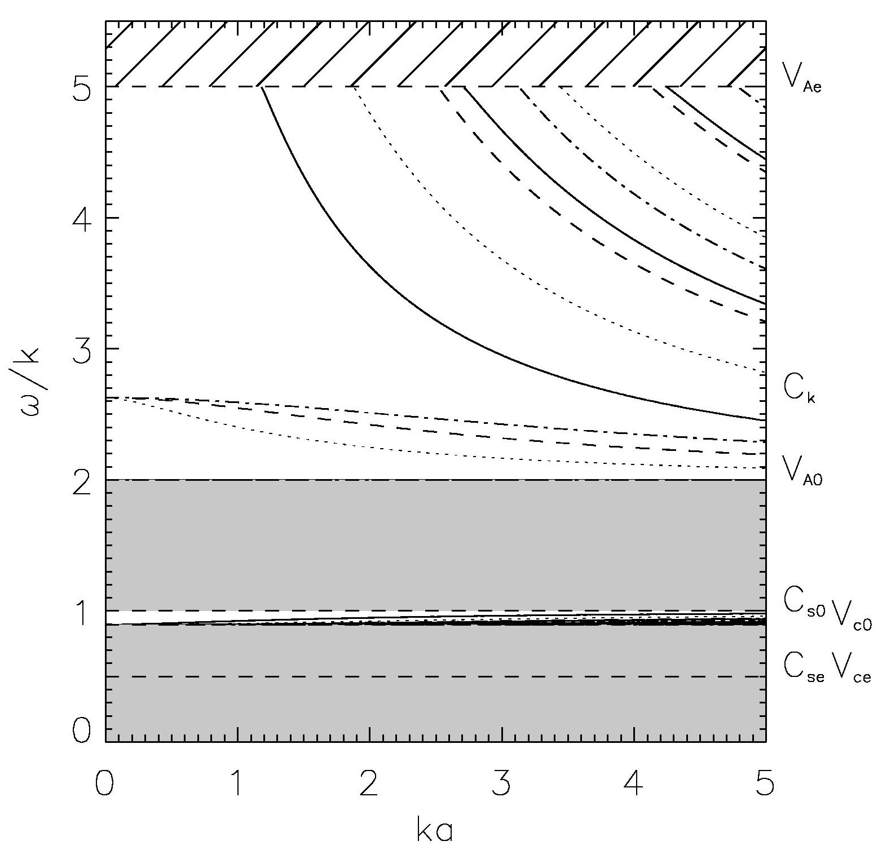
MHD modes of a plasma cylinder
(V. Zaitsev, A. Stepanov, B. Roberts, 1975-…)
Magnetoacoustic oscillations
sausage (|B|, ρ)
kink (weakly compressible)
torsional (incompressible)
acoustic (ρ, V)
ballooning (|B|, ρ)

Slide 24
The observed periodicities of flaring QPP are in the same range as solar coronal MHD oscillations directly (spatially resolved) observed in the solar corona:
Kink oscillations of coronal loops (several min); propagating kinks in supra-arcades; propagating kink waves in the corona and chromosphere.
Propagating longitudinal waves in polar plumes and near loop footpoints (2-10 min)
Standing longitudinal waves in coronal loops (8-15 min)
Propagating fast wave trains. (several s – few min)
Global sausage mode (1-20 s)

Slide 25
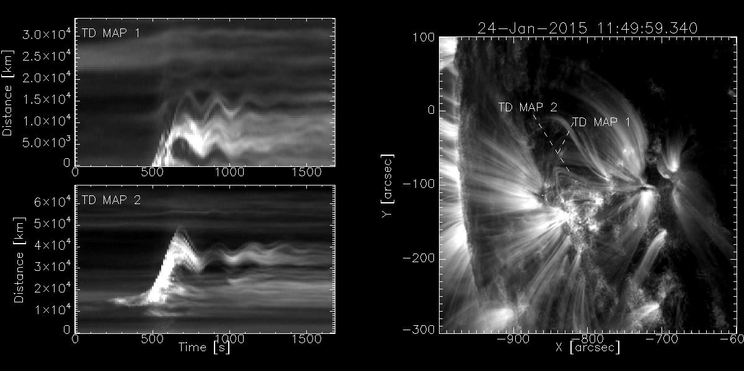
Observations of kink oscillations with SDO/AIA
Nistico et al. in preparation (2015)

Slide 26


Slide 27
A few theoretical examples:

Slide 28
Sausage mode:
m=0 mode
In the trapped regime:
In solar corona:
P = 1-60 s

Slide 29
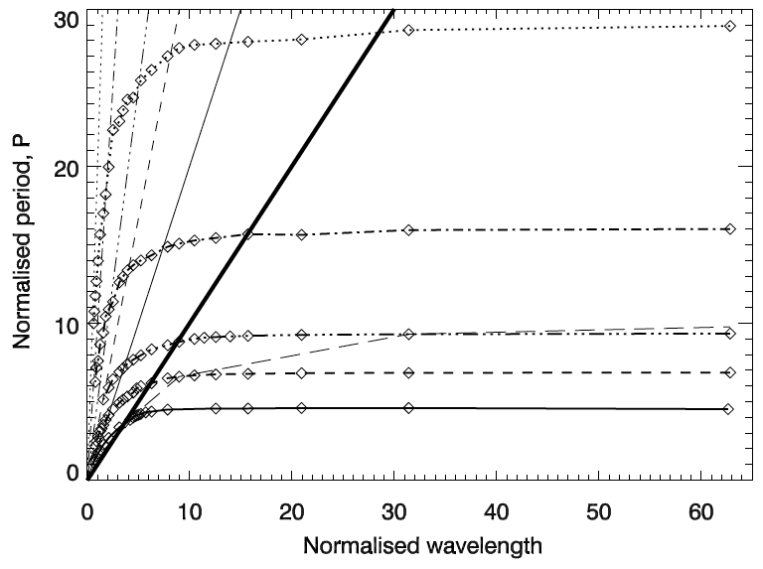
trapped
leaky

Slide 30
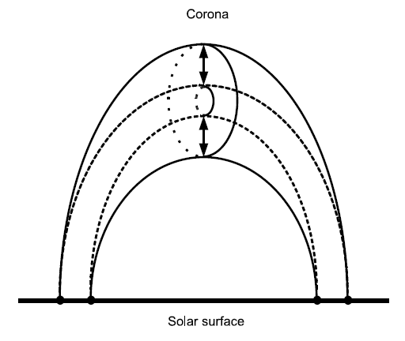
Sausage mode is essentially compressible and can modulate EUV and X-ray directly,
and radio emission, directly, through rho and |B|
or through the modulation of the mirror ratio of non-thermal electrons
(Zaitsev-Stepanov mechanism)

Slide 31
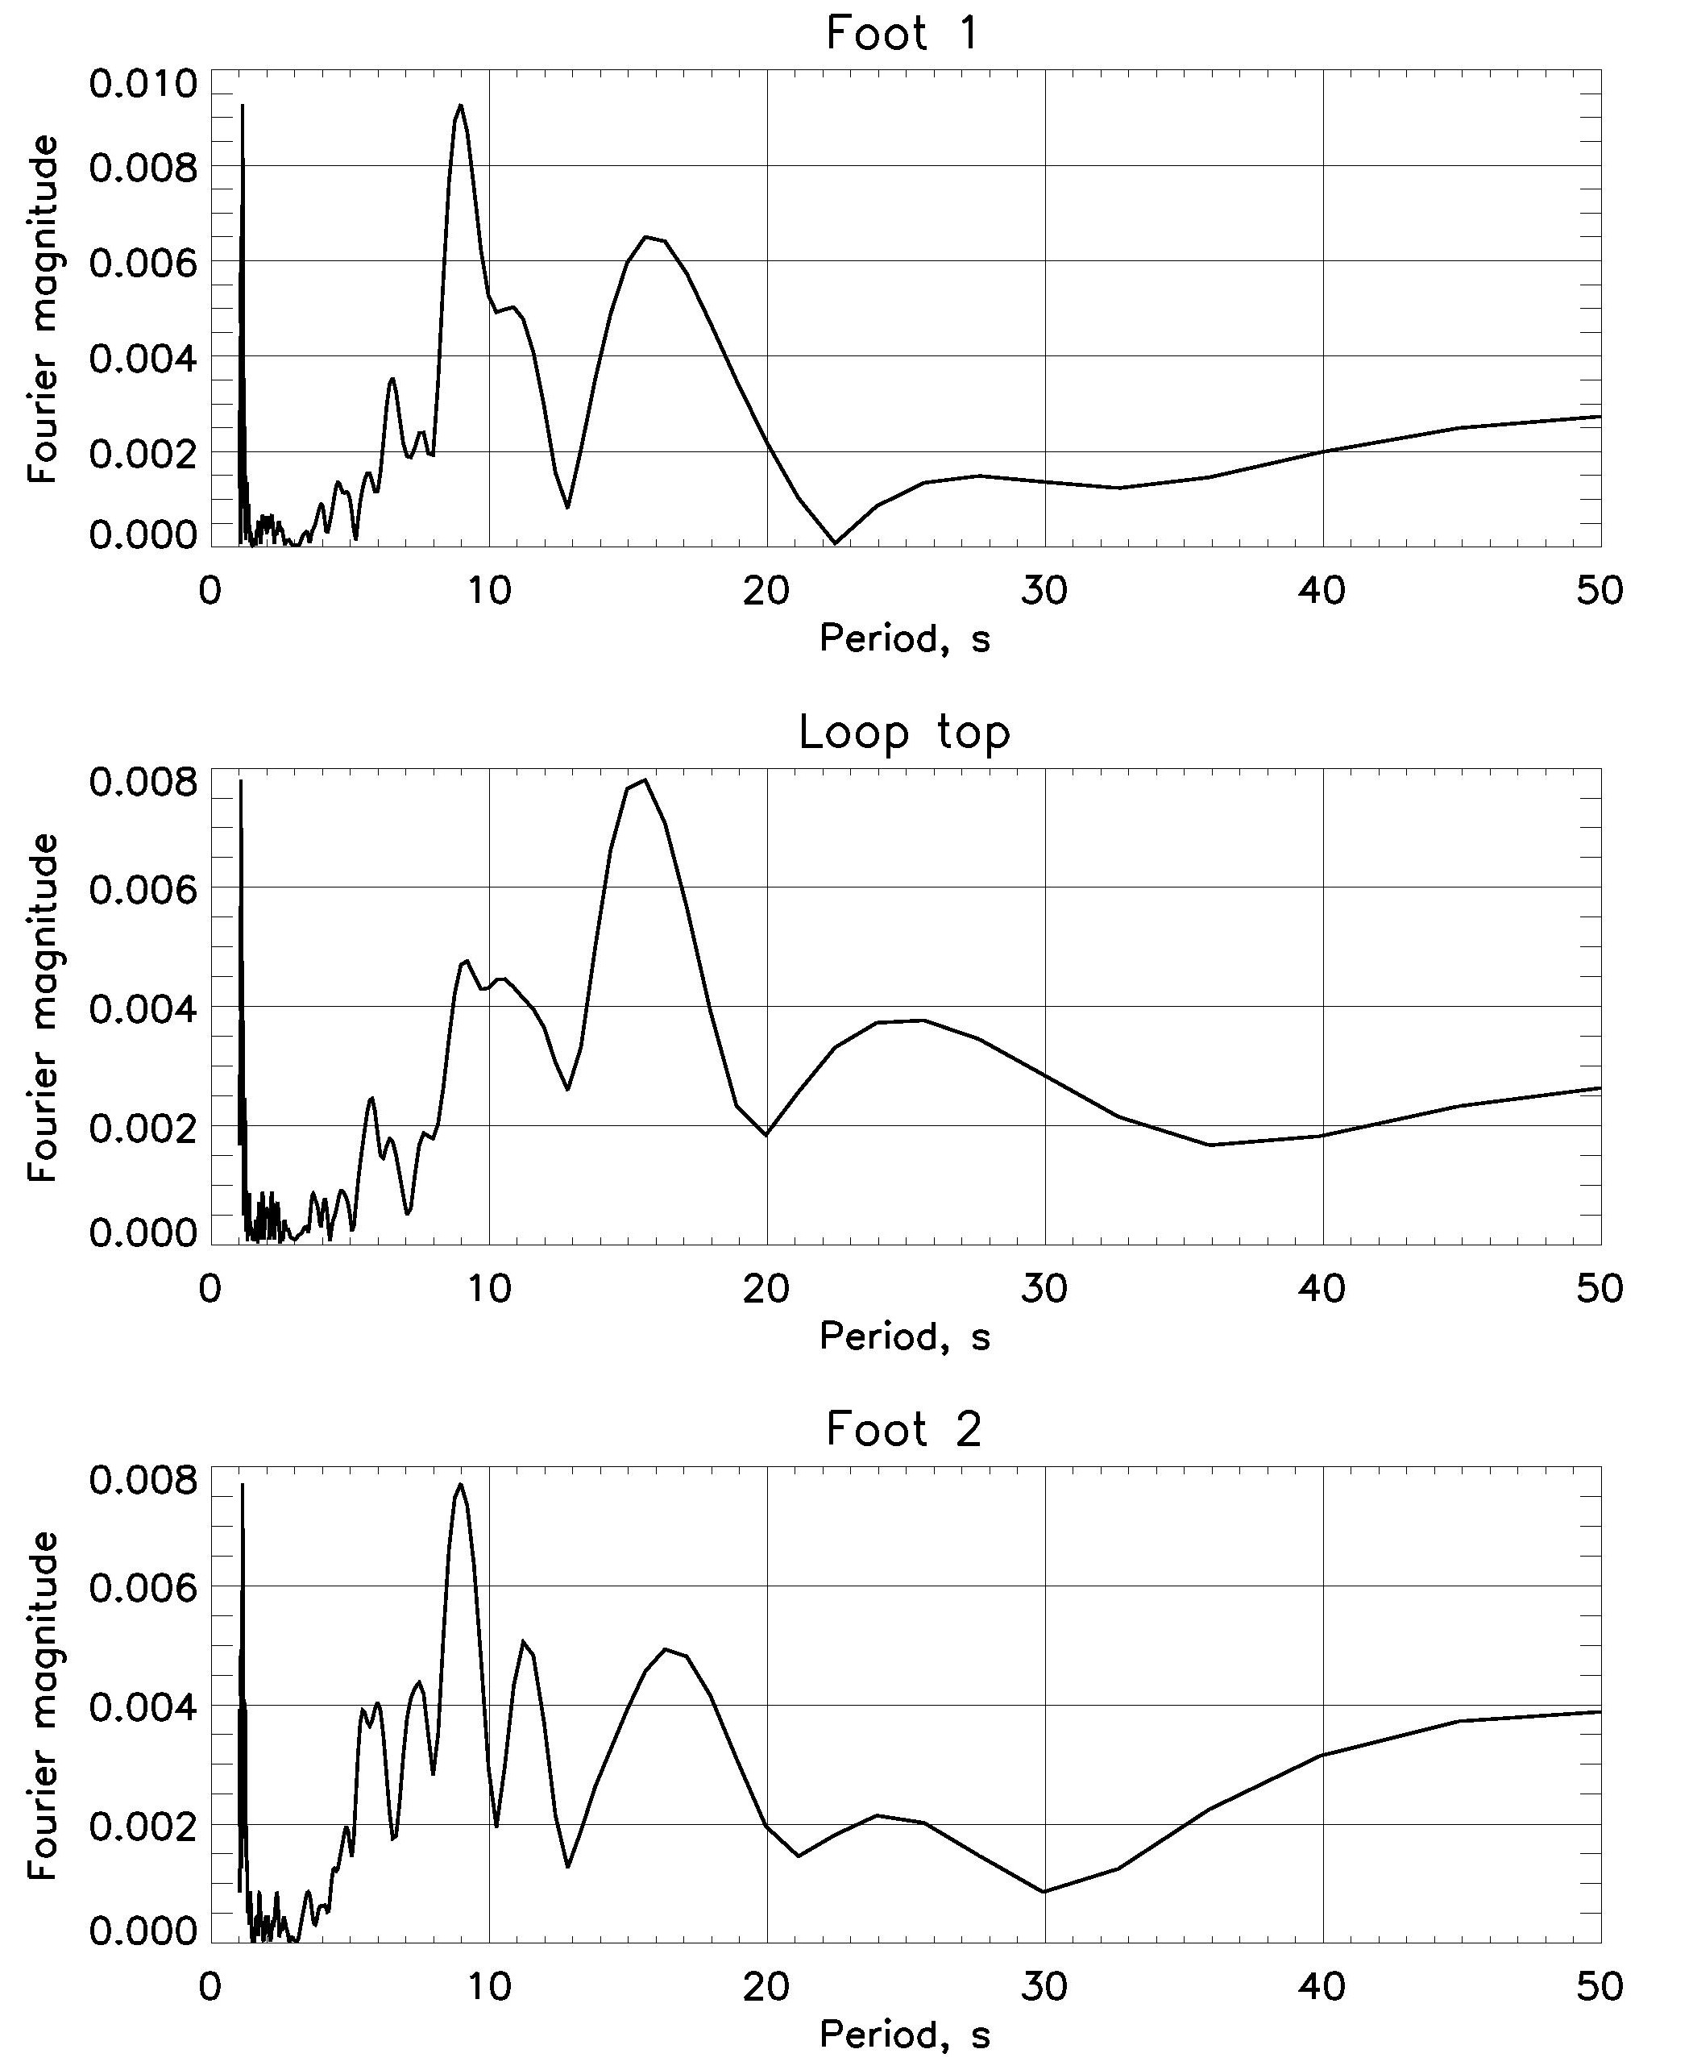
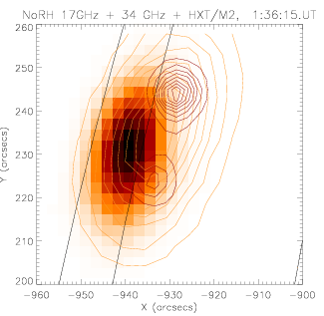
Detection with NoRH:
Spectra at different parts of the loop:
Melnikov, et al. 2003

Slide 32
Longitudinal modes:

Slide 34
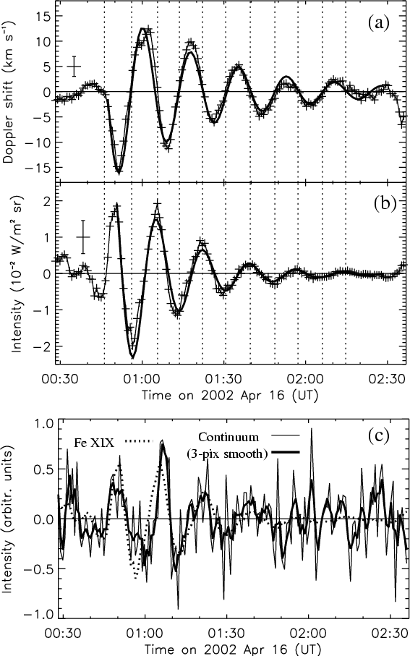
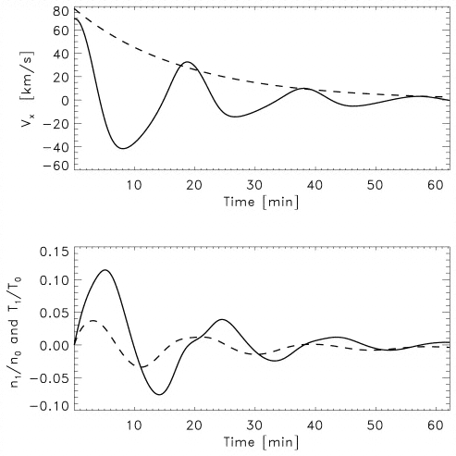
Longitudinal modes:
“SUMER” oscillations
Ofman & Wang 2002

Slide 35
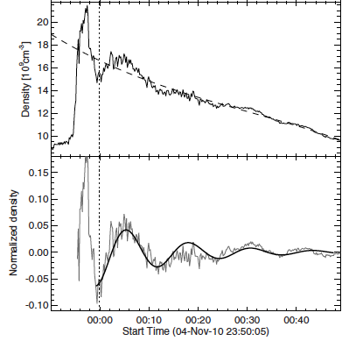
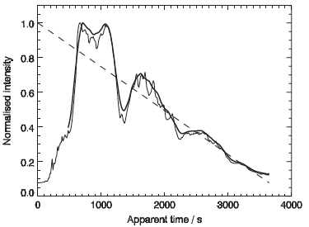
: mm, NoRH
Period = 12.6 min
Decay time = 16 min
SDO/AIA, EUV:
Kim, et al. 2012

Slide 36
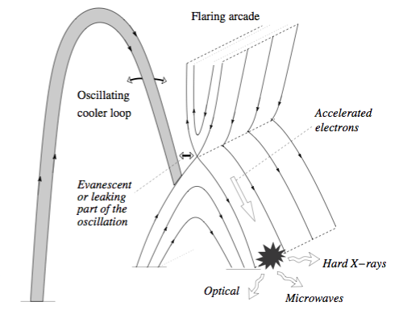

Modulation of magnetic reconnection by an external MHD oscillation: (e.g. Nakariakov et al., 2006, Chen & Priest, 2006)

Slide 37
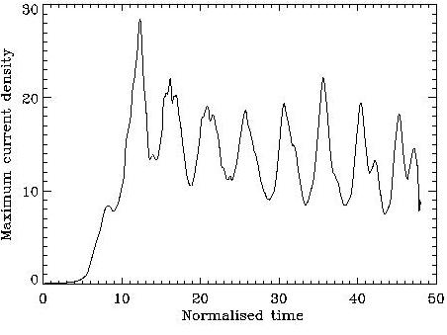
E.g., by a fast kink oscillation:
The fast wave experiences refraction.
The fast wave energy is accumulated near the separatrix.
The current density near the X-point experiences building up.
Incoming periodicity is reflected in current periodicity.
The amplitude of the generated variations of current density is orders of magnitude higher than the amplitude of the driving fast wave.
More work is needed!

Slide 38
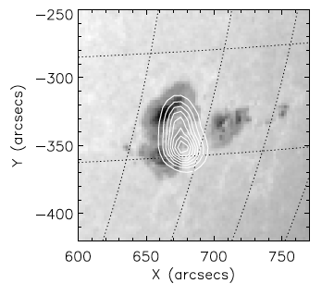
Detection of multiple periodicities favours the MHD-wave-based interpretation of QPP
Inglis & Nakariakov 2009

Slide 39
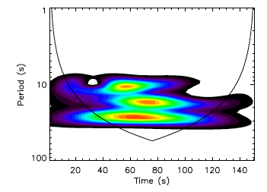
Significant above 99% confidence:
P₁=28 s, P₂=18 s, P₃=11s
P₂/P₁=0.64, P₃/P₁=0.39
If nonlinear oscillation: P_{N}/P₁=1/N
If different spatial harmonics: P_{N}/P₁=(V₁/V_{N})/N
Dispersion: V₁/V_{N} > 1
→ The period ratios are more consistent with different spatial harmonics rather than with temporal harmonics of nonlinear oscillation.

Slide 40
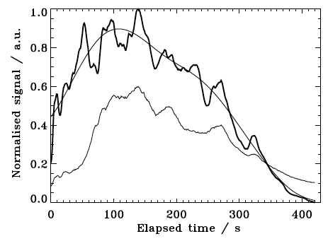
Hilbert-Huang transform of a QPP:
X3.2-class solar flare on 14/05/2013
NoRH 17 GHz
correlation plot and total flux

Slide 41
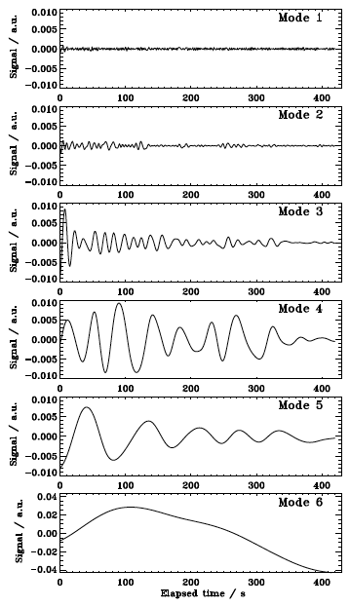
Intrinsic modes:
15 s
45 s
100 s
Periodicities:
Kolotkov et al. A&A 2015

Slide 42
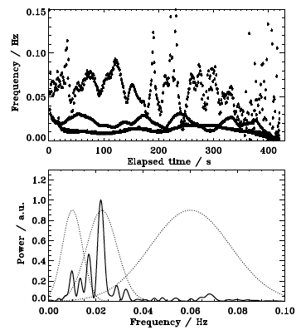
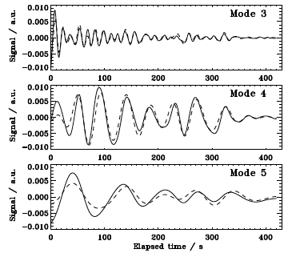
Hilbert spectrum (instant frequencies):
Comparison with intrinsic modes:

Slide 43
Interest in QPP in stellar flares:
Flares on Sun-like stars observed by e.g. Kepler and XMM-Newton are millions of times more powerful than those on the Sun (“superflares”)
Want to deduce possibility of a superflare occurring on the Sun, by comparing the underlying physics of stellar flares and solar flares
Can use QPP periods to constrain parameters of the flaring region of the star, and work towards modelling the flares?

Slide 44
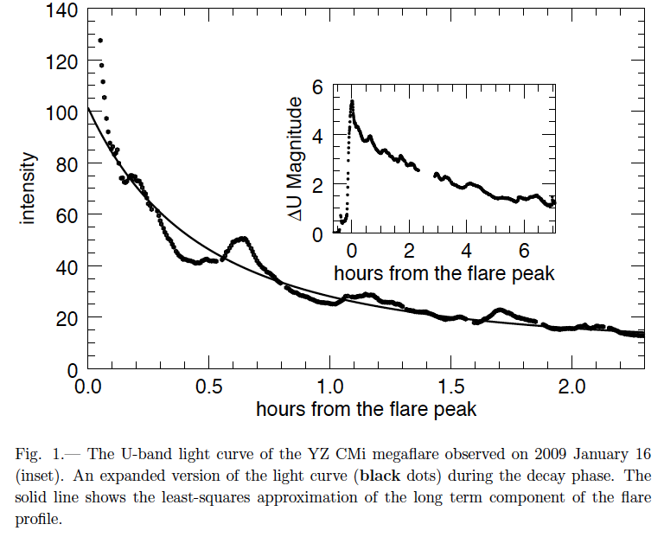


c.f.: QPP in a stellar megaflare:
Anfinogentov et al. 2013

Slide 45
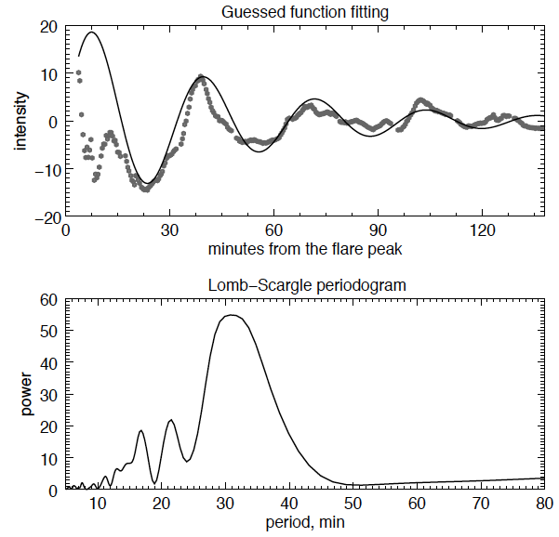
Period = 32 min
Decay time = 46 min
c.f. longitudinal (SUMER) oscillations in solar flares:

Slide 46
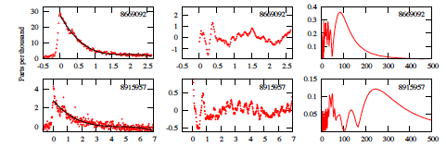

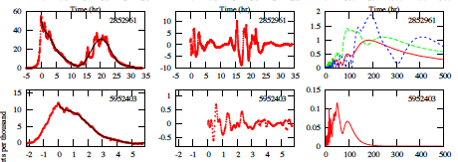
Kepler:
WL,
1-min exposures
Need for systematic study
Balona et al. 2015

Slide 47
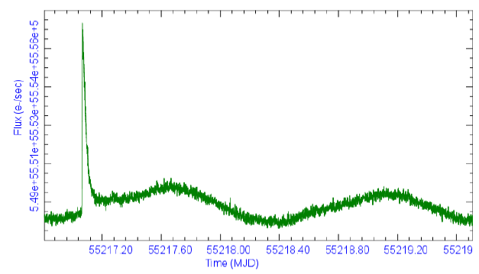
Light curve of KIC 9946017 (K-type eclipsing binary star), with a clear flare:

Slide 48
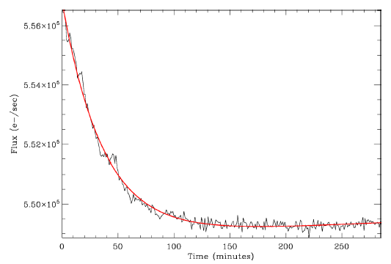

Detrending:

Slide 49
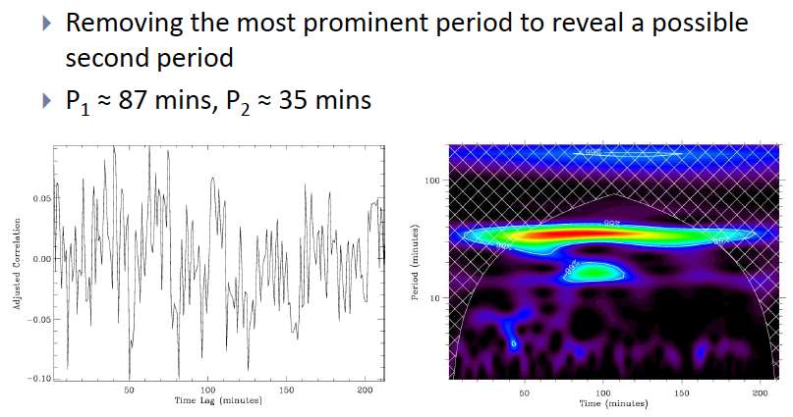
Thus, there are two periodicities in a superflare on a K-class star. Are similar phenomena on Sun-like stars?

Slide 50
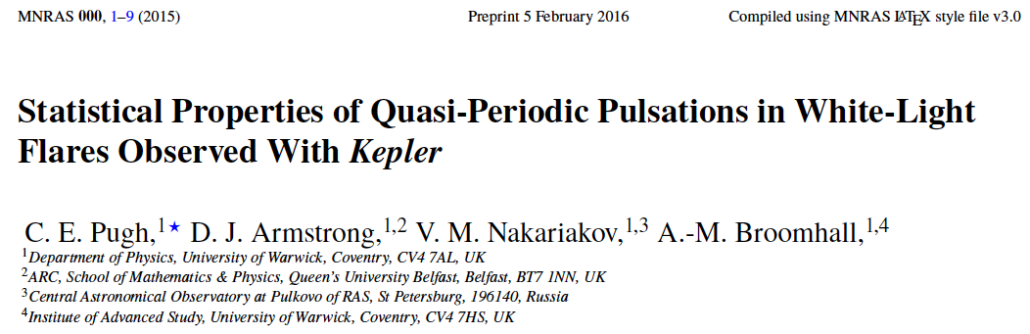
Out of the 3106 flares on 216 different stars detected in the short cadence data, using an automated search, 56 flares are found to have pronounced QPP.

Slide 51
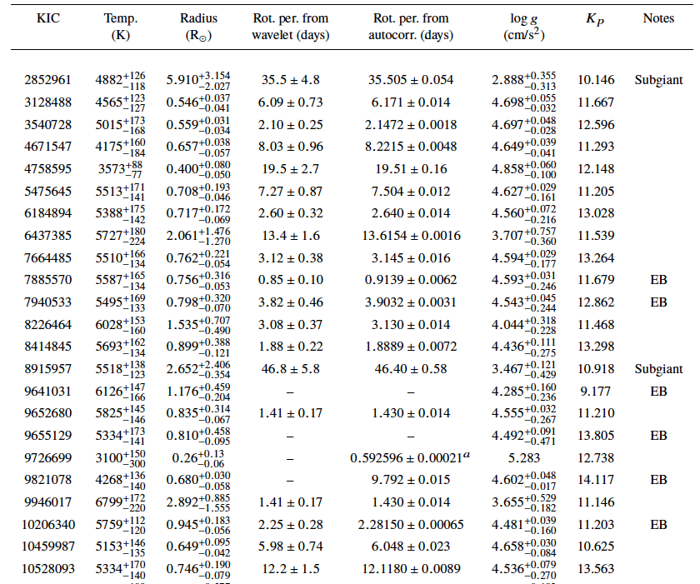

Slide 52

A good example of a flare with “SUMER”-like QPP

Slide 53


Slide 54


Slide 55

Histogram of detected periods:

Slide 56

QPP period vs Flare energy
Red: the flares with a high-quality, stable decaying oscillation

Slide 57

No apparent correlation between QPP period and host star parameters:

Slide 58

c.f.: Kink oscillations of solar coronal loops:
Goddard et al. A&A 585, A137 (2016)

Slide 59

For decaying oscillations,
The decay time vs period and amplitude:

Slide 60


c.f. Kink oscillations of solar coronal loops:

Slide 61
Conclusions:
Light curves of solar and stellar flares often (commonly?) contain quasi-periodic pulsations (QPP). Are QPP an intrinsic feature of flaring energy releases?
Mechanisms for QPP are being studied in detail in solar flares: MHD oscillations or spontaneous self-oscillations.
Detection of multiple periodicities evidences in favour of MHD oscillations (at least in some cases).
Similar QPP (including multi-periodic) are detected in stellar superflares. Does it evidence that solar and stellar flares are caused by the same mechanism? Implications for space weather?

