Slide 1
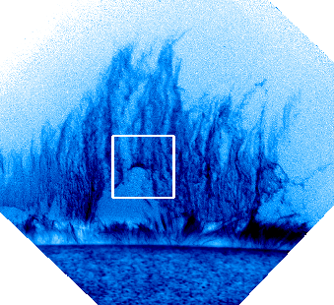



Determination of Prominence Plasma β from the Dynamics of Rising Plumes
Hinode 7 @ Hida Takayama
Andrew Hillier, Richard Hillier
& Durgesh Tripathi

Slide 2
Back to University (+α): Flow around a circular cylinder
The classic solution of flow around a circular cylinder
+ MHD (tube-aligned field only)
+Compressibility correction (van Dyke 1975)
The density distribution and streamlines are shown. Black circle is the circular cylinder

Slide 3
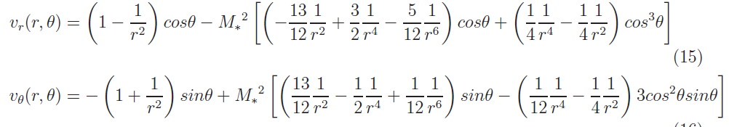

Mathematical model for the Compression
The equations
Shows the connection between the density change222 and the plasma beta of the flow
Image: Compressible MHD flow round a circular cylinder. Magnetic field into screen

Slide 4
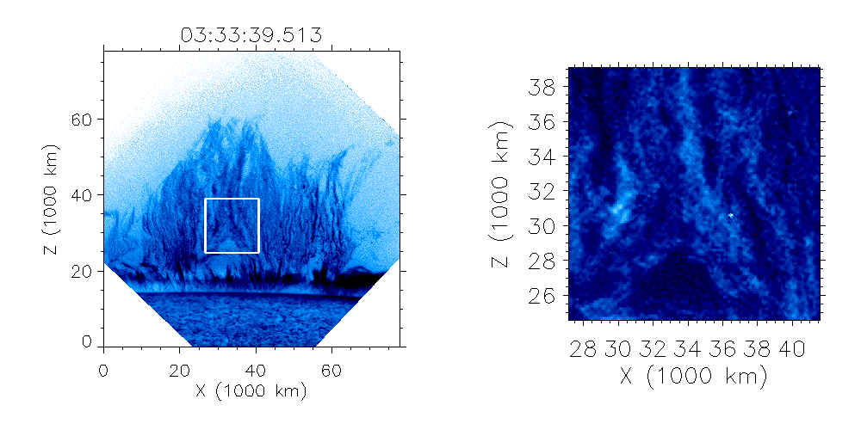
Where this might be useful on the Sun: Prominence plumes
Negative image
Positive image
Movie: Negative image of prominence (left) and positive, enlarged image of white box region (right) observed on 2007/10/03 in the Ca II H line (3968.5 Å)
First observed by Stellmacher & Wiehr (1973). Rediscovered by Berger et al (2008) and de Toma et al (2008)

Slide 5
The important characteristics of plumes
From Observations
Key Point 1: plumes have an elliptical head
Key Point 2: Constant rise velocity (10 – 30 km/s) – Berger et al (2010)
Figure: Zoom image of plume region observed on 2007/10/03 in the Ca II H line (3968.5 Å)

Slide 6
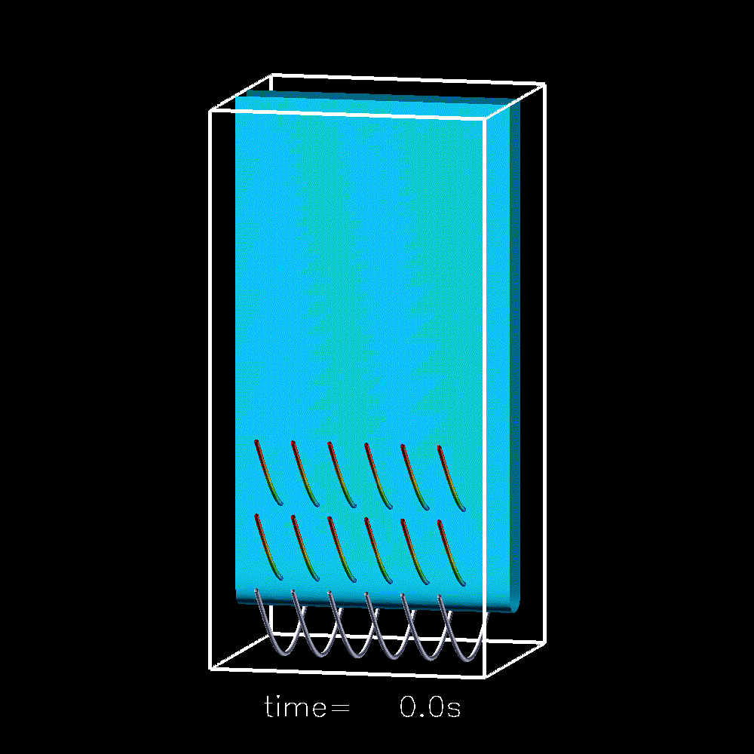
The important characteristics of plumes
From Simulations
Key Point 1: plumes have an elliptical head
Key Point 2: Constant rise velocity (10 – 30 km/s) – Berger et al (2010)
Key Point 3: Plumes are filamentary structure aligned with magnetic field – Hillier et al (2012)
Movie: 3D simulation of magnetic Rayleigh-Taylor instability - Hillier et al 2012

Slide 7
The important characteristics of plumes
From Observations
Key Point 1: plumes have an elliptical head
Key Point 2: Constant rise velocity (10 – 30 km/s) – Berger et al (2010)
Key Point 3: Plumes are filamentary structure aligned with magnetic field – Hillier et al (2012)
Key Point 4: Plumes have a thick, bright hat. Assuming emission of prominences is mainly scattering, this is showing high density
Material is compressed
High total pressure drives material out the way
Plume rises
Figure: Zoom image of plume region observed on 2007/10/03 in the Ca II H line (3968.5 Å)

Slide 8
How can the flow solution be applied?
By modelling the intensity in terms of density, the compression at the top of the plume can be calculated.
This will allow for the plasma beta to be estimated.

Slide 9
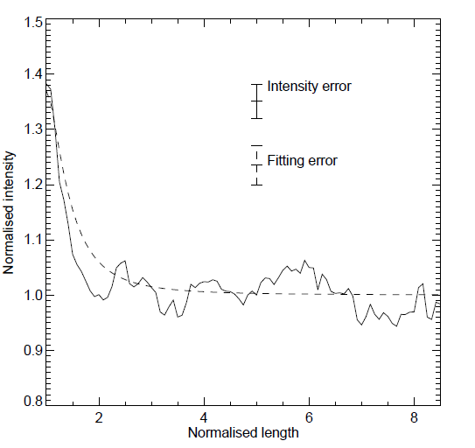
Estimate of Prominence Plasma Beta – Fitting Intensity to calculate β
Assuming that the emission is only proportional to the density we can fit to solve for M*, giving an estimate of the plasma beta of
for

Slide 10
Conclusions
Though it doesn’t directly give the magnetic field strength, we now have a new way to estimate the plasma beta of quiescent prominences using the Rayleigh-Taylor plumes
Application to one prominence gives the plasma β as β=0.47 – 1.13 for γ=1.4 – 1.7. (Is this too large for prominence support cf. Hillier and van Ballegooijen 2013)
There are many potential improvements (especially with regard to the intensity modeling – i.e. work on poster S7- P- 02 by S Gunar) that can be made, that will improve the accuracy AND the amount of information we can extract from the prominence (would be good to compare with David’s work!!)
For greater detail, please see:
Hillier, Hillier & Tripathi (2012) ApJ, 761, 106

