Slide 1
Location of non-thermal velocity in the early phases of large flare: revealing the pre-eruption flux ropes?
Louise Harra, Sarah Matthews, Len Culhane, Mark Cheung, E. Kontar and Hiro Hara

Slide 2
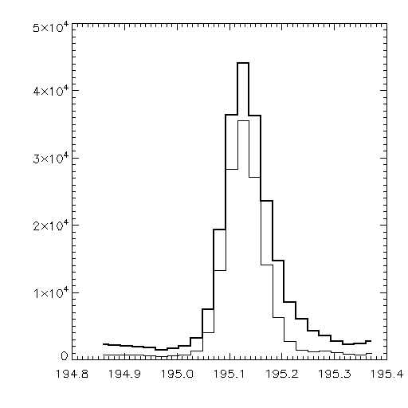
Non-thermal velocity - what does it tell us?
During flare
Before flare
FWHM² = (instr_{fwhm})² + 4ln(2)(λ/c)² (v²_{t} + (v_{nt})²)

Slide 3
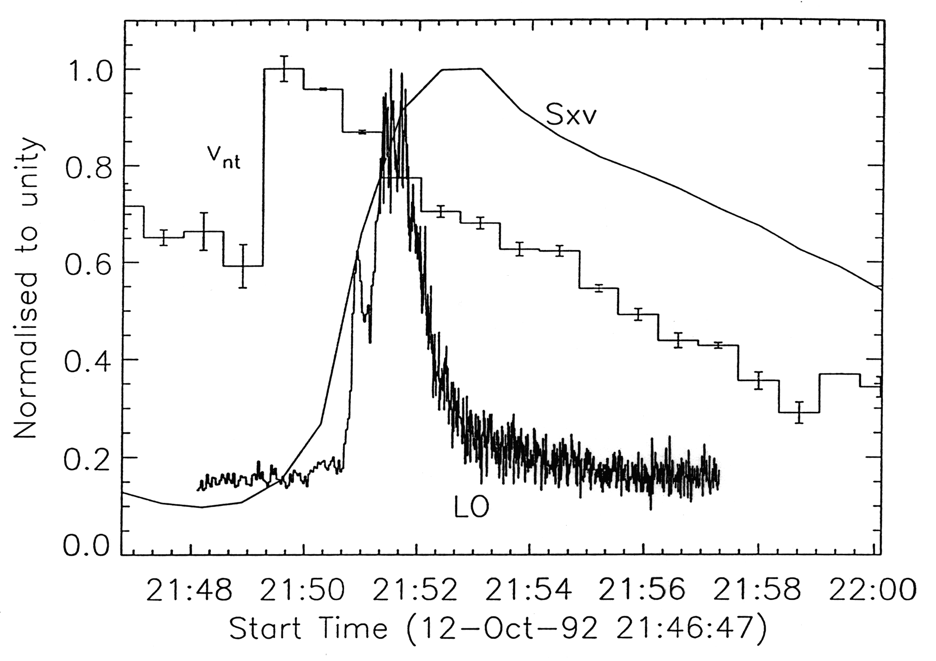
Vnt – an early signature of flaring in the corona
An early peak in Vnt during flares has been noted for many years.
But the spatial location has been difficult to determine…

Slide 4
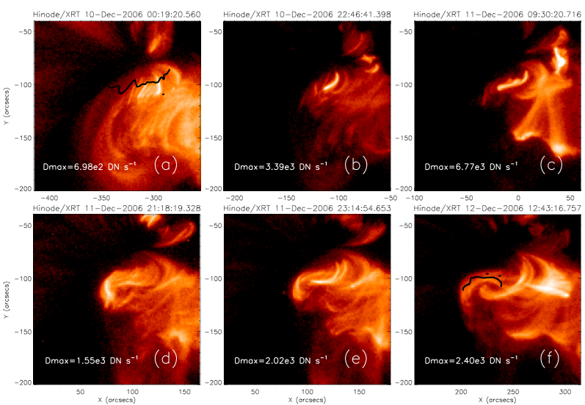
Building up to a large flare…
The shear builds up for several days
Su et al., 2007
EIS measurements quantitatively increases in Vnt more than 12 hrs before the flare begins. (Harra et al., 2009).
Williams et al., 2009 measured twist with EIS right before the flare erupted.
Wallace et al. (2010) looks at preflare Vnt activity in a much smaller event.
Baker et al. (2012) saw velocity enhancements 6 hours before a CME.
Notes:
Photospheric inversion line from MDI shown as a thick black line. Observed with the Be filter on XRT from 10-12th Dec.
On the 10th fields are close tp potential - 22 hrs later loops begin to shear. Many loops lie nearly parallel to the inversion line by the 12th December.

Slide 5
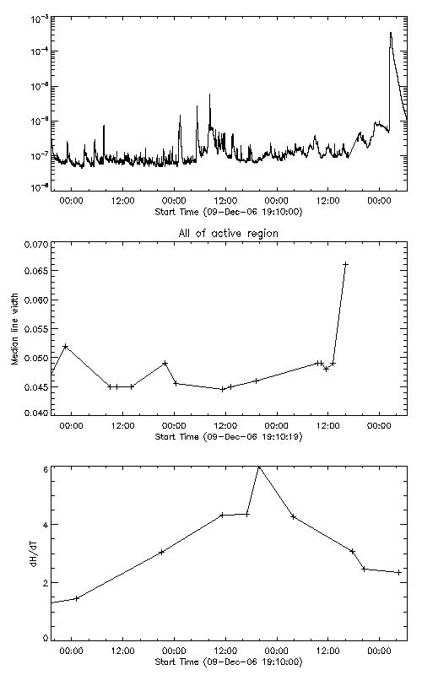
Build-up to a large CME…
Flare
With Hinode we can measure the helicity build-up following flux emergence (Magara and Tsuneta, 2008).
We can follow the response in the atmosphere to determine why and when a large event will go… (Harra et al., 2009).
Sharp increase in
‘turbulence’ of the corona
Peak of helicity

Slide 6
Our aim
To analyse the spatial and temporal evolution of 4 large flares at the limb.
Purpose: to uncover the location of the pre-flare Vnt source to enable us to understand the flare trigger.

Slide 7
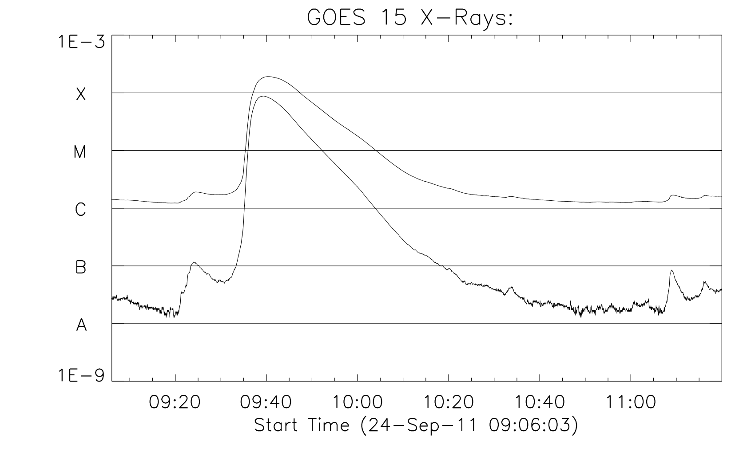
One of the examples – 24 September 2011

Slide 8
Vnt and Intensity for the whole region
Notes:
09:20 Vnt enhancement low down.
09:23 – is in the loop top.
09:30 at flare looptop and above
09:36 – everywhere!

Slide 9
Fe XII Intensity
Fe XII Vnt

Slide 10
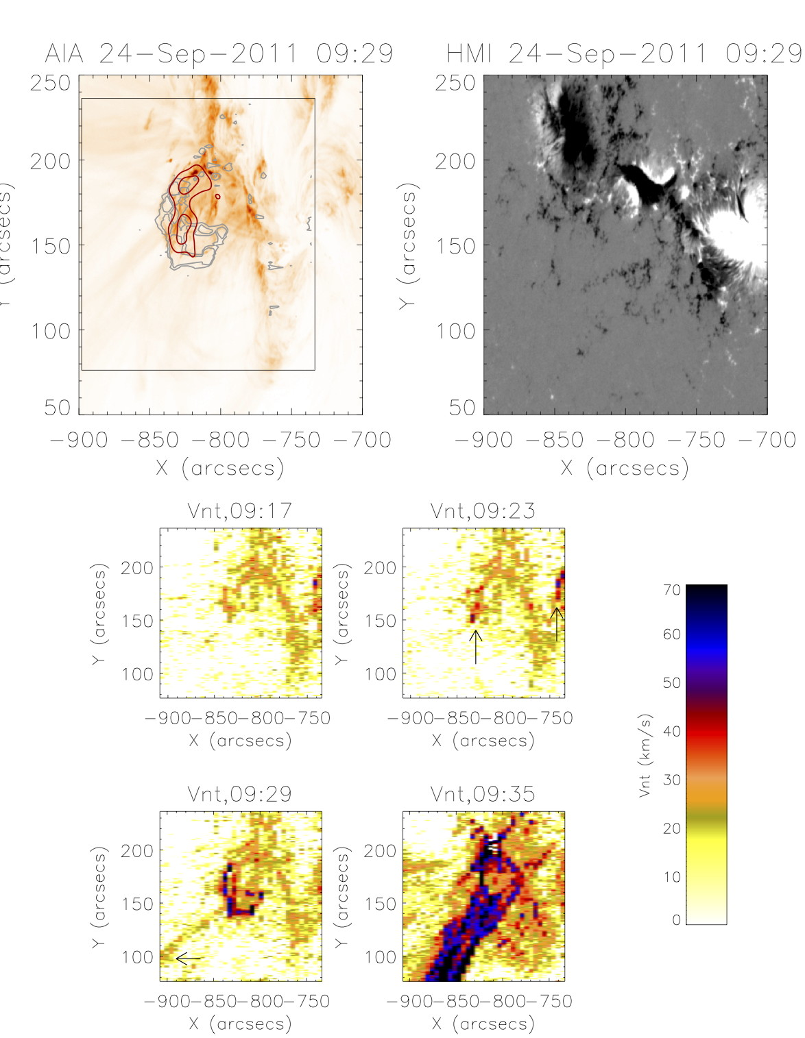
Early Vnt enhancements are away from the core flaring region
RHESSI
Vnt
Preflare
Early phase
Flare peak
Eruption

Slide 11
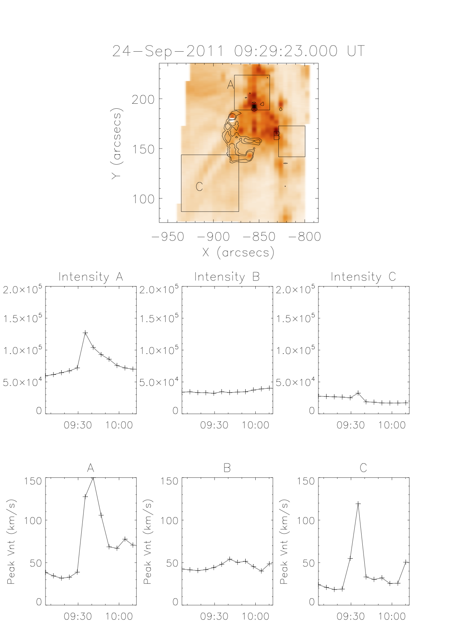
Region B shows enhanced Vnt when there is no equivalent enhancement in intensity.

Slide 12
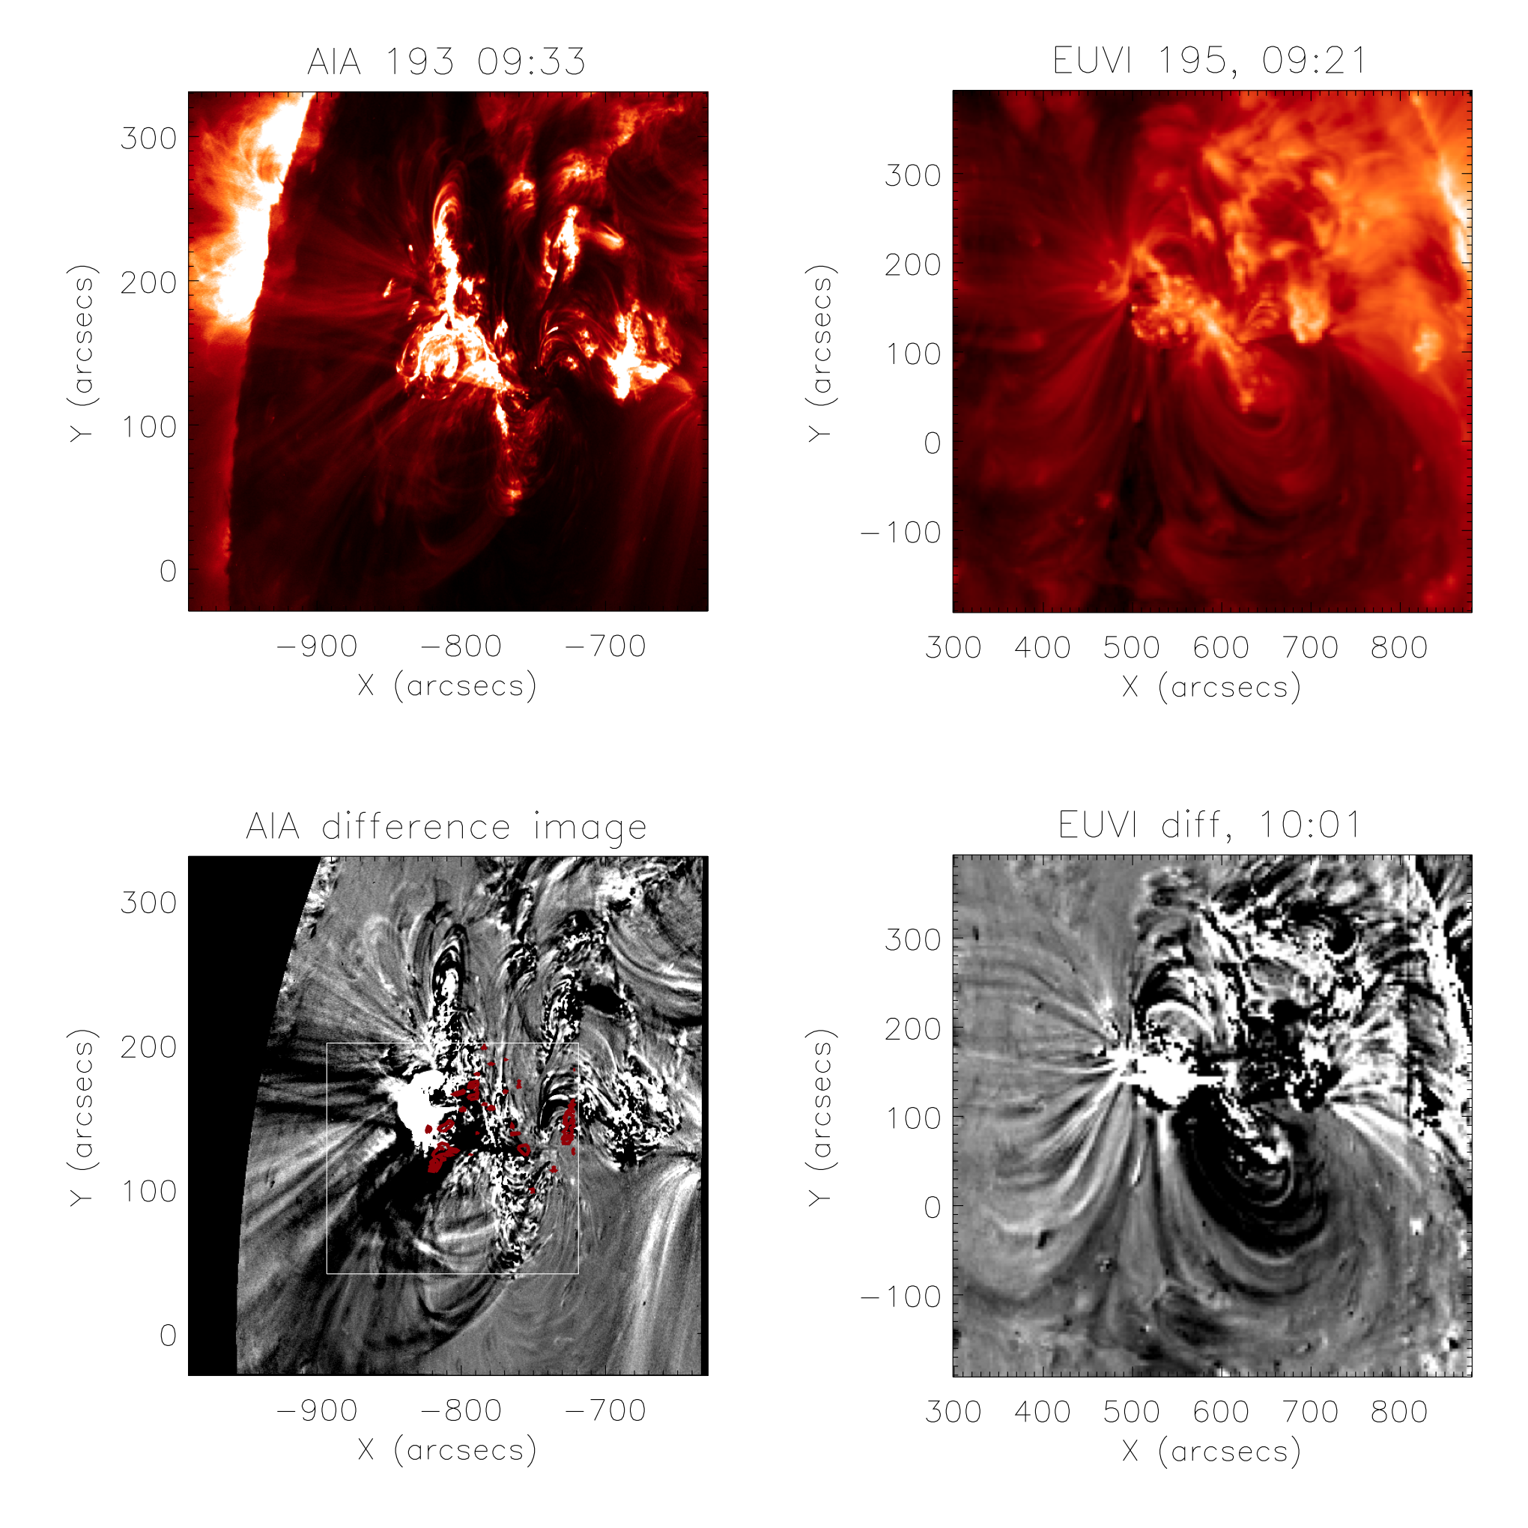
Early Vnt signatures at one footpoint of the dimming region!

Slide 13
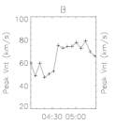
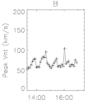
Conclusions
In the 3 eruptive flares early Vnt enhancements occurred away from the main flaring region, lying at the footpoints of the dimming region.
Is this the coronal flux rope being activated??
Pre-flare enhancements are also found above the looptops for the eruptive flares.
The non-eruptive flare also shows pre-flare enhancements in Vnt – these are in the location of the proceeding flare.
All pre-flare Vnt enhancements have a very small spatial scale… and lead to large eruptions/flares. Solar-C very important!

Slide 14
ありがとうございます
Thank you!

