Slide 1
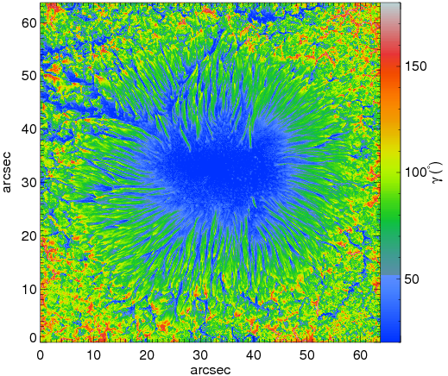
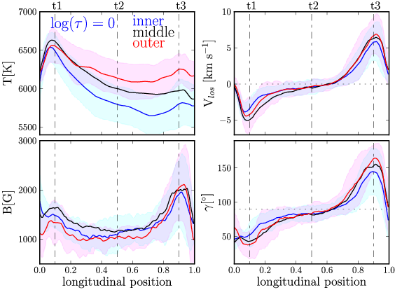
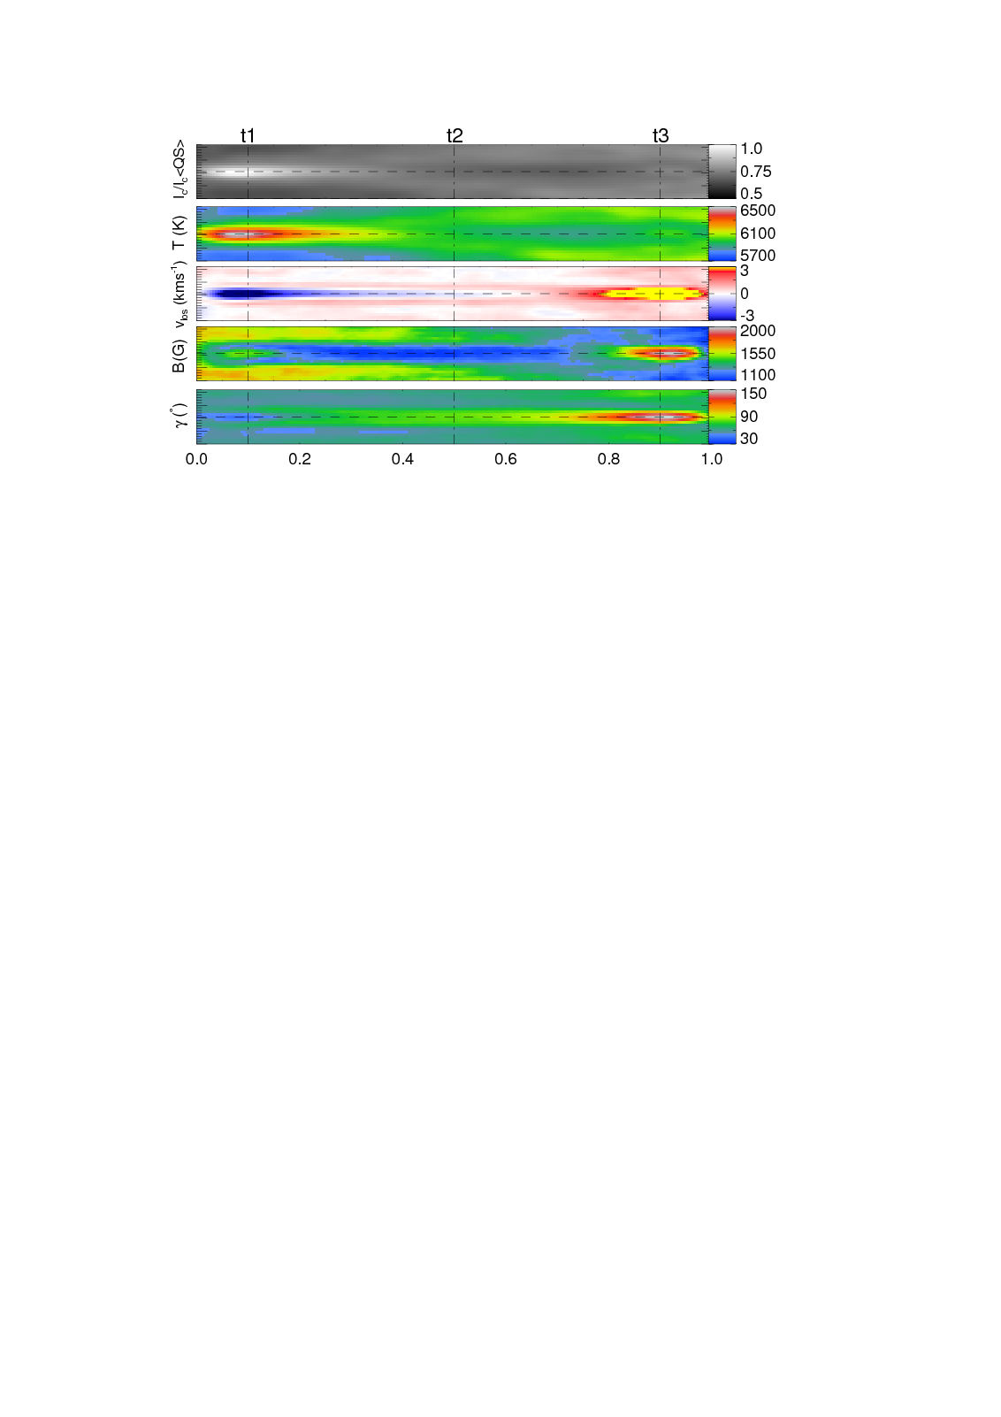
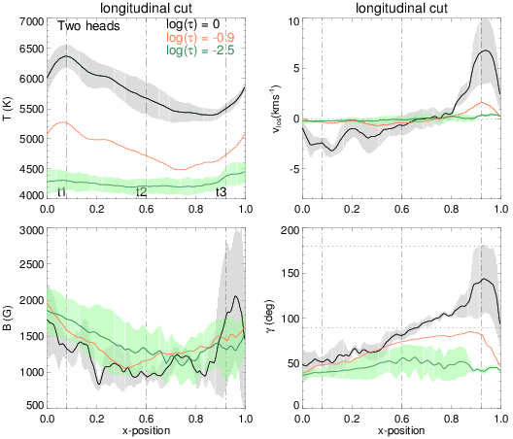
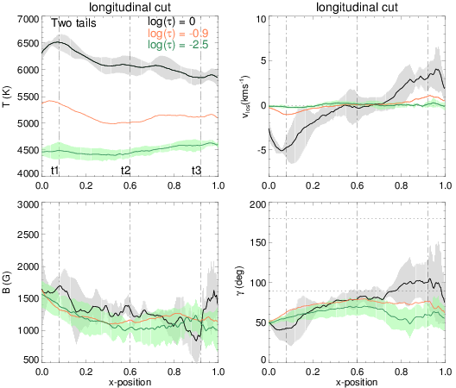
Structure of sunspot penumbral filaments
S. K. Tiwari, M. van Noort, A. Lagg, S. K. Solanki
Max-Planck-Institut für Sonnensystemforschung, Katlenburg-Lindau
We apply a newly developed spatially coupled inversion technique to high-resolution Hinode SOT/SP observations of a sunspot. A height-dependent atmospheric structure is obtained that has led to a unified observational picture of sunspot penumbral filaments, and has given new insights into their physical nature.
l lo
Structure of Averaged Penumbral Filament
transverse cuts along vertical dot-dashed lines
Inversion result: field inclination
longitudinal slice along horizontal dashed line
penumbral filaments are remarkably similar we
can form an average (standard) penumbral filament
radial and lateral convection patterns clearly visible
uniformity of structure constrains MHD simulations
huy
Longitudinal cut along central axis
Strong
upflow (5kms⁻¹)
@heads; stronger downflow
(7kms⁻¹)
@tails
B:1kG@
bulk;1.5-2 kG@head; 2-3.5 kG
@tails
Averaged penumbral filament
Peculiar filaments
Filaments with two heads or tails and shortest/ longest filaments qualitatively resemble the standard filament; quantitative differences are evident.
tiwari@mps.mpg.de

