Slide 1
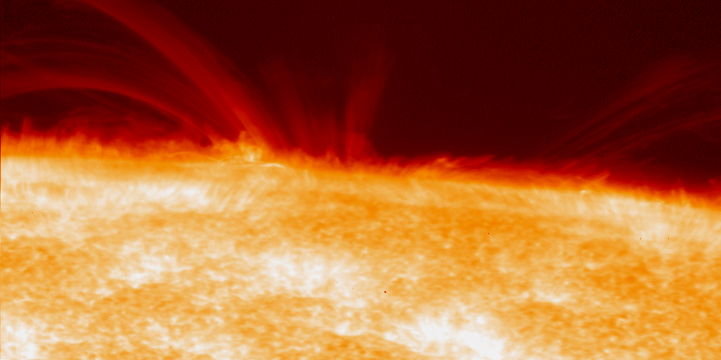
MHD Simulations of the Solar Atmosphere
Hiroaki Isobe (Kyoto Univ.)
acknowledgements:
Nigel Weiss, Mike Proctor (Univ. Cambridge),
and the Hinode team

Slide 2
Outline
Recent observations of the solar atmosphere from Hinode
Activities in quiet sun and coronal hole
Dynamic chromosphere
Hidden magnetism revealed
MHD simulation of the coupling of convection and corona
CIP-MOCCT scheme
Roles of small scale fields and chromospheric reconnection in coronal heating and solar wind acceleration

Slide 3
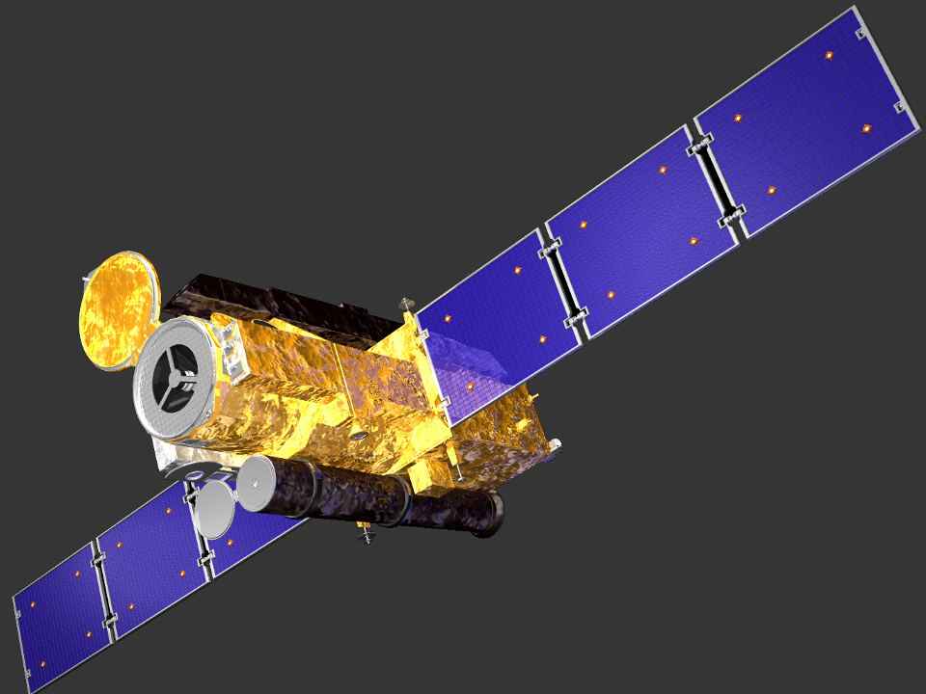
HINODE (“sunrise” in Japanese)
Launched September, 2006
Solar Optical Telescope (SOT)
Accurate measurement of vector magnetic field with high resolution
EUV Imaging Spectrometer (EIS)
Diagnostics of temperature, density and velocity
X-Ray Telescope (XRT)
High-resolution X-ray imaging
Hinode is a Japanese solar mission with NASA and STFC as international partners. Operation is also supported by ESA and NSC.

Slide 4
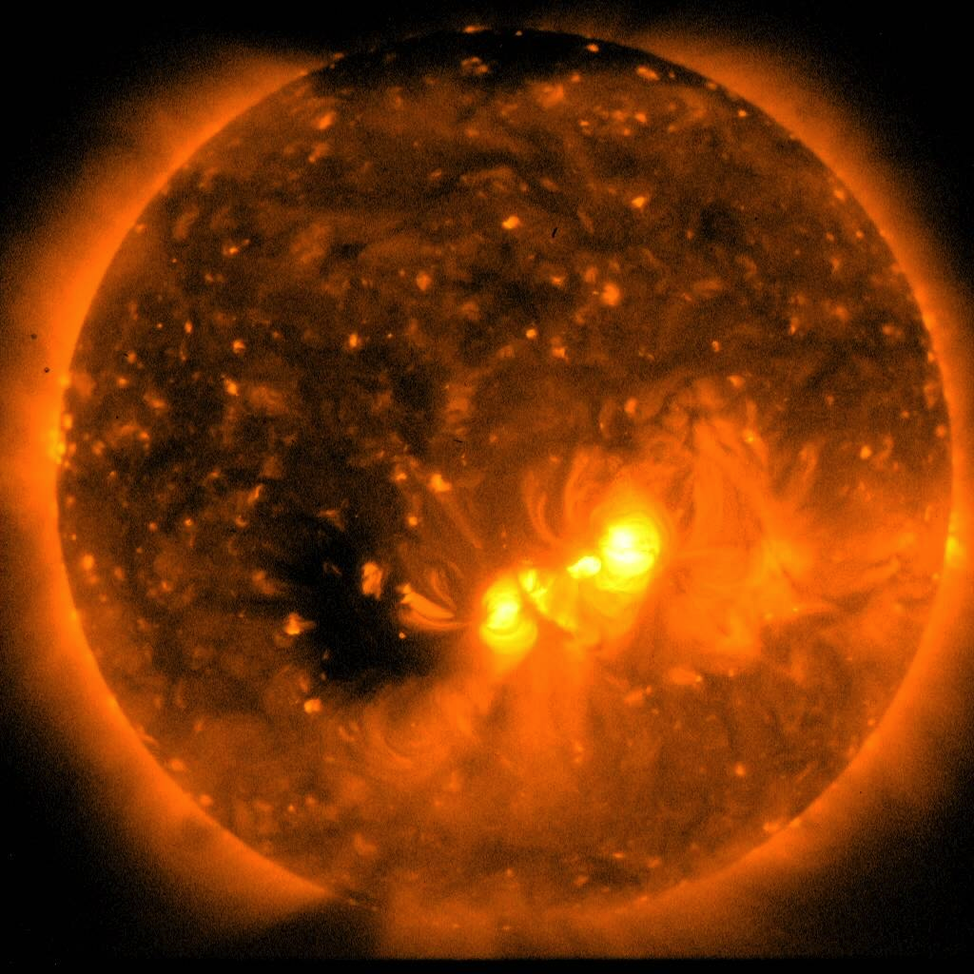
“Quiet sun” is not quiet
Hinode/XRT
Thermal bremsstrahlung from 1-20MK plasma

Slide 5
Activities in polar region
Numerous jets! (≈1 jet/hour)
Origin of solar wind?
Cirtain, Shimojo, Kamio, Calhane, Tsuneta et al.

Slide 6
Dynamic chromosphere (Numerous jets again!)
10000km
Hinode/SOT CaII H line (T≈10000K)
Courtesy of T. J. Okamoto

Slide 7
Magnetic field measurement by Spectro-Polarimeter
Intensity
Field strength |B|
SOT/SP takes full Stokes Profiles, IQUV, of B-sensitive line FeI 636.2 nm
The measured magnetic field vector is used as the boundary condition of MHD simulations =>Matsumoto’s talk
With increasing amount and complexity of the data, solar observers are also very keen to find good tools to explore and visualize their observations.
Angle from line-of-sight
Direction in plane-of-sky
10000km

Slide 8
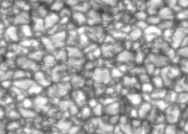
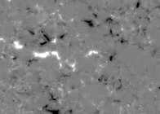
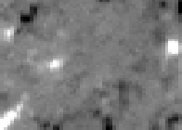
Comparison with ground-based observation
I
V
Hinode/SOT
ASP@Sac Peak

Slide 9
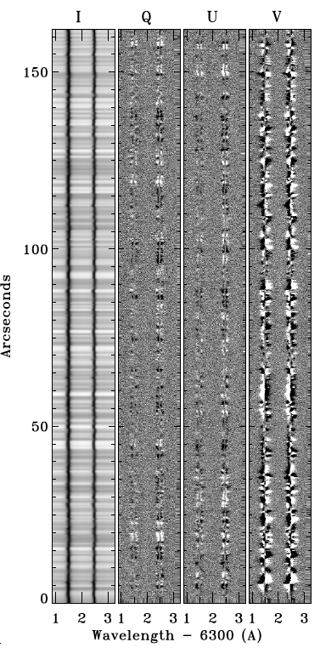
Hidden magnetism: ubiquitous horizontal fields
Linear polarization (Q and U) is produced by components transverse to line-of-sight
They have been difficult to observe from ground, due to weak signal
Lites, Ishikawa, Centeno et al.

Slide 10
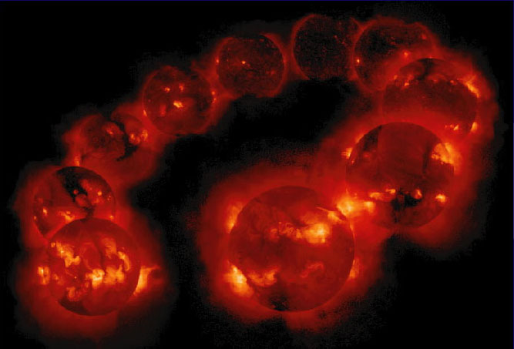
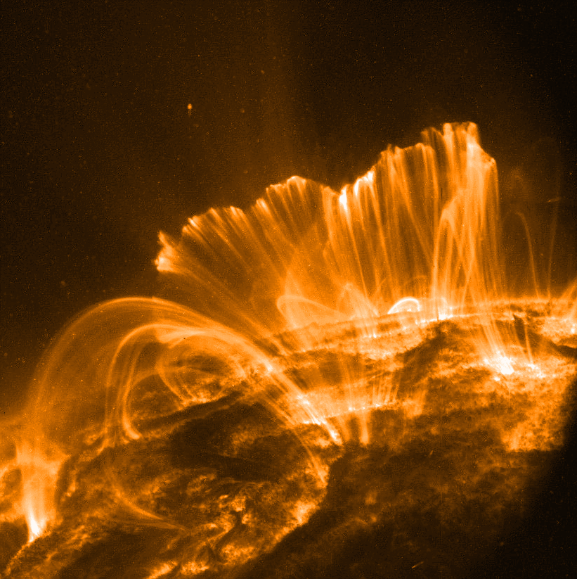
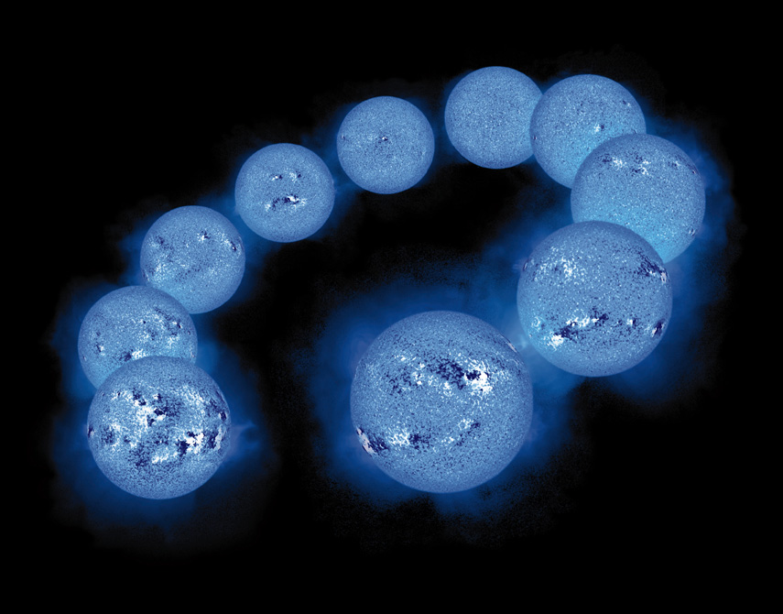
Coronal heating problem
Coronal loops
Soft X-ray
Why there exists
1-10MK corona above
6000K photosphere?
Magnetic field

Slide 11
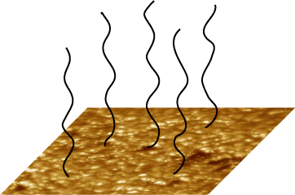
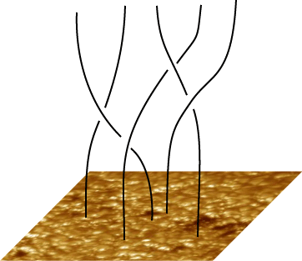
Coronal heating models
Energy source: interaction of convection and magnetic field
If motion is fast:
=> Wave
If motion is slow:
current sheet formation
reconnection (Parker’s nanoflare)
Key question: what are the mode and spectra of magnetic disturbances generated by magneto-convection? => MHD simulation

Slide 12
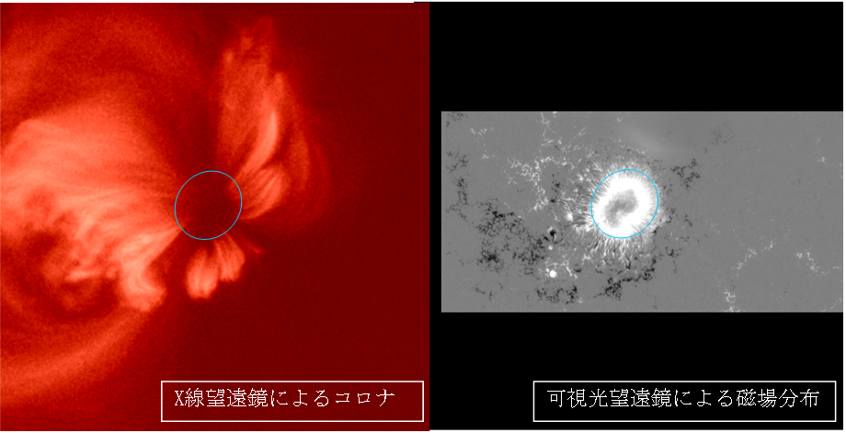
Strong B ≠ Strong heating
Soft X-ray
Stokes V (≈ B)
Corona above umbra is dark

Slide 13
Code: CIP-MOCCT
Induction eq. solved by Method of Characteristics-Constrained Transport scheme (Hawley & Stone 1995)
Mass, momentum and energy eqs. solved by CIP (Cubic-Interpolated Pseudoparticle; Yabe & Aoki 1991).
What is CIP?
Solver of advection term (hyperbolic eqs). Non-advective terms are solved separately (by finite difference).
Spatial derivatives are also time-advanced according to the basic eqs.
Basic eq.
(S: non-advection terms)
Spatial derivative

Slide 14
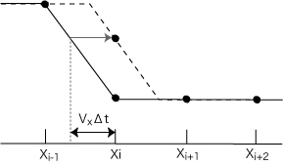
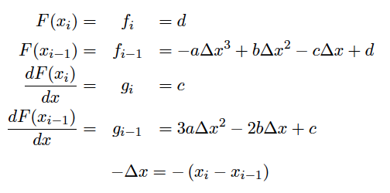
How it goes
Advection equation:
Exact solution:
Interpolate f between xi and xi-1 by 3rd-order polynomial F:
where
Determine a, b, c, d from fi, fi-1, gi, gi-1:
Finally we obtain:
CIP
upwind
where

Slide 15
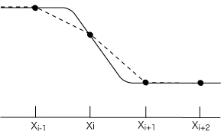
How it works
Both Eulerian variables and their spatial profiles are time-advanced from the basic equations.
A little Lagrangian-like property
Capture discontinuities with less grids
Good at handling large density ratio
CIP
upwind
↑ by F. Xiao (Tokyo Inst. Tech.)
http://www.es.titech.ac.jp/xiao/research_cipmmfvm.html
↑ by K. Uehara (Kyoto U.)

Slide 16
MHD simulation model (Isobe, Proctor & Weiss, 2008, ApJ, 679, L57)
3D compressible MHD
Domain:
10,000x10,000x25,000 km³
from convection zone to corona
Newton cooling in photosphere
No radiative transfer
Initial condition:
fully developed convection
uniform and vertical field
Boundary condition:
horizontal: periodic
bottom: impermeable, stress free, vertical B, fixed T
top: wave damping zone
corona
photosphere
convection
zone
Rayleigh # ≈10⁵
Density contrast in CZ ≈ 5
Density contrast between corona and CZ ≈10⁶

Slide 17
Q=12000 (B≈1kG, strong B like umbra)
Convection is weak and oscillatory
Vertical magnetic field is shuffled by the horizontal motion of convection ... classical view
Magnetic field lines and vertical V at photosphere

Slide 18
Q=300 (B≈100G, active region but outside sunspot)
Vertical flux is concentrated to downflow region (B becomes (>1kG)
Horizontal field is dominant in upflow region
Occasionally, bundles of relatively strong field (≈400G) are driven by convective upflow and emerge in the photosphere
Magnetic field lines and vertical B at photosphere

Slide 19
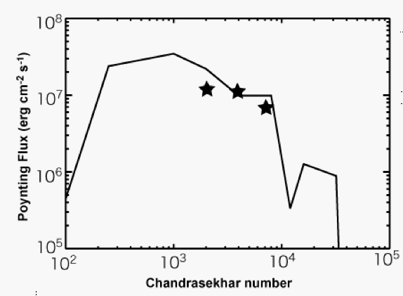
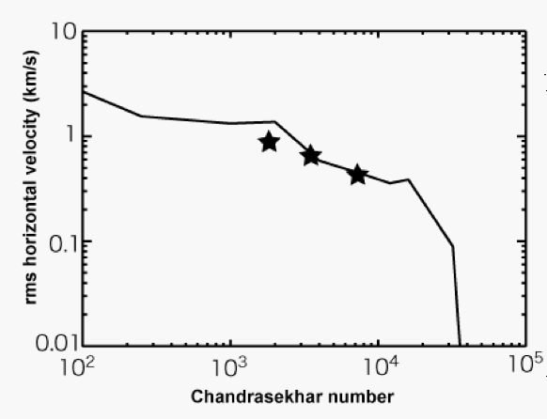
Convection velocity and Pointing flux
Average velocity in photosphere
Upward Poynting flux
Active region
Sunspot
Quiet Sun
Weak B => Small PF
Strong B => Small convection velocity => Small PF

Slide 20
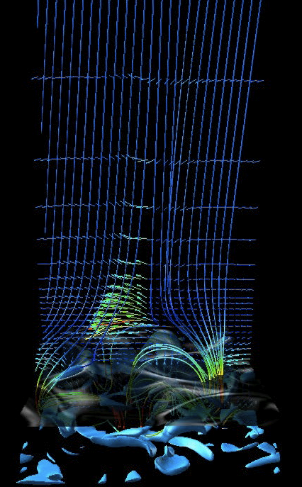
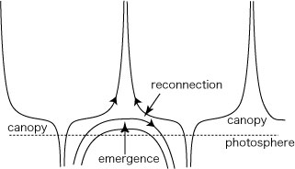
Reconnection in chromospheric “canopy”
The horizontal fields undergo magnetic reconnection in the chromosphere
High-frequency wave is emittted to the corona
wave

Slide 21
2D simulation (but higher numerical resolution)
Reconnection events intermittently emit high frequency waves
Magnetic islands are created by reconnection, stay in the chromosphere for a while, and then reconnect with ambient fields
color: log Temperature

Slide 22
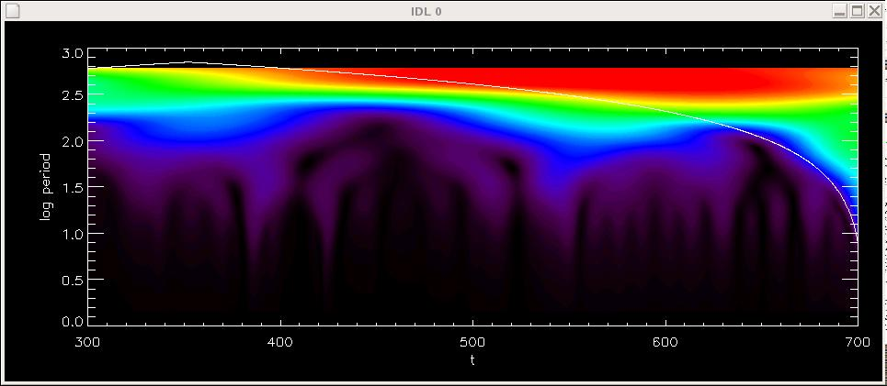
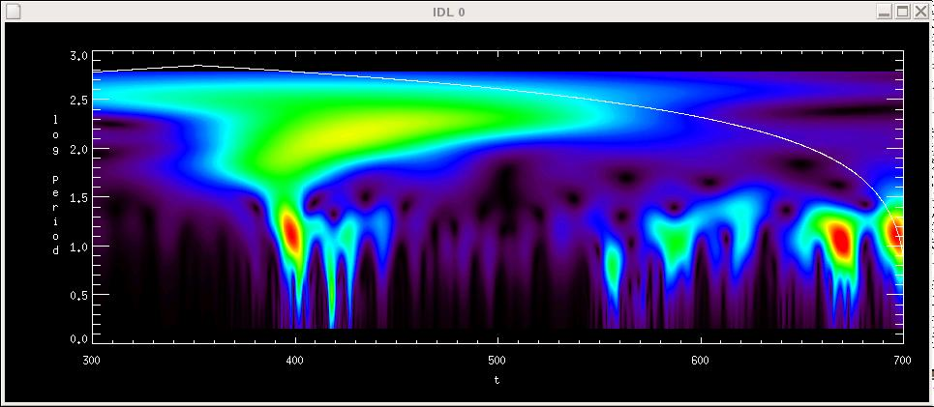
High frequency waves
photosphere
Wavelet spectrum of Vx
log period
Convection motion at photosphere is slow (≈10min)
High frequency (f>0.1Hz) waves are produced intermittently by chromospheric reconnection
10min
corona
log period
10sec

Slide 23
Is bursty reconnection possible in chromosphere?
Chromosphere is fully collisional and weakly ionized
MHD is a good approximation
Gyro frequency > collision frequency. Well magnetized.
S = VAL/η ≈ 10⁵⁻⁶
Sweet-Parker reconnection is probably too slow to explain explosive phenomena (jets, surges etc.)
Petchek reconnection with anomalous (localized) resistivity? Kinetic / Hall effects? Maybe, but how they happen in collisional plasma?

Slide 24
Conclusions
Hinode observations:
Photosphere is full of small-scale horizontal fields
Chromosphere is very dynamic, full of (shock) waves and jets (and reconnection)
MHD simulation
Small-scale horizontal field is natural consequence of magneto-convection when B is not too strong
Reconnection in chromosphere emits high-frequency waves.
Both observation and MHD simulation indicate possible important role of chromospheric reconnection in coronal heating and solar wind acceleration
...but the physics is poorly understood. Even poorer than coronal (collisionless) reconnection!

Slide 25
Thank you.
Hinode/SOT chromospheric CaH line ; courtesy of T. J. Okamoto

Slide 26
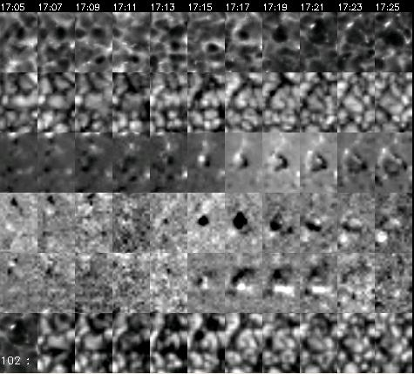
Chromospheric response
CaH
Doppler
V
U
Q
I
SUMER sees lots of brightening in this region (Innes).

Slide 27
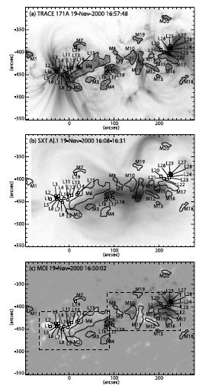
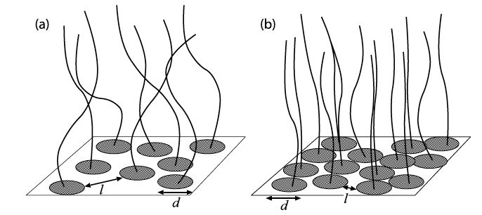
Footpoint |B| of coronal loops (Katsukawa & Tsuneta 2005)
Hot (cool) loops have weaker (stronger) "average" |B|
|B| is similar（~1500G）. Filling factor is different.
Interpretation: strong |B| suppress the convection motion, hence smaller Poyinting flux.
Hot loops
average B 〜200 G
Cool loops
average B 〜500 G

Slide 28
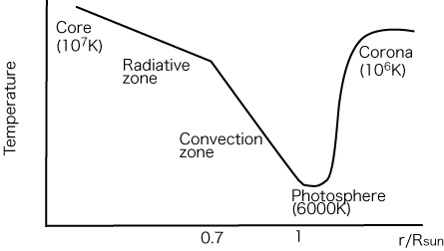
Coronal heating problem
?
Temperature should decrease outward...
Why there is the 1MK corona outside the 6000K surface?

Slide 29
Coronal heating: answer level 1
Solar atmosphere is gravitationally stratified
In the corona:
n〜10⁹ cm⁻³, Ethermal〜1 erg cm⁻³
In the photosphere:
n〜10¹⁷ cm⁻³, Ethermal〜10⁵ erg cm^{-3,} Ekinetic〜10⁴ erg cm⁻³
There is plenty of nonthermal energy in the photoshere.
Such nonthermal energy is transported to the upper atmosphere and then disspated there. => Corona.

Slide 30
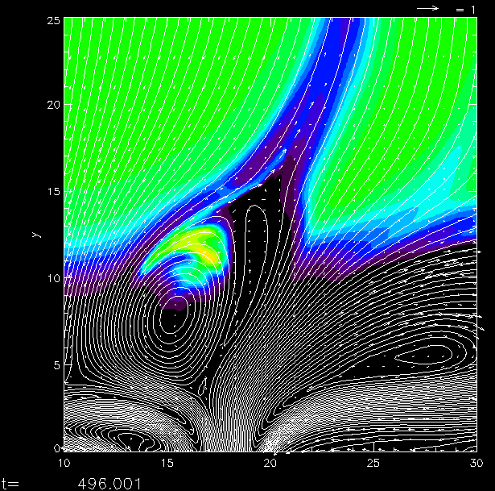
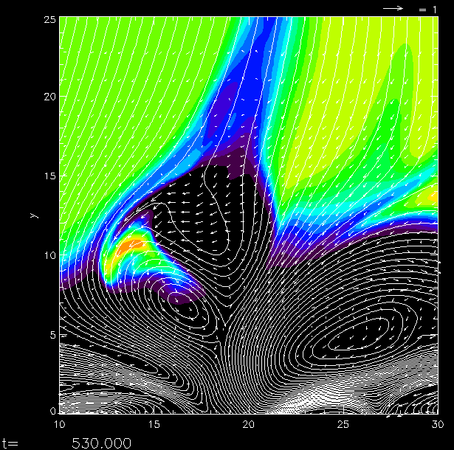
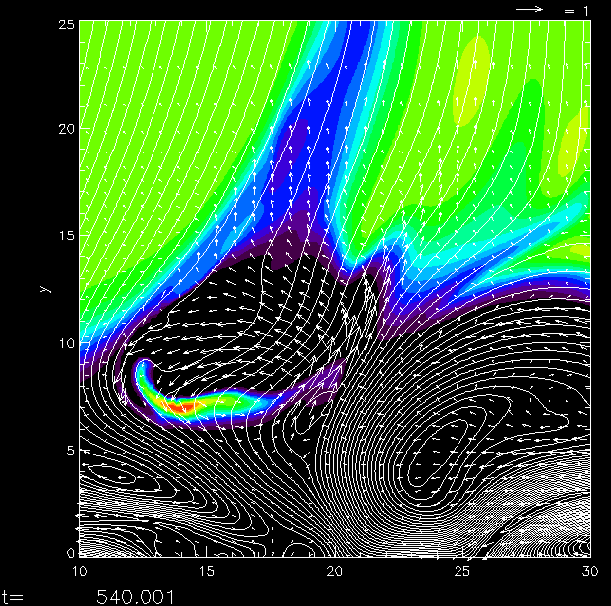
Reconnection of magnetic island in the chromosphere
Reconnection outflow pushes the magnetic island from back
=> self feed-back

Slide 31
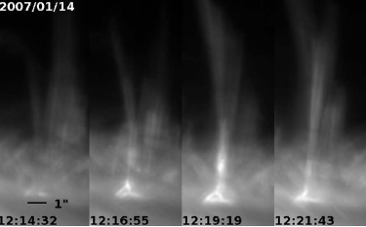
Chromospheric activities
log Density

Slide 32
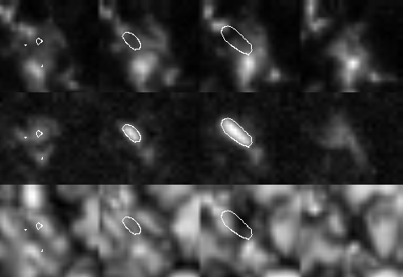
Small scale horizontal field found by Hinode (Ishikawa, Lites, Centeno et al...)
t=0
t=2 min
t=4 min
t=6 min
Vertical field
Horizontal field
2500km
From Ishikawa et al. 2008

