Slide 1
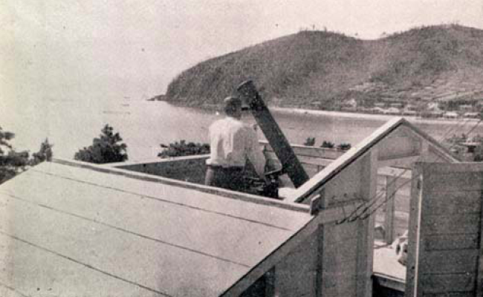
Astronomical and Meteorological Observations at Nagashima-Aiseien, an Hansen's disease sanatorium
Hiroaki Isobe (Kyoto City University of Arts)

Slide 2
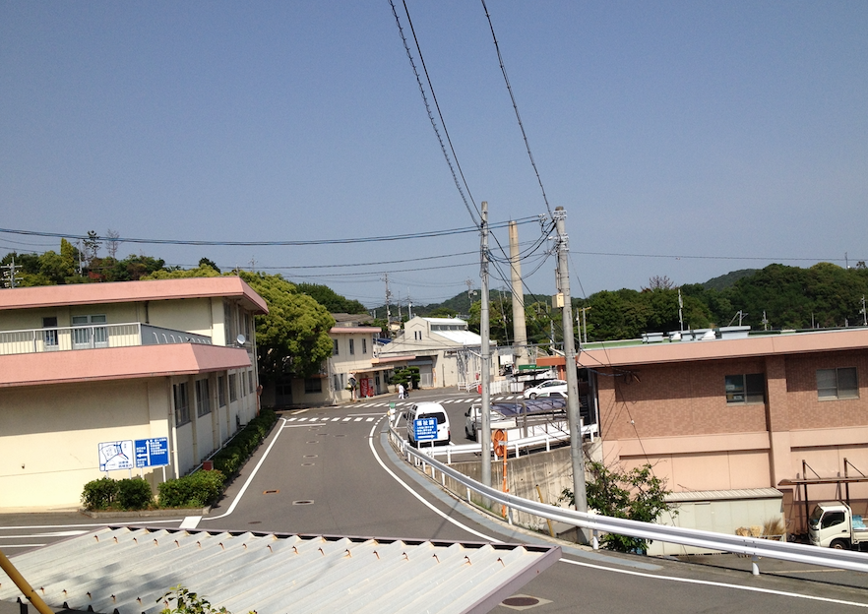
Hansen’s disease and Nagashima-Aiseien
Hansen’s disease, also known as leprosy, is a chronic infectious disease that mainly affects skin, peripheral nerves, and eyes.
In Japan, the national policy of forcibly isolating the Hansen’s disease patients to the sanatoria was taken in early 20th century. The law on which the policy was based was finally abolished in 1996
Patients and their families received fierce discrimination. Many patients changed the name and disconnected from family to prevent them getting involved in discrimination.
Nagashima-Aiseien, established in 1931 in an island of Okayama prefecture, is the first of the 13 national sanatoria. About 200 residents are still living in Nagashima-Aiseien today.
Nagashima
Aiseien

Slide 3
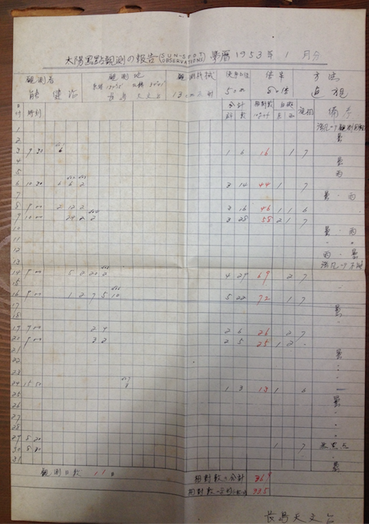
Nagashima astronomical Observatory
There was an astronomical observatory in Nagashima Aiseien from 1949 until sometime around 1960.
Regular observations of sunspots and star occultation was conducted by the patients of sanatorium.
Prof Issei Yamamoto of Kyoto University and Mr Minoru Honda, known for his comet observations, helped them.
Sunspot obs record
Photo in 1949

Slide 4
Teruhiko Yoda
There remains a letter from Teruhiko Yoda, an patient at Nagashima Aiseien, to Prof. Yamamoto at Kyoto Univeristy, asking for his help in building an astronomical observatory
”I am doomed to be kept in this closed island, and I hope to dedicate my life to astronomical observation”
Mr Yoda also had enthusiasm in composing Tanka, Japanese short poetry. Some
あきらめてゐし眼にかすかに木星の衛星が見ゆるよ一つ二つ三つ四つ
I had almost given up on it, but my eye dimly see Jupiter’s moons, one, two, three, four
Photo of Teruhiko Yokoda
adopted from his Tanka collection

Slide 5
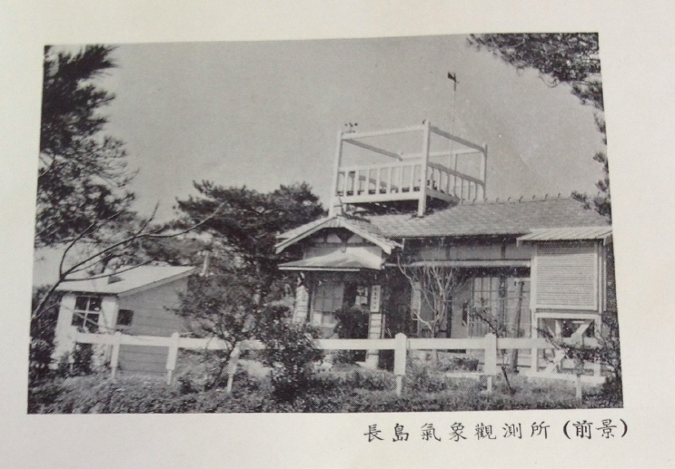
Meteorological observations
The astronomical observatory was a part o Nagashima-Aiseien’s meteorological observatory, which conducted observations from 1935 to 2010. During 1937 to 1977 it provided the official regional data for the Japanese Meteorological Agency.

Slide 6
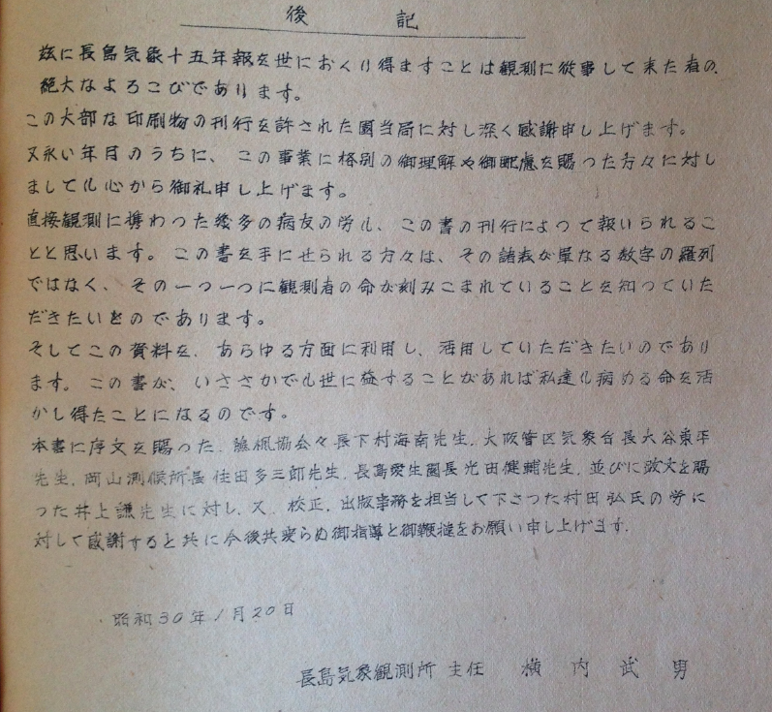
Afterword by the chief observer Takeo Yokouchi in the report of the 15 years of meteorological observatory, 1955
I hope the readers realize that the tables in this report are not just an enumeration of numbers. The lives of the observers are engraved in them… If this report is of any use in this world, our lives with illness are saved.

Slide 7
Takeo Yokouchi, name of the chief observer, was the true name of Teruhiko Yoda, the Tanka composer and the man who wrote to the Prof. of Kyoto Univ. about the astronomical observatory.
He always used his true name for records, reports, and correspondences about his observations.

