Slide 1
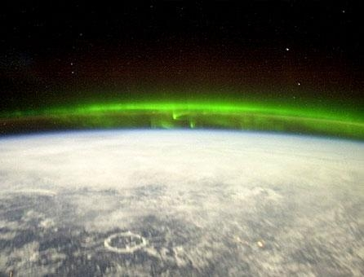
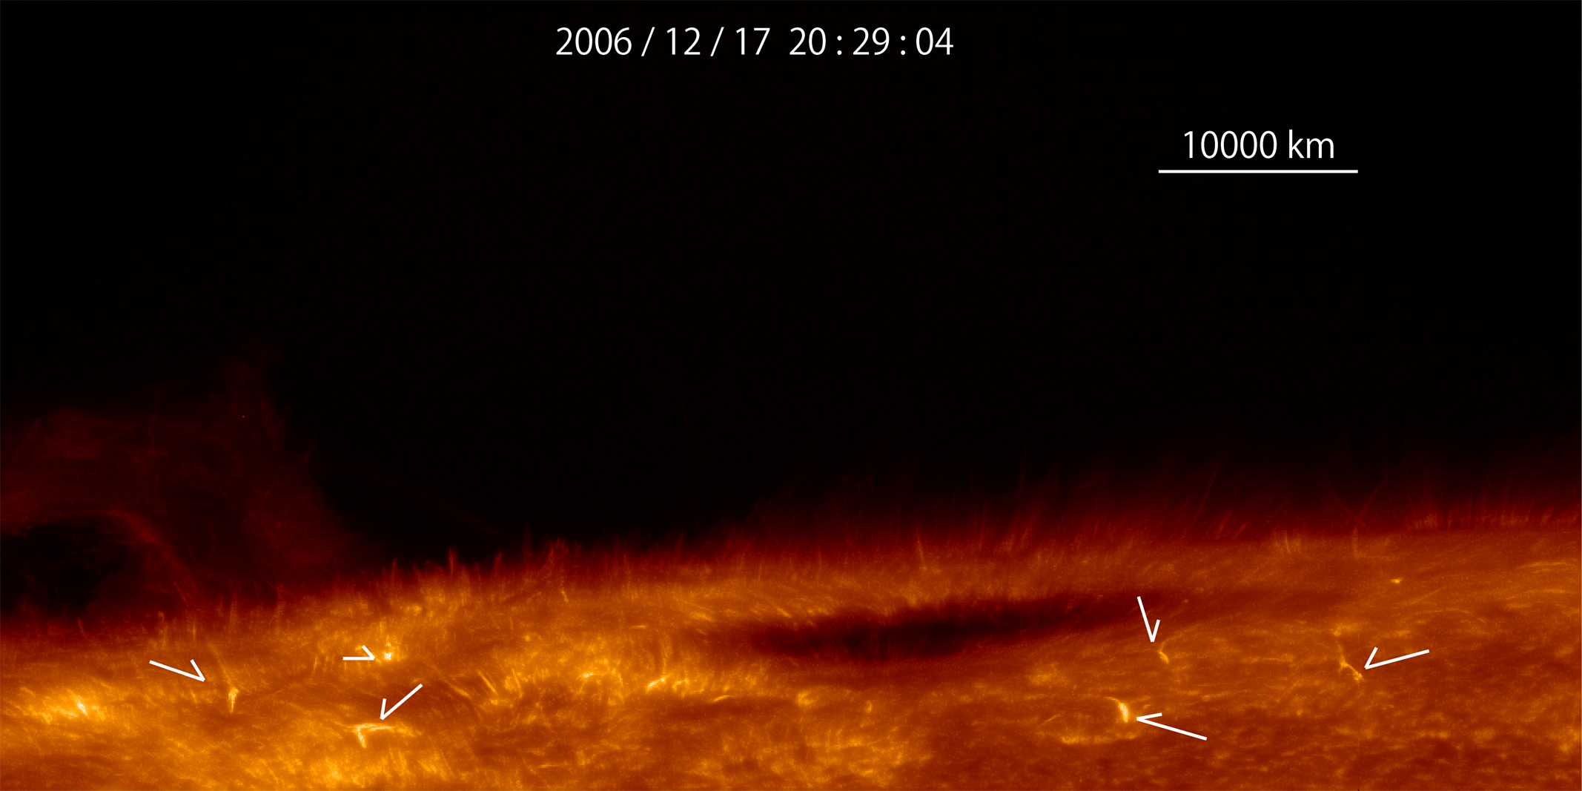
Physical analogies between solar chromosphere and earth’s ionosphere
Japan-Norway Symposium on Space Science in Polar Region. June 5-6, 2012 Oslo
Hiroaki Isobe (Kyoto University)
Acknowledgements: Y. Miyoshi, Y. Ogawa and participants of “Solar chromosphere and Earth’s ionosphere” meeting.

Slide 2
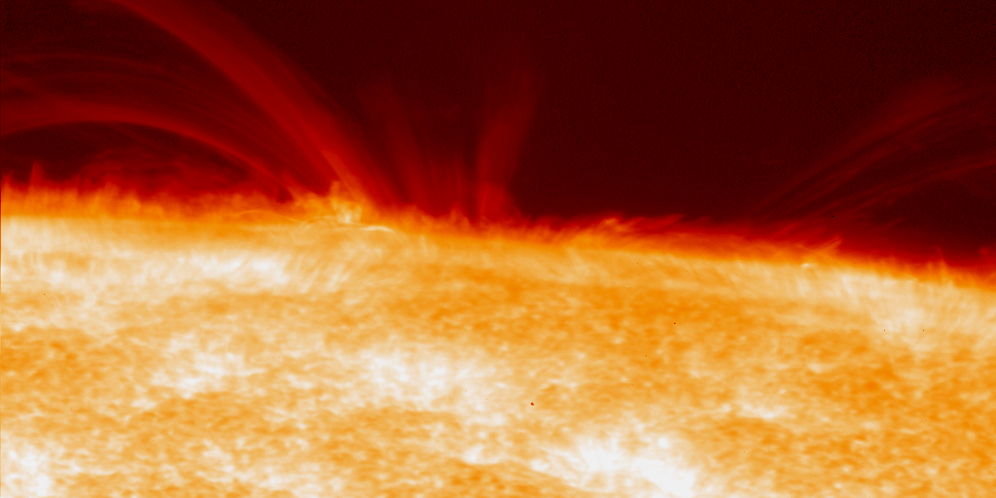
Why chromosphere is important
Intrinsically interesting
Path of mass and energy to corona, solar wind, and thus heliosphere
Origin of UV radiation that affects upper atmosphere of Earth
Unique laboratory of weakly ionized plasma also relevant to molecular cloud, protoplanetary discs and ionosphere

Slide 3
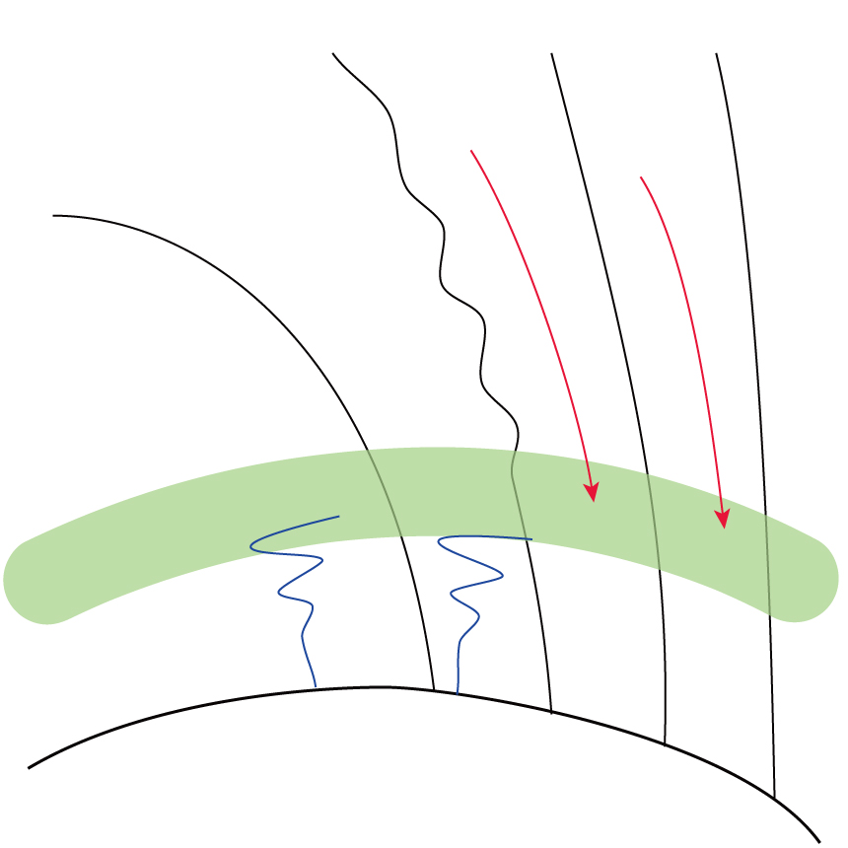
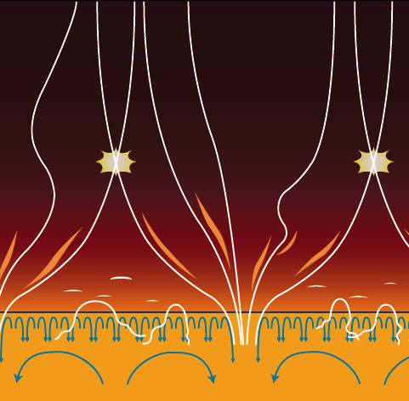
Similarity of chromosphere and ionosphere
Earth
Sun
corona / magnetosphere
chromosphere / ionosphere
photosphere / storato-mesosphere
convection z. / toroposphere
Interface layer between tenuous, magnetically dominant region above and convecting layer below
Coupling with other regions by magnetic field and waves
Gravitationally stratified
Weakly ionized. Neutral/plasma interaction important

Slide 4
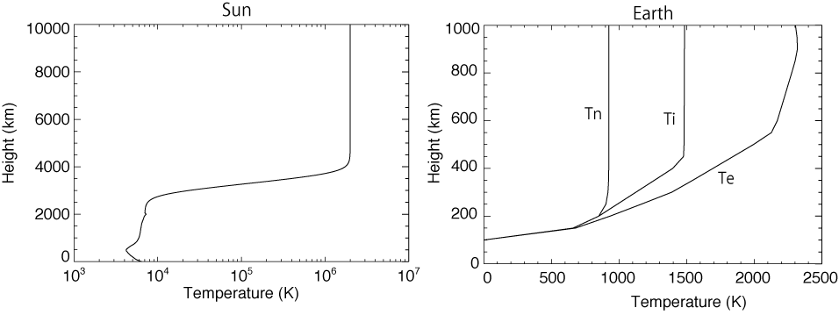
Temperature profile
Corona
Chromosphere
Photosphere
Ti
Tn
T_{n} ~ T_{i} ~ T_{e} in solar atmosphere because of collisional relaxation.

Slide 5
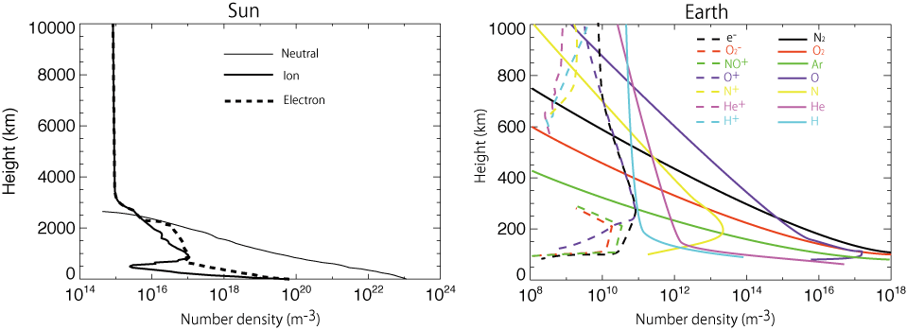
Density profile
Strong stratification: density drops many orders of magnitude.
Weakly ionized (ionization fraction << 1).
In ionosphere, Dominant ion species change as a function of height.
In the sun, H~90% , He~10% (number density) and little others.

Slide 6
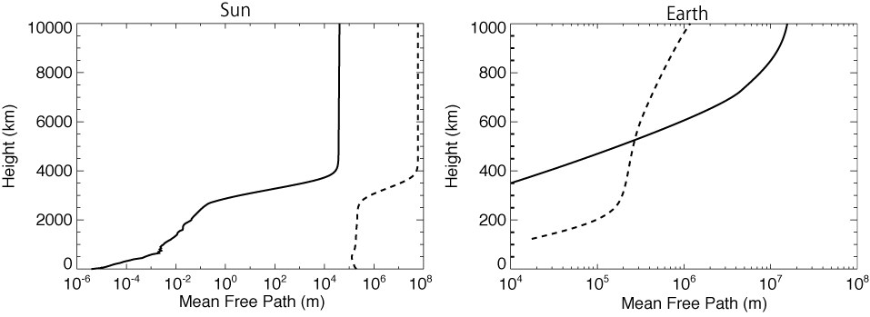
Collisionality
Scale height
e mean free path
Chromosphere is collisional. Neutrals and plasma is strongly coupled and behave as a single fluid, except in small (<~10km) scale.
Lower ionosphere is strongly coupled, while upper ionosphere is nearly collisionless.

Slide 7
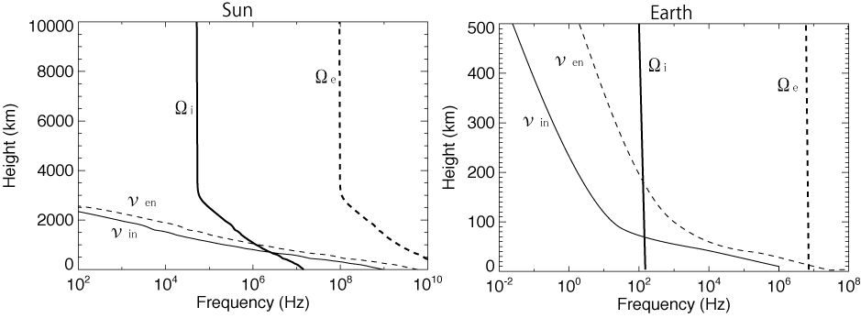
Collisional and cyclotron frequencies
磁場はB∝ρ^{0.3}のモデル値を使用
Collisional freq ν_{in,en} > cyclotron freq Ω_{i,e} means ion/electron is demagnetized by collision with neutrals.
If Ω_{i} < ν_{in} and Ω_{e} > ν_{en} , ion and electron behave differently, producing electric current.
Such “dynamo effects” known in ionosphere, but not identified in chromosphere.

Slide 8
Common physical processes
Sun
Earth
Precipitation of high energy particles during flare/substorms

Slide 9
Common physical processes
Sun
Earth
Magnetohydrodynamic waves
In ionosphere they come from magnetosphere (energy source is solar wind)
In chromosphere they come both above and below (energy source is photospheric convection)

Slide 10
Common physical processes
Sun
Earth
Waves from below
Stratification causes amplitude growth (shock formation)
Gravity wave important in Earth
Sound wave (slow-mode shock) important in Sun
...why different?

Slide 11
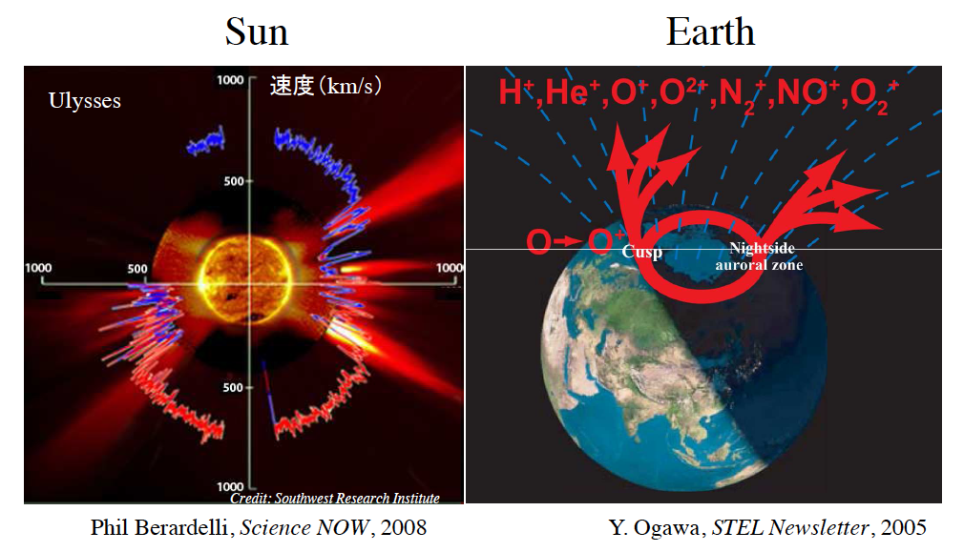
Similar? solar wind and polar wind

Slide 12
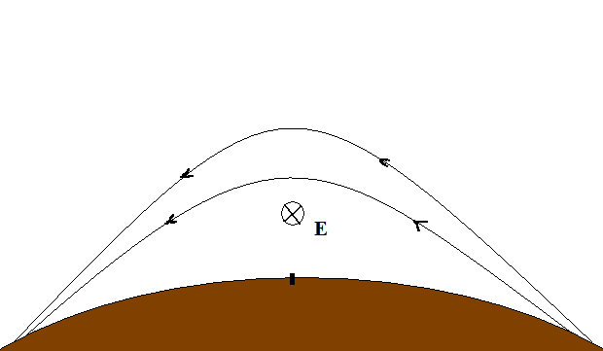
Similar? Emerging flux and plasma bubbles
Emerging flux
“Bubble” in prominence (Berger et al. 2008)
∇P, g
∇P, g
Plasma bubble in Earth atmosphere
(courtesy H. Fujiwara)
E×B
equator
Magnetic Rayleigh-Taylor instability
20ºN
20ºS
fountain effect

Slide 13
Sun-Earth language barrier larger than that of Norway-Japan?
Terrestrial people define plasma beta by
(plasma pressure) / (magnetic pressure)
Solar people define plasma beta by
(plasma + neutral pressure) / (magnetic pressure)
...because plasma and neutrals behave almost as single fluid
We need persevering conversation!

Slide 14
Conclusion
Chromosphere and ionosphere are similar, but there are differences. We can learn from each other.
Norway and Japan have strong groups in both fields.
International and interdisciplinary collaboration promising, but we need continuous conversation.

Slide 15
backup slides

Slide 16
X-ray and radio emission in flares (Guedel-Benz relation, GB1993)
Brown dwarf
Jupiter aurora

Slide 17
Why 1-fluid MHD is OK in chromosphere
Balancing the Lorentz force and ion-neutral drag
Relative velocity is ~ 1m/s in chromosphere, whereas chromosphere is dynamic and always moving around with V > 1km/s.
Except in small scales (such as high-frequency waves and magnetic reconnection), plasma and neutrals can be considered as single fluid.

