Slide 1
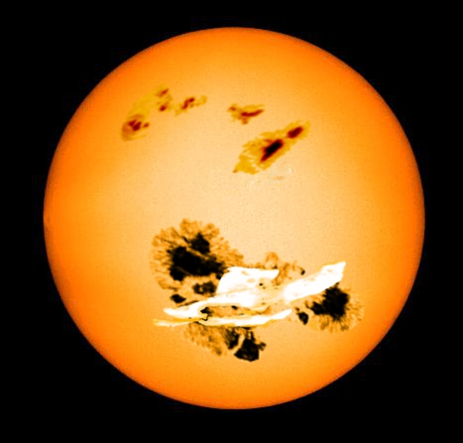
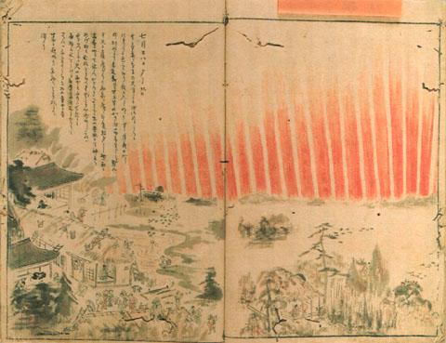
How extreme can a solar storm become? Implications from observations of solar-type stars and historical records
Hiroaki Isobe
Graduate School of Integrated Advanced Studies
in Human Survivability, Kyoto University
Aknowledgements : K. Shibata, H. Maehara, T. Shibayama, Y. Notsu, S. Notsu, S. Honda, D. Nogami, A. Hillier, A. Choudhuri (stellar), H. Hayakawa, H. Tamazawa, A.D. Kawamura (Hisotory)

Slide 2
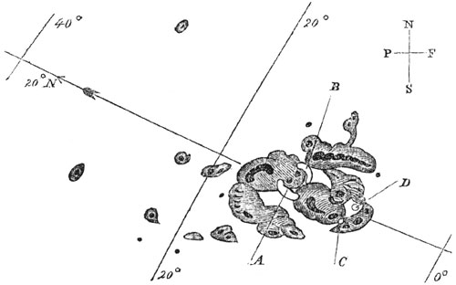
Carrington flare (1859, Sep 1, am 11:18 ）
The first record of flare observation by Richard Carrington in 1859
Estimated to be the largest flare/magnetic storm. DST ~ -1760nT, total energy ~ 10³²⁻³³ ergs (Tsurutani+2003)
Terrestrial impacts:
Bright aurora appeared next day in Cuba, the Bahamas, Jamaica, El Salvador, and Hawaii.
Telegraphy systems in Europe and North America failed
Flare on 2012 July 23 observed by STEREO may have been super-carrington.

Slide 3
Super Flare in solar-type stars?
Schaefer et al. (2000, ApJ) reported 9 superflares (E>10³³⁻³⁸ erg) on ordinary “solar type stars”, namely the spectral class of F8-G8, single, not rapid rotator, not very young.
Interpretation: magnetic interaction with a hot Jupiter because no historical records
=> Search of for super flares in solar type stars by Kepler

Slide 4
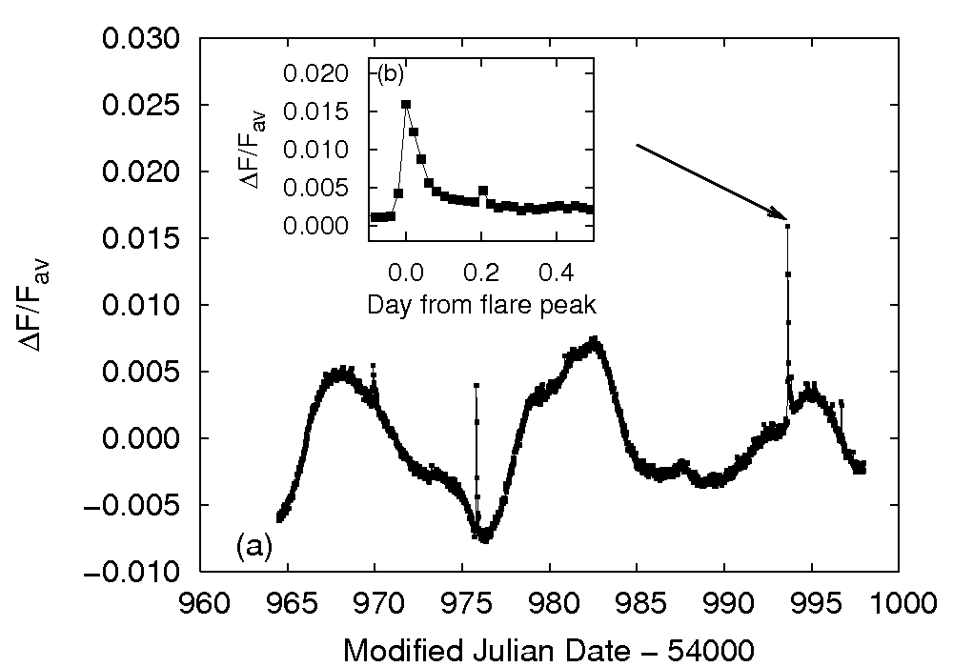
Found many of them (Maehara et al. 2012 Nature; Shibayama et al. 2013 ApJS)
Maehara et al. (2012)
Among 80,000 G-type stars, 1574 superflares (E~10³⁴⁻³⁶ ergs) found in 279 stars.
No signature of hot Jupiters in superflare stars
Spectroscopic observation shows at least two stars are really solar-twins (T_{eff} ~ 5700K, rotational period 21.8d / 25.3d)
(Nogami et al. 2014 PASJ)

Slide 5
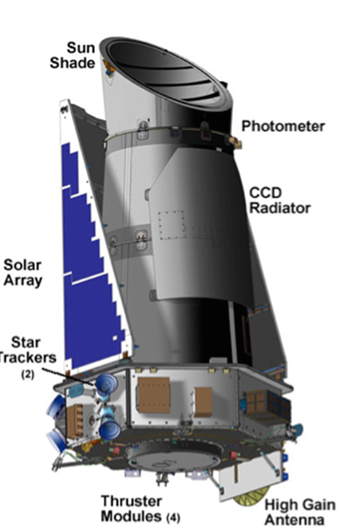
Observation details
Kepler satellite (launched in 2009)
Optical (400-850nm) telescope with 95cm aperture
Main science target; exoplanets hunting by transit method
Accurate photometory (~10⁻⁵ for 12 mag star)
Time resolution 30min or 1min
Data selection and flare detection
5100K < T_{eff} < 6000 and log g > 4.0 => ~80,000 stars
Automatic detection of sharp intensity increase => visual inspection of lightcurves/images to remove suspicious events
Detection limit ~ 0.1-1% of average brightness ~ 0.5-5x10³⁴erg
Assume T~10,000K black body to estimate flare energy
More detail in Shibayama+2013, ApJS

Slide 6
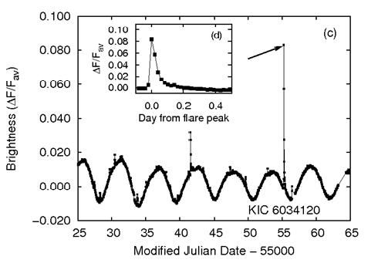
Periodic brightness moduration
Maehara et al 2012
Rotation of big spots?

Slide 7
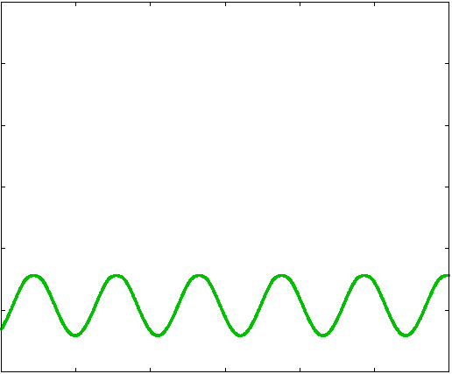
Model calculation of stellar brightness variation
KIC6034120
model(green)
inclination = 45°
Starspot radius
0.16 R*
Stellar
brightness
2％(平均基準)
5 days
time
Notsu et al.

Slide 8
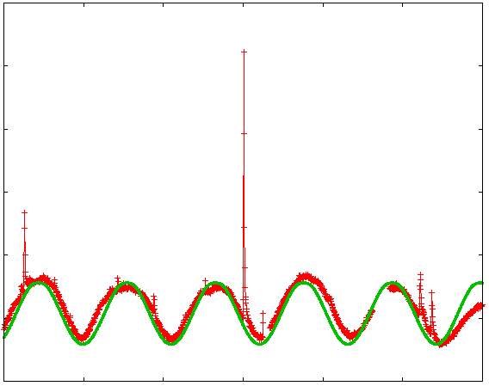
Model calculation of stellar brightness variation
KIC6034120
model(green)
inclination = 45°
Starspot radius
0.16 R*
Stellar
brightness
2％(平均基準)
5 days
time
Notsu et al.

Slide 9
Model calculation of stellar brightness variation
KIC6034120
model(green)
inclination = 45°
Starspot radius
0.16 R*
Stellar
brightness
Rotational period and sunspot area can be estimated.
Rotational period calculated by this method consistent with vsini obtained by spectroscopy (Notsu et al. 2015 PASJ)
2％(平均基準)
5 days
time
Notsu et al.

Slide 10
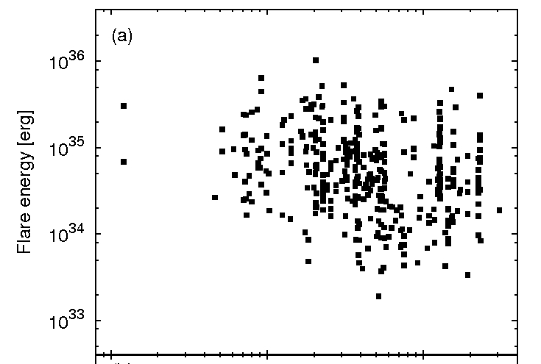
Flare energy vs rotational period
Fast rotation
(young)
Slow rotation
(old)
Stars with
period longer
than 10 days
cf solar rot period ~ 25days
Maehara et al. (2012)

Slide 11
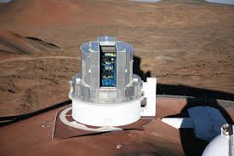
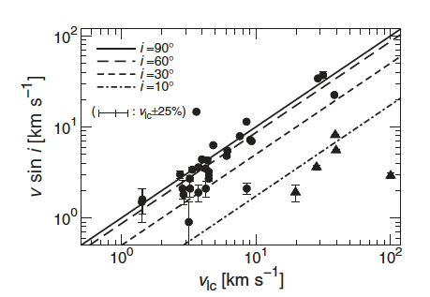
Supectroscopic observations by SUBARU telescope (Nogami et al. 2014, Notsu et al. 2015a,2015b, Honda et al. 2015, all in PASJ)
High dispersion spectroscopy of 50 supar-flare stars
34 shows no evidence of binary
Measured T_{eff}, g, vsini, metalicity, chromospheric activity (depth of CaII infrared triplet)
vsinI Rotational velocity calculated from Kepler light curve
T_{eff} and g are also consitent with the Kepler catalogue are also
Notsu et al. 2015b

Slide 12
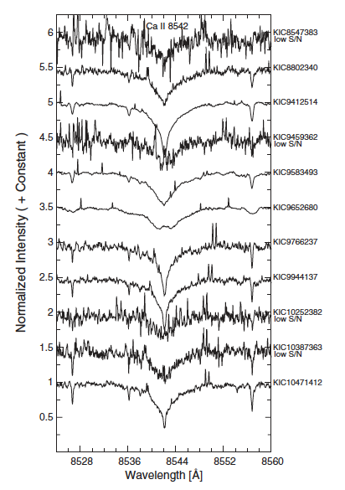
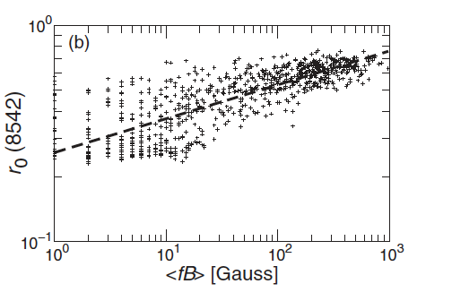
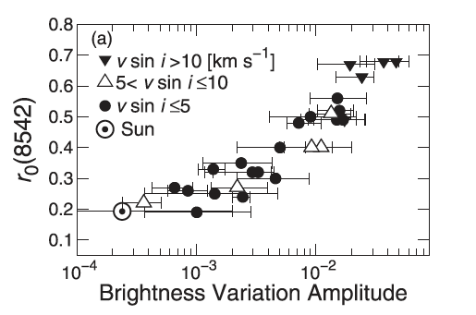
Chromospheric activity and <fB> probed by CaII infrared (8542Å) triplet (Notsu et al. 2015b PASJ)
Solar observation (Hida observatory)
r₀
~ size of spots
Some slowly rotating superflare stars seem to have strong average B

Slide 13
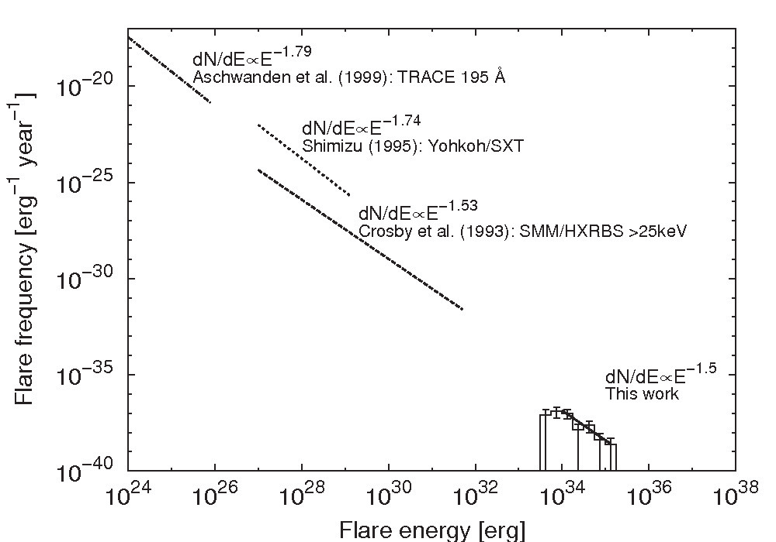
Comparison of statistics between solar flares/microflares and superflares
Shibata et al. 2013
nanoflare
microflare
solar flare
？
Largest solar flare
superflare

Slide 14
Comparison of statistics between solar flares/microflares and superflares
Shibata et al. 2013
Superflares of 1000 times more
Energetic than the largest solar flares occur once in 5000 years
nanoflare
microflare
1000 in 1 year
100 in 1 year
10 in 1 year
1 in 1 year
1 in 10 year
1 in 100 year
1 in 1000 year
1 in 10000 year
solar flare
Largest solar flare
superflare

Slide 15
Can super flares occur in our Sun? (Shibata, Isobe, Hillier et al. 2013 PASJ)
Largest energy of a flare ~ a fraction of total magnetic energy in active region
Need a big spot. Magnetic flux BA_{spot} ~ 10²⁴ Mx.
Comparable to the total flux generated in 11 year cycle.
Non-standard scenario such as radiative zone-core dynamo?

Slide 16
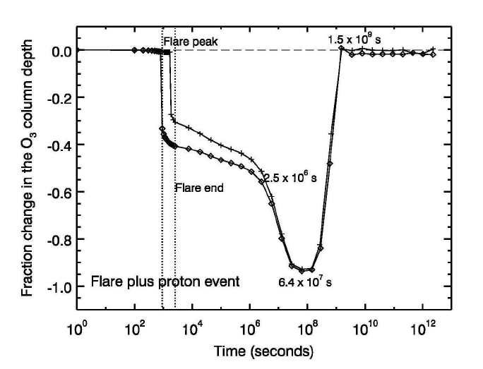
Impact of 10^35 erg superflares
Energetic particles produce NOx in the upper atmosphere and cause Ozone depletion
If solar energetic particle (SEP) intensity proportional to flare energy (which seems unlikely… e.g. Usoskin et al. 2013);
Radiation intensity on the ground will be ~40mSv
All astronauts and some of airline passengers may be exposed to fatal radiation (> 4000 mSv)
Almost all artificial satellites die
Radio communication trouble and blackout would occur all over the planet.
Segura et al. 2010

Slide 17
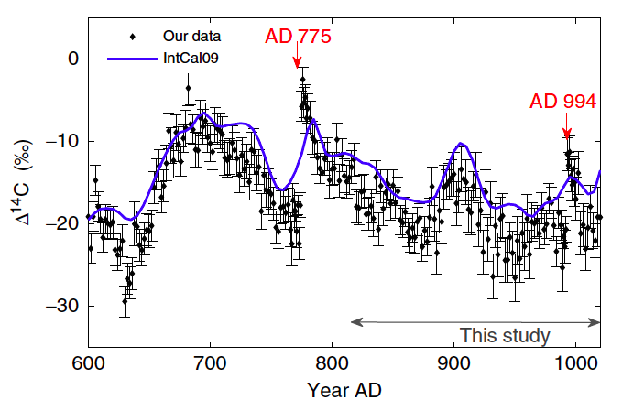
Historical evidence 1: cosmogenic radionuclides
Sharp increase of ¹⁴C in tree rings records (Miyake et al. 2012 Nature, Miyake et al. 2013 Nature Comm.)
Evidence also found in ¹⁴C of other trees (Usoskin+2013; Jull+2014; Güttler+2013), corals (Liu+2014) and ¹⁰Be in antarctic ice core (Miyake+2015).
But no evidence in Greenland ¹⁰Be (Yiou+1997; Berggren+2009; Usoskin+2013)
¹⁴C production rate ~ 10⁸ atoms/cm²/yr. Require X230 (~9x10³³ ergs) flare
(Cliver+ 2014)

Slide 18
Any records in historical literature?
Red aurora in Japan (1770)
National Diet Library of
Japan Digital archive
“This year (774) also appeared in the heavens a red crucifix, after sunset; the Mercians and the men of Kent fought at Otford; and wonderful serpents were seen in the land of the South­Saxons.” Allen (2012)
There also is and German records on “Red shield-like thing above the church” [Annales Regni Francorum: 776]
In China (776)：「大曆十年…十二月丙子（Jan 12, 776），月出東方，上有白氣十餘道，如匹練，貫五車及畢、觜觿、參、東井、輿鬼、柳、軒轅，中夜散去」[新唐書天文二]
Pioneering works of the survey of aurora observation in Chinese, Korean and Japanese literature by Keimatsu (1973) and Yau (1995)
Association with the AD775 event pointed out by Allen (2012), Usoskin (2013), Cliver+(2014)

Slide 19
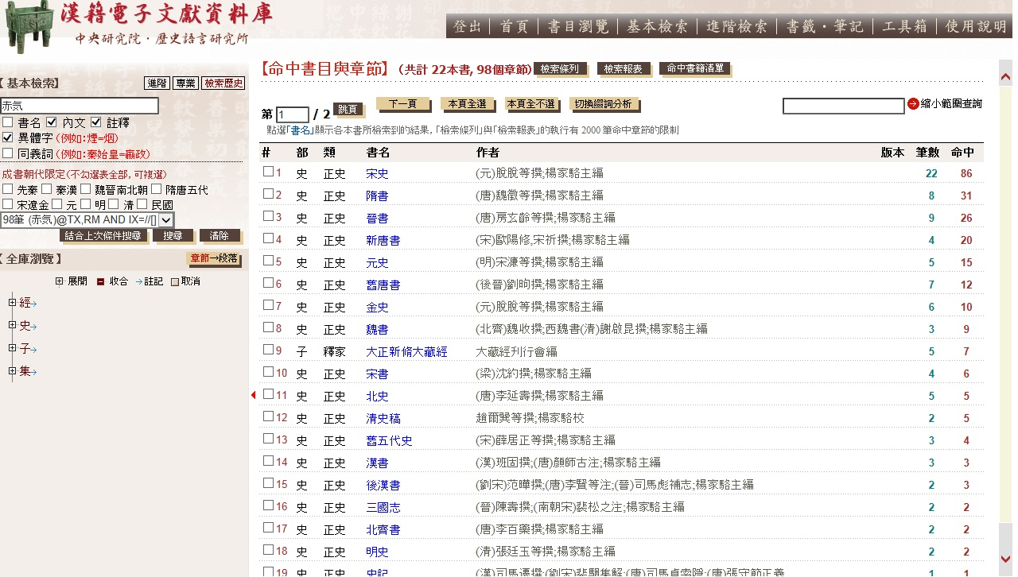
Advantage of Chinese chronicles
Continuous and systematic observation by experts (astronomers) conducted by the central government of each dynasty and summarized in “Astronomical Treatise（天文誌）
Date and place of the observations clearly recorded, often with information of time (day or night), direction, shape, and colors.
Recorded in (apparently) objective style
And now there is a digitized database!

Slide 20
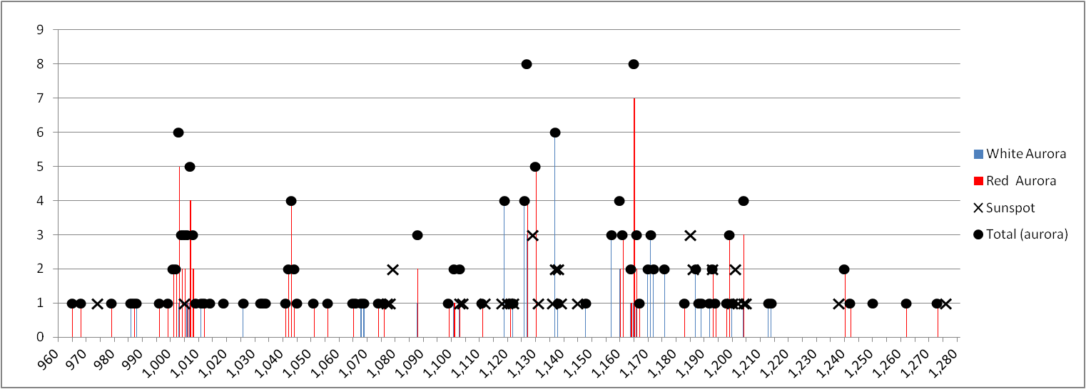
Sunspots and aurora records during Song dynasty (960–1279) (Hayakawa, Tamazawa, Kawamura & Isobe, Earth, Planets and Space in press.)
Sunspots are recorded as “black spots 黒子” or “black vapors（黒気）” inside the Sun.
Some description of size and shapes. e.g., “peach” “plum” “chichen egg” “duck egg”
Aurora candidates are “vapors” with various colots. Among 193 auroral candidates, 75 are white, 58 are red, 28 are blue-white. The other 32 include yellow, blue gold etc.
number of events
year

Slide 21
AD 994 event?
Hayakawa et al. EPS in press.
Points : ¹⁴C(Miyake+2013)
Bar : aurora (total)
No sunspot records during 985-1004 (there is one in 1005)

Slide 22
Summary
Many super flare (E~10 ³⁴⁻³⁵ ergs) found in G-type stars.
Some of super-flare stars look solar-twins (spectral type, rotational period, age, metalicity etc)
Some evidence of extreme cosmic-ray event in cosmogenic radionuclides
Survey of aurora/sunspots in historical records ongoing. Table will be provided online for scientific community
European collaborators welcome!

Slide 24
References
Discovery and statistics (Maehara et al. 2012 Nature; Shibayama et al. 2013 ApJS)
Theory (Shibata et al. 2013, PASJ)
Supectroscopy by SUBARU
Discovery of solar twins (Nogami et al. 2014 PASJ)
T_{eff}, g, matalicity, vsini (Notsu et al. 2015a, PASJ)
Stellar rotation, starspots, chromospheric activities (Notsu et al. 2015b, PASJ)
Li abundances (Honda et al. PASJ in press, arXiv 1505.06050)
G, K, and M dwarfs (Candelaresi et al. 2014 ApJ)
Temporal variation by 1-min cadence Kepler data (Maehara et al. 2015 Earth, Planets and Space)
Historical records (Hayakawa, Tamazawa, Kawamura & Isobe, Earth, Planets and Space Earth, Planets and Space 2015, 67:82)

Slide 25
Note on cosmic ray events
10 Be are more sensitive to short-term variations than 14C the atmospheric residence time. 14C is ~8 years and 10Be is 1–2 years
But 10Be deposition is also easily affected by climate noise
AD775 event detected in Dome Fuji ice core, but not from quasi-decadal data of the Greenland ice core (Yiou et al., 1997; Berggren et al., 2009; Usoskin et al., 2013)
10Be sharp increase found in annual data of 10Be in Dome Fuji ice core, but its amplitude is uncertain (Miyate+2015 GRL)

