Slide 1
科学・学術と社会のコミュニーション
Science communication with public
磯部洋明 Hiroaki Isobe
Contact:
Higashiichijokan Room 203
isobe@kwasan.kyoto-u.ac.jp
http://www.kwasan.kyoto-u.ac.jp/~isobe/

Slide 2
Why do scientists need to communicate with public?

Slide 3
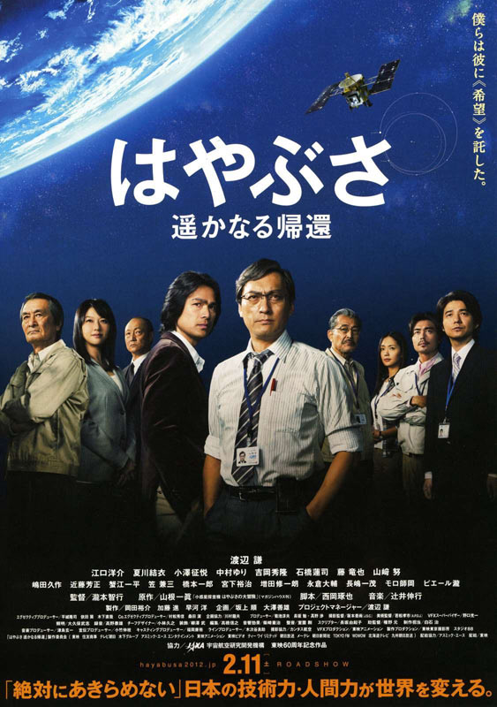
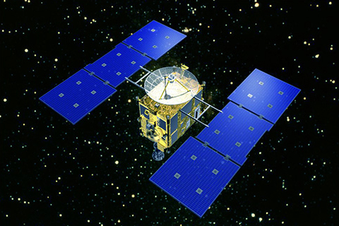
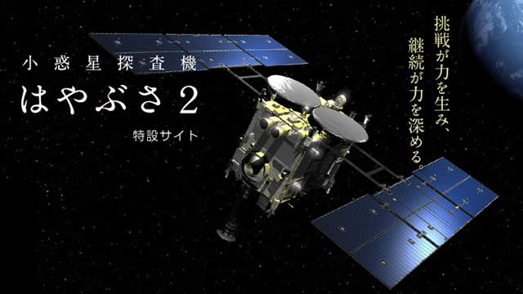
Example 1: science project funded by science
The asteroid exploration mission HAYABUSA brought about a big boom in public because of its dramatic journey to and back from the asteroid ITOKAWA.
The successive mission HAYABUSA2 was put forward by the government without the usual process of competition based on the assessment of scientific impact and technical feasibility by the expert.
Can enthusiasm in public justify this?
cf. Cost of the mission ~ 30 billion yen > JAXA’s annual budget spent for pure science.

Slide 4
Example 2
After the accident of Fukushima nuclear plant, the provisional limit of radiation exposure was changed from the normal value of 1mSv/year to 20mSv/year.
Is this acceptable?

Slide 5
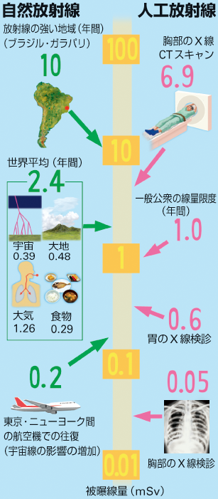
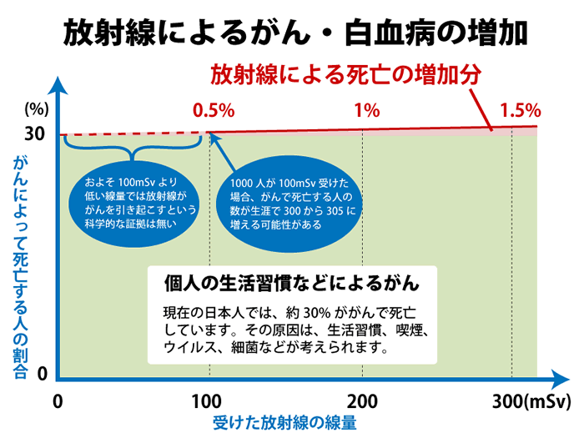
“Scientific evidence” behind the 20mSv

Slide 6
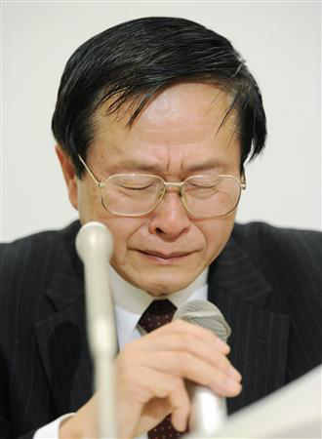
「 この数値を乳児、幼児、小学生に求めることは、学問上の見地からのみならず、私のヒューマニズム からしても受け入れがたいものです。 」
“I cannot require children to accept this threshold, not only from academic point of view, but also from my humanism”
小佐古敏荘東京大学教授 内閣官房参与辞任時の会見
Dr Toshiso Kosako, Prof. in atomic engineering at Univ. Tokyo, at his press interview on resigning the special adviser of the cabinet.
Should humanism of an expert be reflected to the decision making in the government?

Slide 7

Example 3: Genetically modified crop

Slide 8
Example 4:
Non-invasive prenatal genetic testing is now available to diagnose 13 trisomy, 18 trisomy and 21 trisomy (the Down's syndrome).
Trisomy: anomaly of chromosome. 13 trisomy and 18 trisomy are fatal, while 21 trisomy is not.
Is “informed consent”

Slide 9
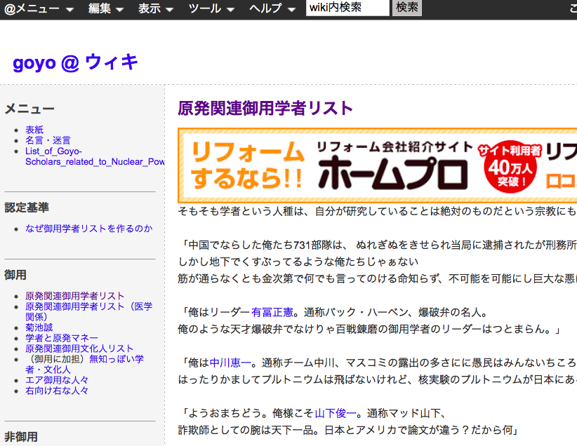
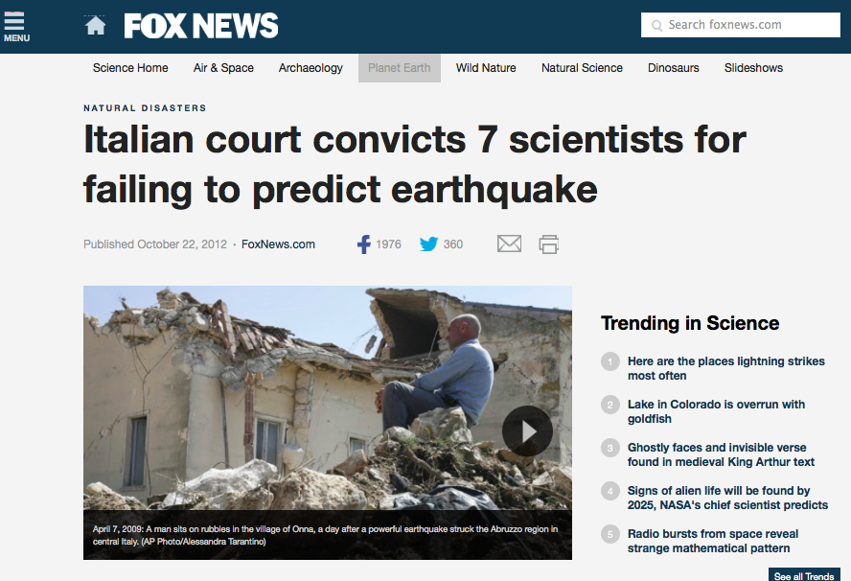
Public distrust of scientist

Slide 10
Why we need science communication
Accountability
Contribution
Better decision making by individual/public

Slide 11
Science events attracting diverse people?
小/中学生 2名
高校生 2名
大学生/院生 3名
会社員 2名
公務員 1名
自営業 1名
教職員 4名
イラストレーター 1名
退職 1名
無回答 1名
(%)
女性
50%
男性
50%
(%)
緑：参加者
（n=18）
薄緑：全国web調査
（n=868）
「となりの元素 ーモトモトヒトは元素人！？ー（2011年4月23日実施）」より
加納、水町、岩崎、磯部、川人、前波 科学コミュニケーション (2013)

Slide 12
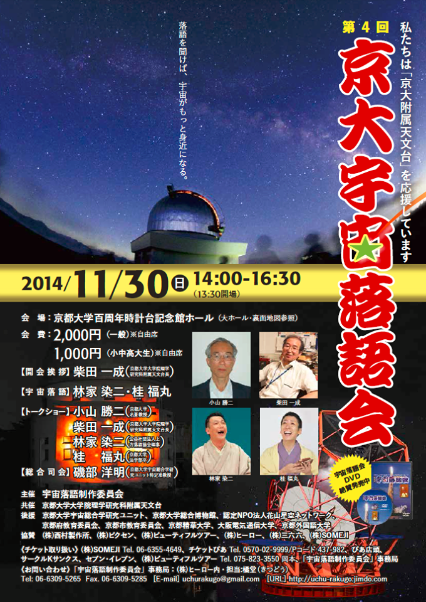
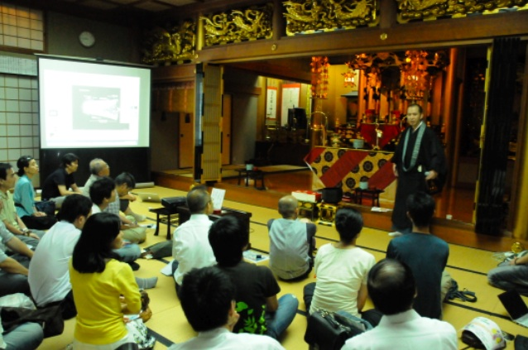
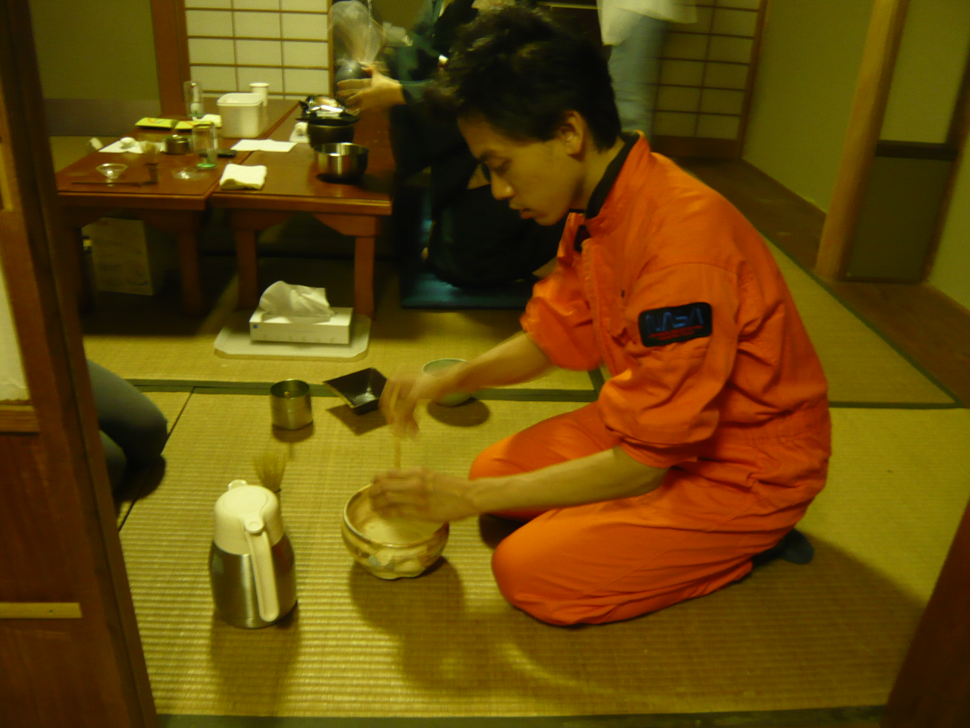
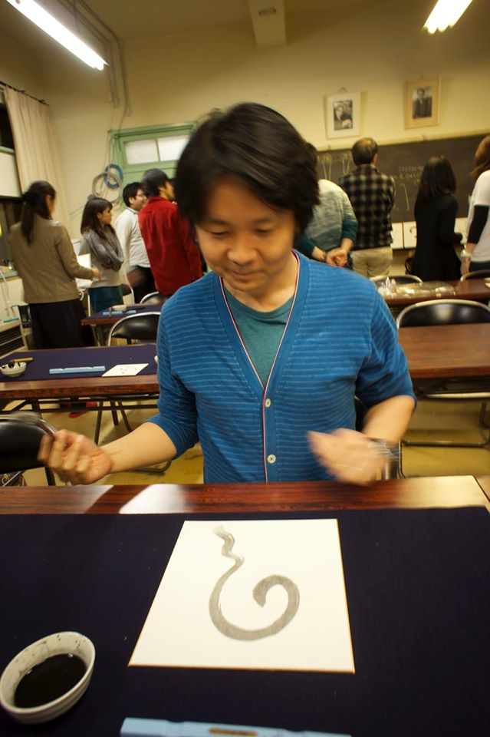
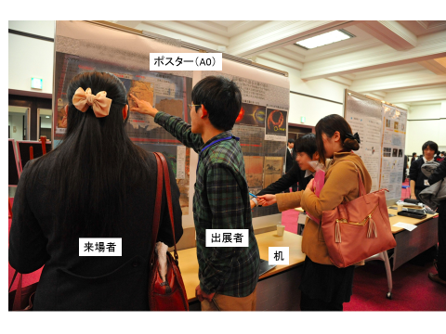
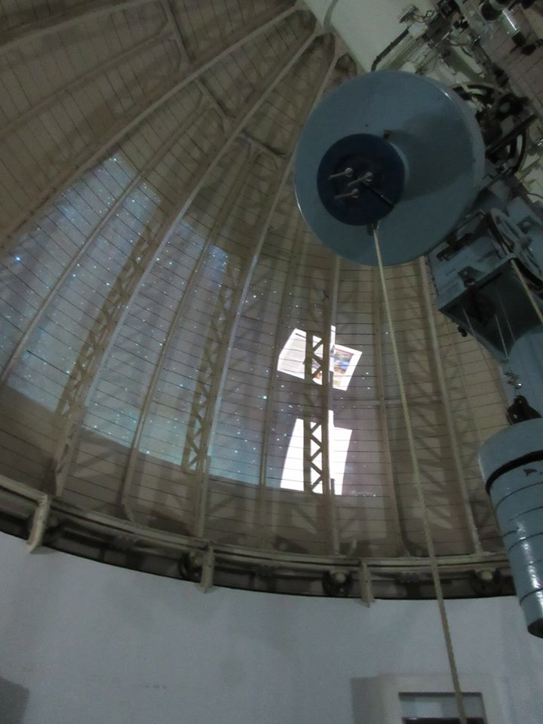
Collaboration with arts/traditional cultures for public engagements
Rakugo
Round table in temple
Tea celemony
Caligraphy
Space Forum
Observatory Gellery

