Slide 1
Development of space weather in Japan
Hiroaki Isobe
Center for the Promotion of Interdisciplinary Education and Research
Kyoto University
Notes:
Talk on from 2 stand points.
One is as a scientist in this field. I work on solar physicist at the university.
The other is that I’ve been involved in space policy which I explain later.

Slide 2
Significant changes in Japanese space policy
“Basic space law” enacted in 2008
The Office of National Space Policy is established in the Cabinet Office as the headquarters to coordinate Japan’s overall space policy
From R&D to “Expansion of Space Utilization”
First “Basic Plan on Space Policy” under the new organization established in January, 2013, in which space weather is mentioned in the context of Space Situational Awareness (SAA).
Notes:
Recently there were significant changes in Japanese space policy.
Previously there wasn’t anything like “basic space law” in Japan, but it was finally enacted in 2008.
And accordingly, The office of national space policy is established in the Cabinet Office as the headquarters to coordinate the overall space policy.
The new policy can be characterinzed as “from R&D tt Expansion of Space Utilization”
And in last year, first “Basic Plan on Space Policy” under the new organizaion was established. All the space policy is determined according to this plan.
Space weather is mentioned in the context of SAA

Slide 3
Organization of the establishments related to space weather
Strategic Headquarters for Space Policy
Government organization
Incorporated Administrative Agencies
Committee on National Space Policy
Office of National Space Policy, Cabinet Office
Inter-University Research Institute Corporation
MOE
MLIT
MOD
MIC
METI
MEXT
NiPR
NICT
JAXA
NAOJ
Universities
MEXT: Ministry of Education, Culture, Sports, Science and Technology
METI: Ministry of Economy, Trade and Industry
MIC: Ministry of Internal Affairs and Communication
MOE: Ministry of Environment
MLIT: Ministry of Land, Infrastructure and Transport
MOD: Ministry of Defense
NICT: National Institute of Information and Communication Technology
JAXA Japan Aerospace Exploration Agency
NiPR: National Institute of Polar Research
NAOJ: National Astronomical Observatory of Japan
Notes:
This is an organization chart of the establishments related to space weather.
The strategic Headquaters for space policy is chaired by the prime minister.
And the office of national space policy is in charge of coordinate the related ministries and make the draft strategy
Of the Japanese space policy.
And this committee of national space policy, which is consists of 7 experts, is consulted by the Office of National Space
Policy and Strategic Headquaters.
So this part is now very important in Japanese space policy.
JAXA is the core agency of the national space projects,
But the space weather information service is assigned to the NICT.
Scientific researches are going on more-or-less independent manner in univerisities and research institutes.

Slide 4
Space weather in Basic Plan on Space Policy (2013)
http://www8.cao.go.jp/space/plan/plan-eng.pdf
In previous “Basic Plan” in 2009, space weather was mentioned in the context of “preservation of the environment“ but “SAA”

Slide 5
Japanese Institutes working on space weather

Slide 6
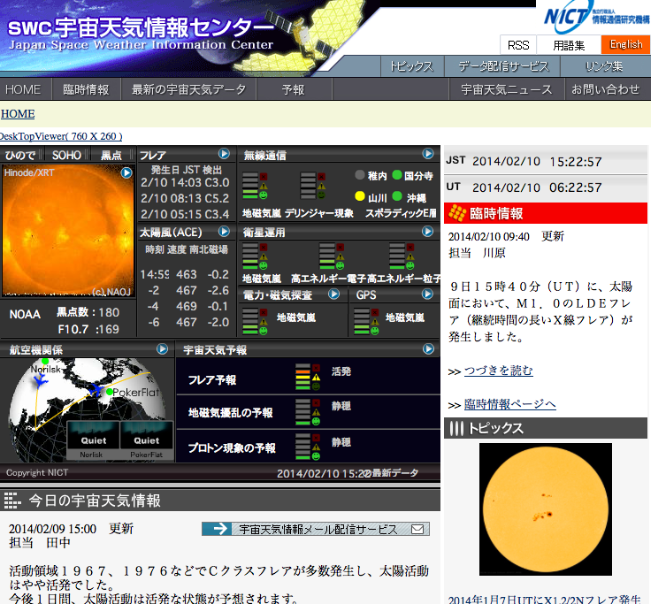
National Institute of Information and Communication Technology (NICT)
Space weather service provider in Japan
Japanese participant of ISES
Web-based real-time information of space weather
Daily/weekly summary report by email
Ground-based observation facilities such as solar microwave, ionozond etc
http://swc.nict.go.jp

Slide 7
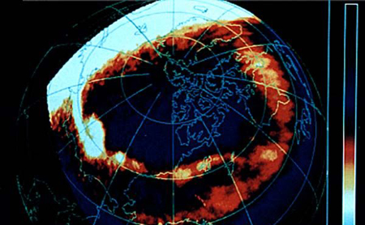
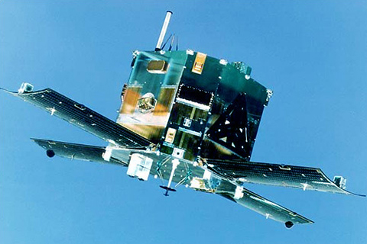
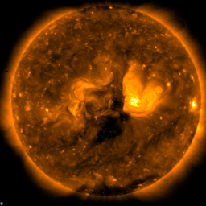
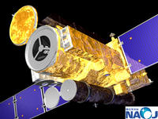
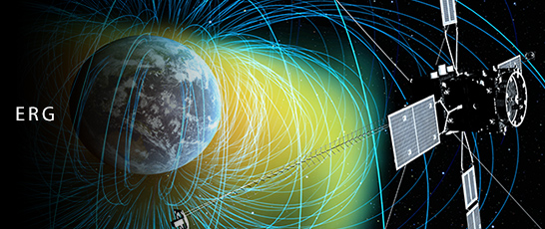
Space weather in JAXA
“the core organization that provides technical support for the entire governmental development and utilization of space projects” (Basic Plan on Space Policy, 2013)
Space Environment Group monitor the geospace environment and anomaly of the satellites operated by JAXA
SW-related science missions (Akebono, GEOTAIL, Hinode, ERG, Solar-C…)

Slide 8
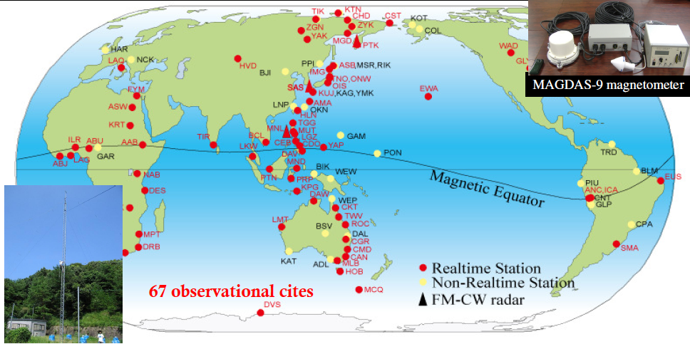
Kyushu University
International Center for Space Weather Science and Education (2012-)
MAGDAS network
Education and capacity building

Slide 9
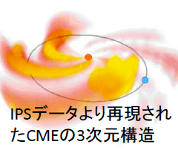
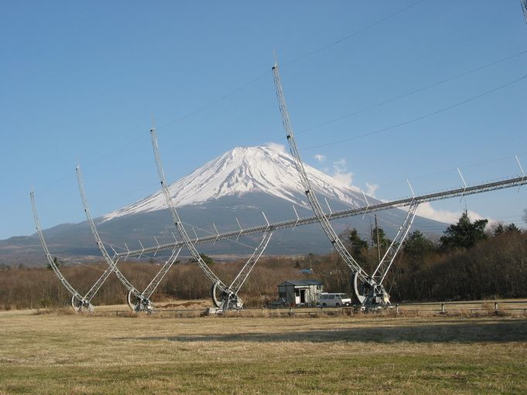
Other institutes
Nagoya University
Solar and Terrestrial Environment Laboratory, the only Inter-University Research Institute on solar and terrestrial environment
Solar Wind observation of Interplanetary Scintillation
Participate SuperDARN (Super Dual Auroral Radar Network)
Numerical modeling and data center
Tohoku University: solar and planetary radio observation
Shinshu University: Muon detector
NAOJ: solar observations
…

Slide 10
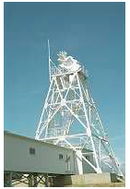
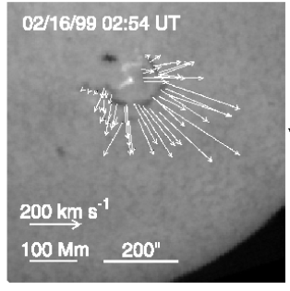
Kyoto University
Operate World Data Center for Geomagnetism
Solar optical observations
Middle and Upper atmosphere Radars

Slide 11
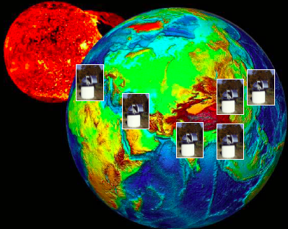
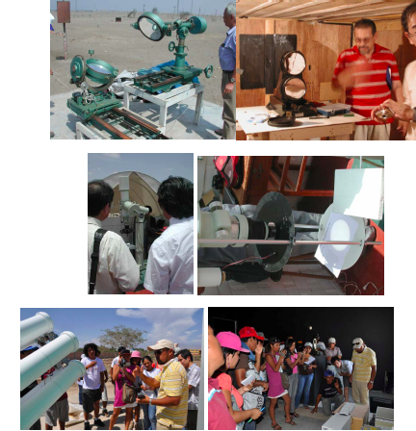
Continuous H-Alpha Imaging Network (CHAIN)
Network of full-disk H-alpha observation to monitor the eruptive events, in particular the 3D velocity of erupting filament
Kyoto Univ operates SMART at Hida obsevatory in Japan, and move our old Flare Monitoring Telescope to ICA university, Peru
Real time data available on web: used for e.g., planning of space missions
New telescope in Algeria being planed in collaboration with Centre de Researche Astronomie Astrophysique et Geophisique
Invite participation from other ground observatories for data sharing
Capacity building: student exchange, technical training etc

Slide 12
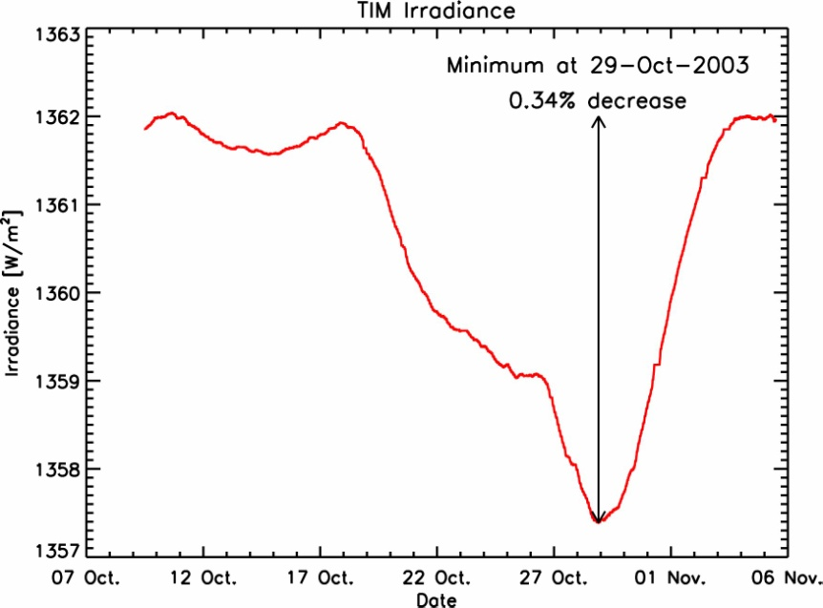
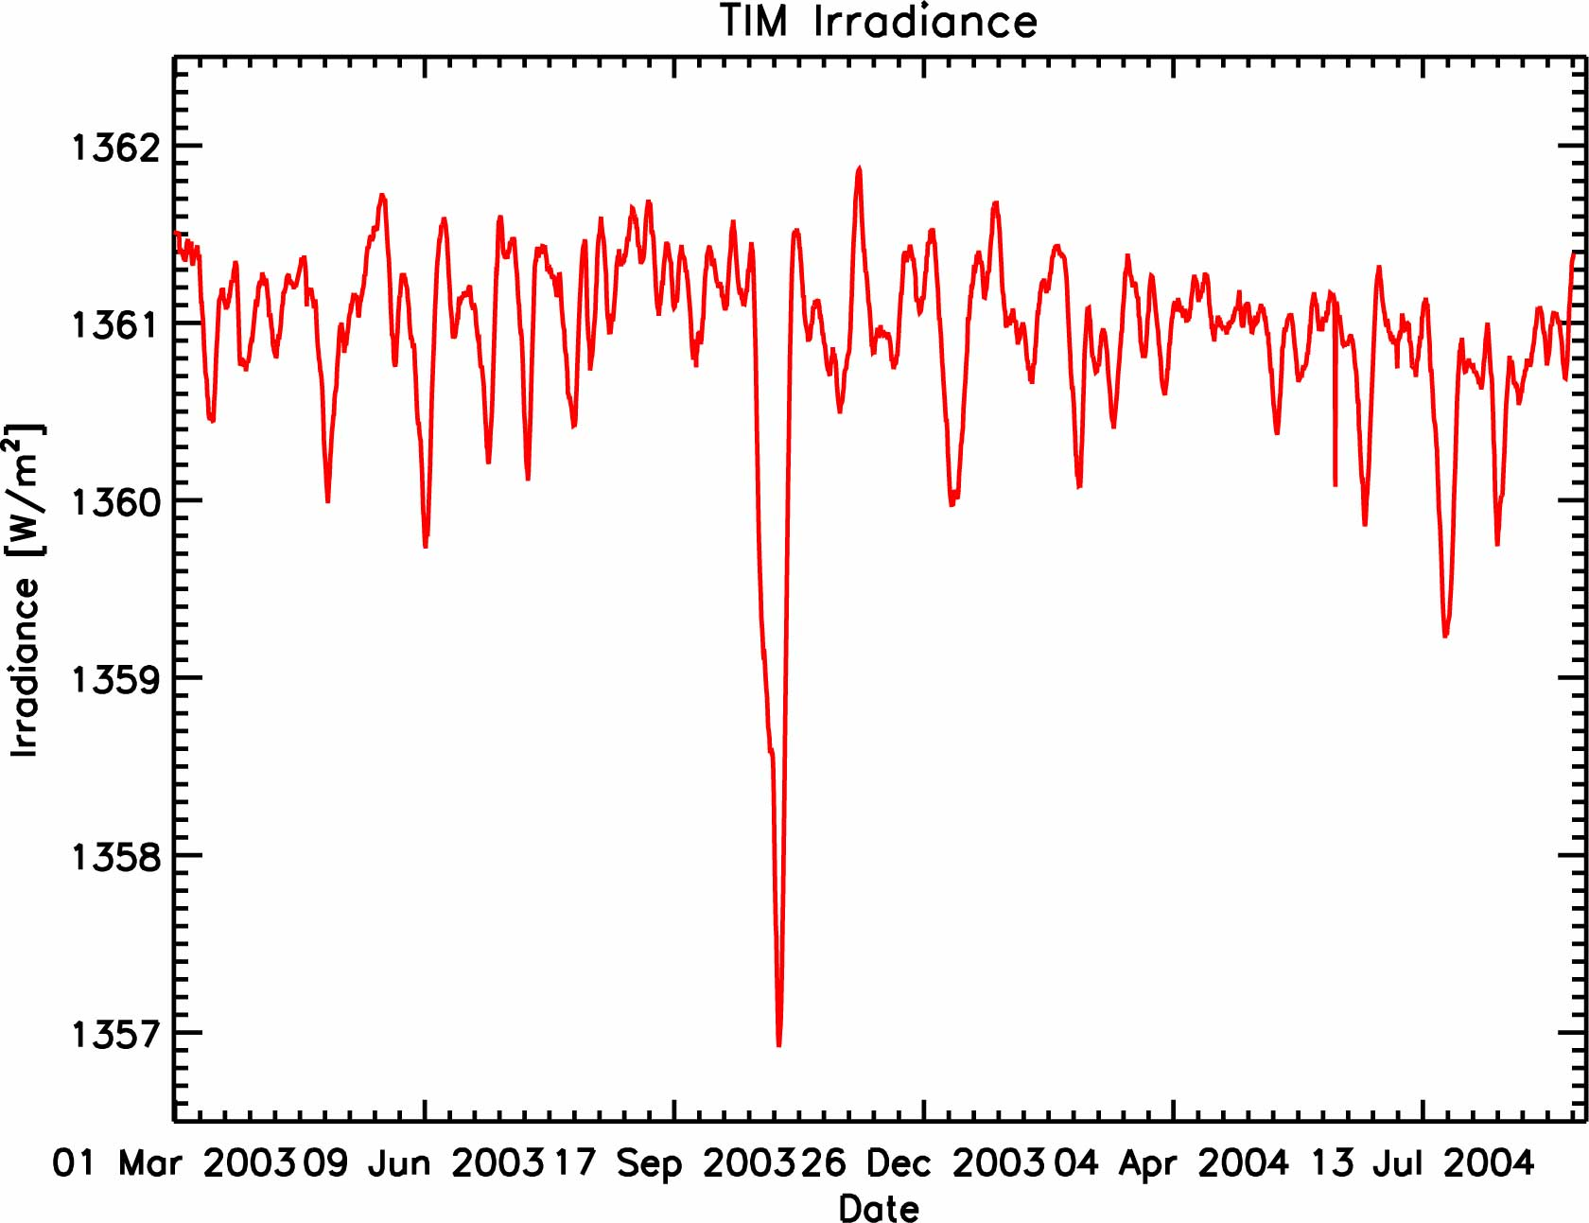
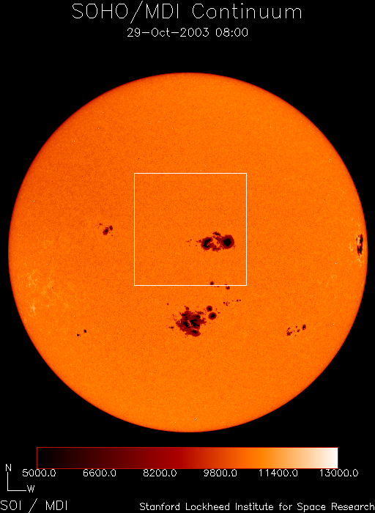
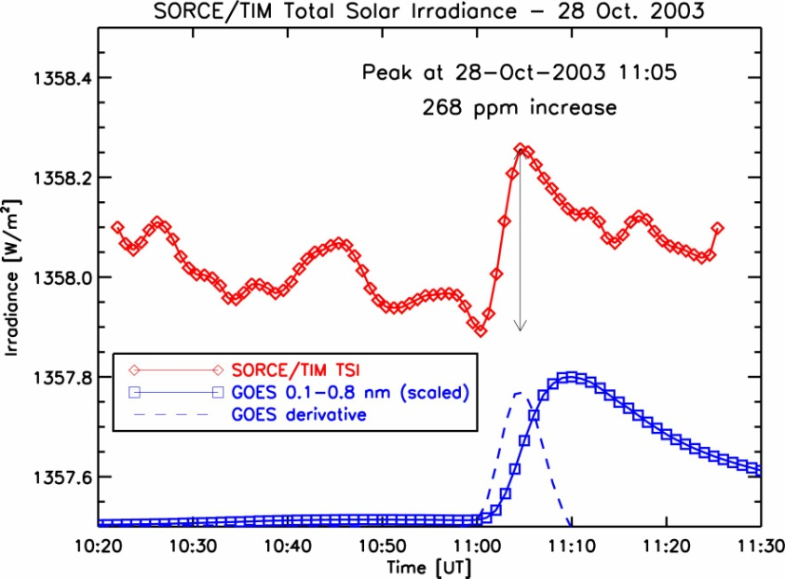
Research topic: Extreme event detected in TSI
Total Solar Irradiance
optical
X-ray
G. Kopp 2003
TSI increase by ~0.01%

Slide 13
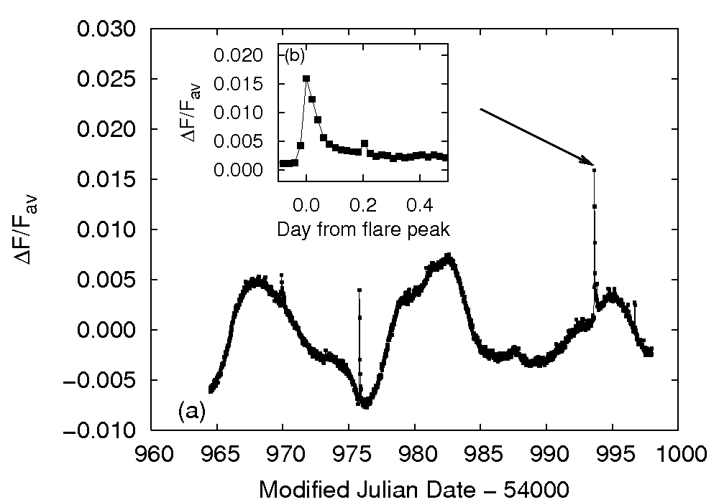
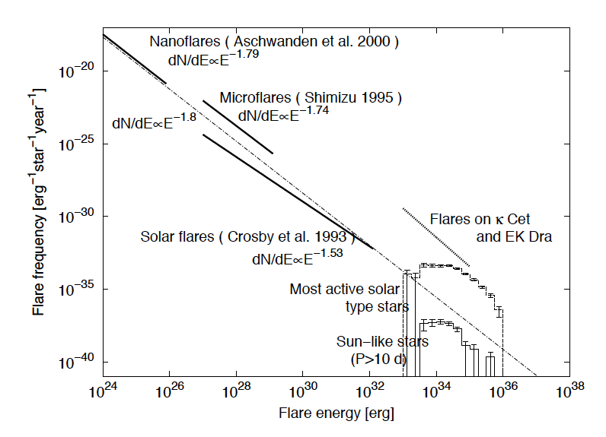
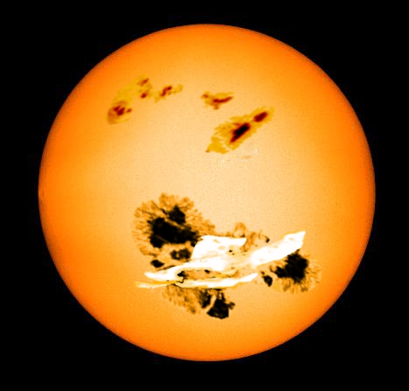
“Super flares” in solar type stars detected by Kepler
(Maehara et al. 2012, Nature)
Intensity in visible continuum increase ~1%!
Corresponding to energy ~10^29 J = 1000 times larger than largest known solar flare
Shibayama et al. 2013, ApJS
Occurrence rate of 10^29J event ~ once in 5000 years in our Sun!
What are the expected influence? How to prevent them?
Notes:
Once in 5000 years sounds very rare. But actually the occurrence rate of the
Big earthquake similar to the one in 2011 that his Eastern Japan including the Fukushima nuclear plant
Is said to be once in 1000 years.
So preparing such rare but extreme events has become a serious issue,
And space weather is no longer an exception.

Slide 14
Summary
Major changes in Japanese space policy. From R&D-oriented to utilization-oriented.
In the “Basic Plan on Space Policy”, space weather is mentioned as a part of SSA.
Many space and ground-based assets in Japan, but operated more-or-less independently by individual institutes
Mostly science-driven. Need more coordinated, service-oriented and continuous observation (<= also good for science)
International cooperation is important

