Slide 1
Magnetic reconnection and jets in the lower atmosphere
Hiroaki Isobe (Kyoto Univ)
collaborators:
K.A.P. Singh, K. Shibata (Kyoto U)
V. Krishan (Indian Inst. Astrophys. Bangalore)

Slide 2
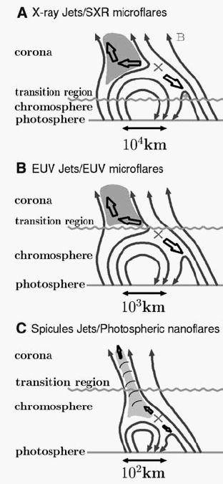
Reconnection + plasma jets at various heights
X-ray jet
~100,000km
(corona)
EUV jet ~ 10,000 km
(upper chromo ~
transtion region)
Nishizuka+07
Chromospheric jet
~1000km
Shibata+07

Slide 3
Cool jet acceleration
Reconnection

Slide 4
Can chromo-reconnection produces high jets?
Available magnetic energy B²/8π ≈ ρgh (potential energy)
h ≈ (B²/8π) /ρg
≈ (B²/8π)/ρRT*(RT/g)
= H/β (H: scale hight, β: plasma beta)
If β ≈ 1, reconnection jet (or any magnetic driver) can ascend only H ≈ 300 km.
Needs a clever way to accelerate only a fraction plasma.

Slide 5
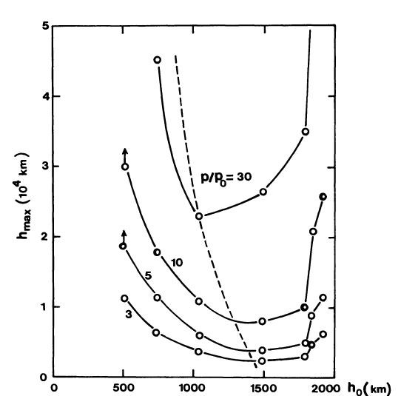
1D hydrodynamic simulation
Explosion in high-chromo
direct acceleration
Explosion in low-chromo
slow-mode wave => shock
jet
Shibata+ 1982

Slide 6
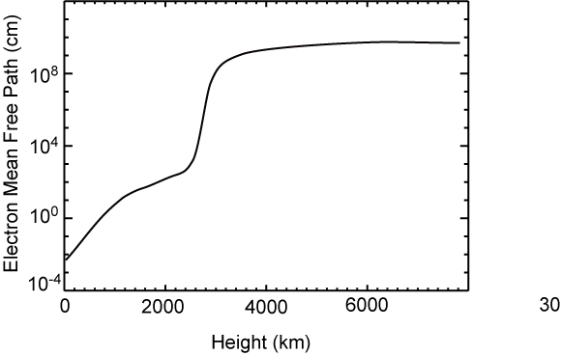
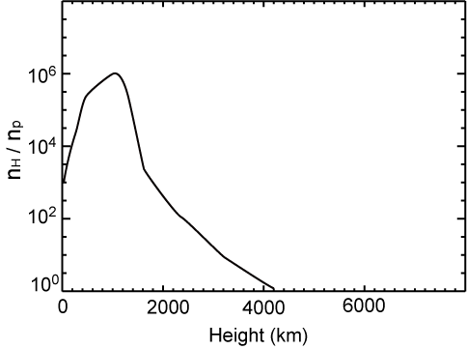
Mean free path and ionization fraction
Corona
Transition region
Chromosphere
Chromosphere
Photosphere
Transition region
Photosphere
Corona
Corona: almost collisionless and fully ionized
Chromosphere: fully collisional and weakly(partially) ionized

Slide 7
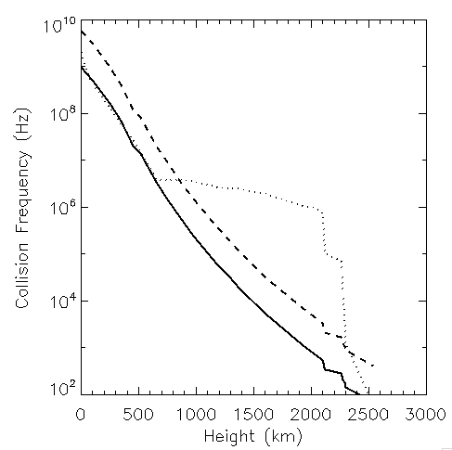
Collision frequency
Electron-Neutral
Electron-Ion
Ion-Neutral

Slide 8
Strong coupling approximation is good in chromosphere
Balancing the JxB force and drag force on ion flow:
Typical flow velocity in photosphere-chromosphere = 1~10 km/s
=> 1-fluid MHD OK
Hall
Ambipolar
diffusion

Slide 9
How ambipolar and Hall terms work
where
and
Hall effect bends magnetic field lines in the direction of –J
Ambipolar diffusion transports the magnetic flux in the direction of JxB force
(similar to magneto-friction, but no reconnection)
・ Ambipolar duffusion dissipates magnetic energy, while Hall effect does not.

Slide 10
Diffusivities
log
η_{Amb}/η_{Hall}= ωci/νin
by K.A.P. Singh
Chromosphere: η_{Amb} >> η_{Hall >>} η
Photosphere: η_{Hall} > η >> η_{Amb}

Slide 11
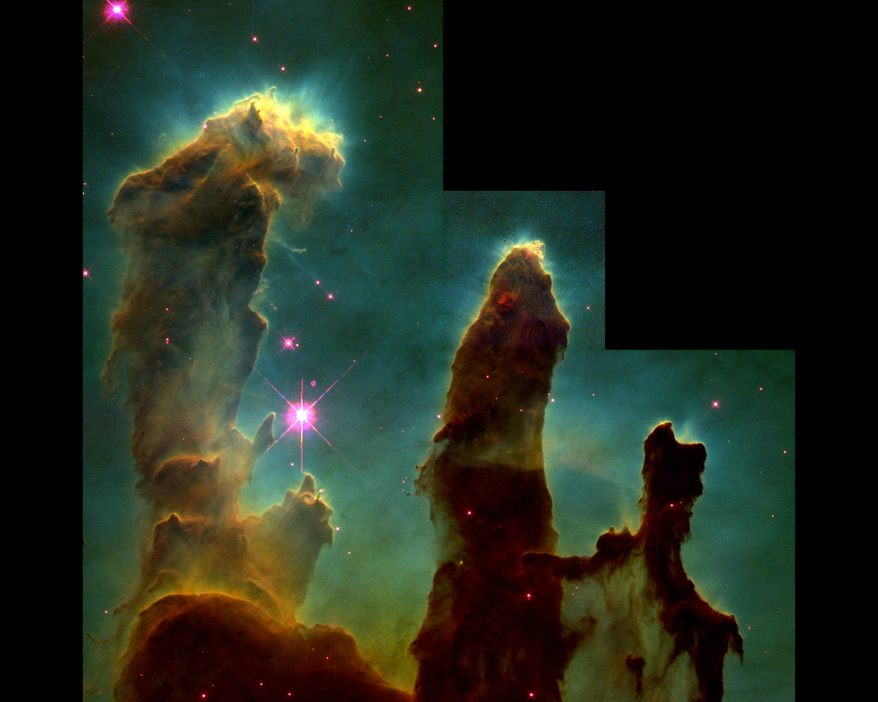
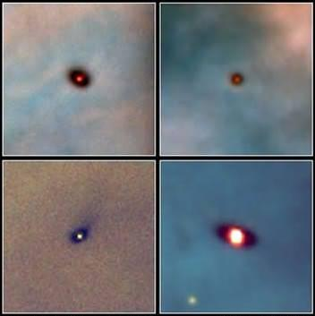
Similar astrophysical plasmas: molecular clouds and protoplanetary disk
Sano & Stone 2002
disk
molecular
cloud
T≈10-100K
Hall dominates in inner disk ... photosphere - like
Ambipolar dominates in outer disk and molecular clouds ... chromosphere-like

Slide 12
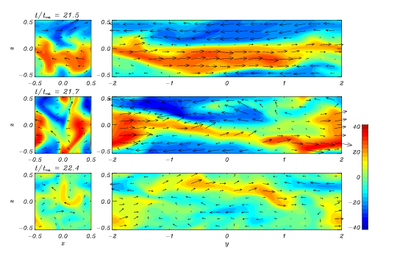
Reconnection plays key role in MRI
Magneto-rotational instability (MRI) is essential for angular momentum transfer in accretion disks
Reconnection controls its saturation level (Sano & Inutsuka 2001)
Reconnection (magnetic diffusion) plays essential roles in collapse of molecular clouds and angular momentum transfer in proto-planetary disks
Solar atmosphere provides unique lab for such plasmas
Understanding chromospheric jets => understanding origin of life

Slide 13
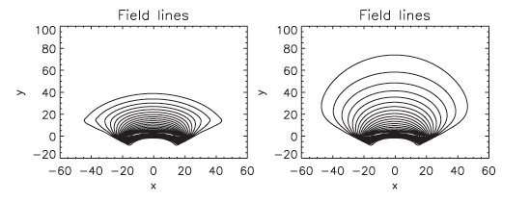
Flux emergence and partial ionization
η_{c} : Cowling resistivity (=ambipolar + ohmic)
without ambipolar
with ambipolar
Leake & Arber 2006 see Arber+ 2007 for 3D
Ambipolar diffusion dissipate perpendicular current => force-free B
Should be tested for twisted tube emergence

Slide 14
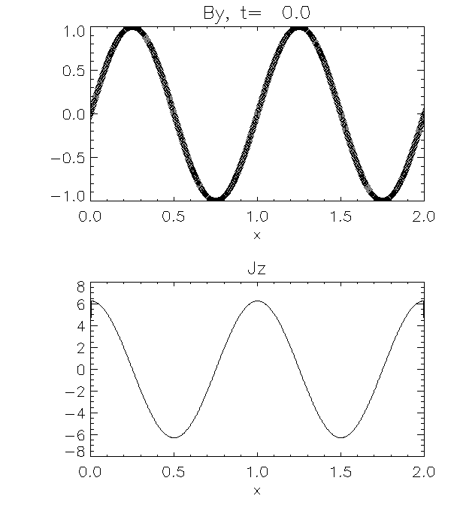
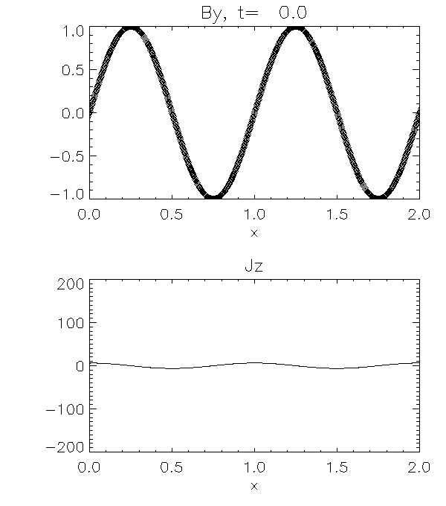
Current sheet thinning by ambipolar diffusion
(Brandenburg & Zweibel 1994)
Only resistive diffusion
Only ambipolar diffusion

Slide 15
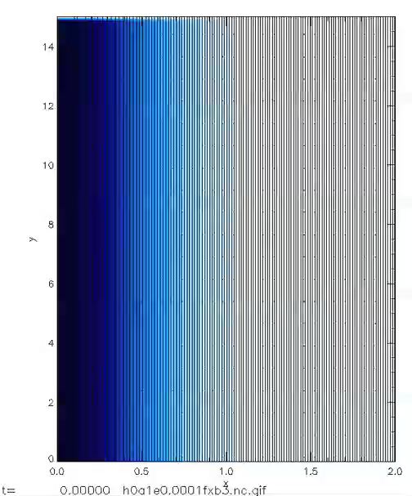
Numerical simulation
2.5D MHD with Ambipolar and resistive terms
No Hall effect, no guide field
Numerical scheme: CIP-MOCCT
color: current density

Slide 16
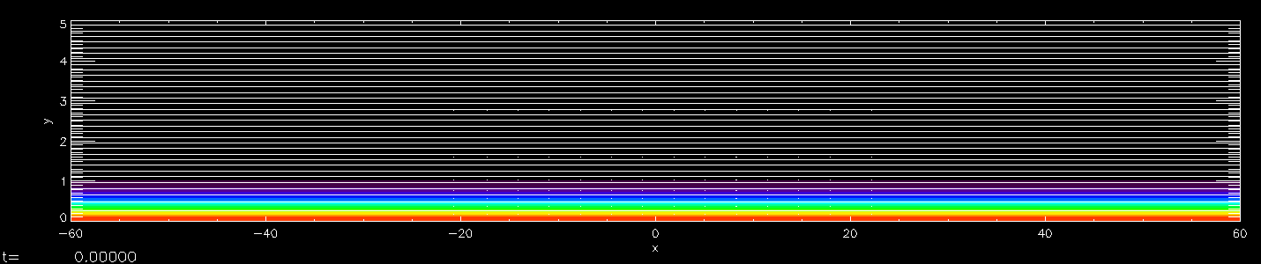
Effect of non-uniform ambipolar diffusion
2D, no Hall, no guidefield
Ambipolar diffusion localized in x < ±20L, where L is current-sheet thickness
Ohmic resistivity is uniform
LV_{A}/η ~ 2000, LV_{A}/η_{A} ~ 400
Grid: 1400x400, non-uniform
color: current density
Ambipolar diffusion ≠ 0

Slide 17
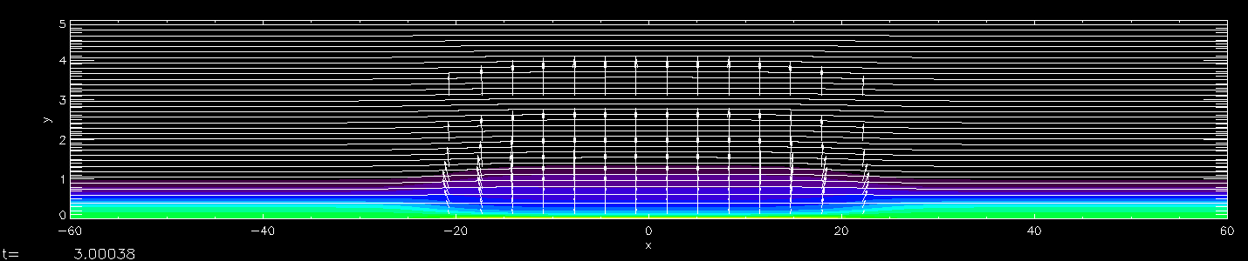
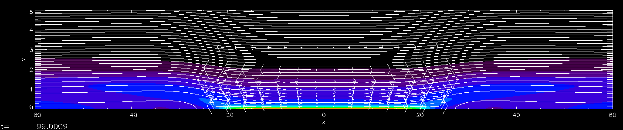
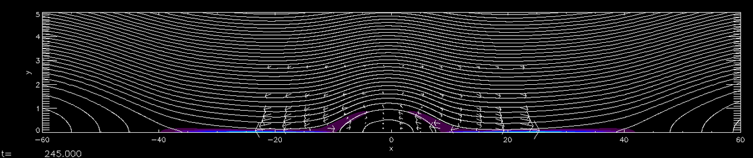
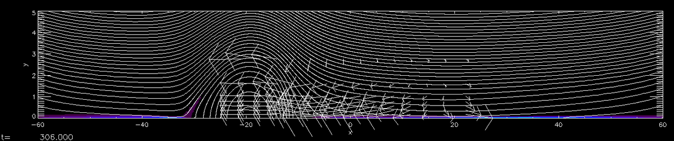
t=5
Thinning
Sweet
-Parker
reconnection
t=150
Tearing and
island
formation
t=250
Island ejection and time-dependent fast reconnection
t=300

Slide 18
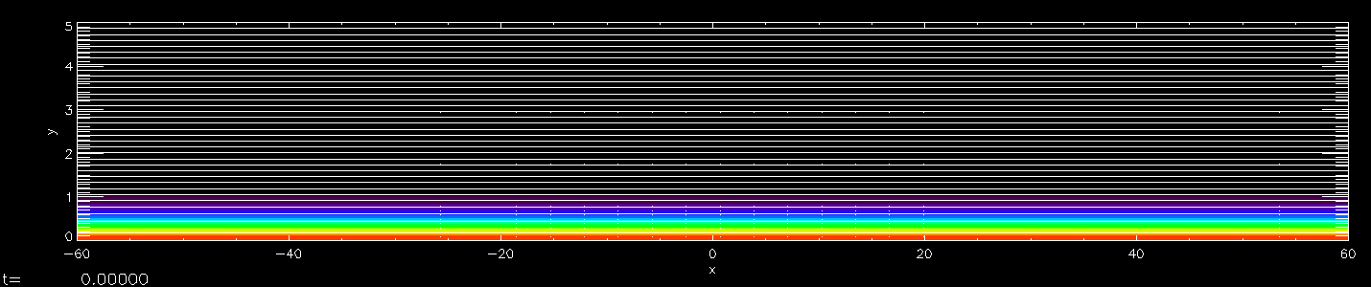

Effect of non-uniform ambipolar diffusion
2D, no Hall, no guidefield
Ambipolar diffusion localized in x < ±5L, where L is current-sheet thickness
Ohmic resistivity is uniform
LV_{A}/η ~ 2000, LV_{A}/η_{A} ~ 400
Grid: 1400x400, non-uniform
Ambipolar diffusion ≠ 0

Slide 19
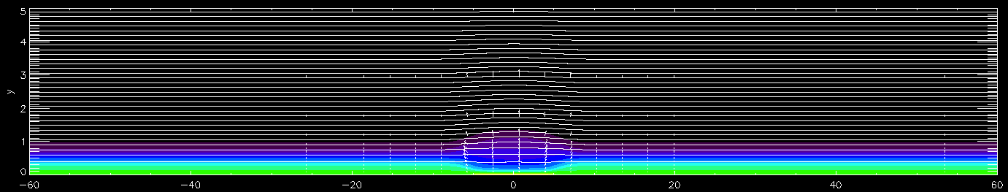
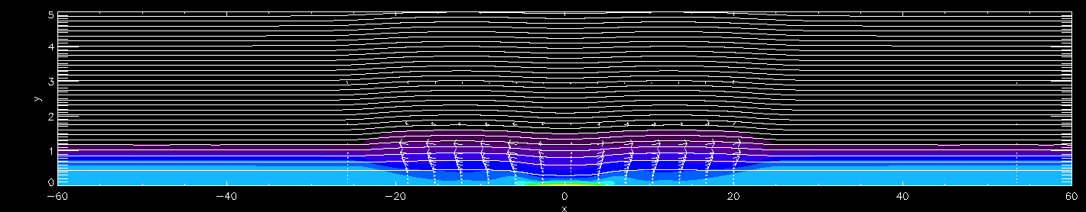
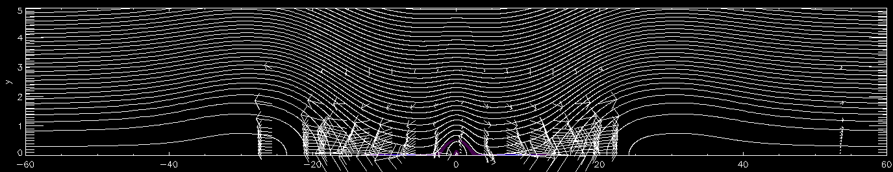
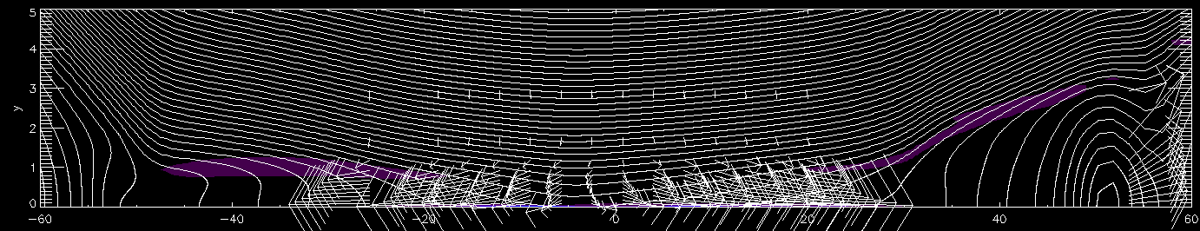
t=3
Thinning
Sweet
-Parker
reconnection
t=25
Tearing and
island
formation
t=135
Island ejection and steady fast reconnection
t=300

Slide 20
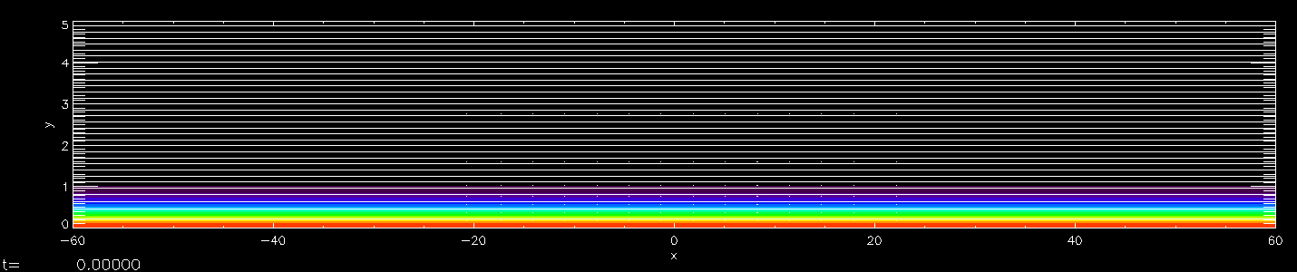
Petschek-like regime
2D, no Hall, no guidefield
Ambipolar diffusion localized in x < ±2L, where L is current-sheet thickness
Ohmic resistivity is uniform
LV_{A}/η ~ 2000, LV_{A}/η_{A} ~ 400
Grid: 1400x400, non-uniform
color: current density

Slide 21
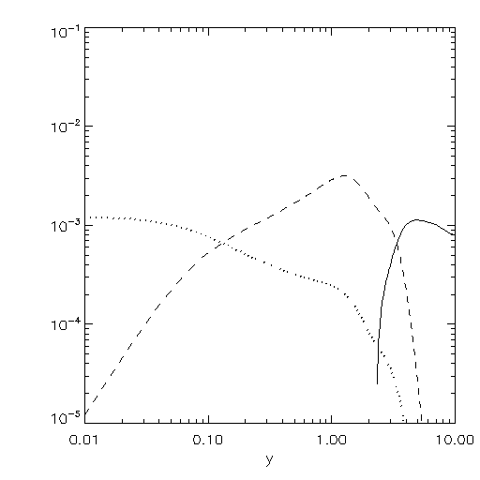
S-P like reconnection
advection
ambipolar
resistive
Contribution to E
In Sweet-Paker-like stage, the reconnection region consists of 3 layers:
- resistive-dominant inner current sheet
ambipolar-dominant outer current sheet
advection-dominant inflow region
Ambipolar diffusion causes plasma heating
outflow driven by gas-pressure gradient from the ambipolar layer
Note: two-fluid treatment is necessary to quantitatively address the (ion-dominant) outflow from resistive layer
Reconnection rate ~ 0.001
ηJ
-VxB

Slide 22
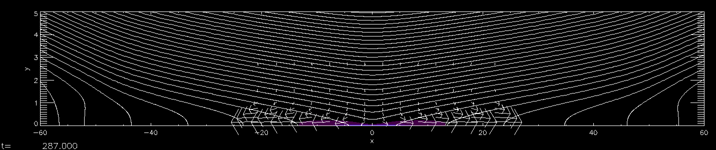
Reconnection rate ~ 0.01
Even though the resistivity is uniform, the localization of ambipolar diffusion causes local thinning of the current sheet, leading to Petschek-like fast reconnection
The “ambipolar layer” almost disappears.
-VxB
ηJ

Slide 23


Effect of guide field
Bz=0
Bz=0.5By
Thinning by ambipolar diffusion does not work

Slide 24
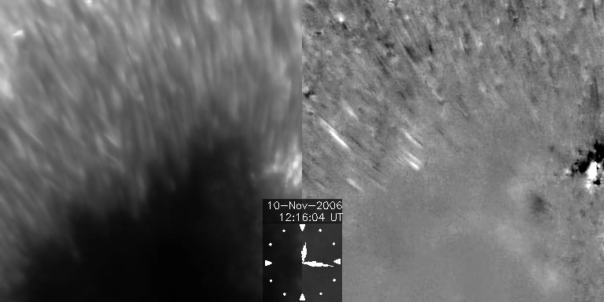
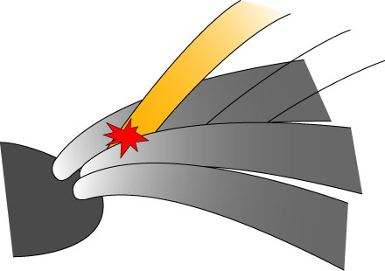
Penumbra jets
Katsukawa+ 07, Science
Reconnection in the interlocking-comb like magnetic field
Strong guide field. No ambiploar thinning?
Life time of penumbral filament >> Alfven time. If reconnection is very efficient filaments may not survive long
Non-uniform guide field (e.g., by twist) may leads to fast reconnection and jet

Slide 25
Summary
Neutral effect (ambipolar diffusion) in chromosphere causes current sheet thinning (Brandenburg & Zweibell 1994)
Localized ambipolar diffusion facilitate both Sweet-Parker and Petschek-type reconnection
Field-aligned flow driven by ambipolar heating in Sweet-Parker regime
Suppression of thinning by guide field may explain long life time of penumbra

Slide 26
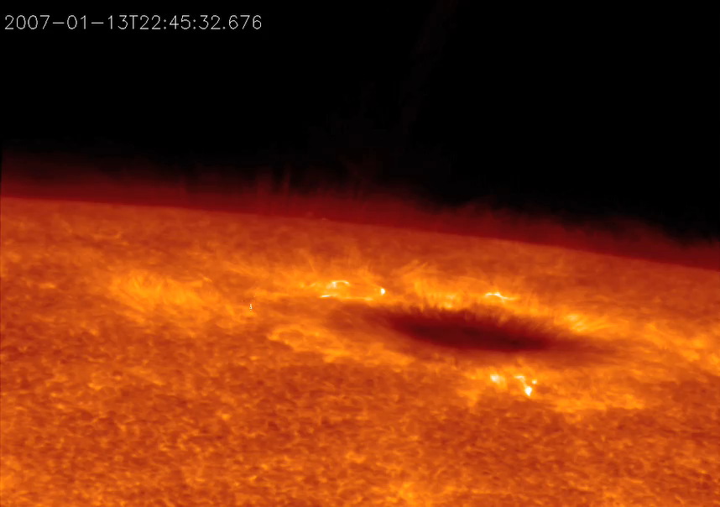
Magnetic reconnection in the chromosphere
700km
Shibata+ 07, Science
CaII H line, obtained by Hinode/Solar Optical Telescope

