Slide 1
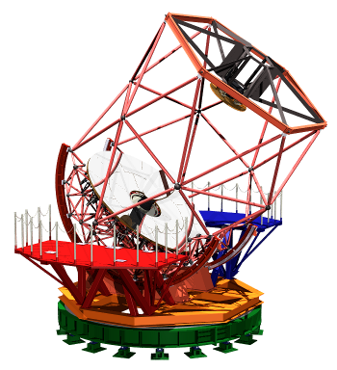
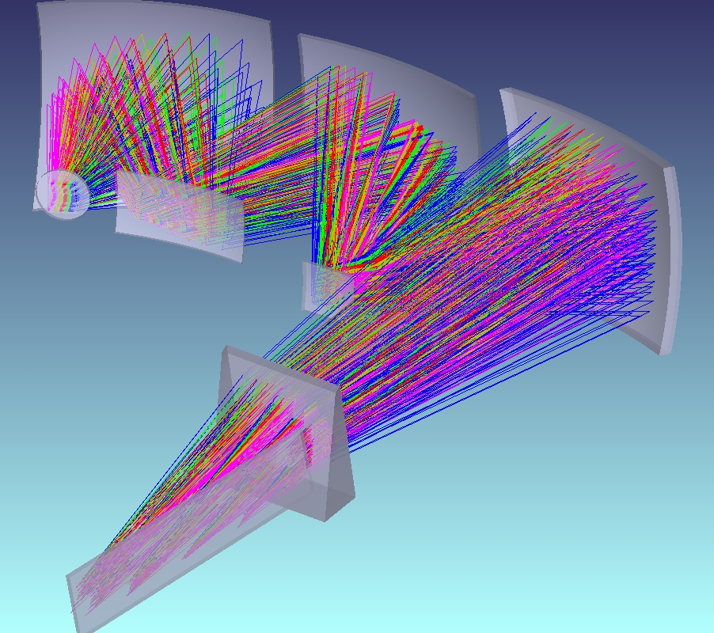
Short comment:
HDS for Kyoto 3.8m telescope
Fumihide Iwamuro
Specification &
Optical design
Keywords:
Sparse fiber slit
Biconic mirrors

Slide 2
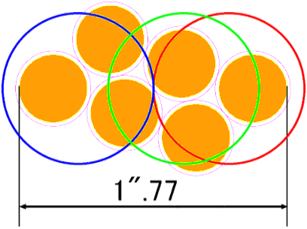
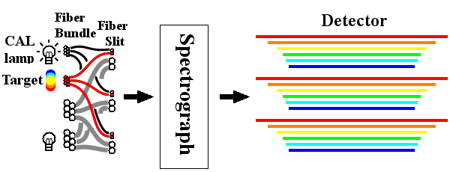
High-dispersion spectrograph
Fiber diameter 0”.45 (φ50μm)
0".91 (φ100μm)
Number of fibers 6 (for each bundle)
Wavelength range u～z (simultaneously)
Spectral resolution ～100,000 (φ50μm)
～ 50,000 (φ100μm)
Limiting mag ～13mag(@1h, S/N=50)
ADC is under consideration.
z =26.5°
seeing 1”

Slide 3
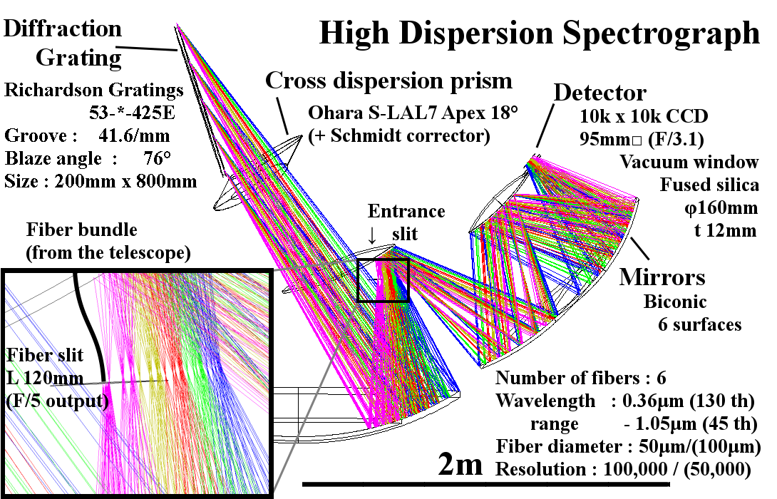
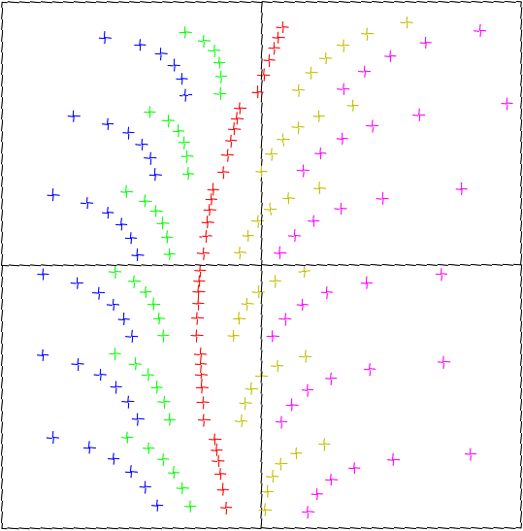
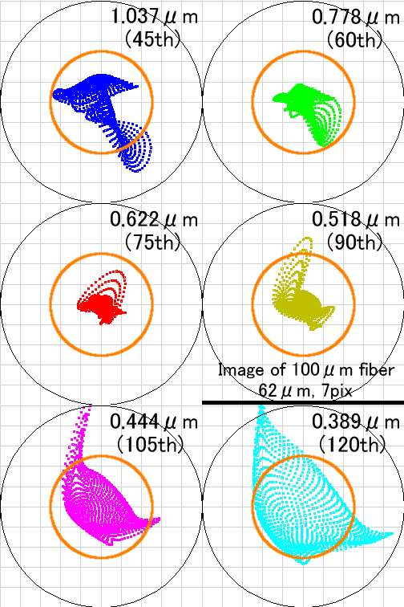
Spectral
format
(95mm□)
Spot diagram
7x7 pixels

